Slide 1
Homework 2
Machine Discovery (Fall 2016)

Slide 2
Introduction
Discover hidden link in a heterogeneous graph
Given some indirect information
Heterogeneous graph:
There are different types of nodes and links in the graph
Nodes can contain attributes
E.g., Foursquare, DBLP,...
Indirect information
Aggregative statistics of data (see next page)

Slide 3
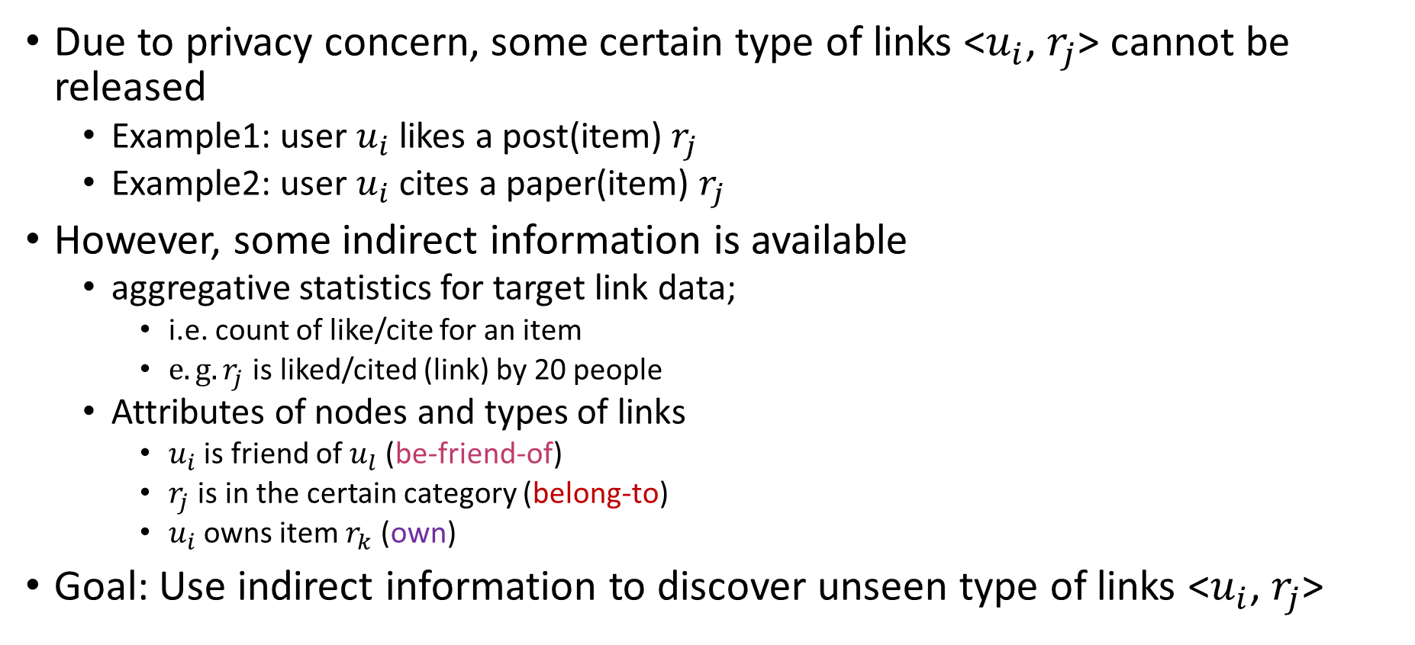
Available Information
Due to privacy concern, some certain type of links <$u_{i}$, $r_{j}$> cannot be released
Example1: user $u_{i}$ likes a post(item) $r_{j}$
Example2: user $u_{i}$ cites a paper(item) $r_{j}$
However, some indirect information is available
aggregative statistics for target link data;
i.e. count of like/cite for an item
$e.g. r_{j}$ is liked/cited (link) by 20 people
Attributes of nodes and types of links
$u_{i}$ is friend of $u_{l}$ (be-friend-of)
$r_{j}$ is in the certain category (belong-to)
$u_{i}$ owns item $r_{k}$ (own)
Goal: Use indirect information to discover unseen type of links <$u_{i}$, $r_{j}$>

Slide 4
Solutions
Any free-to-use third-party tools are permitted to use
However, you CANNOT use your classmates’ codes.
It’s your obligation to ensure the feasibility and scalability of your program.
If you have no idea how to start, feel free to use solutions in this paper:
“Unsupervised Link Prediction Using Aggregative Statistics on Heterogeneous Social Networks”, KDD’ 13
Can you do better than the KDD13 paper?
Modify KDD’13 components. E.g., learning algorithm, feature engineering method, …
Modify the discovery process (using count information to learn a ranked margin) in KDD’ 13

Slide 5
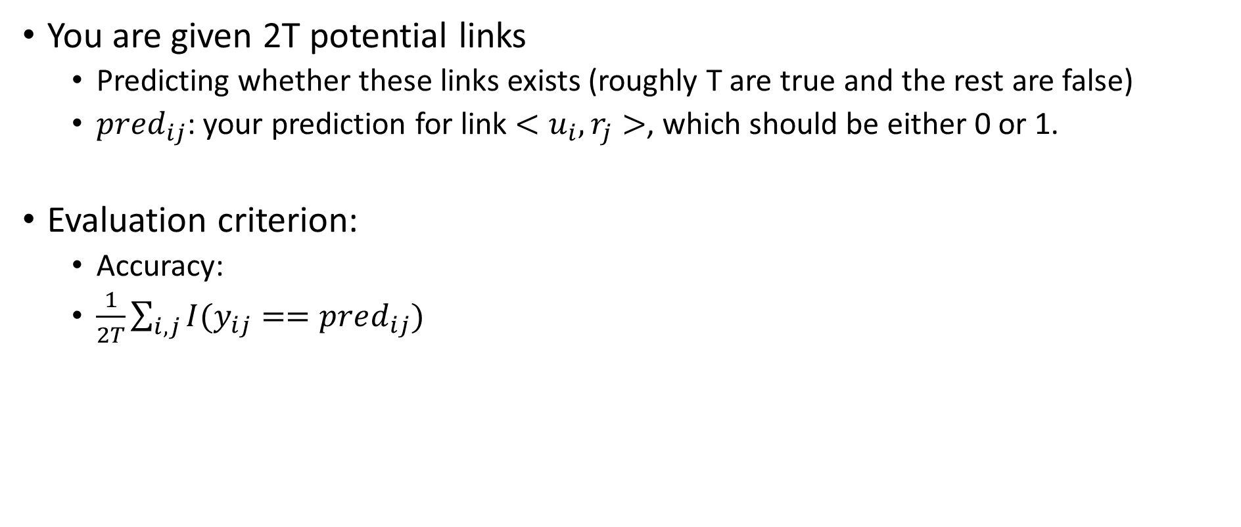
Evaluation (different from the KDD 2013 paper)
You are given 2T potential links
Predicting whether these links exists (roughly T are true and the rest are false)
${pred}_{ij}$: your prediction for link $<u_{i},r_{j}>$, which should be either 0 or 1.
Evaluation criterion:
Accuracy:
$\frac{1}{2T}\sum_{i,j}{I(y_{ij}==pred_{ij})}$

Slide 6
Datasets – data format
We provide you 2 datasets for testing (test1/, test2/) and 1 dataset for validation (valid/); each line in the data is separated by ‘\t’
For each of the two datasets, we have
User List (user.txt); each line contains one user id;
u_id
User relationship (relation.txt); each line contains certain relationship between nodes (directed).
u_id1 u_id2 (from u_id1 to u_id2)
Item Information (message.txt); for an item, each line contains a user owing the item, item id, a category of the item, the number of total links connected to the item.
The same item may appear in different lines, because an item may belong to different categories and be owned by different users, but the total # of links should be identical for an item.
owner_uid item_id category_id link_count
For the validation data, we also have
Ground-truth unseen link (response.txt); each line contains hidden link from user to item, which belongs a category
u_id item_id

Slide 7
Datasets – what will you have in hw2.zip?
We provide you 2 datasets for testing (available next week) and 1 dataset for validation (DBLP)
In short, in this homework, you will be given:
for folder = {test1, test2, valid}
hw2/folder/user.txt
hw2/folder/relation.txt
hw2/folder/message.txt
hw2/folder/pred.id (prediction file for you, explained next page)
This ppt file
hw2/hw2.ppt
We provide you validation outputs with additional ground truth for validation
hw2/valid/response.txt

Slide 8
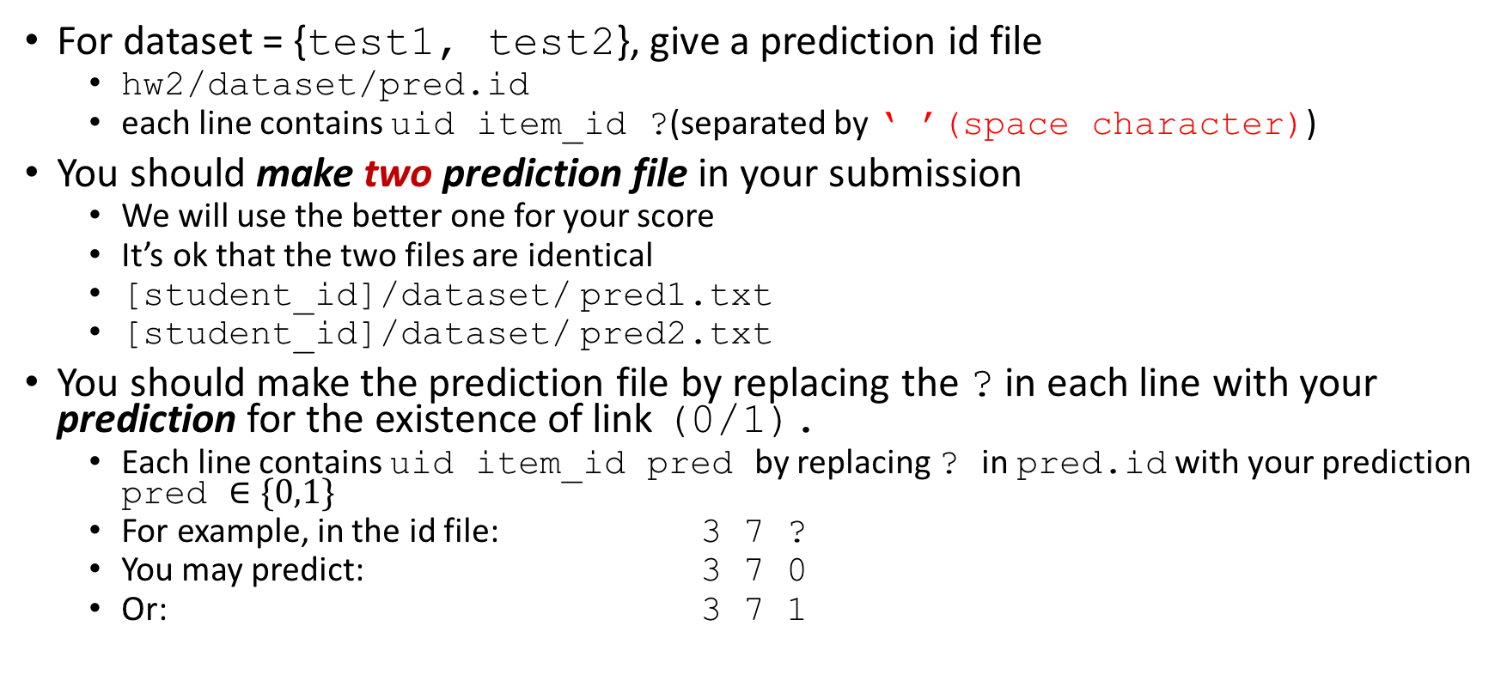
What you should do - prediction file
For dataset = {test1, test2}, give a prediction id file
hw2/dataset/pred.id
each line contains uid item_id ?(separated by ‘ ’(space character))
You should make two prediction file in your submission
We will use the better one for your score
It’s ok that the two files are identical
[student_id]/dataset/ pred1.txt
[student_id]/dataset/ pred2.txt
You should make the prediction file by replacing the ? in each line with your prediction for the existence of link (0/1).
Each line contains uid item_id pred by replacing ? in pred.id with your prediction pred $∈\{0,1\}$
For example, in the id file: 3 7 ?
You may predict: 3 7 0
Or: 3 7 1

Slide 9
What you should do - report
A single PDF file: [student_id]/report.pdf
***Explain your algorithm and experiment results (under different experimental settings in validation dataset) ***
Algorithm: model, learning algorithm, feature engineering method or how you conduct discovery
experiment results: Is your discovery system sensitive to parameter?
All the settings/assumptions/references you used.
The contribution of each individual member in this homework.

Slide 10
Submission Guidelines
All the contents listed below should be included in a single folder named by the concatenation of the student IDs in your team and then zip it before uploading to CEIBA.
If the team consists of R04922001, B02922002, D05922012,
[student_ids]= R04922001-B02922002-D05922012 (The order of of IDs doesn’t matter)
Please submit the file using only one of your team member’s CEIBA account.
source codes placed in path: [student_ids]/src/
a list of the third-party tools you used: [student_ids]/used-tools.txt
a report explaining your method: [student_ids]/report.pdf
Your predictions for test1 and test2:
[student_ids]/test1/pred1.txt
[student_ids]/test1/pred2.txt
[student_ids]/test2/pred1.txt
[student_ids]/test2/pred2.txt
a README file including the instructions to execute your codes and reproduce your results:
[student_ids]/README.txt
You don’t need to upload data. You can assume they are available in test1/ and test2/ in your code.
Submission deadline: 2016/11/14 09:00am
Late penalty: your score will obtain 50% deduction if within 24 hours delay. You will not receive any credit if delayed for more than 24 hours.
Feel free to contact TAs via mails or TA hours.

Slide 11
Scoring
Evaluation on prediction (50%)
Accuracy
Completeness of the report (50%)
Any type of plagiarism is strictly inhibited.
Please cite any references or materials you used.
Discussions between classmates are encouraged, but ALL the code and final design of model must complete by yourself.
Please give credit to your classmates in the report if you used any ideas from them.
You will simply receive -X point for any violations.

