Slide 1
Relaxation/Shenmen/Point Zero Acupoints
Images source: Dr. Shu-ming Wang

Slide 2
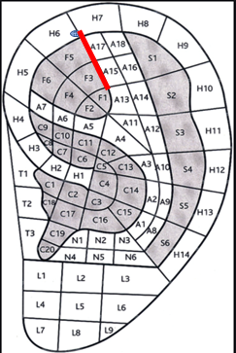
Relaxation Point
also know as Hypertension
Located under the helix
on the line between A17 & F5
Tip: tracing the right cartilage ridge surrounded the triangular fossa till the probe hit the top of under the ridge ( see the red line ) in the new power point.
Problem: Even though the NIR has good penetration capability on human skin. Energy expenditure in superficial skin might cause less energy passing to the reacting acupoint than enough.

Slide 3
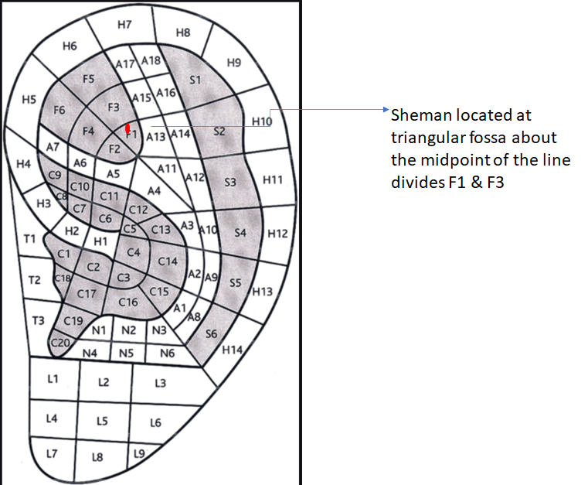
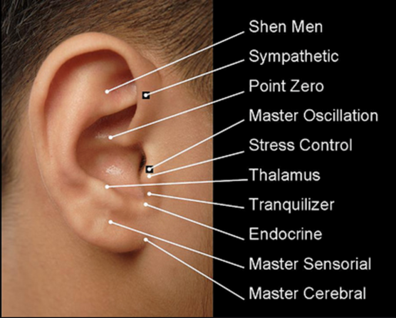
Shenmen Point
located at triangular fossa about the midpoint of the line divides F1 & F3

Slide 4
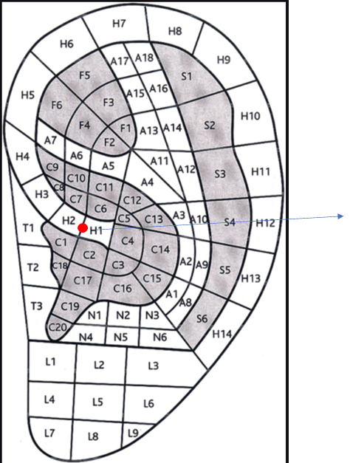
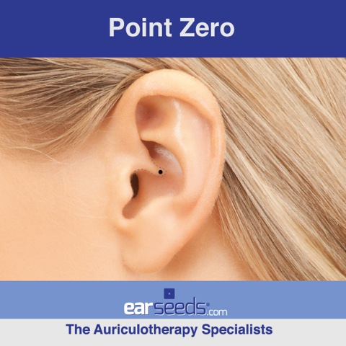
Point Zero
also know as Hypertension
Located under the helix
on the line between A17 & F5
Point Zero is located at the center of the ear which lies directly on the helix root.
Near the base of the helix root where it begins to rise you may feel a notch where Point Zero is located. (used in this doc)

Slide 5

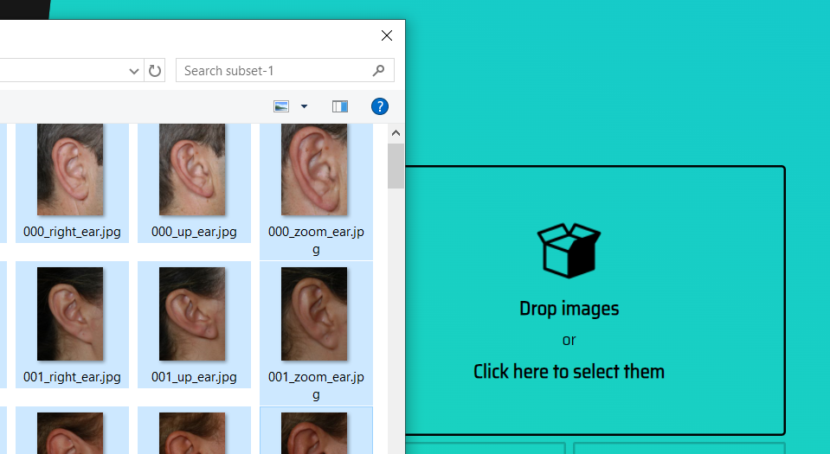

Annotation online tool https://www.makesense.ai/
Get Start
Load images
Object Detection

Slide 6
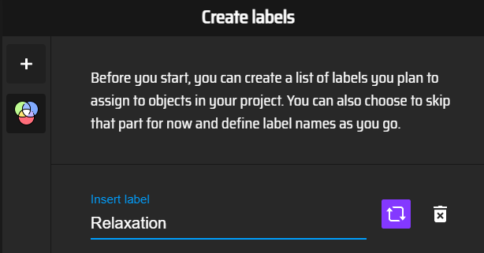

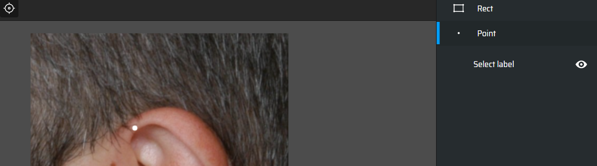
Create one label
Start Project
Select Point annotation
Label the acupoint on each image

Slide 7
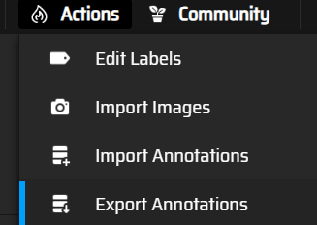
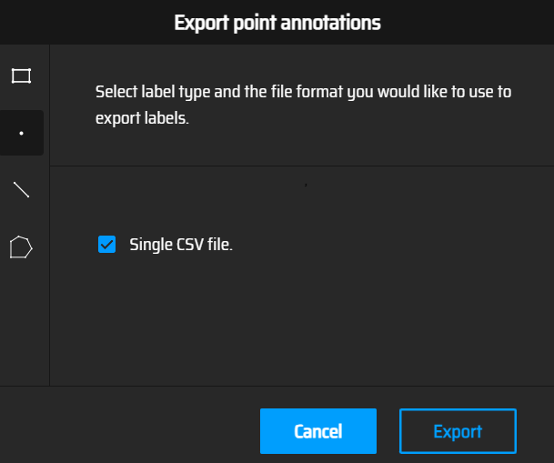
Once finish labeling the acupoint on all images
Actions -> Export Annotations
Single CSV file
Export
Then you will have the coordinated of your labels. A simple python script will mark these coordinates on the original images.

Slide 8
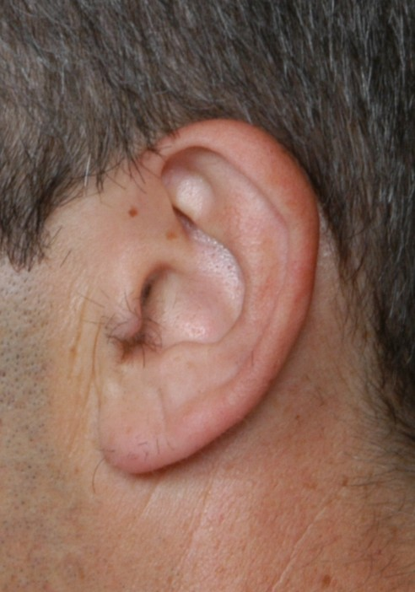
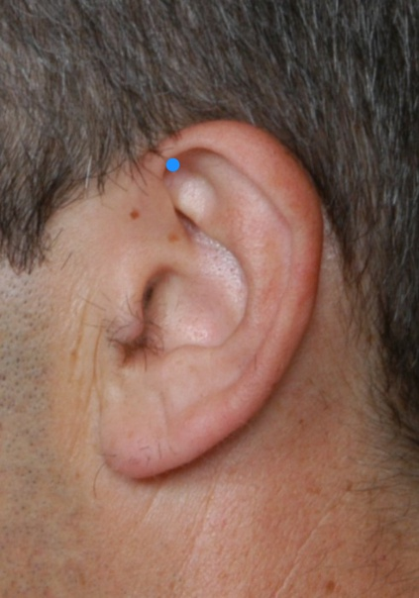
Python script to visualize all the annotations
+ annotations
=

Slide 9
Example: Google Colab
%matplotlib inline # The resulting plots will then also be stored in the notebook document.
import os
import random
import numpy as np
import keras
import io
import matplotlib.pyplot as plt
from matplotlib.pyplot import imshow
from keras.preprocessing import image
from keras.applications.imagenet_utils import preprocess_input
from keras.models import Sequential
from keras.layers import Dense, Dropout, Flatten, Activation
from keras.layers import Conv2D, MaxPooling2D
from keras.models import Model
Import packages

Slide 10
Example: Google Colab
The images can also be download using:
Load images:
!echo "Downloading Ear AMI dataset subset-1 for image notebooks"
!curl -L -o subset-1.zip --progress-bar https://ctim.ulpgc.es/research_works/ami_ear_database/subset-1.zip
!unzip subset-1.zip
!rm subset-1.zip
!ls
subset1_images = []
include = ['_back_ear.jpg','_front_ear.jpg','_left_ear.jpg','_right_ear.jpg']
for dp, dn, filenames in os.walk(root):
print(dp)
for m in include:
# print(m) # str
for i in range(len(filenames)):
if m in filenames[i]:
subset1_images.append(os.path.join(dp, filenames[i]))

Slide 11
Example: Google Colab
Load the image and add corresponding annotations
relaxation_labels = pd.read_csv('/content/drive/MyDrive/PhD/2020-2021/2021 Acupoint detection/Dataset/Annotation download/First annotation/labels_relaxation_2021-06-09-08-12-11.csv', header=None)
relaxation_labels_np = relaxation_labels.to_numpy()
relaxation_coordinates = relaxation_labels.iloc[:, [1,2]]
relaxation_coordinates_np = relaxation_coordinates.to_numpy()

Slide 12
Example: Google Colab
images_dir = '/content/relaxation_subset1/'
for i in range(len(subset1_images)):
img_path= subset1_images[i]
print(img_path)
# load the coordinate from labels
coordinate = relaxation_coordinates_np[i]
cx = coordinate[0]
cy = coordinate[1]
print(cx,", ",cy)
# load the image from path
img = image.load_img(img_path)#, target_size=(702, 492)
# download to relaxation_subset1/subset-1/....
file_name = subset1_images[i]
plt.figure(dpi=200)
plt.imshow(img)
#plt.annotate('25, 50', xy=(25, 50), xycoords='data',
#xytext=(0.5, 0.5), textcoords='figure fraction',
#arrowprops=dict(arrowstyle="->"))
plt.scatter(cx, cy, s=15, c='dodgerblue', marker='o')
plt.axis('off')
Load the image and add corresponding annotations (cont.)

