Slide 1
exploratory data analysis
Walmart Stores Coffee Analysis
Github Pgae

Slide 2
Contents
1
Team Memebers
2
Data Process
3
Streamlit App

Slide 3
Team 19
Xuehua Luo:42054053
Data process
Streamlit app
Write the README
Peiyuan Wang:42054041
Data process
Design PPT

Slide 4
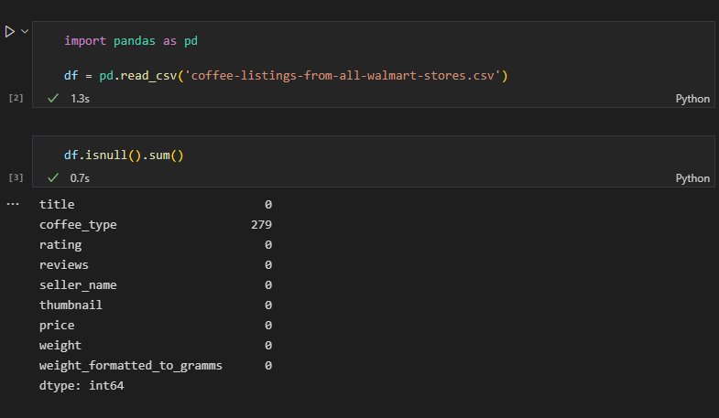
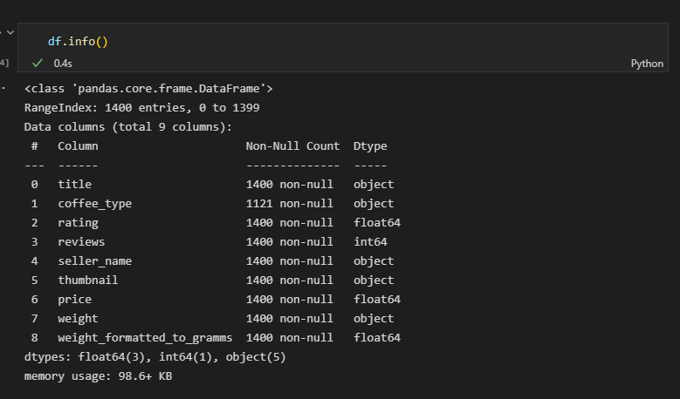
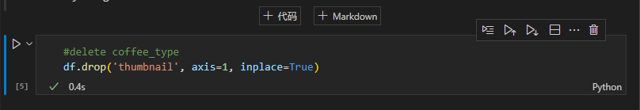
1.After simple data processing, we delete some unimportant data columns.

Slide 5
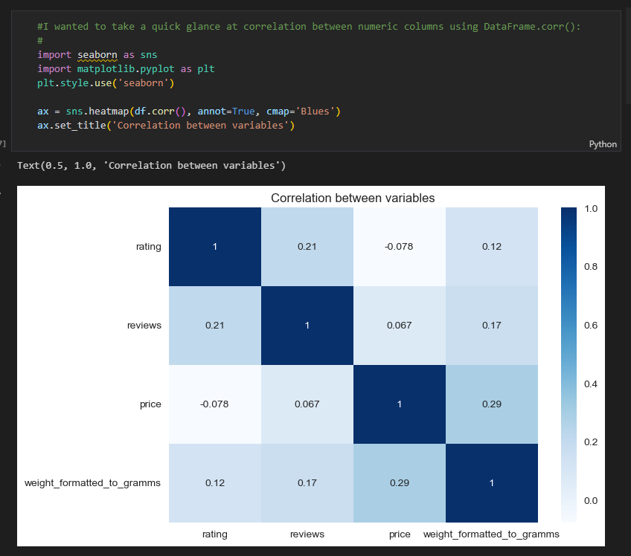
2.We used seaborn to analyze
the relationship between
variables.

Slide 6
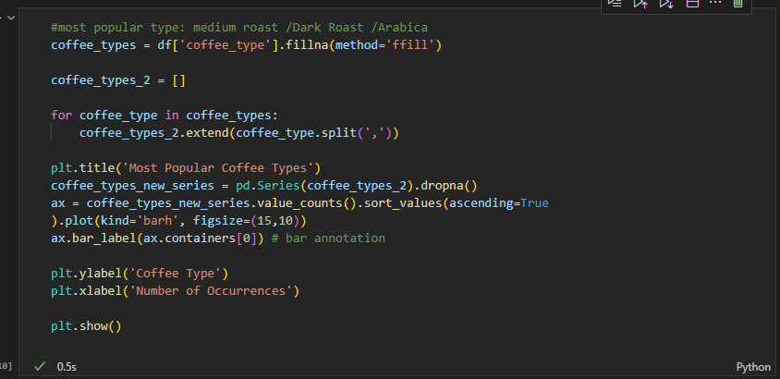
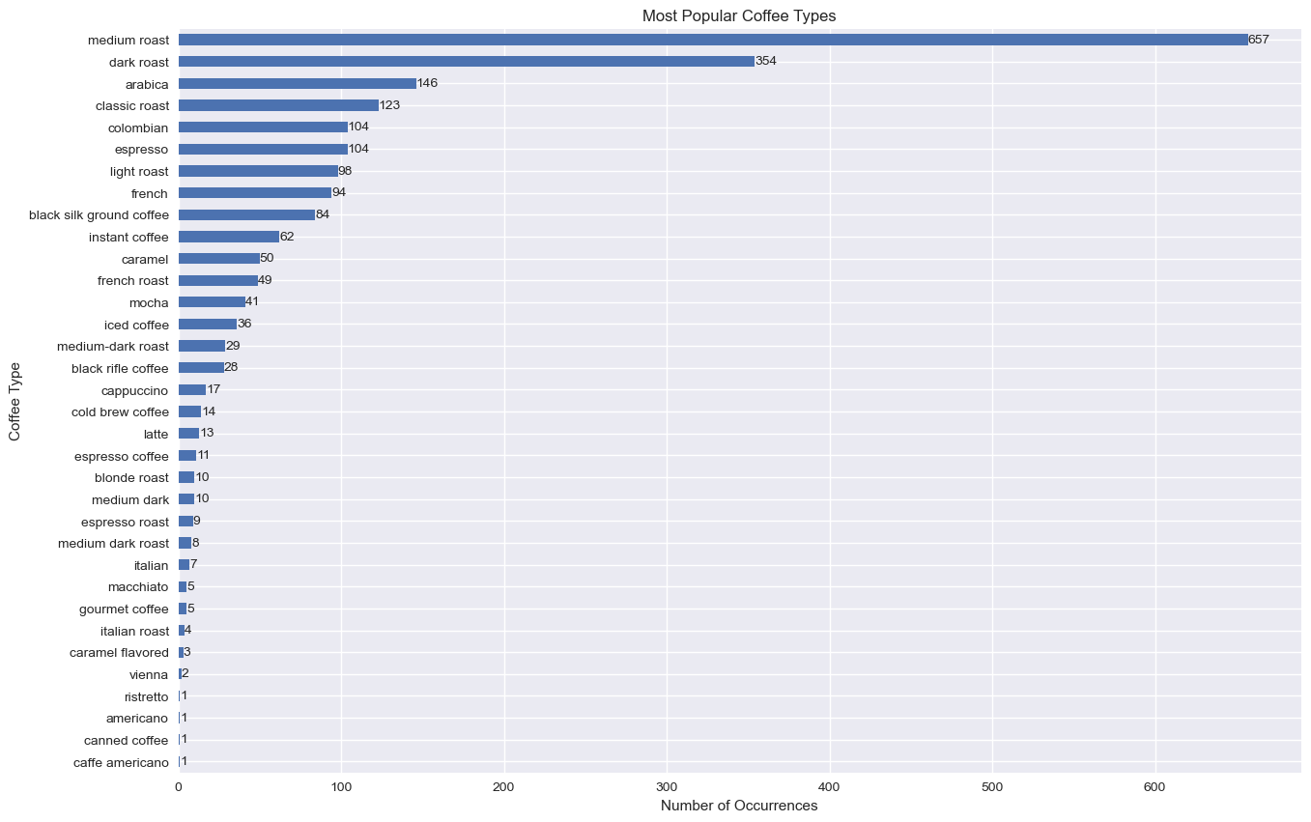
3. Through iteration, we found the ranking of the most popular coffee types among consumers,
among which the top three--Medium roast /Dark Roast /Arabica.

Slide 7
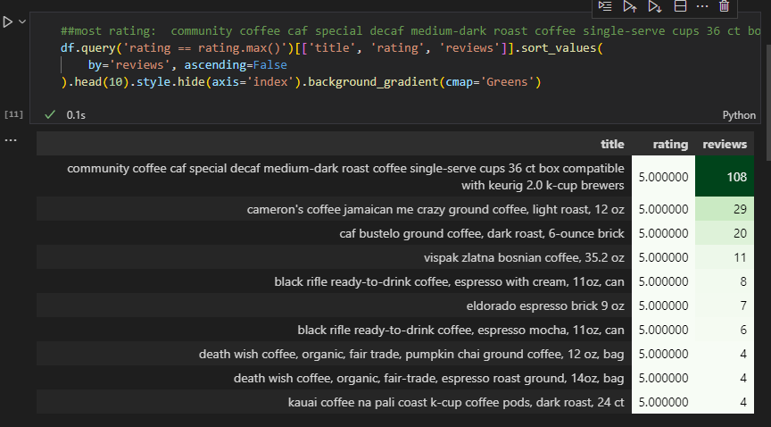
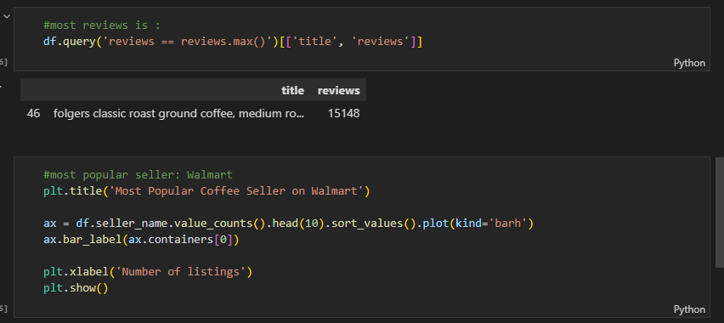
4. We find that
community coffee caf special decaf medium-dark roast coffee single-serve cups
36 ct box compatible with keurig 2.0 k-cup brewers / rating of 5 and 108 reviews.
"Folgers classic roast ground coffee" has 15k+ reviews which is the maximum value from the data set.

Slide 8
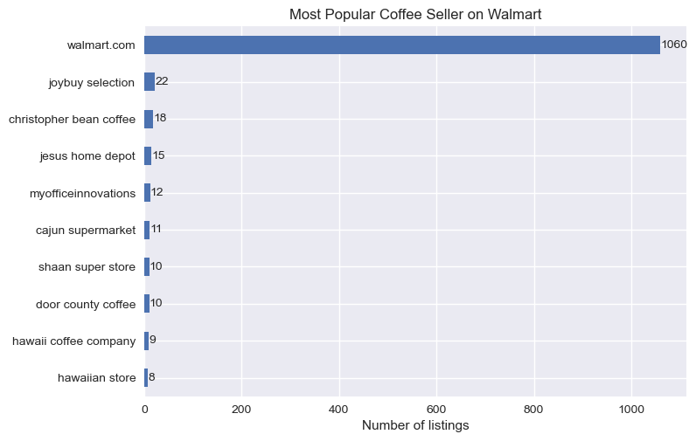
Walmart is the most popular seller of coffee.

Slide 9
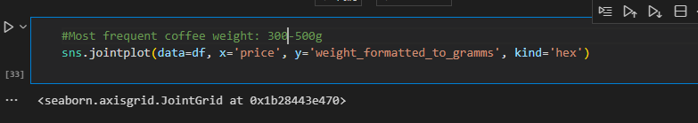
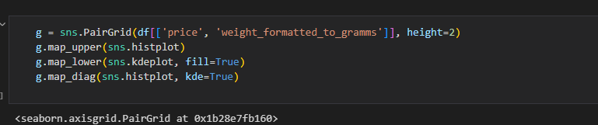
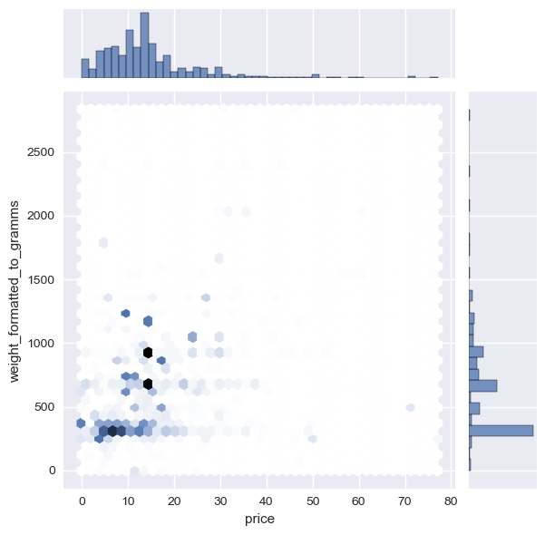
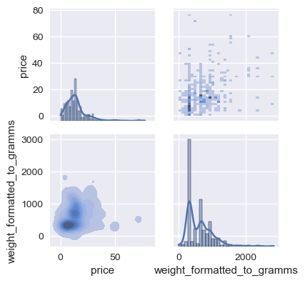
~300-500 grams is the most frequent weight.
More weight (grams) doesn't equal a higher price.
A lower gram coffee may cost more than a higher gram coffee.

Slide 10
exploratory data analysis
Streamlit App Show
Github Pgae
Streamlit App Pgae

