Slide 1
Los Alamos Coding Dojo Meeting #3 Minesweeper Kata
Boonthanome Nouanesengsy

Slide 2
Plan
Minesweeper kata
Talk about kata, possible implementations
Everyone codes the kata
Some people show and talk their implementation
Testing Minesweeper
Software API Adaptor
Possible other kata???
Retrospective

Slide 3
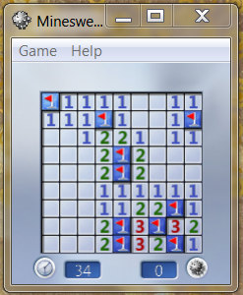
Minesweeper Kata

Slide 4
Minesweeper Kata (2)
* . . .
. . . .
. * . .
. . . .
* 1 0 0
2 2 1 0
1 * 1 0
1 1 1 0

Slide 5
Minesweeper Kata (3)
Input File
Output to stdout
4 4
* . . .
. . . .
. * . .
. . . .
3 5
* * . . .
. . . . .
. * . . .
0 0
Field #1:
* 1 0 0
2 2 1 0
1 * 1 0
1 1 1 0
Field #2:
* * 1 0 0
3 3 2 0 0
1 * 1 0 0

Slide 6
Possible Directions

Slide 7
Let’s Code!
Any language / IDE you want
Things to consider:
Objects and Classes
Functional style
TDD
Tests (How to fit in tests?)
Test Cases
Extensibility (e.g. modify field)

Slide 8
Testing
Input: ???
Output: ???
How do we test this?

Slide 9
Software API Adaptor

Slide 10
Test Cases

Slide 11
Implement Tests
Write your own software api adaptor
Add tests to your code

Slide 12
Retrospective
What did you learn today?
Did testing help?

