Slide 1
Coding Dojo #10 Yatzy Kata with Randori

Slide 2
Randori Rules
One computer to work on the kata
A pair works on the kata
Driver – has the keyboard, types whatever the Navigator says
Navigator – tells Driver what to do, tells audience what is going on
Switch every 5-7 minutes
Driver becomes Navigator
Some from audience becomes Driver

Slide 3
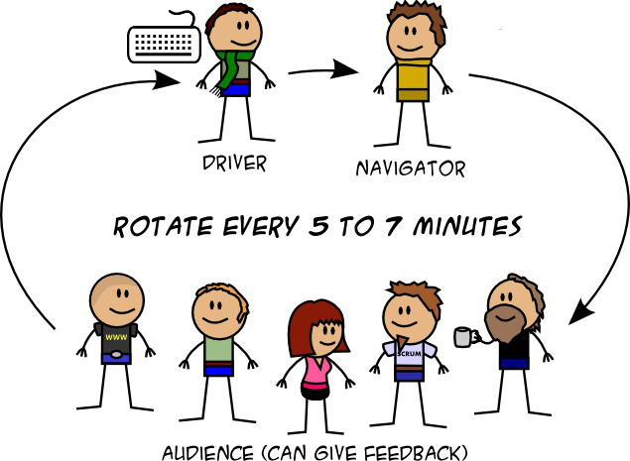
Randori Rules (2)

Slide 4
Randori Rules (3)
If you don’t know what to type, ask for help
If asked for help, respond kindly
If you see an opportunity for learning or improvement, choose an appropriate time to speak up

Slide 5
Yatzy Kata
What programming language to use?
Kata Overview
Strategy to Implement Kata
Testing?

