Slide 1
module 21 challenge
Carlos DE LA ROSA

Slide 2
Home work 21
What is the problem?
Which Applicants should get funded
Who has this problem?
Alphabet Soup Foundation
Why should this problem be solved?
Who has the best success with funding
How will I know this problem has been solved?
Using a NN Machine Learning Model

Slide 3
Background Information
Where did you get the data ?
Explore CSV file containing 34k organizations that received funding over the years

Slide 4
Workable Solutions
NN ML model 1
Drop the NAME and EIN column
Bin the Application type and Classification Column
Compile, Train, Evaluate the NN ML model
Two hidden layers with the first layer set to 8 neurons and second layer with 5 neurons. Epoch set to 100
Accuracy of 0.7233819365501404
Compile more models for Optimization
Using NN ML 1 as a baseline hyper tune three more models
Look for improvement on Area under curve , recall , F1-Score , model Accuracy
Perform baseline models : Linear Regression , Random Forest , Extreme GB
Prediction values established
Further exploration opportunities

Slide 5
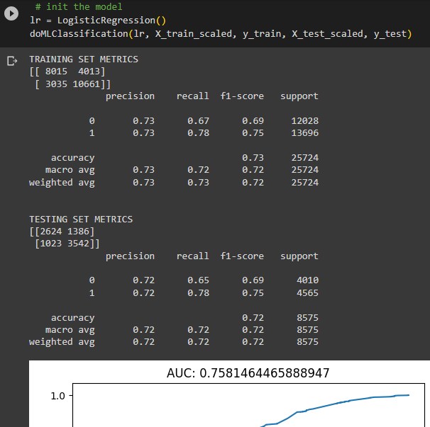
The baseline Models
Linear regression
Overfit, maybe, but not significant
Accuracy 72%
Recall ok at .78
F1-score .75
AUC .7581464465888947
<Insert a picture or drawing of your prototype here>

Slide 6
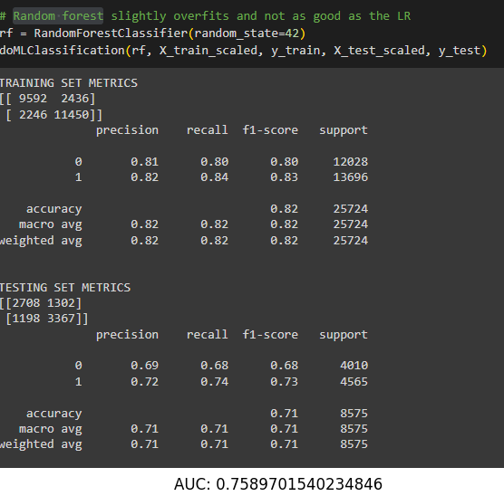
The baseline Model
Random Forest
Overfit identified
Accuracy 71%
<Insert a picture or drawing of your prototype here>

Slide 7
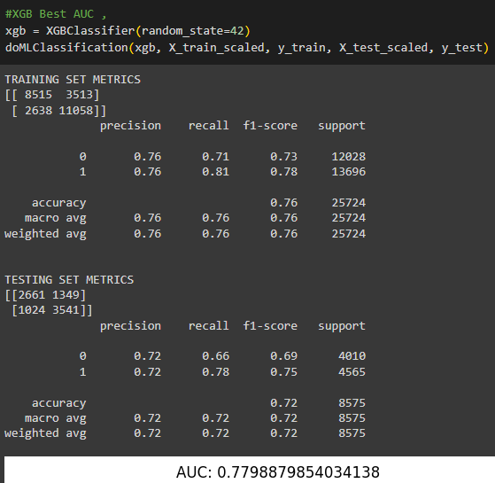
The baseline Model
Extreme GB slight overfit
Accuracy 72%
Recall at .75 on testing set
F1-score lower on testing set
AUC .7798879854034138
<Insert a picture or drawing of your prototype here>

Slide 8
Testing The baseline neural network model 1
Parameters of the NN Model 1
The NN Model 1 used two hidden layers with the 1st layer using 8 neurons and the 2nd layer using 5 neurons. The activation function for the neurons was Relu, due to its faster learning and simplified output. The output layer used sigmoid function because of its usefulness at predicting probability. In this problem it will help predict which applicants will be successful if funded by Alphabet Soup.

Slide 9
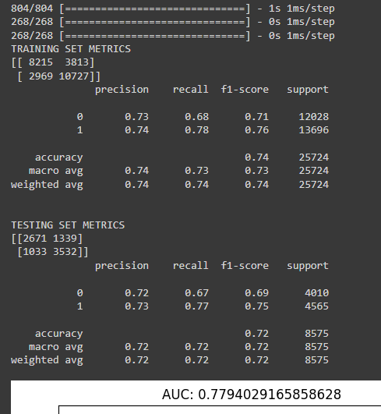
The baseline NN Model 1
Recall aka sensitivity , .77
No overfit identified
Accuracy 72%
Recall at .78 on testing set
F1-score is not a perfect balance
AUC .7794029165858628
<Insert a picture or drawing of your prototype here>

Slide 10
The baseline NN Model 1
Recall aka sensitivity , .77
No overfit identified
Accuracy 72%
Recall at .78 on testing set
F1-score is not a perfect balance
AUC .7794029165858628
<Insert a picture or drawing of your prototype here>

Slide 11
Optimized models
Use the data from your testing to redesign with…
Feature engineering
Bin’ed the two features ‘NAME’ and ‘CLASSIFICATION’
Rerun the baseline models
Hyper tune the neural network model in three runs of the model

Slide 12
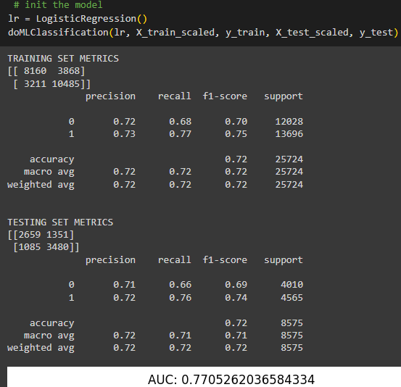
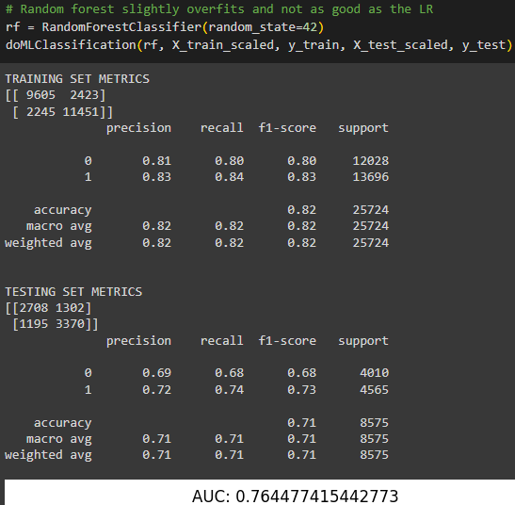
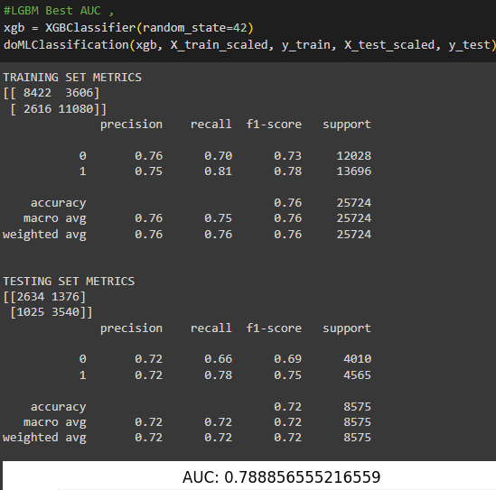
Optimized models diff. feature
Linear Regression
Random Forest
Extreme GB
Random forest didn’t do any better overfit again
Liner still performed better
Xgb better AUC than Linear very similar in metrics

Slide 13
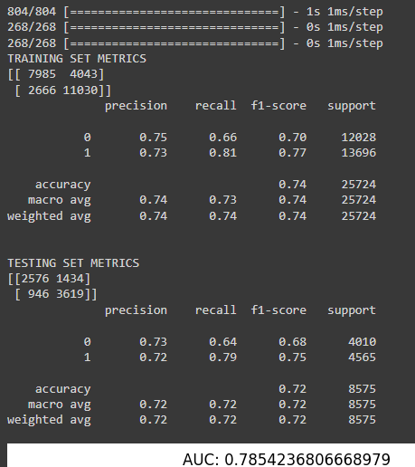
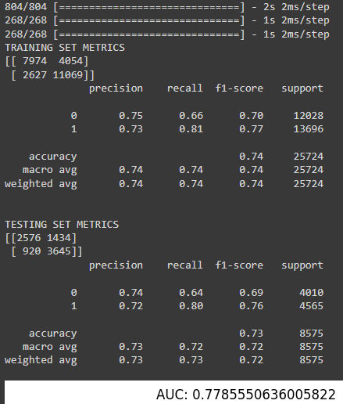
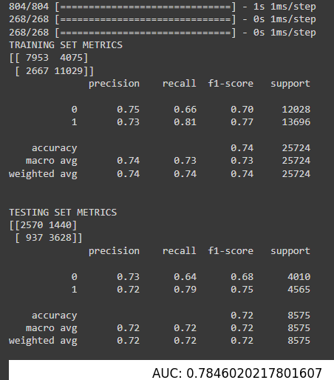
Optimized models
2nd NN Model
3rd NN Model
4th NN Model
2nd NN Model 3 hidden layers
Neurons , lyr 1= 12, lyr2=8, lyr3=5
Epoch = 150
Activation function relu, output function =sigmoid
3rd NN Model 3 hidden layers
Neurons , lyr 1= 10, lyr2=6, lyr3=3
Epoch = 100
Activation function relu, output function =sigmoid
4th NN Model 4 hidden layers
Neurons , lyr 1= 8, lyr2=6, lyr3=4, lyr=2
Epoch = 50
Activation function relu, output function =sigmoid

Slide 14
Final Result
The problem for which applicant should be selected for funding by nonprofit foundation Alphabet Soup had a big data set to use for modeling. The target for the problem is what would predict a successful model for funding of applicants. The specific target is Is_successful and the variable features used for the model where classification, name and application type. The first model dropped the name and EIN because of the difficulty using these string values that would not be beneficial to the first run on the data set. The neurons, layers and activation functions selected for the first model , were selected as a baseline with the understanding that relu as a activation function due to its speed and sigmoid doing well at predicting. The neurons selected for the first model where randomly selected and the hidden layers were selected because I wanted to begin with an even number to discover if odd number of neurons or more even numbered neurons would produce results that would help identify which had a better accuracy prediction. After the first neural network model was ran, my intention was to get the accuracy metric to improve with adjustments to features. This is the action taken on the optimized models with the binning of the NAME feature. The model remained using CLASSIFICATION and after scaling the data I again used the baseline algorithms on the original model. Three additional neural network models were made, and the 2nd model utilized four neurons and epoch value of 150. I kept the activation function for the hidden layers as reuls for speed purposes and the sigmoid because of the usefulness in predicting. The accuracy score remained at 72%, and a similar hyper tune was done on the 4th model using four hidden layers, this time, with the first layer using 8 neurons , layer 2 six neurons and layer 3 using 4 neurons and layer 4 using 2 neurons. The accuracy score did not move by much and remained at 72%. The improvement came with the third model, this model utilized three hidden layers with the first layer using 10 neurons and the second hidden layer using 6 neurons and the third layer using 3 neurons. This model, had the best accuracy of 73% . It did not have a better area under curve than models 2 and 4 , but precision and recall were slightly better than model 2 and 4. The improvement made with model 3 leads me to believe with additional feature engineering and further exploration on the neurons assigned to each layer and experimenting with odd number of hidden layers may have even better results. The data set is large , and the use of a neural network model has its advantages , but the linear regression model may be the best choice for this problem. It is less complex which would lead to easier interpretability to stakeholders. The neural network models had comparable results but required more tuning and testing to gain slightly better results.

