Slide 1
Lightning Products and Services at NOAA’s National Climatic Data Center
Steve Ansari, Stephen Del Greco, Neal Lott
(NOAA / NCDC)

Slide 2
Introduction
Damage and Casualty Reports:
NCDC Storm Events Database
Archive of the Vaisala National Lightning Detection Network (NLDN) data from 1986 to present (> 700 Million Strikes) - Joint project with USAF 14th Weather Squadron.
Raw data from NCDC is available to only Government and Military users.
NCDC is developing several derived products which are freely available for all users.

Slide 3
Storm Events Database
Verified reports from storm spotters, emergency management and more…
1959-present (currently 2000-present online)
Damage and casualty information
Narratives
Pictures (coming soon)

Slide 4
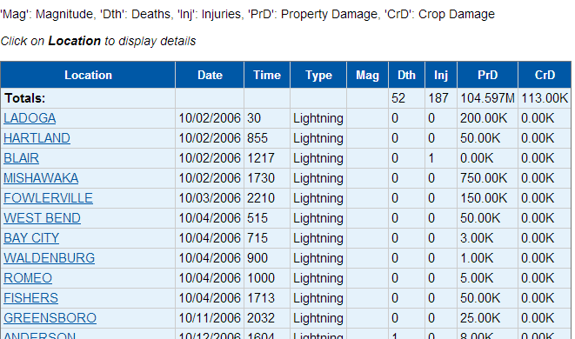
Storm Events Database

Slide 5
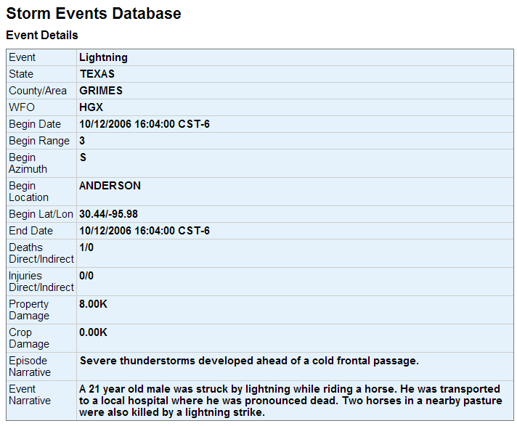
Storm Events Database

Slide 6
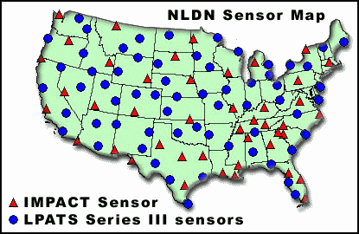
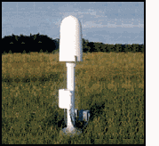
Strike Data
Vaisala’s National Lightning Detection Network (NLDN)
130 Sensors Nationwide, 1986 – Present
Images courtesy of NASA (http://thunder.msfc.nasa.gov/primer/primer3.html)

Slide 7
County/State Summaries
Number of cloud-to-ground lightning strikes are calculated for each day for all U.S. Counties and States.
Part of the NCDC Severe Weather Data Inventory project.
Currently available as CSV text reports. Web services in the future…

Slide 8
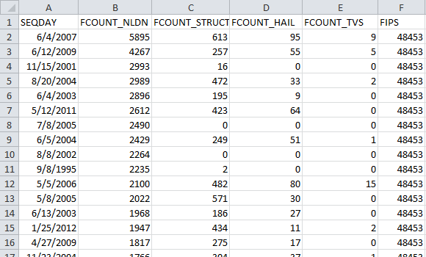
County/State Summaries
Travis County, TX

Slide 9
Tile Summaries
Daily strike counts in 0.10 Degree (~10 km) tiles.
Part of the NCDC Severe Weather Data Inventory (SWDI) project.
Accessible from SWDI RESTful (simple, URL-based) web services:
http://www.ncdc.noaa.gov/swdiws/

Slide 10
Gridded Summaries
4 km Albers Equal Area grid, fit to the Continental United States.
Number of cloud-to-ground lightning strikes are calculated for each day, month, year and 1986-to-present period of record
Summarized by hour over month, year and period of record.
Grids for only positive polarity strikes.
Available in NetCDF format from FTP and THREDDS

Slide 11
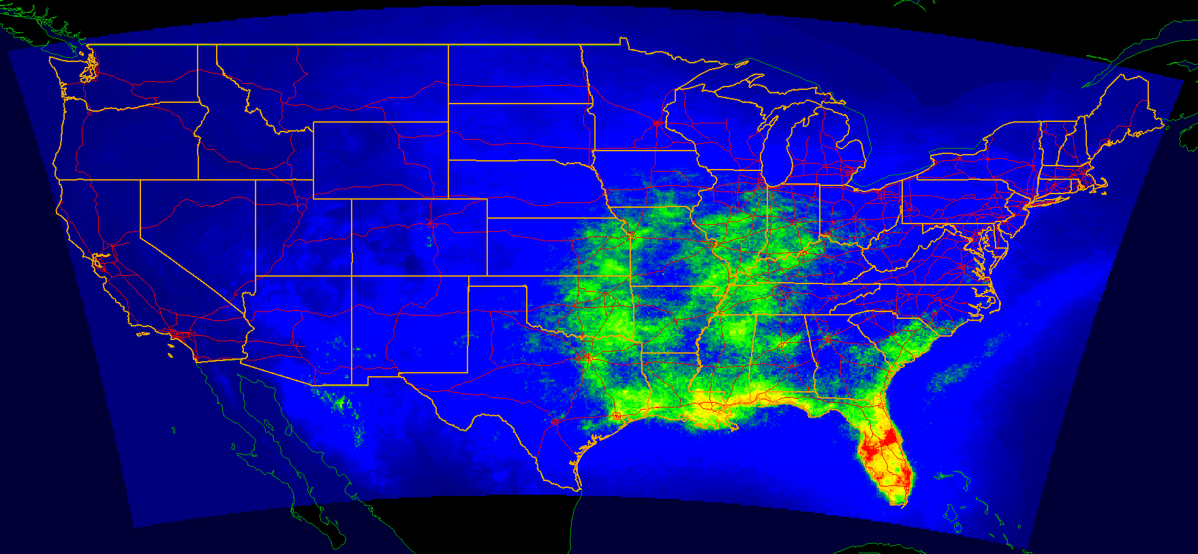

Gridded Summaries
Average annual strike count (1990-2012)

Slide 12
Gridded Summaries
THREDDS capabilities:
XML catalog for datasets and file metadata.
Aggregation capabilities to combine many dates and variables into a single, large virtual file.
Web Services provide access as OPeNDAP, WMS (Web Map Service) and NetCDF Subset Service
NetCDF Subset Service provides simple, URL-based access to time series at specific grid cell.

Slide 13
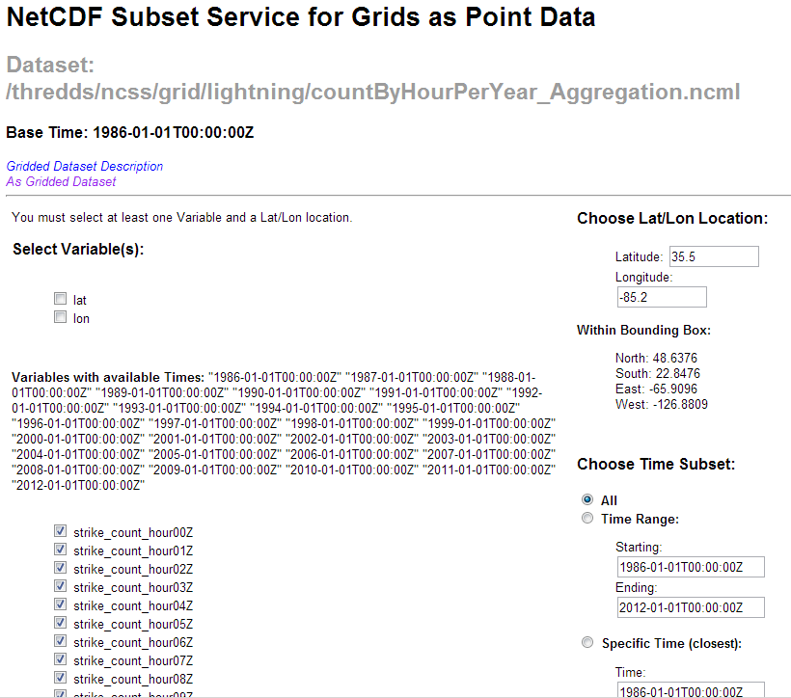
Gridded Summaries

Slide 14
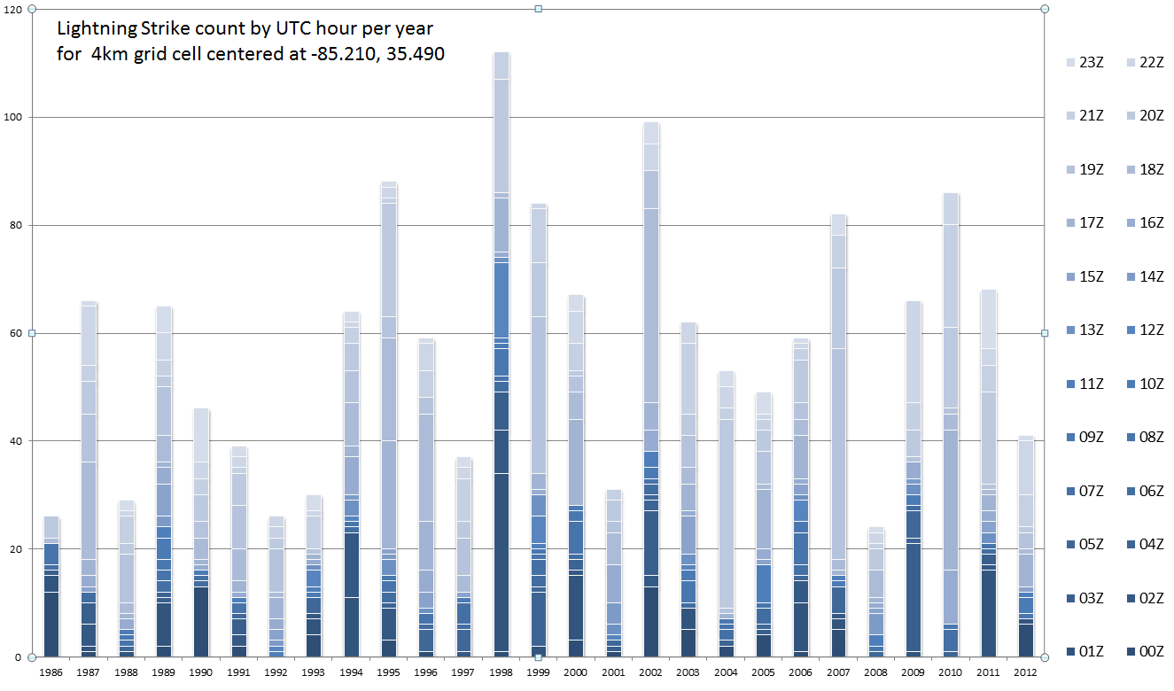
Gridded Summaries

Slide 15
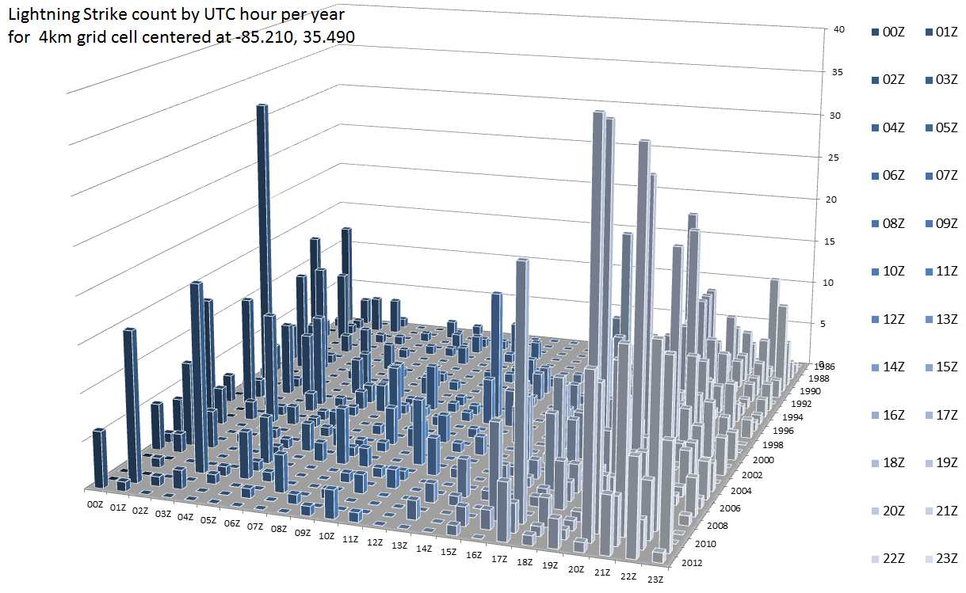
Gridded Summaries

Slide 16
Gridded Summaries
Many NetCDF tools exist.
IDL, MatLab, R, Ferret, NCL, GrADS, IDV, ArcGIS, GRASS-GIS, Quantum-GIS and many more.
Weather and Climate Toolkit

Slide 17
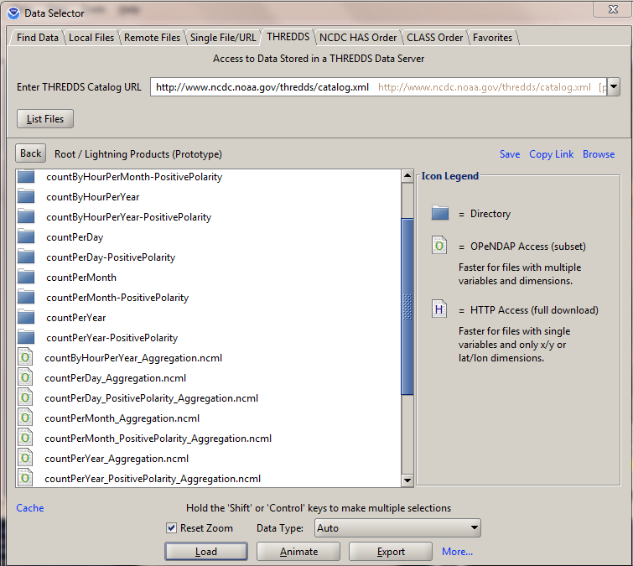
Gridded Summaries
Weather and Climate Toolkit Example

Slide 18
Gridded Summaries
Weather and Climate Toolkit Example

Slide 19
Gridded Summaries
Weather and Climate Toolkit Example
Subset by time and space
Simple visualization
Export to common formats for GIS and more…

Slide 20
Future Work
“By Hour” county and state summaries.
Web Services for county and state summaries.
Improved CF-conventions for gridded NetCDF files.
Online GIS Map Services and integration into Climate.gov

Slide 21
Conclusion
Damage and Casualty Reports:
NCDC Storm Events Database
Archive of the Vaisala National Lightning Detection Network (NLDN) data from 1986 to present (> 700 Million Strikes) - Joint project with USAF 14th Weather Squadron.
Raw data from NCDC is available to only Government and Military users.
NCDC is developing several derived products which are freely available for all users.

Slide 22
Conclusion
Derived products are still PROTOTYPE!
Please help us guide, test and improve these products!
Feedback Welcome!!!
Thank You!
Contact: Steve.Ansari@noaa.gov
Website: http://www.ncdc.noaa.gov/severe-weather/lightning-products-and-services

