Slide 1

Department of Computer Science and Engineering
Continues Assessment – 2
Subject- Theory of Computation
TOPIC :- String acceptance by a Regular Language .

Slide 2
content
Introduction to Finite Automata.
Basic terminologies of Finite Automata.
Types of Finite Automata .
Regular Languages.
Problem.

Slide 3
Introduction to Finite Automata
- A finite automaton (FA) is a simple idealized machine used to recognize patterns within input taken from some character set (or alphabet).
-The job of an FA is to accept or reject an input depending on whether the pattern defined by it occurs in input.
- FA can be defined by using five tuples which are as below,
Q : Finite set of states.
∑ : set of Input Symbols.
q : Initial state.
F : set of Final States.
δ : Transition Function.

Slide 4
Basic terminologies of Finite Automata
Symbol: Symbol is the smallest building block, which can be any alphabet or letter .
Ex. A,b,c,1,2,..
String: String is a finite sequence of symbols , it is generally denoted as w and length of a string is denoted as |w|.
Language: A language is a set of strings . It can be formed over specific input symbols & it may Finite or Infinite in nature.
Alphabets (Σ): Alphabets are collection of symbols, which are always finite.

Slide 5
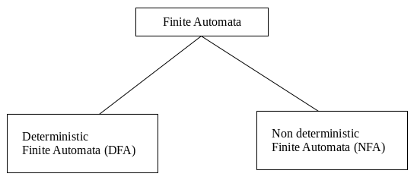
Types of Finite Automata
There are two types of FA depending up on the nature of transition among different states of automata which are as below,
1) Dtereministic Finite Automata (DFA)
2) Nondeterministic Finite Automata(NFA)

Slide 6
Detereministic Finite Automata (DFA) : -
DFA refers to deterministic finite automata. Deterministic refers to the uniqueness of the computation. In the DFA, the machine goes to one state only for a particular input character. DFA does not accept the null move.
Nondeterministic Finite Automata(NFA) :-
NFA is similar to DFA except following additional features :
1. Null (or ε) move is allowed i.e., it can move forward without reading symbols. 2. Ability to transmit to any number of states for a particular input.

Slide 7
Regular Languages.
A language is said to be a regular if & only of a finite automata accepts that language ,otherwise the language is not regular language.
A language is describe a set of strings which possesses an unique property which is common in all The strings in the set.
Some rules applicable on regular languages are as follows: For two regular expressions r1 and r2 :
r1 + r2 is a regular expression denoting union of L(r1) and L(r2). That is L(r1 + r2) = L(r1) U L(r2)
r1r2 is a regular expression denoting the concatenation of L(r1) and L(r2). That is L(r1r2) = L(r1) . L(r2)
r* is a regular expression denoting the closure of L(r). That is L(r*) = L(r)*

Slide 8
Problem
Design a deterministic finite automata that accepts all the strings which are accepted by the language
L = {a^{n}b^{m} | n mod 2=0, m≥1}.
solution :
Our aim is to design an finite automata that accepts all the strings which can described by the given language.
The Regular expression for the given language is
L = (aa)*.b⁺
from the expression we can easily understand that
a string that content even no. of ‘a’ & greater than or equal to one no. of ‘b’ having the order first ‘a’ than ‘b’.

Slide 9
Examples :
Input String : aab
Result : Accepted
Input String : abb
Result : Not accepted
Input String : baa
Result : Not accepted
Input String : aaaab
Result : Accepted

Slide 10
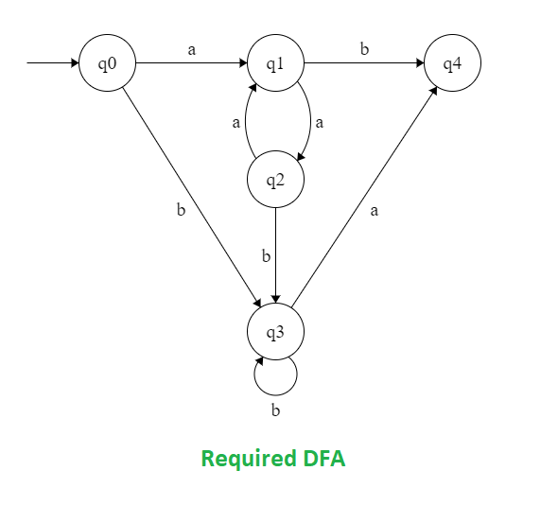

Slide 11


