Slide 1

CS-E5710 – Bayesian Data Analysis
Project Work
Bayesian analysis of a public health surveillance study in Shandong, China
Jacopo Losi
Nicola Saljoughi

Slide 2
01/15
ANALYSIS PROBLEM
The objective of the project is to use the bayesian approach to develop models to evaluate the most influential factors related to serious suicide attempts (SSAs, defined as suicide attempts resulting in either death or hospitalisation) and being able to make predictions about the age of the attempters.
Losi, Saljoughi 09 December 2019

Slide 3
02/15
DATA
Data from two independent health surveillance systems were linked, constituted by records of suicide deaths and hospitalisations that occured among residents in selected countries during 2009-2011.
SOURCE
Sun J, Guo X, Zhang J, Wang M, Jia C, Xu A (2015) “Incidence and fatality of serious suicide attempts in a predominantly rural population in Shandong, China: a public health surveillance study”
Losi, Saljoughi 09 December 2019

Slide 4
03/15
ANALYSIS STRUCTURE
Bayesian vs. frequentist approach
Parameter selection
Full and reduced logistic regression models
Convergence and efficiency analysis
Model comparison
Sensitivity analysis
Predictive checking
Age prediction
Losi, Saljoughi 09 December 2019

Slide 5
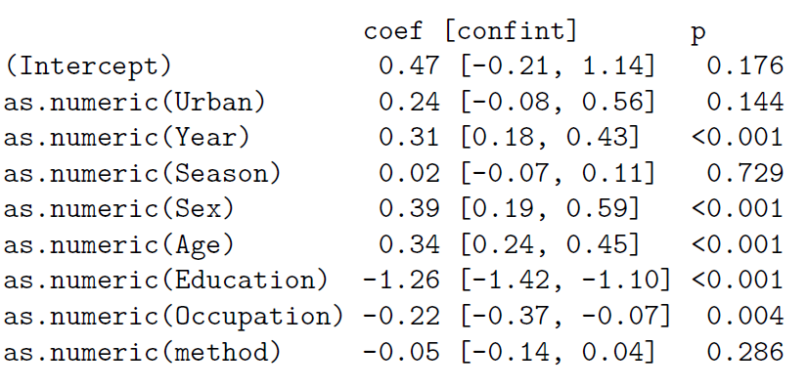
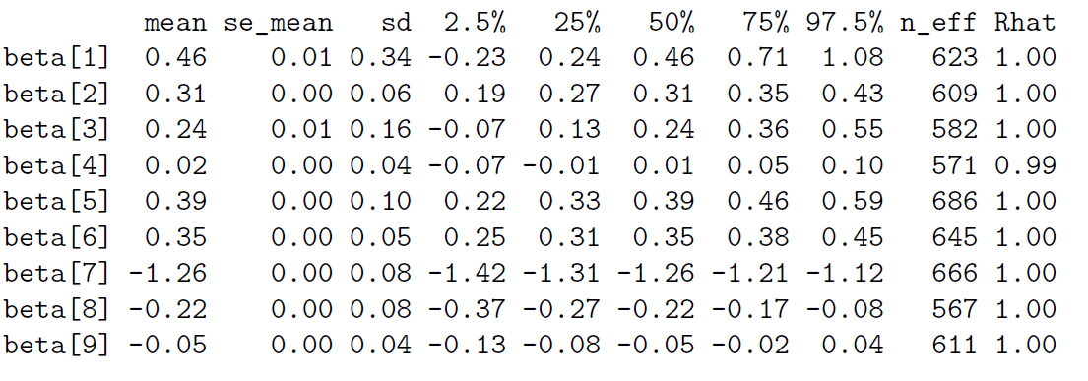
04/15
BAYESIAN vs. FREQUENTIST
Losi, Saljoughi 09 December 2019

Slide 6
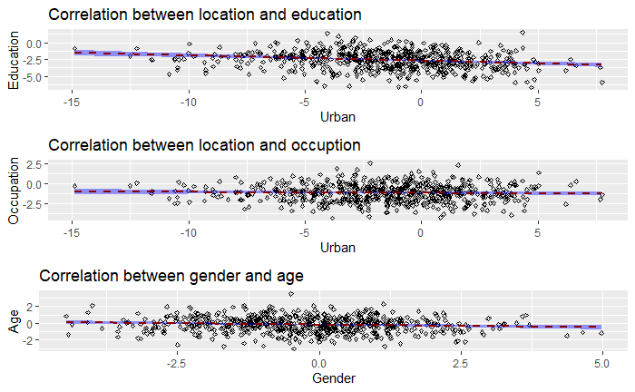
05/15
PARAMETER SELECTION
Losi, Saljoughi 09 December 2019

Slide 7
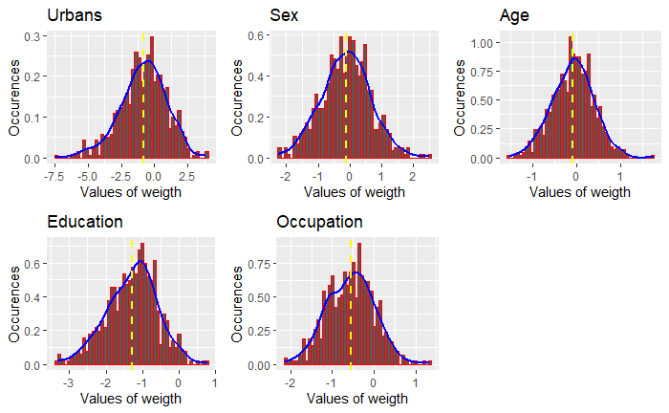
06/15
PARAMETER SELECTION
Losi, Saljoughi 09 December 2019

Slide 8
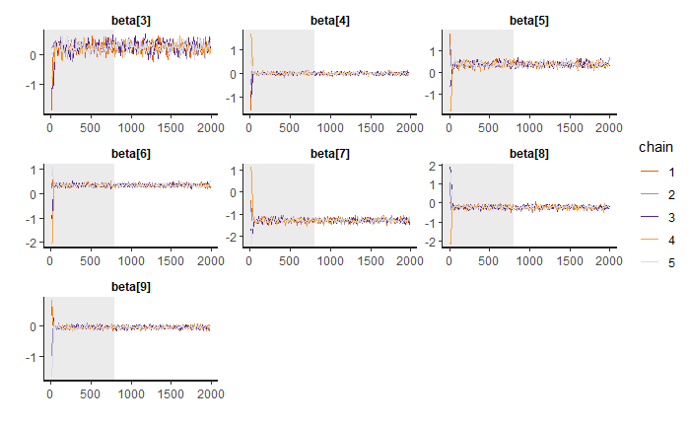
07/15
FULL and REDUCED LOGISTIC REGRESSION MODELS
Results of the Stan fitting for the Full model.
It is possible to notice that the convergence is obtained for all the coefficients of the regression model in all the chains
The grey area highlights the warm-up length
Losi, Saljoughi 09 December 2019

Slide 9
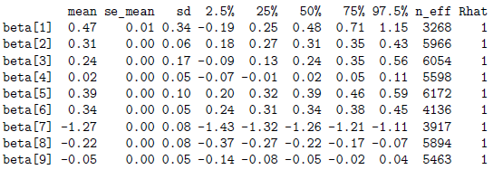
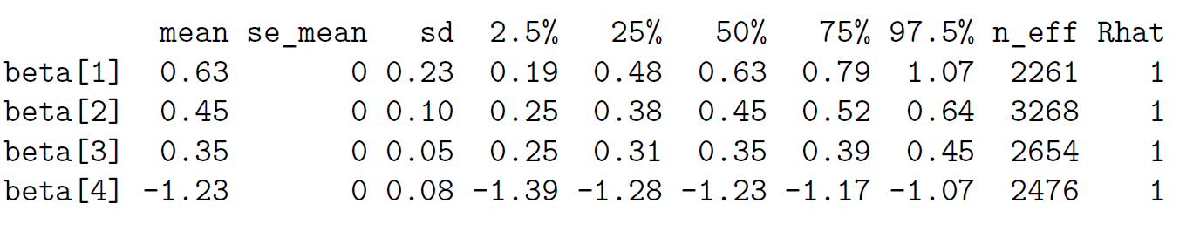
08/15
CONVERGENCE and EFFICIENCY ANALYSIS
HMC Diagnostic
0 of 6000 iterations ended with a divergence
0 of 6000 iterations saturated the maximum tree depth of 10
E-BFMI indicated no pathological behaviour
Losi, Saljoughi 09 December 2019

Slide 10

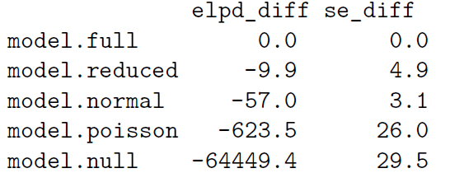
09/15
MODEL COMPARSION
Chosen the full model
Tested model with different families of distribution and tested with leave-one-out cross-validation
Losi, Saljoughi 09 December 2019

Slide 11
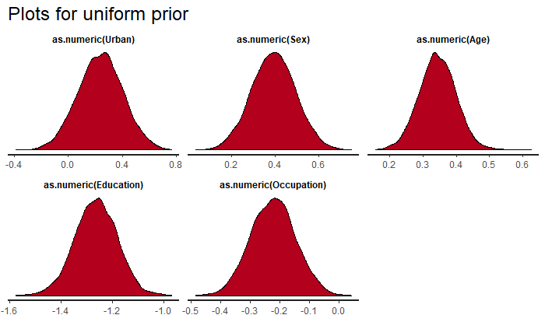
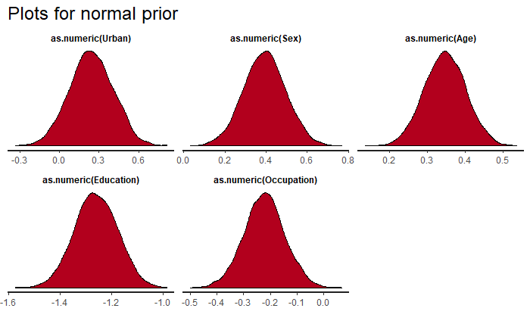
10/15
SENSITIVITY ANALYSIS
Losi, Saljoughi 09 December 2019

Slide 12
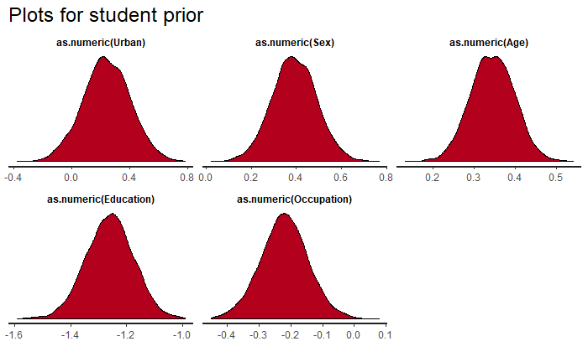
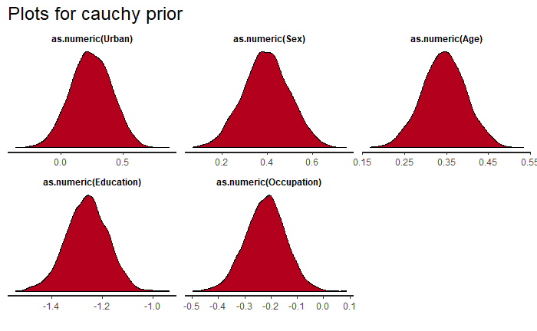
11/15
SENSITIVITY ANALYSIS
Losi, Saljoughi 09 December 2019

Slide 13
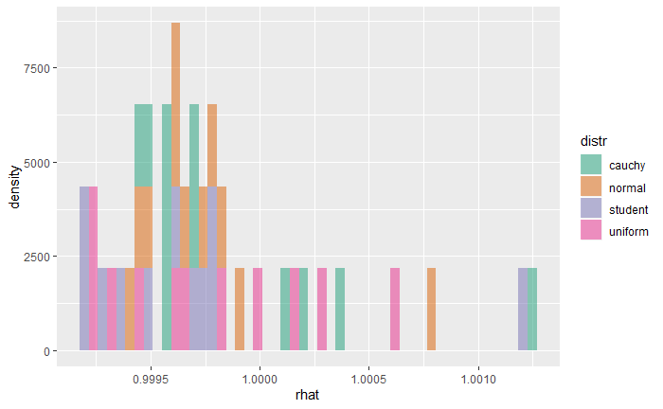
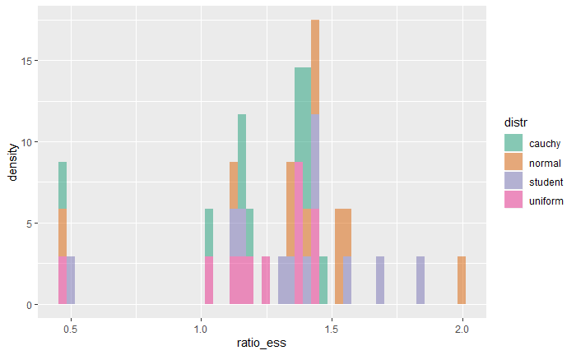
12/15
CONVERGENCE and EFFICIENCY ANALYSIS
Losi, Saljoughi 09 December 2019

Slide 14
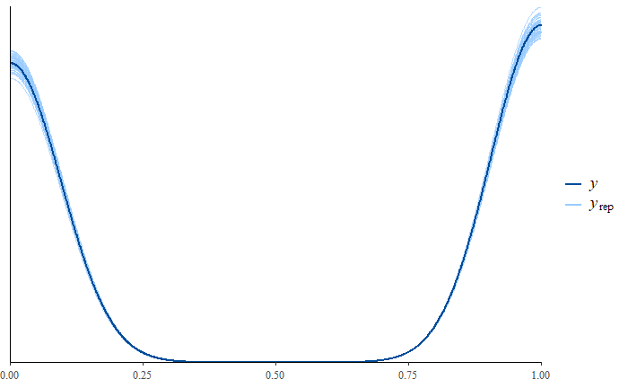
13/15
PREDICTIVE CHECKING
Posterior predictive checking on the probability of SSA
The prediction on the model reflects the posterior distribution
Interesting to notice that the density is higher close to 1
Losi, Saljoughi 09 December 2019

Slide 15
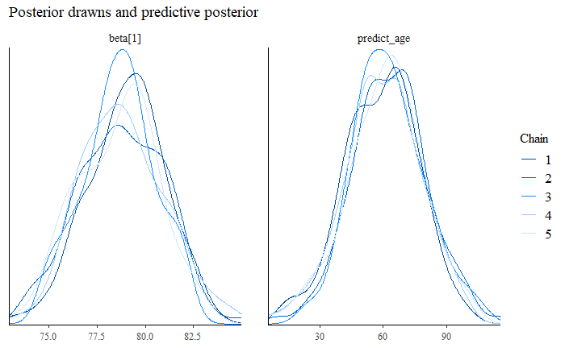
14/15
AGE PREDICTION
Further analysis for one of the more influent parameters
The mean value for the prediction is close to the mean of the posterior
Our results reflects the one obtained in the paper
Losi, Saljoughi 09 December 2019

Slide 16
15/15
CONCLUSION AND IMPROVEMENTS
Conclusion
Improvements
Some of the parameters of the dataset are more relevant.
However the model works better using all parameters and a binomial distribution
The average value for the age of the SSAs is 65 years old
Lot of initial work was required to understand the most suitable model for a meaningful analysis
More complex models could be designed in order to study more in deep the parameters correlation
Losi, Saljoughi 09 December 2019

Slide 17
CS-E5710 – Bayesian Data Analysis
Project Work
Bayesian analysis of a public health surveillance study in Shandong, China
Jacopo Losi
Nicola Saljoughi

