Slide 1

CS-E5710 – Bayesian Data Analysis
Project Work
Bayesian analysis of a public health surveillance study in Shandong, China
Jacopo Losi
Nicola Saljoughi

Slide 2
ANALYSIS PROBLEM
The objective of the project is to use the bayesian approach to develop models to evaluate the most influential factors related to serious suicide attempts (SSAs, defined as suicide attempts resulting in either death or hospitalisation) and being able to make predictions about the age of the attempters.

Slide 3
DATA
Data from two independent health surveillance systems were linked, constituted by records of suicide deaths and hospitalisations that occured among residents in selected countries during 2009-2011.
SOURCE
Sun J, Guo X, Zhang J, Wang M, Jia C, Xu A (2015) “Incidence and fatality of serious suicide attempts in a predominantly rural population in Shandong, China: a public health surveillance study”

Slide 4
ANALYSIS STRUCTURE
Bayesian vs. frequentist approach
Parameter selection
Full and reduced logistic regression models
Convergence and efficiency analysis
Model comparison
Sensitivity analysis
Predictive checking
Age prediction

Slide 5
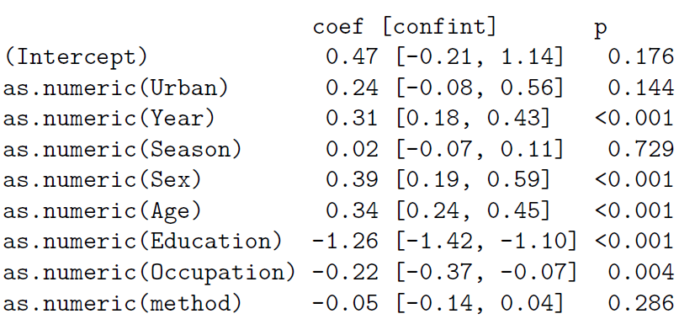
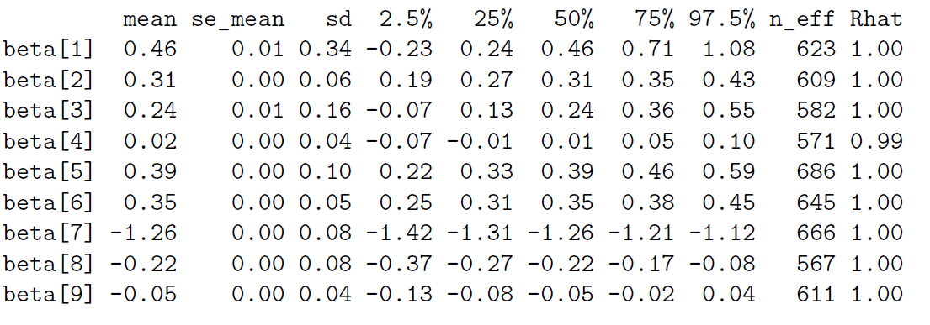
BAYESIAN vs. FREQUENTIST

Slide 6
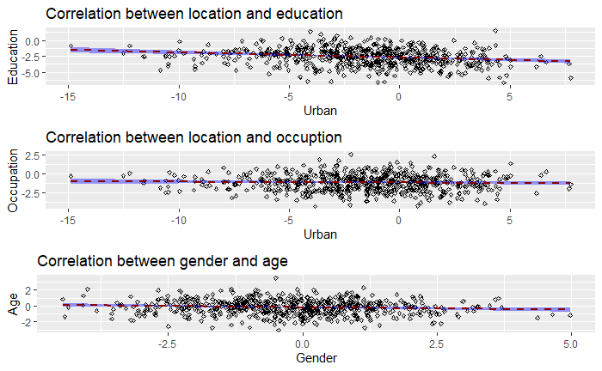
PARAMETER SELECTION

Slide 7
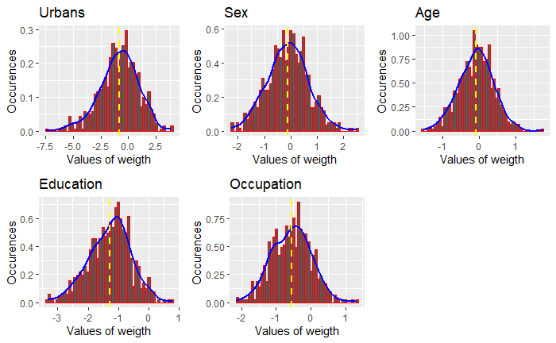
PARAMETER SELECTION

Slide 8
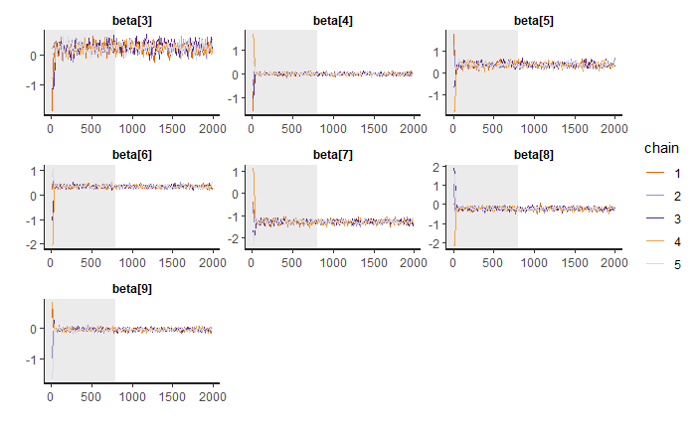
FULL and REDUCED LOGISTIC REGRESSION MODELS

Slide 9
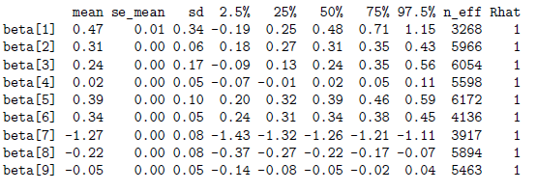
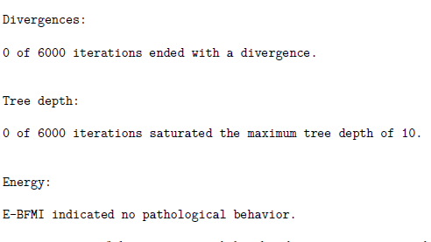
CONVERGENCE and EFFICIENCY ANALYSIS

Slide 10
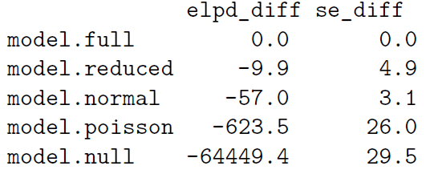
MODEL COMPARSION

Slide 11
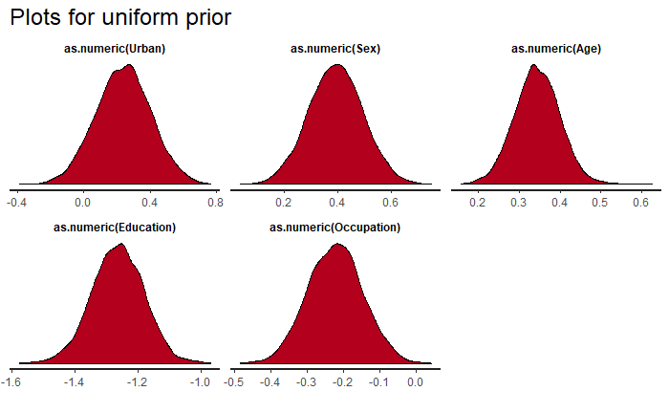
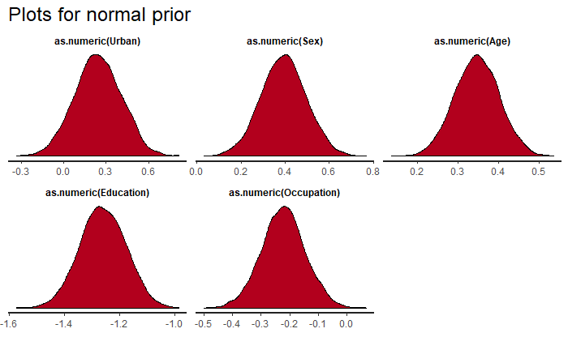
SENSITIVITY ANALYSIS

Slide 12
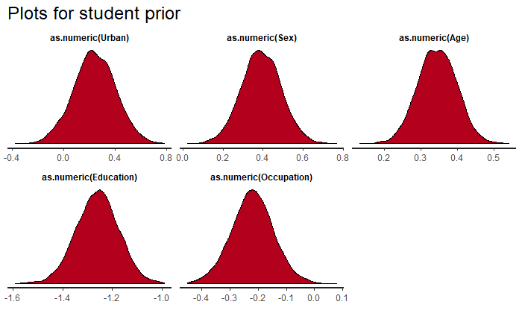
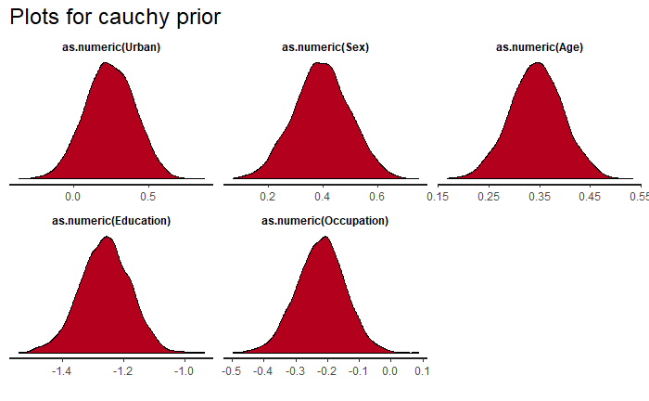
SENSITIVITY ANALYSIS

Slide 13
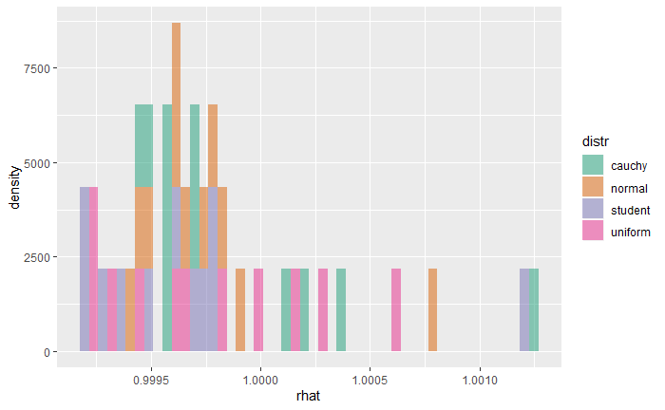
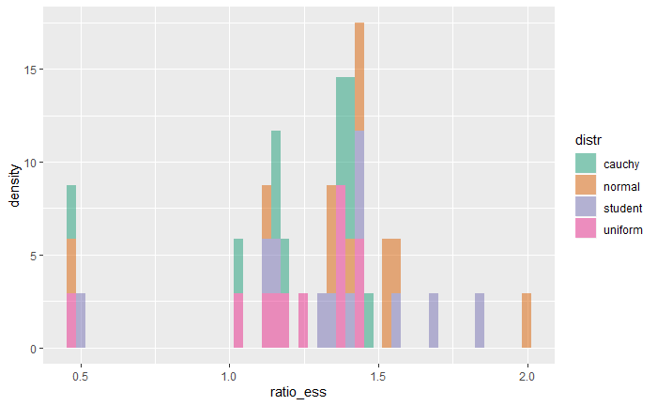
CONVERGENCE and EFFICIENCY ANALYSIS

Slide 14
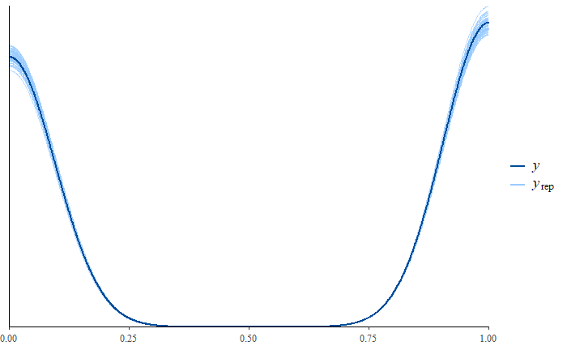
PREDICTIVE CHECKING

Slide 15
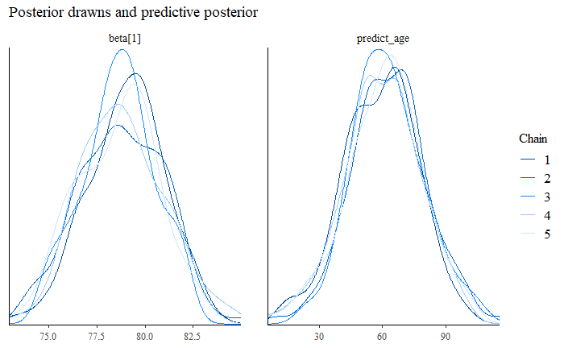
AGE PREDICTION

Slide 16
CS-E5710 – Bayesian Data Analysis
Project Work
Bayesian analysis of a public health surveillance study in Shandong, China
Jacopo Losi
Nicola Saljoughi

