Slide 1




Welcome
To
Byte Knight Technology

Slide 2
Project Plan
Chumani & Yonela

Slide 3
Content Page
Content Page
Project Cover Page…………
Project Overviews……………
Project components………………
Audience……………………………
References……………………………
Acronyms ………………………………
Definition and Documentations……………
Project Organization…………………………

Slide 4
Project Goal
This project involves creating website for Byte Knight Technology our goal is to be handing over the project by the next 3 weeks

Slide 5
Project Team members
Yonela Pangalele
Siphesihle Vani
Dalumzi Gladile
Itumeleng Mashishi
Nelson Tabile
Gcobani Dike
Bongiwe Havi
Chumani masibulele qolohle

Slide 6

Project Tools and Technique

Slide 7
Time
For
Real deal Website

Slide 8
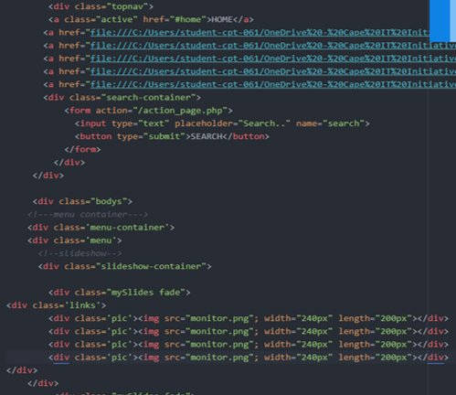
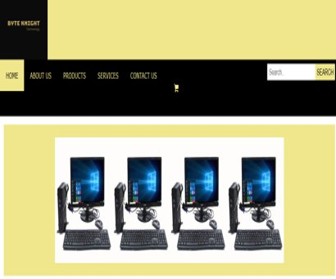
Navigation and Slide show

Slide 9
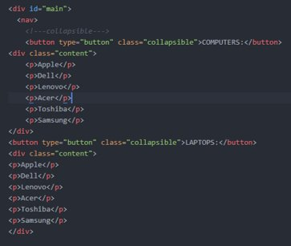
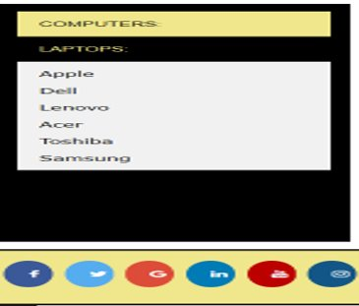
Collapsible

Slide 10
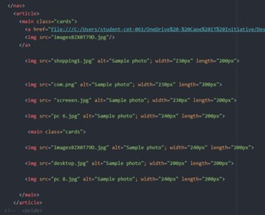
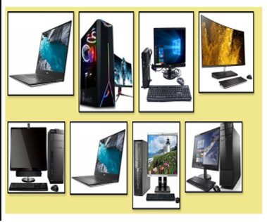
Cards

Slide 11
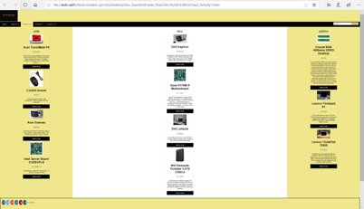
Products

Slide 12
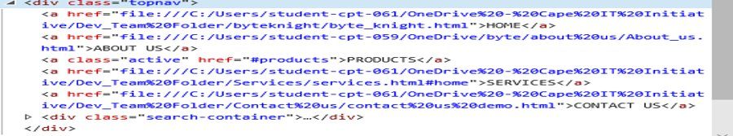
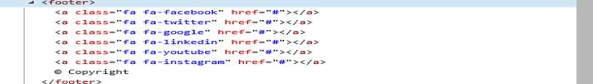
Header and Footer

Slide 13
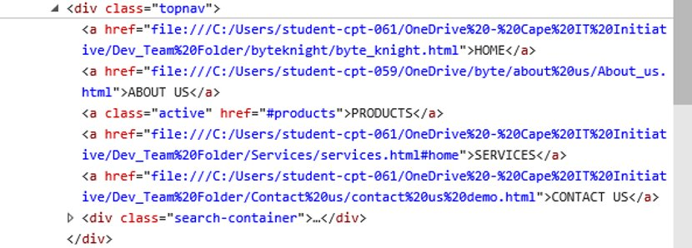
Navigation Bar with Search Bar

Slide 14
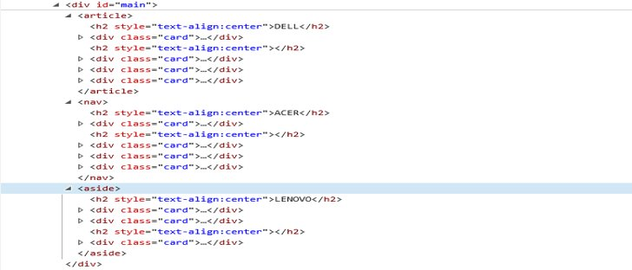
Main Division

Slide 15
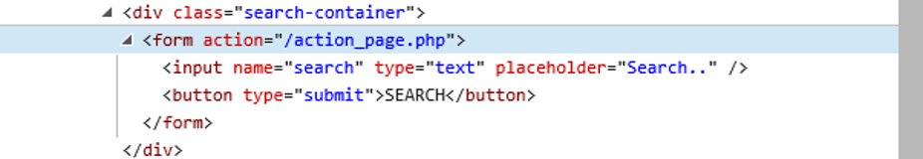
Search Bar

Slide 16

Any Questions ????

