Slide 1
CS 6476 Project 4
[Ruize Cao]
[rcao73@gatech.edu]
[rcao73]
[904012084]

Slide 2
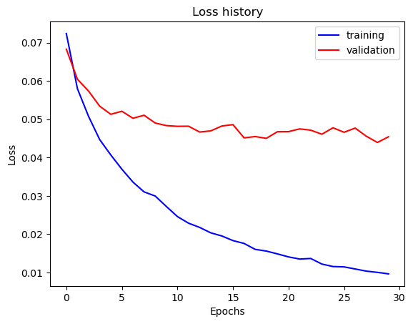
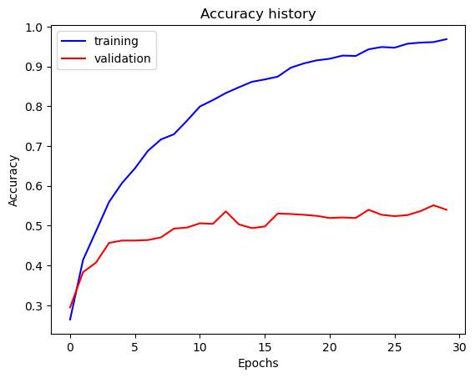
Part 1: SimpleNet
[Insert loss plot for SimpleNet here]
Final training accuracy: 0.9685092127303182
Final validation accuracy: 0.54
[Insert accuracy plot for SimpleNet here]

Slide 3
Part 2: SimpleNetFinal
Add each of the following (keeping the changes as you move to the next row):
 | Training accuracy | Validation accuracy
SimpleNet
Jittering
Zero-centering & variance-normalization
Dropout regularization
Making network "deep"
Batch normalization

Slide 4
Part 2: SimpleNetFinal
[Insert loss plot for SimpleNetFinal here]
Final training accuracy:
Final validation accuracy:
[Insert accuracy plot for SimpleNetFinal here]

Slide 5
Part 2: SimpleNetFinal
[Name 10 different possible transformations for data augmentation.]
[What is the desired variance after each layer? Why would that be helpful?]

Slide 6
Part 2: SimpleNetFinal
[What distribution is dropout usually sampled from?]
[How many parameters does your base SimpleNet model have? How many parameters does your SimpleNetFinal model have?]
[What is the effect of batch norm after a conv layer with a bias compared to having no batch norm?]

Slide 7
Part 3: ResNet
[Insert loss plot here]
Final training accuracy:
Final validation accuracy:
[Insert accuracy plot here]

Slide 8
Part 3: ResNet
[Insert visualization of confusion matrix obtained from your final ResNet model.]

Slide 9
Part 3: ResNet
[Insert visualizations of 3 misclassified images from the most misclassified class according to your confusion matrix. Explain why this may have occurred.]

Slide 10
Part 3: ResNet
[What does fine-tuning a network mean?]
[Why do we want to "freeze" the conv layers and some of the linear layers from a pre-trained ResNet? Why can we do this?]

Slide 11
Part 4: Logging to Weights and Biases
[Add the link to the weights and Biases project below. Make sure your project is public.]

Slide 12
Extra credit
[Add the link to the Weights & Biases run for the model used in the “huggingface.py” script below]

