Slide 1

Week 12 Assignment 12.2
Hockey Assumptions
Eric Quina
DSC530-T302 Data Exploration and Analysis Matthew Metzger
February 16, 2024

Slide 2
Introduction
Overview
Variables
Probability Mass Function and Cumulative Distribution Function
Normal Probability Plot
Scatter Plot
Hypothesis Test
Regression Analysis
Conclusion

Slide 3
Overview
National Hockey League (NHL) General Managers (GMs) have a belief that right shot defensemen are better assets (Akabas, 2023). (right shot in hockey is typically left-handed)
Is this due to scarcity or actual skill set?
Are right shot defensemen better than left shot defensemen?
An analysis of the 5 variable below will help develop an understanding whether right shot players are better that left shot players
Goals per game
Points per game
Hits per game
Blocked Shots per game
Total Shooting Percentage

Slide 4
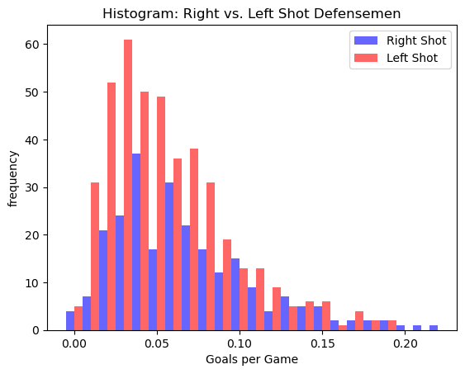
Variables: Goals per Game
Variable Meaning:
Number of goals scored per game played. A goal is credited when the puck completely crosses the goal line into the net and is credited to the last player on the scoring team that touched the puck.
Summary Statistics:
The median is: 0.05
The mean is: 0.06
The highest mode is: 0.04
The spread is: 0.0
The skewness is: 1.12
The Pearson's skewness is: 0.69
Analysis:
There are 3 outliers. These players are all right shot defensemen and considered star players. Dustin Byfuglien is particularly interesting as it is unusual for a star of this caliber to fall so late in the draft. The outliers will remain in the data set as the intent is to see whether right shot defensemen are coveted for a valid reason.

Slide 5
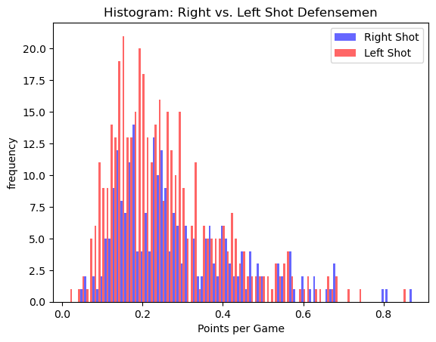
Variables: Points per Game
Variable Meaning:
Number of goals and assists scored per game played. A goal is credited when the puck completely crosses the goal line into the net and is credited to the last player on the scoring team to touch the puck. An assist is credited to the last two players on the scoring team to touch the puck before the goal scorer. One or two assists can be credited per goal depending on the number of players that touched the puck prior to the goal scorer scoring without an opposing player gaining possession.
Summary Statistics:
The median is: 0.24
The mean is: 0.27
The highest mode is: 0.14
The spread is: 0.02
The skewness is: 1.17
The Pearson's skewness is: 0.68
Analysis:
There are a few outliers above 0.8. However, these outliers are some of the most prolific players of their time. All but one player was draft in the first round and the top three players are still active. These are outliers because they are the best offensive defensemen to play the game. The outliers will remain in the data set as the intent is to see whether right shot defensemen are coveted for a valid reason.

Slide 6
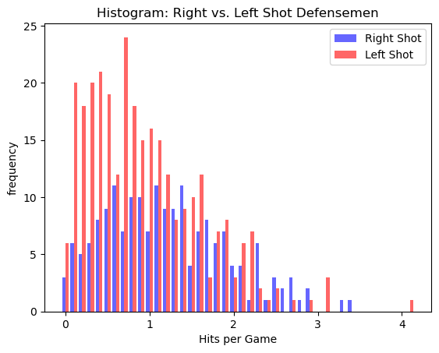
Variables: Hits per Game
Variable Meaning:
Number of hits registered per game played. A hit is registered when a player intentionally makes forceful contact with an opposing player who has the puck, causing them to lose possession of the puck.
Summary Statistics:
The median is: 0.91
The mean is: 1.05
The highest mode is: 0.13
The spread is: 0.51
The skewness is: 0.82
The Pearson's skewness is: 0.58
Analysis:
There are a few outliers above 3 Hits per Game (HPG). However, these defensemen are not known for being prolific scorers. These players are defensive defensemen and do not join offensive rushes in the same way as Cale Makar or Quinn Hughes as show by the low Points per Game (PPG). The outliers will remain in the data set as the intent is to see whether right shot defensemen are coveted for a valid reason.

Slide 7
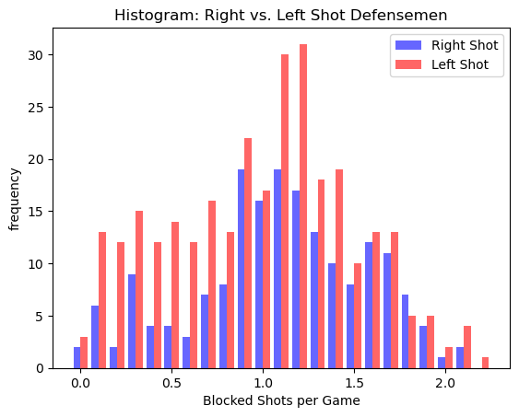
Variables: Blocked Shots per Game
Variable Meaning:
Number of blocked shots registered per game played. A blocked shot is registered when a player deflects or blocks an opposing player’s shot before it can become a shot on goal.
Summary Statistics:
The median is: 1.08
The mean is: 1.03
The highest mode is: 1.25
The spread is: 0.25
The skewness is: -0.14
The Pearson's skewness is: -0.29
Analysis:
There are no significant outliers in Blocked Shots per Game.

Slide 8
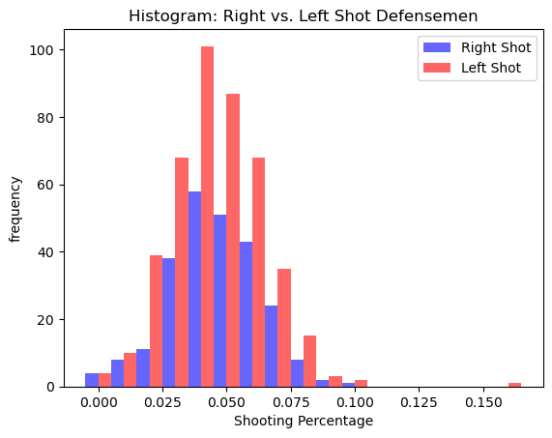
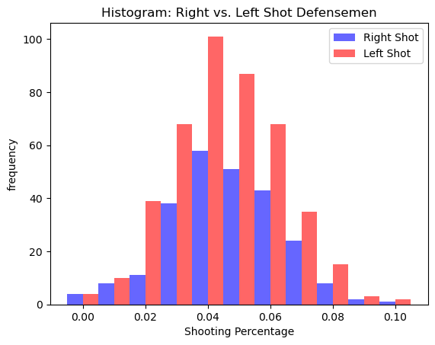
Variables: Total Shooting Percentage
Variable Meaning:
The number of goals scored divided by the number of shots on goal taken.
A goal is credited when the puck completely crosses the goal line into the net and is credited to the last player on the scoring team that touched the puck.
A shot on goal is when a player shoots the puck with the intent of scoring, and the shot would have gone in the net if it hadn't been stopped by the goaltender.
Summary Statistics:
The median is: 0.04
The mean is: 0.05
The highest mode is: 0.04
The spread is: 0.0
The skewness is: 0.42
The Pearson's skewness is: 0.12
Analysis:
The single outlier is Wade Brookbank. This is an interesting outlier as Wade Brookbank is not a prolific scorer or a superstar. He did not play a single 82 game season in his career. He amassed 6 goals in 6 seasons. In the 2006-2007 season, he had a shooting percentage of 100% with 1 shot and 1 goal. This player is an anomaly and will be removed from the dataset. With 127 games played, 38 shots and 6 goals, he would not be considered a notable player other than that he made his few shots count.

Slide 9
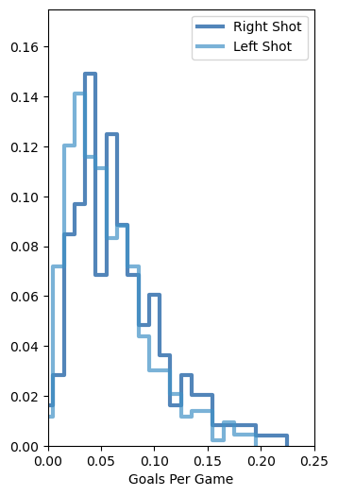
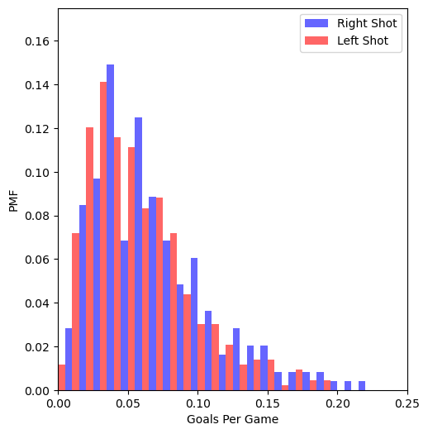
Probability Mass Function (PMF)
Analysis:
The PMF results support a slight advantage for right shot defensemen in goals per game. The right shot defensemen have a consistent edge in goals per game and the edge over left shot defensemen increase as the goals per game increase. The PMF indicates that right shot defensemen have a higher goals per game.

Slide 10
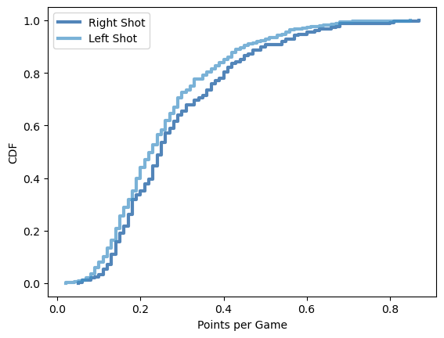
Cumulative Distribution Function (CDF)
Analysis:
The CDF shows the cumulative distribution of points per game. This helps answer why NHL GMs think that right shot defensemen are better assets. However, this only provides support that the right shot defensemen appear to be better offensively as the CDF for right shot defensemen is skewed toward higher points per game.
This does not evaluate the defensive capabilities of the defensemen, and this is their primary function. There are NHL GMs that are willing to take an offensive defenseman hoping that offensive production will out weight the defensive short falls that normally accompany a defenseman that presses more fully into an offensive zone than a defensive minded defenseman.

Slide 11
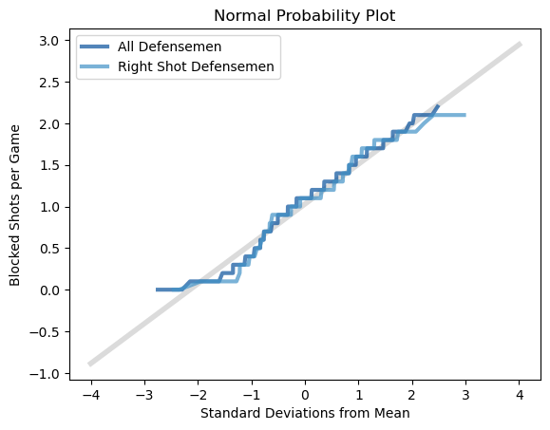
Normal Probability Plot
Analysis:
The normal probability plot shows that the right shot defensemen are not significantly better at blocking shots than the entire population of defensemen. This also indicates that right shot defensemen are also not significantly worse than the population. Given the slight edge in the offensive capabilities and the indication of being on pace in a defensive category, this does indicate that right shot defensemen give a team an edge.

Slide 12
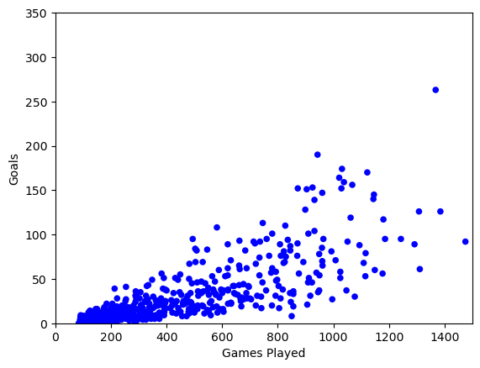
Scatter Plot: Game Played & Goals
Analysis:
Games played and goals share a strong correlation in both correlation measures with a 0.76 Pearson’s correlation and a 0.82 Spearman correlation. While correlation is not always causation, goals have a causal relationship with games played. The more games that a player is involved in, the more opportunities that player will have score a goal. While other factors come into play, having increased time is a large contributing factor and the correlation factors support this.
Correlations:
The covariance is 8181.82
The Pearson’s correlation is 0.76
The Spearman correlation is 0.82
Analysis:
provide your analysis on correlation and causation. Remember, covariance, Pearson’s correlation, and Non-Linear Relationships should also be considered during your analysis

Slide 13
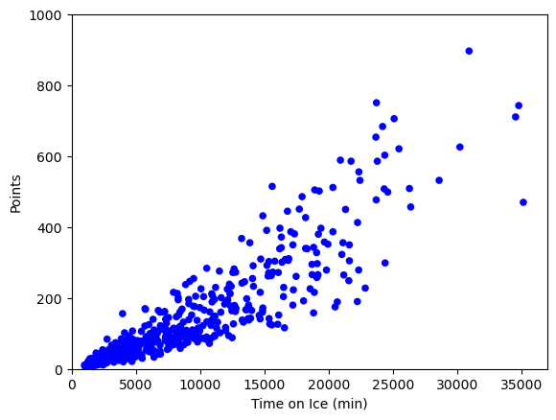
Scatter Plot: Time on Ice & Points
Analysis:
As with games played and goals, Time on Ice and points have a strong correlation. In fact, the correlation is near perfect with a 0.9 Pearson’s correlation and a 0.94 Spearman correlation.
The higher level of correlation is logical as more time playing is a stronger indicator than just dressing for a game. A player with 20 minutes of play time will have 4 times the opportunities as a player with 5 minutes of play time. While other factors such as powerplays (opposing team penalty) and short-handed situations (team penalty) will impact how the time on ice is spent. The increased time and the addition of assists to goals (points) increases that players opportunity to register a point.
There is a correlation between these variables and the relationship is causal.
Correlations:
The covariance is 952490.97
The Pearson’s correlation is 0.9
The Spearman Correlation is 0.94
Analysis:
provide your analysis on correlation and causation. Remember, covariance, Pearson’s correlation, and Non-Linear Relationships should also be considered during your analysis

Slide 14
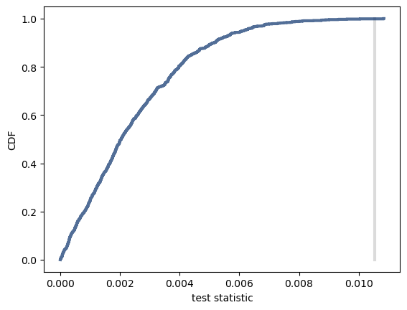
Hypothesis Test
The p-value is 0.001
Analysis:
The hypothesis test confirms that the hypothesis is valid. The p-value indicates that the value is not because of chance in the sampling. This supports that for the factor of Goals per Game. The NHL GMs are validated in their theory that right shot defensemen have more offensive value.
However, additional testing is needed to determine if the offensive edge that is obtained from right shot defensemen is worth any defensive short falls that may exist if the right shot defensemen as not as skilled defensively.

Slide 15
Regression Analysis
OLS Regression Results
Dep. Variable: | goals | R-squared: | 0.596
Model: | OLS | Adj. R-squared: | 0.595
Method: | Least Squares | F-statistic: | 998.8
Date: | Sun, 16 Feb 2025 | Prob (F-statistic): | 1.95e-135
Time: | 21:58:38 | Log-Likelihood: | -3106.4
No. Observations: | 680 | AIC: | 6217.
Df Residuals: | 678 | BIC: | 6226.
Df Model: | 1
Covariance Type: | nonrobust
Analysis:
Conducting a regression analysis indicates that the intercept and the games played are a good indicator of goals that a player will have. This as a low p-value indicting that this result is not due to random chance.
The R-squared indicates that 59.6% of the observed variation in goals is explained by the games played. While other factors influence the number of goals that a player has, the games played is a strong indicator given that this increases the opportunity for goals. While factors like skill, shots, powerplay time, and ice time will also influence the number of goals, much of the variance is explained by games played.
Omnibus: | 266.566 | Durbin-Watson: | 2.037
Prob(Omnibus): | 0.000 | Jarque-Bera (JB): | 1967.770
Skew: | 1.567 | Prob(JB): | 0.00
Kurtosis: | 10.722 | Cond. No. | 983.
 | coef | std err | t | P>|t| | [0.025 | 0.975]
Intercept | -10.9009 | 1.620 | -6.727 | 0.000 | -14.082 | -7.719
games_played | 0.0942 | 0.003 | 31.603 | 0.000 | 0.088 | 0.100
Notes: [1] Standard Errors assume that the covariance matrix of the errors is correctly specified.

Slide 16
Conclusion
Analysis:
The exploratory data analysis (EDA) was conducted to determine if right shot defensemen are better assets than left shot defensemen. This is a widely held belief of National Hockey League General Managers and analysts (Akabas, 2023). The data appears to support this finding in one dimension of play. Right shot defensemen show a measurable offensive advantage over left show defensemen. In a game that can be decided with one shot, this is a marked advantage.
While the focus is often on offensive power, defensemen are paid to defend. If a right shot defenseman is better offensively, but is a defensive liability, the team is not in a better position overall. However, if the player is better offensively and on par defensively, this would be a marked advantage.
Additional analysis would be needed to determine if the offensive advantage is not outweighed by any defensive shortfalls.

Slide 17
Reference
Akabas, L. (2023, February 3). “Right-Handed Defensemen Are the NHL’s Hot Commodity: Data Viz”. Sportico.com. Retrieved 2/18/2025 from
https://www.sportico.com/leagues/hockey/2023/nhl-highest-paid-players-right-handed-defensemen-1234708533/
Downey, A. (2014). Think stats: Exploratory Data Analysis. “O’Reilly Media, Inc.”
Elite Prospects (2025). “Advanced Player Search”. Retrieved January 12, 2025, from https://www.eliteprospects.com/search/player?
Ellis, M. (n.d.). “NHL Game Data”. Retrieved January 12, 2025, from https://www.kaggle.com/datasets/martinellis/nhl-game-data

