Slide 1
Face Reenactment for Speech Therapy Applications
An End-to-End Prototype
Atharva Sonare(22116022) · Barath Chandran C.(22116026)
Supervisor: Dr. Vinod Pankajakshan
Department of Electronics and Communication Engineering
Indian Institute of Technology Roorkee · B.Tech Project (ECN-400B) · May 2026
Notes:
Good Afternoon , everyone. We are Atharva and Barath , and our B.Tech Project, supervised by Dr. Vinod Pankajakshan, is on Face Reenactment for Speech Therapy. In the next ten minutes we will explain the speech-therapy problem we set out to solve, the technical journey we took, and the end-to-end system we finally built.

Slide 2
Motivation — Why Speech Therapy Needs Better Tools
The Patient's View
What We Set Out to Build
• Traditional therapy relies on mirrors and the therapist's face — patients struggle to map another face onto their own
• Hard to remember the correct lip shape between sessions
• Practice at home lacks structured feedback
• Patients with articulation disorders need visual cues, not only audio
• Show the patient performing the correct exercise on their own face
• Use the patient's own voice (or a close-matching default)
• Provide an objective score and feedback against the therapist's reference
• Keep inference light enough to run on consumer hardware — no cluster required
Notes:
Globally there are around one billion people who experience some form of communication or speech disorder , these include children , stroke patients. All these people require speech therapy which depends heavily on visual feedback. Patients have to watch the therapist and somehow translate that to their own face, which is a hard mental mapping. Our idea is simple: instead of showing the therapist's face, what if we could show the patient their own face doing the exercise correctly, with their own voice on top , and also provide them reliable feedback for self practise.

Slide 3
Problem Statement
Given:
• A single image of the patient
• A reference video of the therapist performing a speech exercise
• (Optional) a voice sample from the patient
Result:
• A video of the patient's face performing the same exercise
• Optionally re-voiced with the patient's own voice or a close-matching default
• An objective score comparing the patient's practice attempt against the reference
Notes:
So formally out problem statement can be framed as this : Given a patient photo and a therapist demo video, generate a video of the patient doing the exercise, optionally with their voice, and score how well the patient's own attempt matches the reference. The hard constraint throughout was compute — we built this to run on a regular consumer laptop, not a server.

Slide 4
Proposed End-to-End System
Patient Image
Generation Core
• LivePortrait reenactment
• Seed-VC voice transform
• Audio–video sync
Therapist Reference Video
Generated Patient Demo Video
Patient's Voice Sample (optional)
Patient's Practice Recording
Evaluation Module
Articulation (30 %)
Dialogue Acoustic (30 %)
Dialogue Transcript (40 %)
LivePortrait lip kp + FastDTW (cosine)
silero-vad + ContentVec + FastDTW (cosine)
Whisper transcription + Word-Error-Rate
Notes:
Here's the system at a glance. On the left, three inputs: patient image, therapist reference video, and optionally a voice sample. These go into a generation core combining LivePortrait for the visuals and Seed-VC for the voice .The output is a personalized demo video. The patient then records their own attempt, and our evaluation module compares the two using three components — articulation, acoustic similarity, transcript accuracy — weighted 30, 30, 40 percent. We'll come back to each later in our explanation.

Slide 5
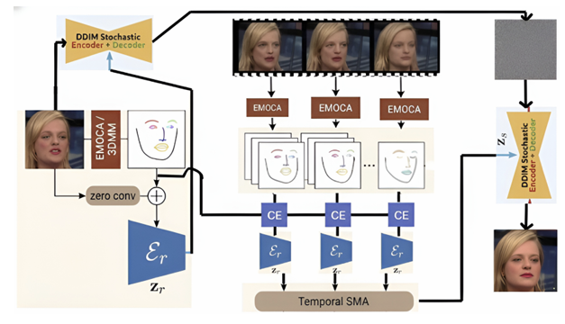
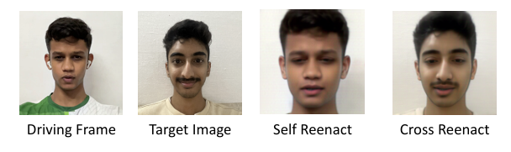
Phase 1 — Improving DiffusionAct
We started with DiffusionAct (Bounareli et al., FG 2025), a controllable diffusion autoencoder for one-shot reenactment.
Our two proposed improvements:
• Identity-preserving DDIM prior — noised target frame instead of noised source (cuts identity leakage)
• Feature-space moving average on semantic codes — SMA (K = 12) and EMA (α = 0.7) on z_t (cuts jitter)
Phase 1 pipeline (from our mid-eval poster):
Phase 1 fidelity metrics:
Metric
Baseline
Ours (SMA)
Expression MSE
0.345
0.371
Pose MSE (×10⁻³)
0.60
0.37
Identity Cosine
0.84
0.90
Expr. TMSE (×10⁻¹)
0.51
0.31
Pose TMSE (×10⁻⁴)
0.554
0.522
Notes:
We did not outright start with the system we have currently, In Phase 1, we tried to make DiffusionAct — a controllable diffusion autoencoder — work for video , which likes most reenactment models had two problems identity leakage and flicker. The pipeline on the left, from our mid-eval poster, shows the two changes we made: we switched the DDIM prior from the noised source to the noised target frame to cut identity leakage, and we applied a moving average — SMA in the results column — on the semantic codes to dampen jitter. The numbers on the right show the improvement: Identity Cosine jumped from 0.84 to 0.90 and pose error dropped. So the changes worked on paper. But qualitatively we were not satisfied as we could still feel the jitter, so we decided to push further to find the cause by performing some experiment.

Slide 6
Five Experiments That Did Not Work
Each failure narrowed down the real source of jitter in DiffusionAct.
1. Optical-flow loss in training
2. Retrieval-based target selection
Penalised frame-warp residuals. Training became unstable — model traded texture realism for flow coherence.
Searched the target-identity DB for pose-matched frames per source frame. Per-frame quality up — sequence continuity down.
3. One-Euro filter on landmarks
4. Alignment rotation smoothing
Smoothed input bounding boxes and landmarks. Crops became smoother, output still flickered → jitter is not input noise.
Smoothed the per-frame eye-alignment rotation. The model 'corrected' the smoothed input and produced eye distortions.
5. Static-video sanity check
Key Insight
Reenacted the same image looped at 25 fps. The output still jittered — jitter is intrinsic to diffusion sampling itself.
Stochastic diffusion sampling injects variation even when the input is constant. Smoothing is a band-aid. A different model family is needed.
Notes:
We tried five stabilisation strategies, each failing in an instructive way. Optical flow training was unstable. Retrieving pose-matched frames killed continuity. Filtering the landmarks smoothed the crops but the output still flickered, so input noise isn't the culprit. Smoothing the alignment rotation caused eye distortions. The killer experiment: we fed the model the same image 25 times a second, and the output still jittered. That's when we knew the jitter is in the diffusion sampler itself, not anything we can pre-process away. Time to switch model family .

Slide 7
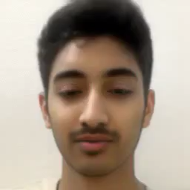
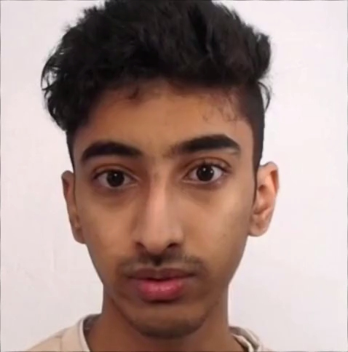
Diffusion (then) vs LivePortrait (now)
DiffusionAct
LivePortrait
• Diffusion autoencoder, stochastic sampling
• High single-frame fidelity
• Identity leakage in cross-reenactment
• Persistent texture flicker across frames
• Slow inference (~seconds / frame)
• Heavy compute footprint
• Implicit-keypoints GAN, deterministic
• Built-in stitching + eye/lip retargeting ( we do not use this in our case)
• Negligible flicker on long sequences
• 12.8 ms/frame on RTX 4090; runs on consumer-grade hardware
• Lightweight enough for our prototype
Cross reenact- DiffAct
Cross reenact- LivePort
Notes:
So we ended up choosing LivePortriat , Head-to-head: DiffusionAct gives beautiful single frames but the stochastic sampler injects flicker, it's heavy, and inference is slow and outputs are somewhat smoothened images. LivePortrait is a GAN-based implicit-keypoint model — deterministic, trained on a much larger dataset, with built-in stitching and lip retargeting, and light enough to run on a normal laptop. For a clinical prototype, those properties are what we were looking for. So this is a side by side comparison of diffusion and live portrait for cross reenactment. The video is much more stable in liveportrait.

Slide 8
LivePortrait — Model Architecture
Source Image
Appearance Extractor F
F_s (3-D feat.)
Warping W
Decoder G
Final Frame
Source + Driving
Motion Extractor M
kp, R, t, s, expression δ
Driving Video
Stitching
Source + Driving
Motion Extractor M
Source
kp, R, t, s
The four base modules + two heads:
• F extracts 3-D appearance features • M extracts implicit motion parameters
• W warps F_s by the motion, G decodes • Stitching changes the motion embedding of driving video to better align with keypoints of source image.
Notes:
So we will see why it is much more stable through its architecture. The appearance path takes the source image and an Appearance Extractor F produces a 3-D feature volume F-s. The motion path takes source and driving frames; a Motion Extractor M produces canonical keypoints, head rotation, translation, scale, and an expression deformation delta. We combine these to get resulting implicit keypoint embedding. Both outputs converge at the Warping module W, which warps F-s by the motion. The decoder G turns that into a face frame. The decoder G is a gan which is trained through a cascaded loss. The reason why live portrait is better than diffract is the embedding have a temporal context. *(brief pause)* And critically, this is where the stitching block comes in —. That gives us the final frame. The model is trained in two stages on around 69 million frames, inference is deterministic, and it runs on consumer hardware. We use it as-is — no fine-tuning.

Slide 9
Seed-VC V2 — Voice Conversion Architecture
Source audio (therapist)
Content Encoder (HuBERT)
Speaker-invariant content embedding
Diffusion-Transformer Decoder (30 steps, CFG = 0.7)
Target voice ref (patient or preset)
Speaker Encoder (CAM++)
Target speaker embedding
Re-voiced audio (merged onto video)
Vocoder
Mel-spectrogram
Why this architecture works for us
Default Voice Gallery
• Content encoder is speaker-invariant — keeps the words, drops the timbre
• Speaker encoder reads timbre from a short target clip — no per-patient training
• 30 diffusion steps gives natural prosody at a few seconds per clip
Used when patient sample is missing or fails guardrails:
Male — High
Female — High
Male — Medium
Female — Medium
Male — Low
Female — Low
Notes:
Seed-VC V2 is the voice transformation model. There are three learnt components. A content encoder — typically based on self-supervised speech features like HuBERT — pulls out speaker-invariant linguistic content from the source audio: the words and rhythm, with the timbre stripped out. A speaker encoder reads the target voice reference, which can be the patient's own sample or one of our six presets, and produces a fixed embedding capturing timbre. Both feed a diffusion-transformer decoder that generates a mel-spectrogram, conditioned on both. Finally a vocoder turns that mel-spectrogram into a waveform. We use 30 diffusion steps and a similarity CFG of 0.7, which gives stable timbre transfer at a few seconds per clip on our laptop. Balancing both the naturalness of the audio and conditioning. The transformed audio is then merged back onto the generated LivePortrait video, with sync.

Slide 10
Dynamic Time Warping — Aligning Two Sequences in Time
The intuition
A patient does not speak at the same pace as the reference. Some syllables stretch, some compress. A frame-by-frame comparison would punish this as an articulation error. DTW first aligns the two sequences in time, then scores them.
The setup
Two sequences a = (a₁, …, aₘ), b = (b₁, …, bₙ) and a local cost d(aᵢ, bⱼ).
reference sequence →
DTW recurrence (dynamic programming):
D(i,j) = d(aᵢ,bⱼ) + min{ D(i−1,j−1), D(i−1,j), D(i,j−1) }
Score
Average per-step cost along the optimal path:
patient sequence →
avg_cost = D(m, n) / L L = path length
= optimal alignment path
Local cost — cosine distance (direction, not magnitude):
each cell D(i, j) depends on its three neighbours
d_cos(u, v) = 1 − (u · v) / (‖u‖ ‖v‖) ∈ [0, 2]
Notes:
DTW deserves its own slide because it appears twice in our evaluation. The setup is straightforward: we have two sequences of possibly different length, a and b, and a local cost function d. The classical DTW recurrence — shown on the slide — fills in a cost matrix D, where D(i,j) is the minimum cumulative cost of aligning the first i elements of a with the first j elements of b. Each cell can be reached from three neighbours: the one below, the one to the left, and the diagonal below-left. We take the minimum of those three and add the local cost at (i,j). We score on the average per-step cost — total cost divided by path length — because long sequences would otherwise score worse simply for being longer. The local cost function we use is cosine distance: one minus the inner product divided by norms, which lives in zero to two. Cosine matters because it compares direction, not magnitude — so the score is invariant to face size, camera distance, and audio volume. On the right, a 6-by-6 grid: x-axis is the patient sequence, y-axis is the reference, the teal cells form the optimal alignment path. In practise we use fastdtw an approximate optimized version of DTW.

Slide 11
Evaluation — Articulation Score
Compares the patient's lip motion against the reference using LivePortrait's own representation.
Crop face (LivePortrait)
Extract expression code δ = kp_info['exp']
Slice lip indices [6,12,14,17,19,20]
Zero-centre + scale per video
FastDTW (cosine)
Score 0–100
Scoring rule:
articulation_score = max( 0, 100 − avg_DTW_cost × 50 ) (cosine cost ∈ [0, 2])
What this score captures:
• Lip-motion signal comes from LivePortrait's own expression coefficients — directly aligned with the model's control path
• Zero-centre + per-video scaling removes resting-face bias and makes the score invariant to face size
• DTW alignment is the FastDTW configuration — cosine distance, no global constraint
Notes:
The articulation score is the heart of evaluation. We pull LivePortrait’s keypoint coefficients — specifically the six indices that control lip and mouth deformation. We zero-centre and normalise per video so a resting face doesn't bias the comparison, then run FastDTW with cosine distance — the same DTW configuration from the previous slide. The cosine distance maps cleanly to a 0–100 score. And if fewer than five frames pass face detection, we refuse to score.

Slide 12
Evaluation — Two Dialogue Accuracy Methods
Acoustic (ContentVec + FastDTW)
Transcript (Whisper + WER)
• silero-vad strips silence
• ContentVec-768 frame-level embeddings
• FastDTW alignment with cosine distance
• Score map: 0 → 100, 1 → 50, 2 → 0
• Captures phonetic / acoustic similarity
• Whisper transcribes both clips
• Word-level Levenshtein WER
• Score = (1 − WER) × 100
• Catches outright wrong content
Video/Audio Pair | Articulation Score | Acoustic Score
Orig vs Orig | 100 | 100
Orig vs Slow | 98 | 90
Orig vs Pause | 98 | 99
Orig vs Self Reenact | 92 | 95
Orig vs Cut | 83 | 73.1
Orig vs Frozen | 55 | -
Notes:
Articulation alone isn't enough — a patient could move their lips well while saying nothing intelligible. So we added two complementary dialogue-accuracy measures, both at the therapist's suggestion. Acoustic similarity uses ContentVec embeddings and FastDTW. We use silero-vad to remove the silent frames. The silent frames add noise and considerably reduces the score. To stress test the scores we tested them on a few toy audio/video pairs. For the original video with itself it gives 100 score in both. Even if the original video is slowed down or has a pause the score is still high more than 90. If the original video is cut by half the score drops by 20-30 points. Now for an upper bound we find the score between the original video and a synthetic self reenacted video this come out to be 95. to get a lower bound even if the video is completely frozen no lip movements, the score is around 50 percent. For acoustic score we have a guardrail. Transcript accuracy runs Whisper (audio to text) and computes Word Error Rate.The word error rate is number of one word substitutions, deletion or insertions to change one sentence into another. We weight them 30/30/40, with a key catch: if the average dialogue score is below 40, we halve the articulation contribution. You shouldn't be rewarded for nice lip-shapes if you said the wrong thing.

Slide 13
Guardrails — Refuse to Score Unreliable Inputs
Duration
Frame count
Motion
1 s ≤ video ≤ 60 s
≥ 10 decoded frames ≥ 5 with face detected
Mean inter-frame pixel diff ≥ 2.0 (else stationary)
Speech energy
Transcript
Score penalty
Audio RMS ≥ 1e-3 (else silent)
Whisper must return non-empty text
Articulation halved if avg dialogue score < 40
Notes:
Because this might one day be used clinically, we put hard guardrails everywhere. Six concrete checks: duration bounds, frame count, motion so the system rejects a still photo, audio RMS so it rejects silent recordings, non-empty Whisper output, and the dialogue penalty . If a module fails, the system gracefully reweights the others instead of crashing. We never present a misleading number.

Slide 14
Demo · UI Walk-through · Therapist Validation
Demo
Therapist Validation
Walks through: ① upload patient image ② upload therapist video ③ select voice option ④ generate ⑤ record practice ⑥ view weighted score + feedback
Dr. Sunali Dhavan, IIT Roorkee Institute Hospital Reviewed the system and shared: • Genuine clinical value • Encouraging for patients • Suggested adding acoustic + transcript accuracy alongside articulation — became our 30/30/40 weighting • Future direction: tongue-movement analysis (dataset-limited)
Notes:
We'd like to play the demo briefly — it shows the five-step workflow end to end: upload patient image, upload therapist video, pick a voice option, generate, then record a practice attempt and see the scores. On the right is our validation step. Dr. X from IIT Roorkee's institute hospital reviewed the system. Her feedback was that it has real clinical value and would be encouraging for patients. She recommended we go beyond pure articulation and also score the spoken content — that is exactly why our evaluation has both an acoustic and a transcript component. She also noted tongue movement as a natural next step, which today is blocked by dataset availability.

Slide 15
Contributions, Limitations, and Future Work
Contributions
Limitations
Future Work
• End-to-end working prototype
• Multi-env integration
• Wholistic 3-component metric
• Six guardrails
• Failure analysis of diffusion
• Only two languages tested (English and Hindi
• No tongue / inside-mouth signal
• Whisper depends on clear audio
• Patient’s Image should have neutral expression
• Patient face must be roughly frontal
• Tongue-movement modelling (with new datasets)
• Multi-language transcript accuracy
• On-device deployment (mobile)
Notes:
To close the technical story: our contributions are the end-to-end working prototype, the multi-environment integration, the custom three-component metric with its penalty rule, the six guardrails, the diffusion failure analysis, and the clinician-validated design. Honest limitations: English only, no inside-mouth signal, dependent on clean audio, research prototype not a clinical product, requires roughly frontal faces. Future work is tongue analysis once datasets exist, longitudinal tracking, multi-language support, on-device deployment, and a small clinical pilot.

Slide 16
References
[1]
Bounareli et al. DiffusionAct: Controllable Diffusion Autoencoder for One-shot Face Reenactment. IEEE FG, 2025.
[7]
Silero Team. Silero VAD. GitHub: snakers4/silero-vad, 2021–24.
[2]
Guo et al. LivePortrait: Efficient Portrait Animation with Stitching and Retargeting Control. arXiv 2407.03168, 2025.
[3]
Radford et al. Robust Speech Recognition via Large-Scale Weak Supervision (Whisper). ICML, 2023.
[4]
Hsu et al. HuBERT: Self-Supervised Speech Representation Learning. IEEE/ACM TASLP, 2021.
[5]
Qian et al. ContentVec: An Improved Self-Supervised Speech Representation by Disentangling Speakers. ICML, 2022.
[6]
Plachta et al. Seed-VC: Zero-Shot Voice Conversion with Diffusion-Based Style Transfer. 2024.
Thank you
Questions?
Atharva Sonare · atharva_ns@ece.iitr.ac.in
Barath Chandran · barath_cc@ece.iitr.ac.in
Notes:
These are the key references for the methods we used in the project. The full bibliography is in our report. Thank you — we are happy to take your questions.

