Slide 1
Humanity
People for the Ethical Treatment of Animals

Slide 2
Catalogue
Brief Introduction
Positions
PETA Asia-Pacific

Slide 3

BREAF INTRODUCTION
Founded | March 22, 1980; 38 years ago
Founder | Ingrid Newkirk Alex Pacheco
Type | 501(c)(3)
Focus | Animal rights
Location | Norfolk, Virginia, United States
Members | 6.5 million (including supporters)
Revenue | $43 million in 2014
Employees | 389
Website | www.peta.org

Slide 4
Positions
Direct action and the ALF
Neutering, backyard dogs, working animals and pets
Animal testing
Clothing
Autism and dairy products controversy
Wildlife conservation personalities

Slide 5
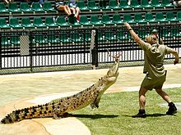
Wildlife conservation personalities
PETA argues that conservation personalities, such as Steve Irwin(pictured above), place animals under stress.

Slide 6
PETA Asia-pacific

Slide 7
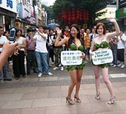
Vegetarian/vegan/factory farming
Lettuce Ladies in Guangzhou, China

Slide 8
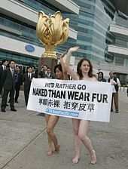
Anti-fur
PETA Asia-Pacific "naked" demo during Hong Kong fashion week

