Slide 1
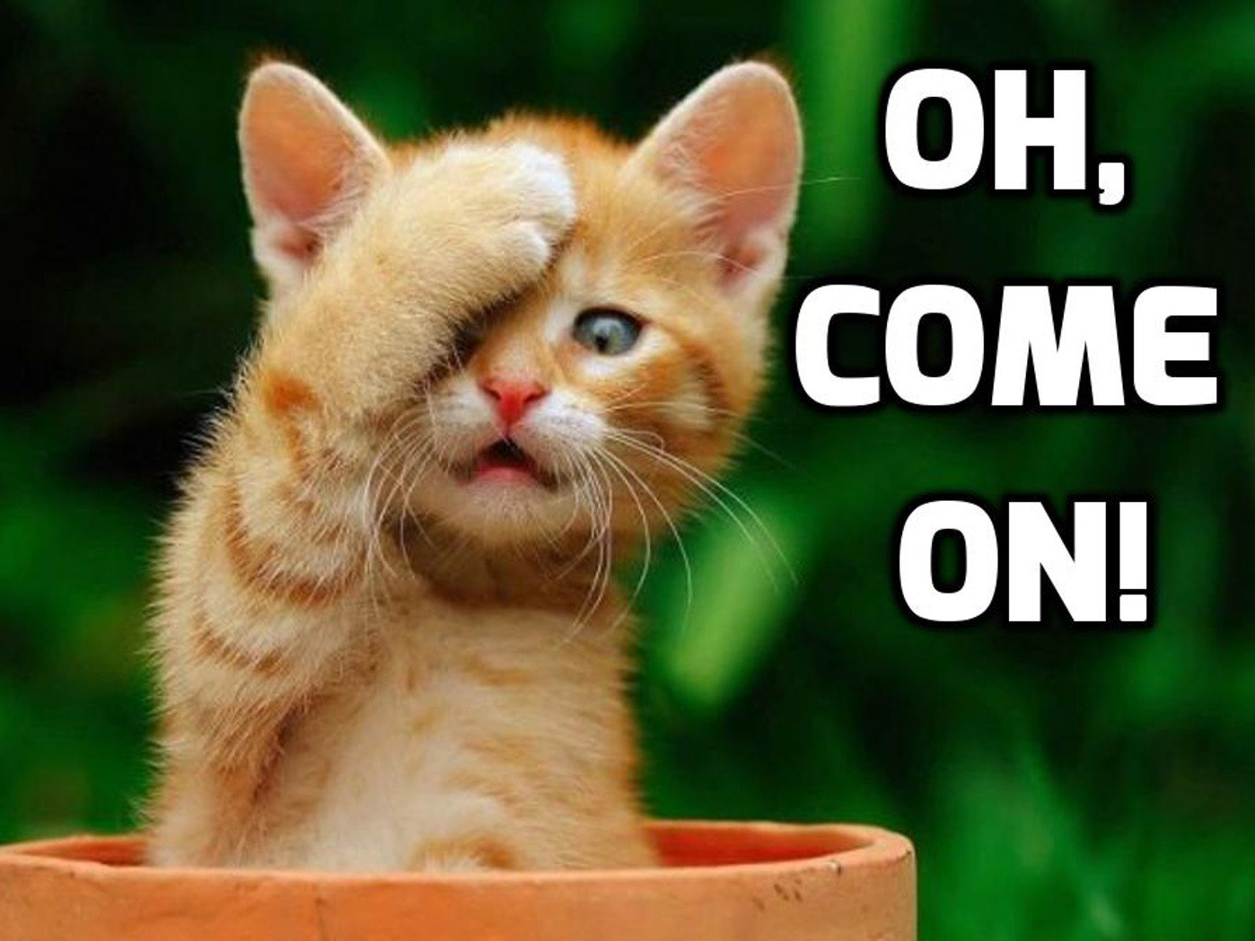
Understanding
animals

Slide 2
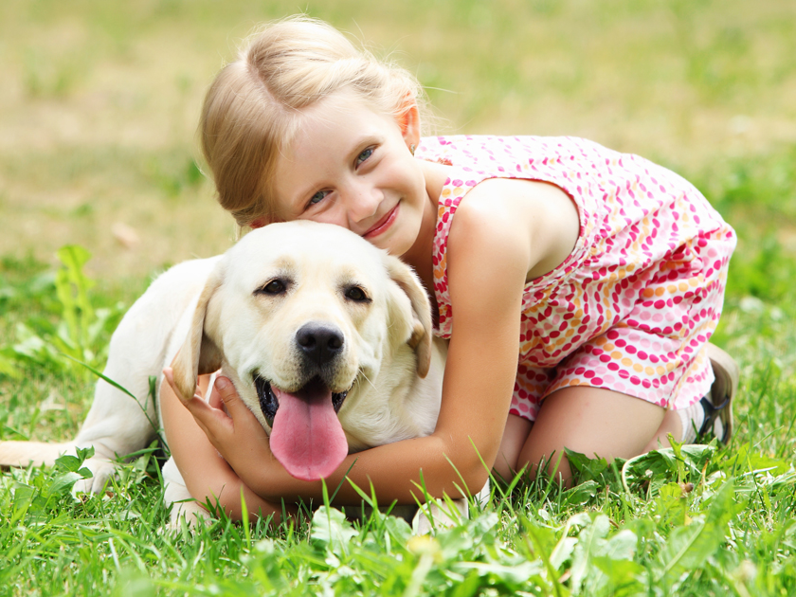
Animals & people

Slide 3
Relationship

Slide 4
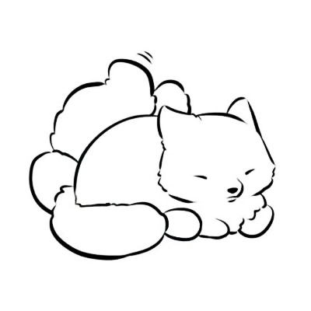
Reality
Notes:
Well ,let know about some realities. The reality about the relationship between human beings and animals.

Slide 5
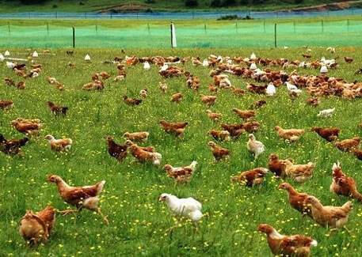
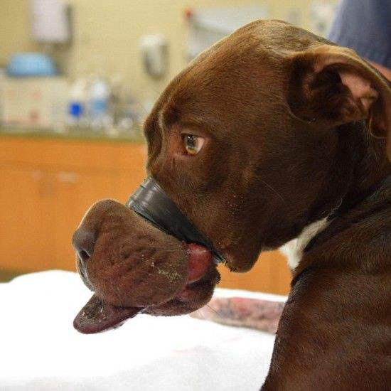
Public impression
Notes:
* One major opinion is that animals raised by human beings have rights like human beings and live a happy life.
* Like what displayed on television and printed on advertisement paper. They have big ‘play ground’ to play freely and eat delicious foods. Besides, they will accept physical examination and be treated timely. With reasonable and humanistic breeding they will keep in good health and have a positive mood.
*Another major opinion is that animals are suffering great pain and they totally have no rights or respect.
* We can also see on some video that many animal like pig will killed cruelly. Some pets like dogs were under maltreat of their owners. Some endangered animals were killed because of the drive of the of the profile.

Slide 6


Facts
Notes:
* As a matter of fact. Both of them exists. In some area, most animals are taken good care of even if some kind of animals like pigs. People will let them fell less pain when killing them. However, in other places, thing may not be so fantastic to animals. We have to admit that some of us kill animals just for unreasonable profile, vanity or just for fun. They killed animals in extremely cruel way. That's what most of us can't accept.

Slide 7
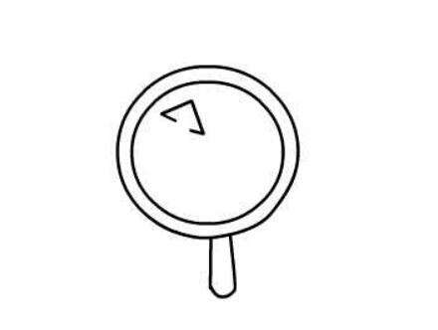
Present situation & future
Notes:
* We are happy to witness the found of all kinds of animal rights protection organizations and more and more volunteers participating various of activities. With the developing of human beings, animals rights were being more and more think highly of. We start to care about what animals feeling and whether they lives well.
* We are also sad to see news that there were still hundred of thousands of abandoned pet walking alone the street and have no place to sleep and no food to eat. Hundreds of thousands of endangered animals were being killed everyday illegal because it will bring income to hunters. Some children and adults get joy by cheating small and weak animals such as their home hold animals, Id don't think their home hold animals can be seen as pets, these animals are more like inanimate objects to their owner.
* Well we shoud be confident to our future ,and at the meantime, we have to suffering the pain to overcome the difficulty to improve our mind and thought.

Slide 8
Humanity & ecology

Slide 9
Humanity

Slide 10
Ecology

Slide 11
Take action

Slide 12
Humanitarianism activities

Slide 13
Group IV
汪三科
冯书逸
徐志鹏
何子玉
卢立强

