Slide 1
FITPASS APP
Class Name: FULL STACK DEVELOPER
Group Name: K24WD-01
Members:
o Đinh Hà Tuấn Anh – MSHV: 124010123019

Slide 2
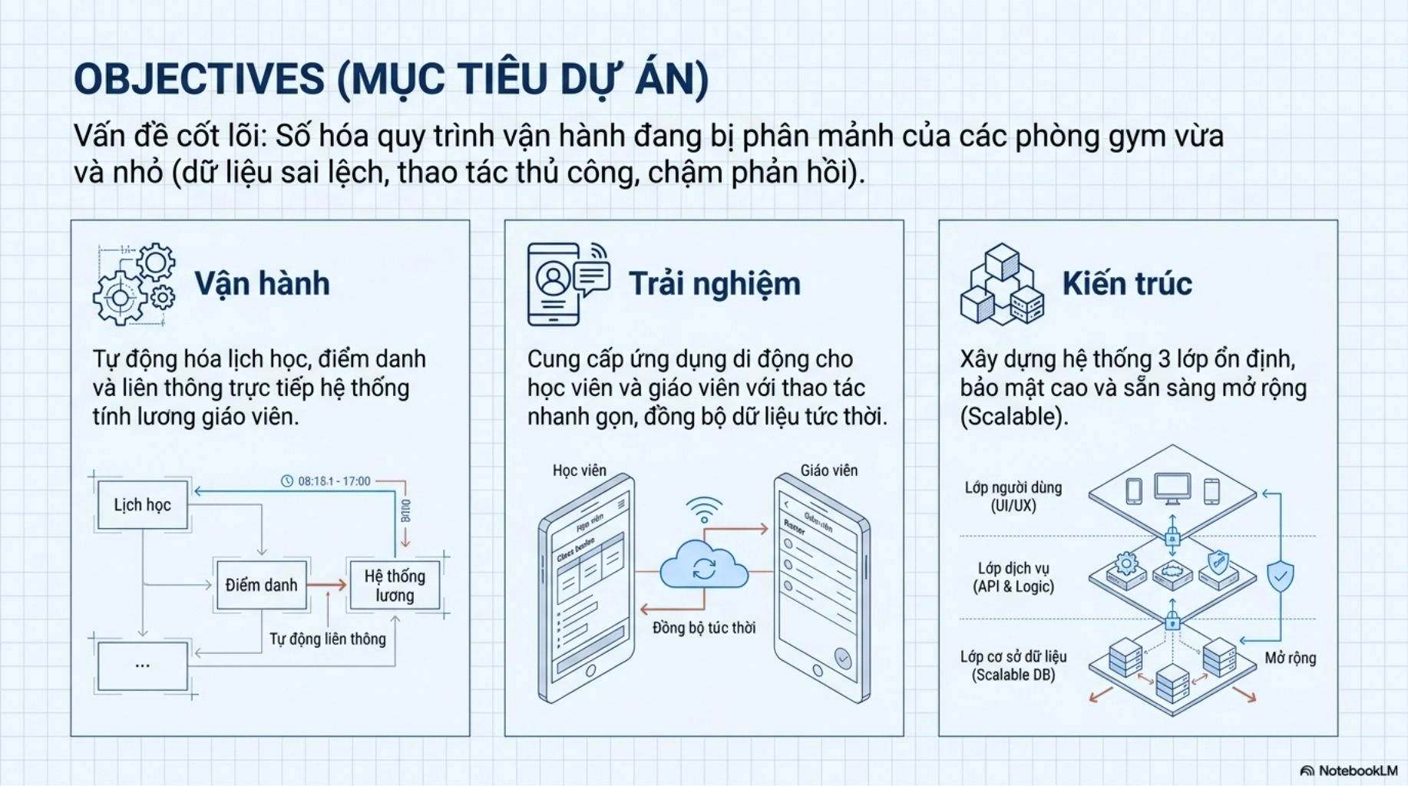
OBJECTIVES

Slide 3
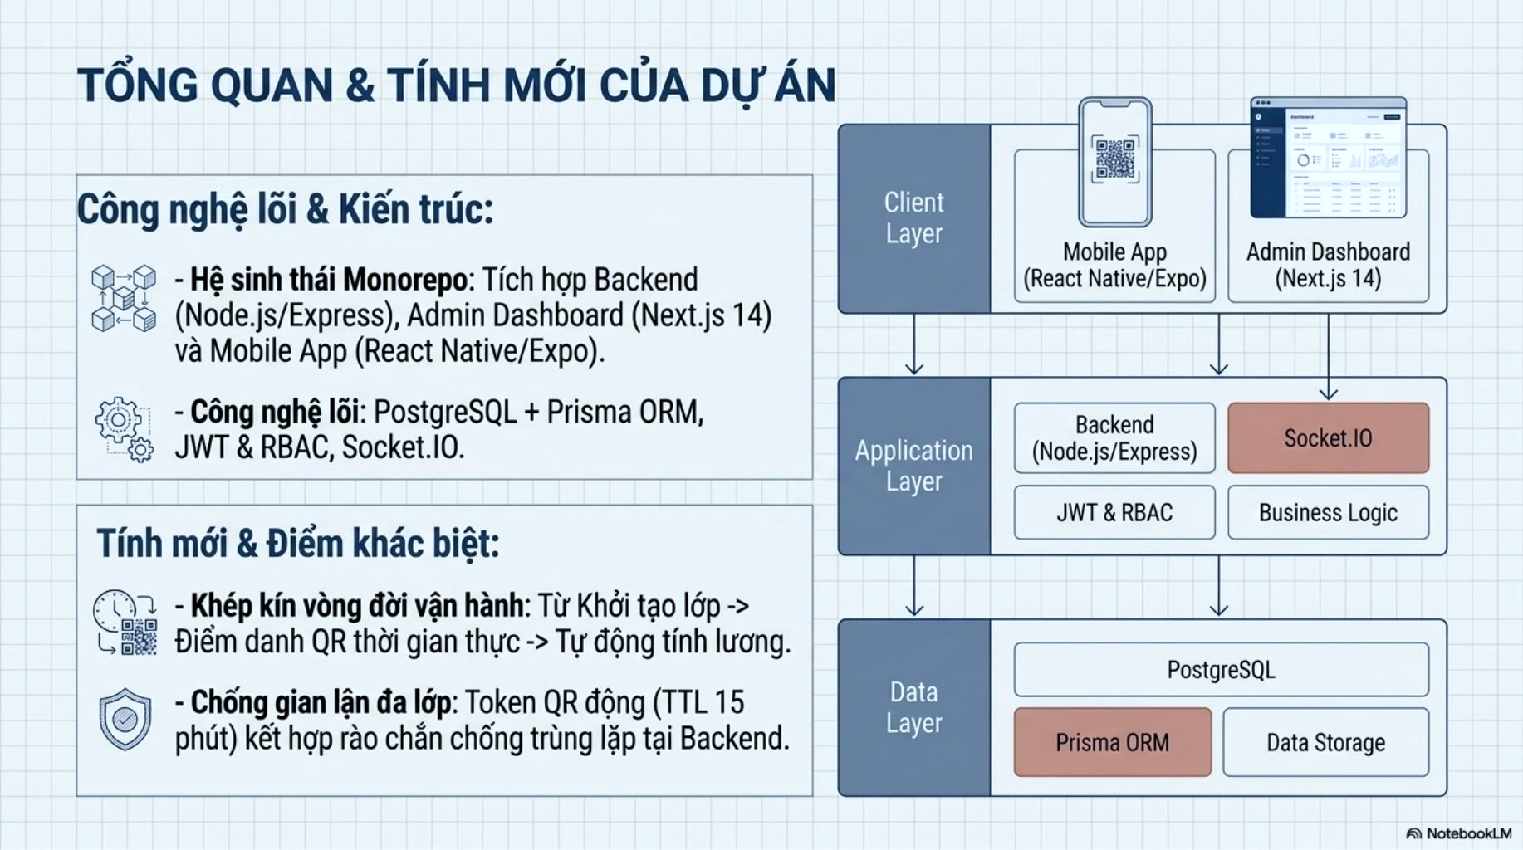
INTRODUCTION TO PROJECT

Slide 4
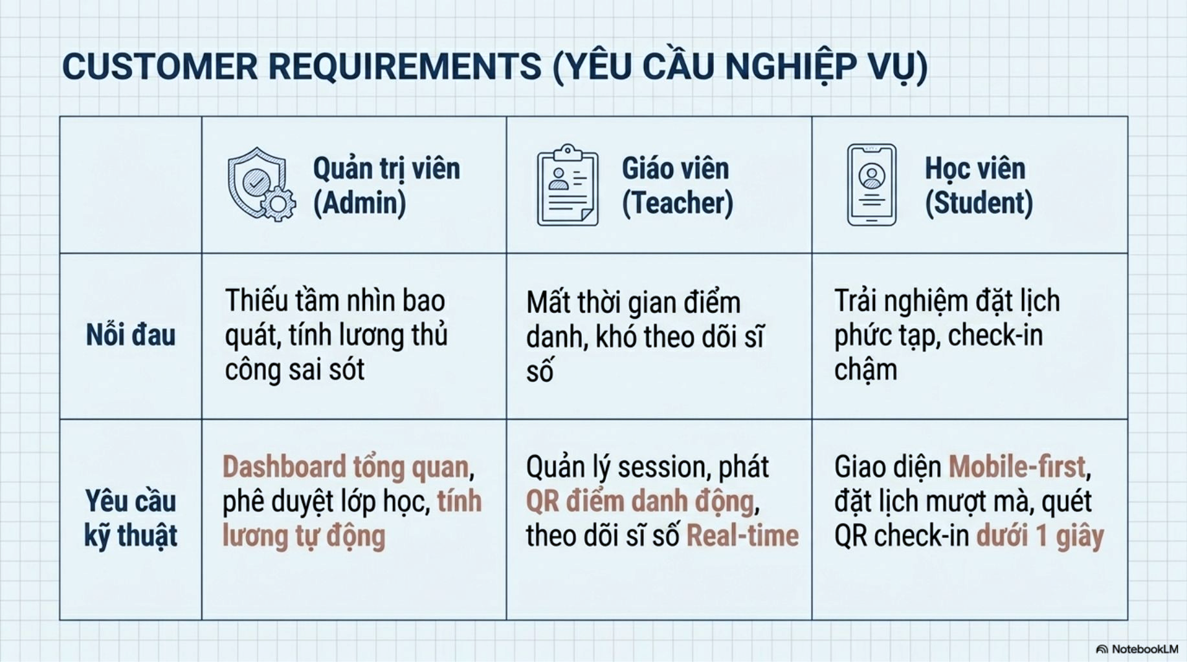
CUSTOMER REQUIREMENTS

Slide 5
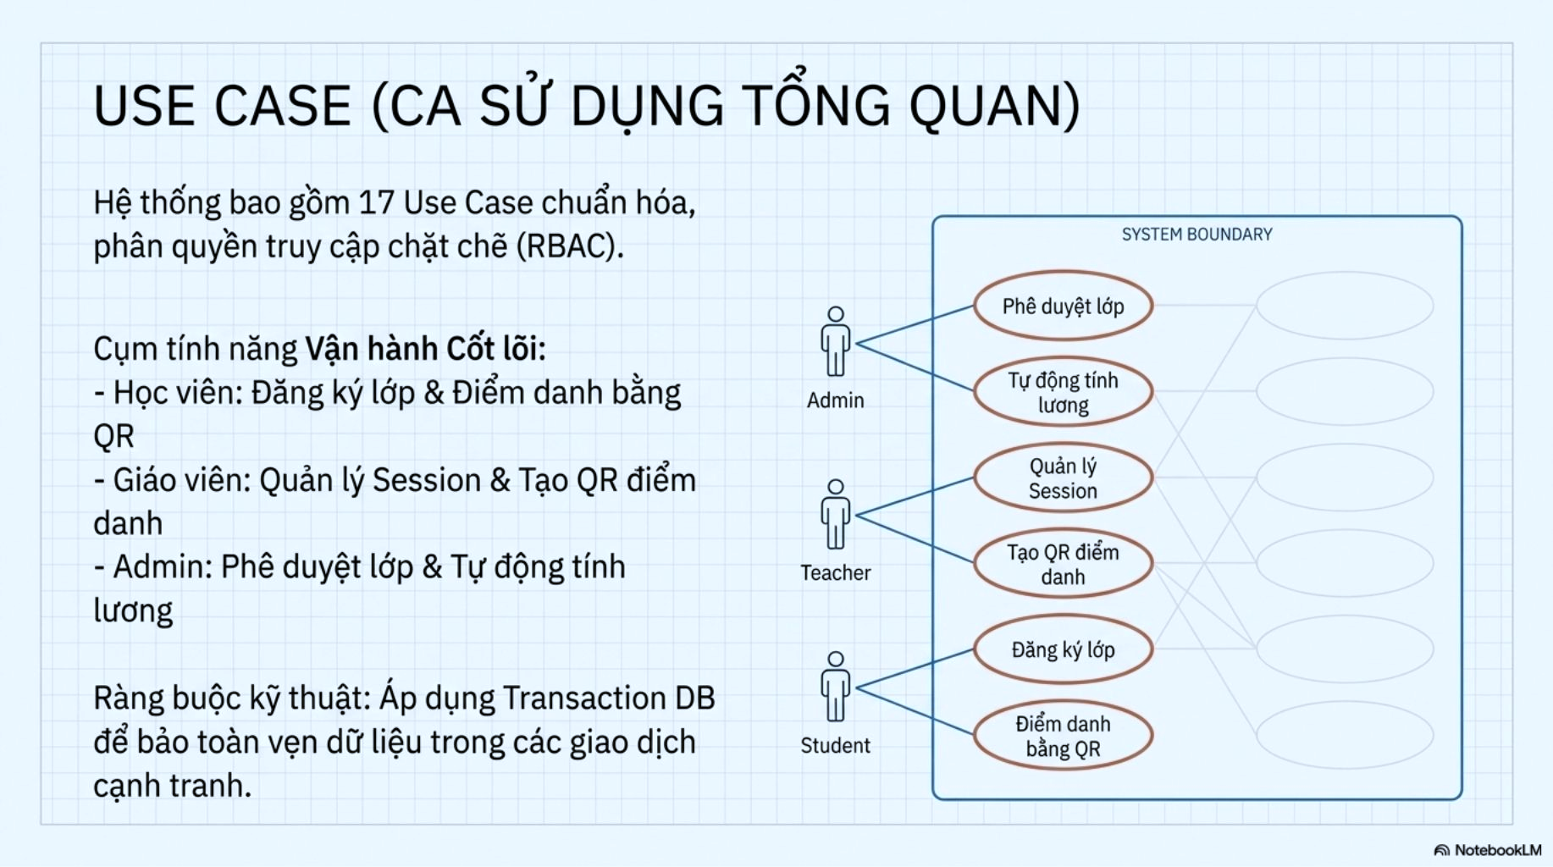
USE CASE

Slide 6
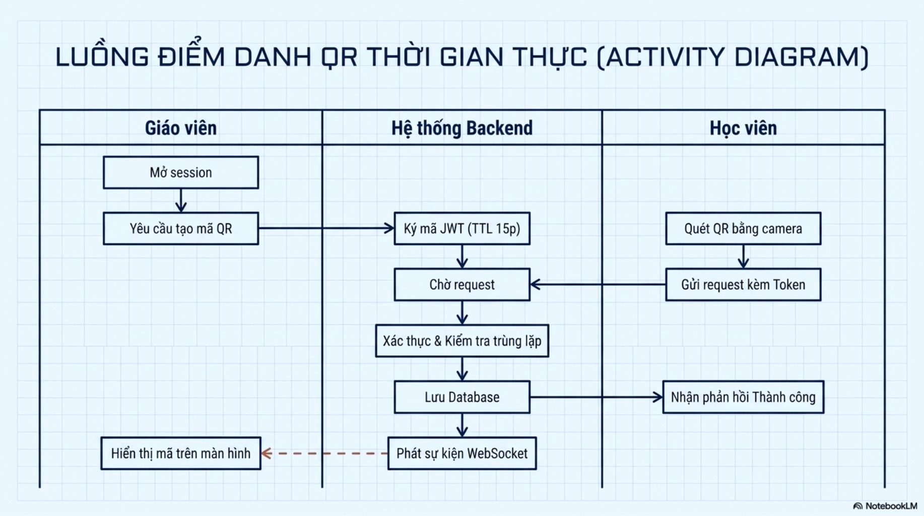
ACTIVITY DIAGRAM

Slide 7
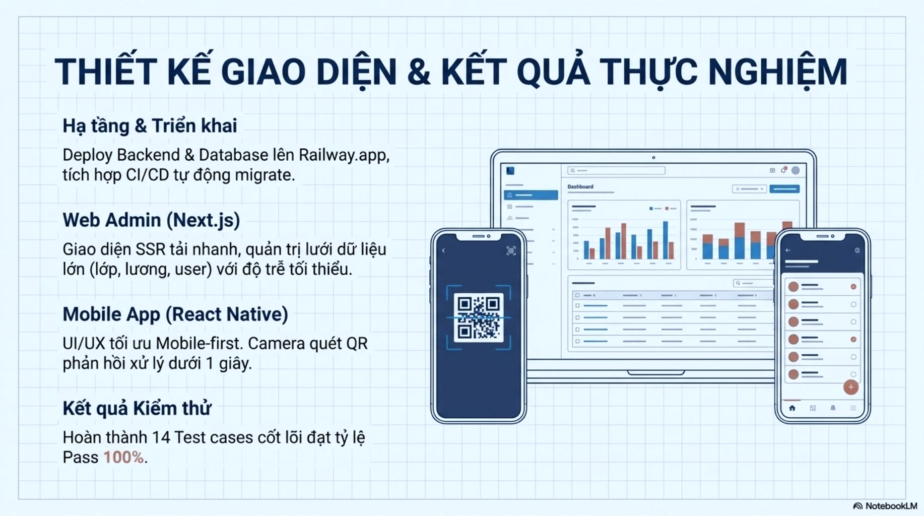
UI DESIGN

Slide 8
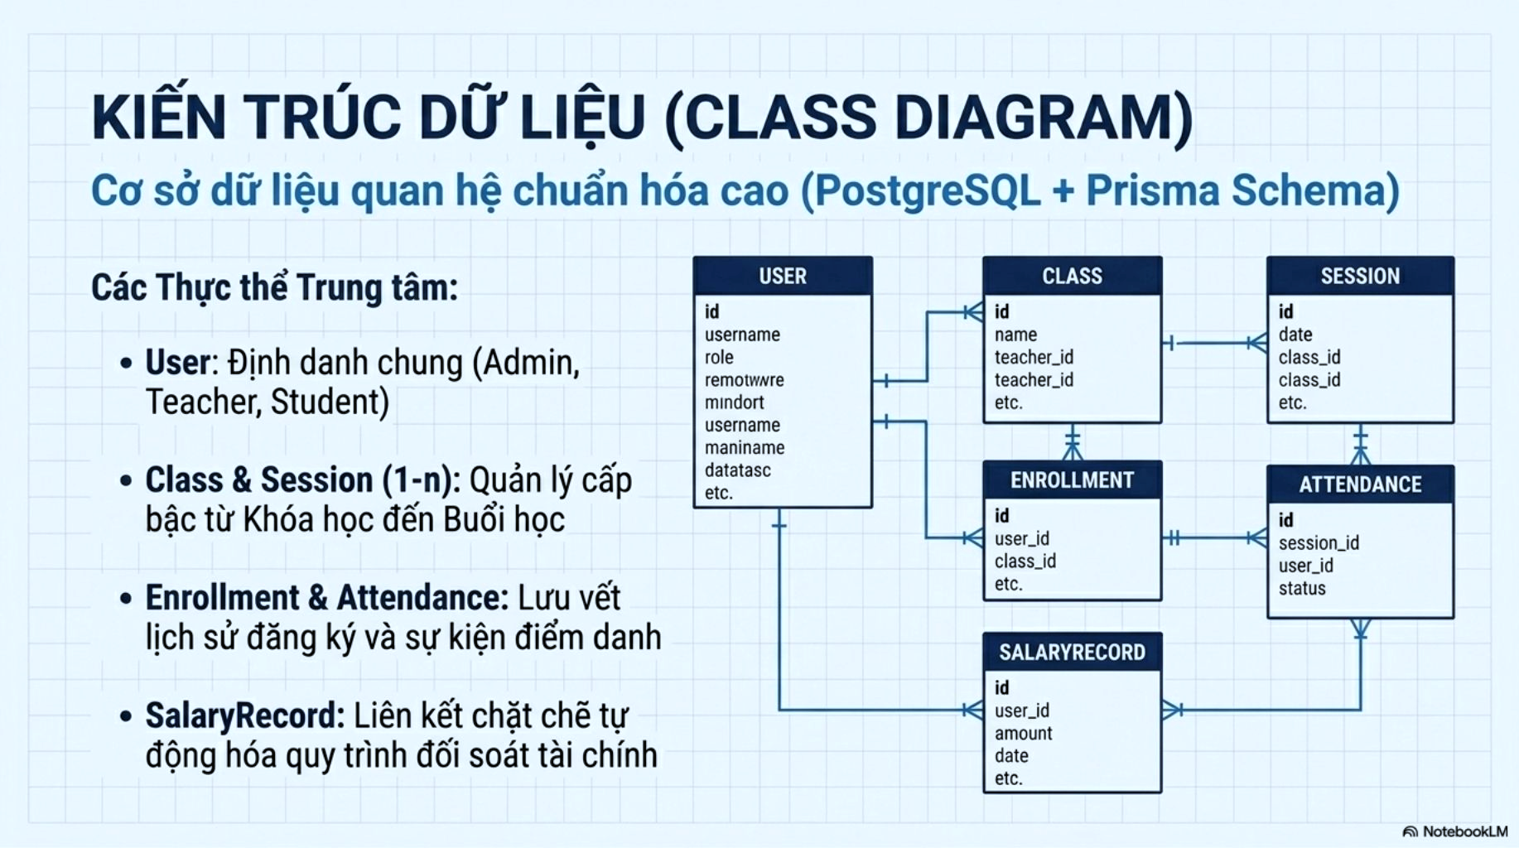
CLASS DIAGRAM

Slide 9
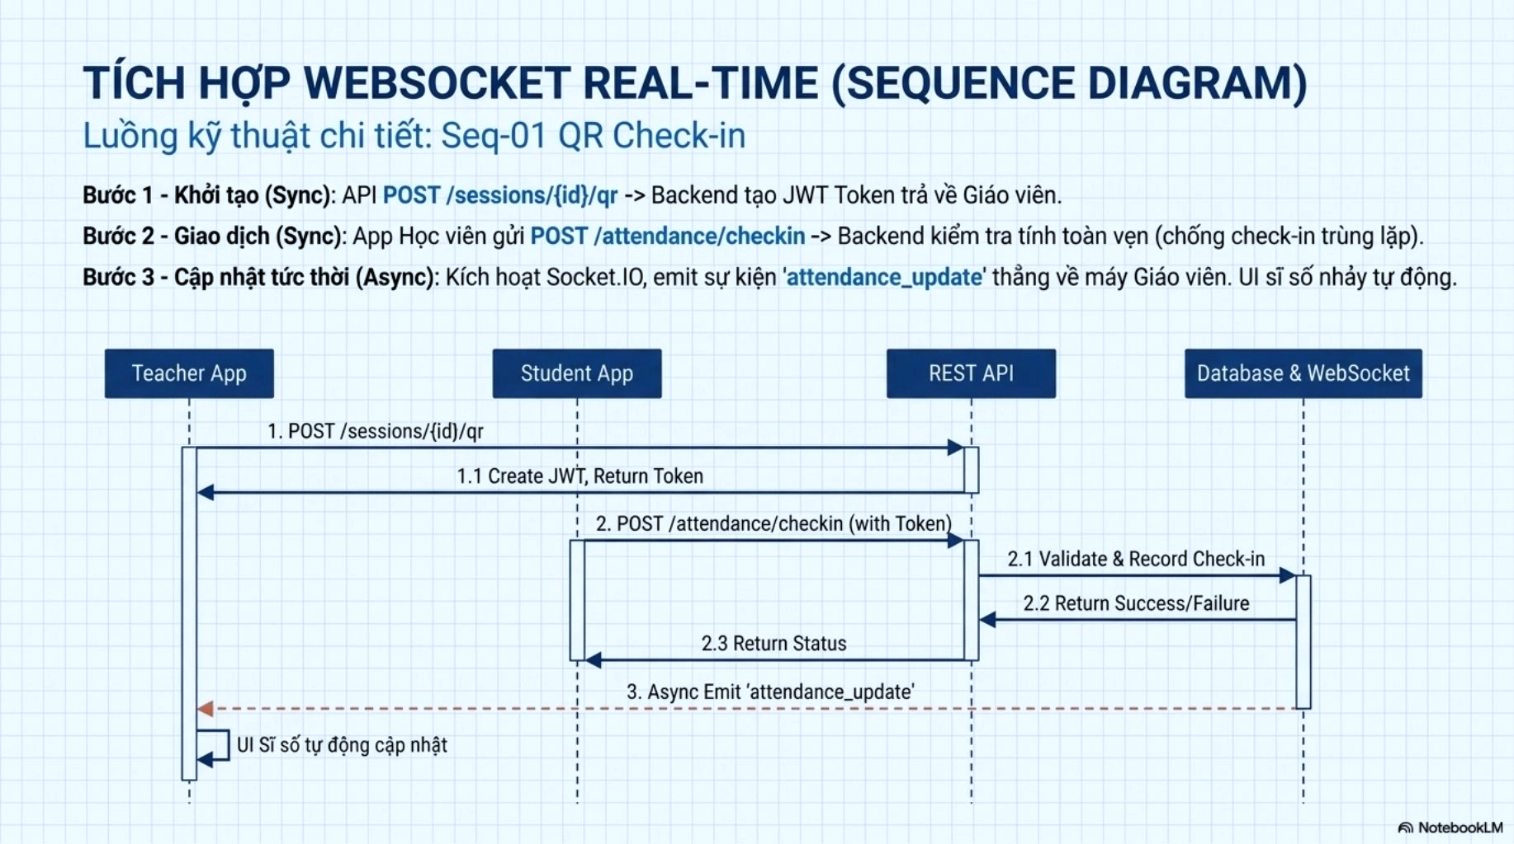
SEQUENCE DIAGRAM

Slide 10
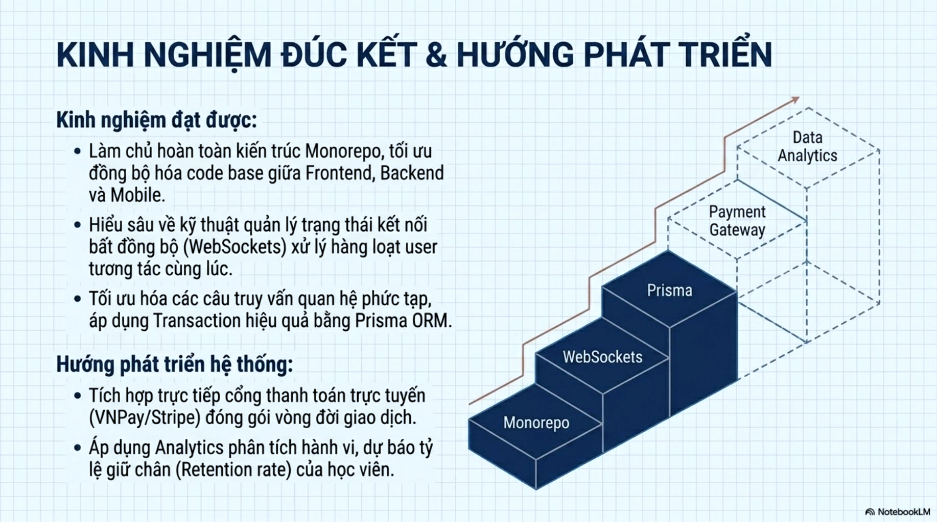
EXPERIENCE LEARNED

Slide 11


Slide 12
Q & A

