Slide 1
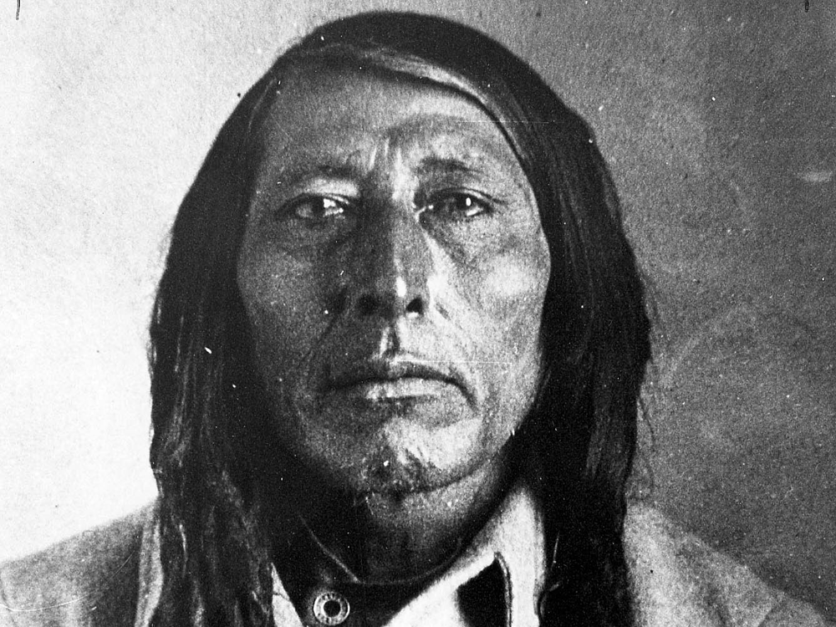
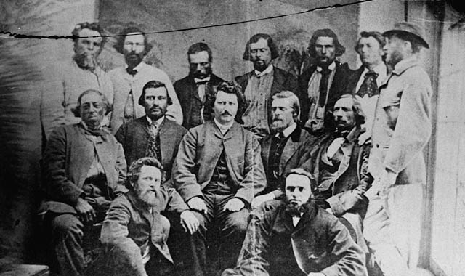
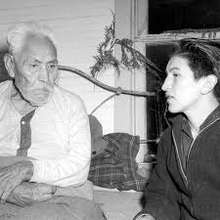
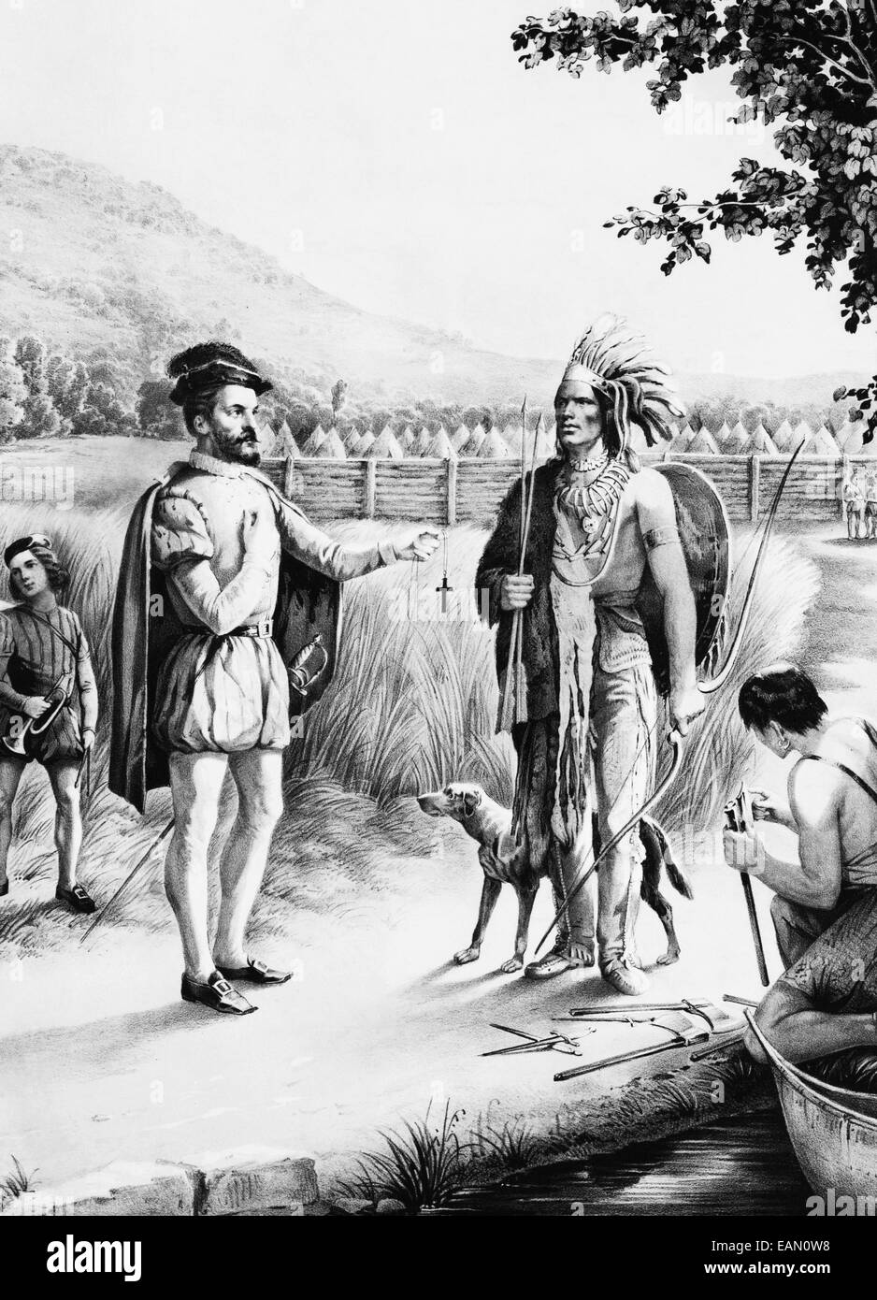
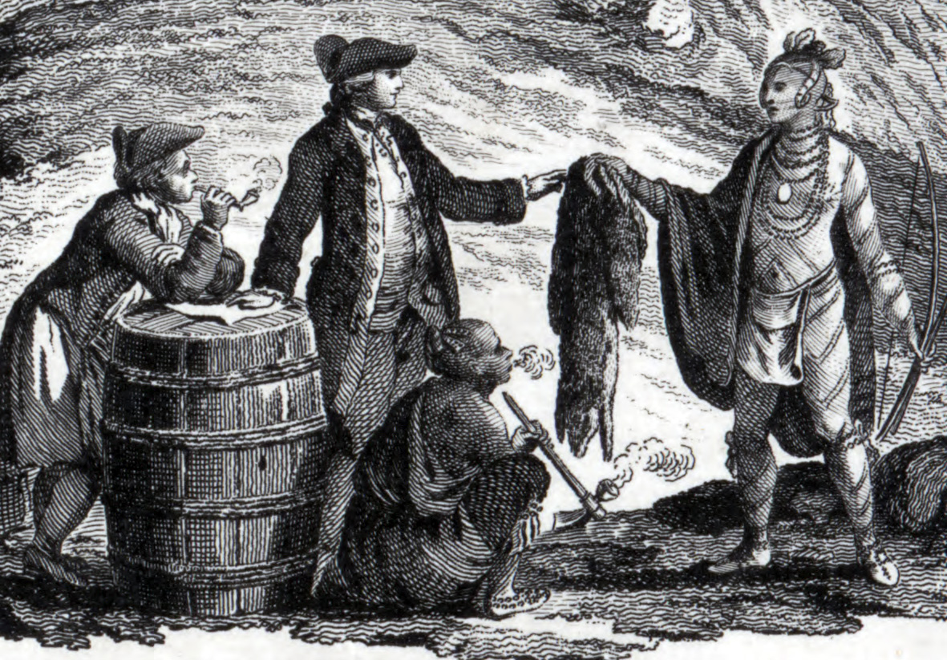
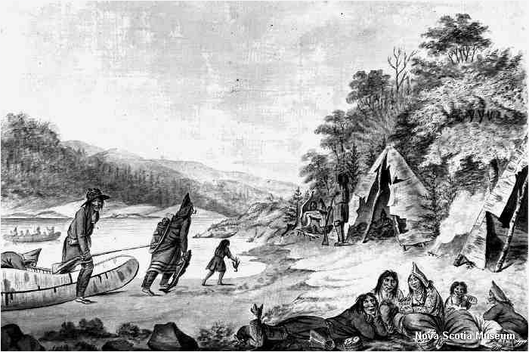
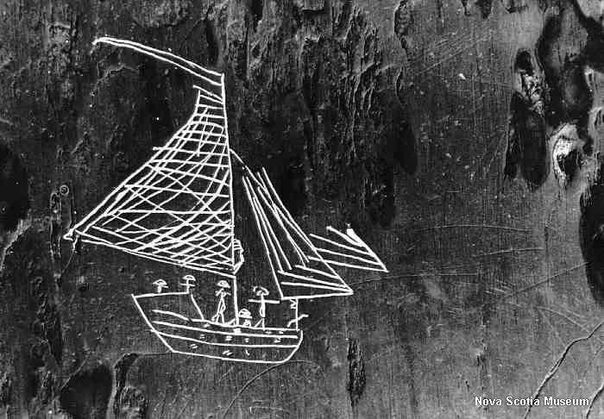
HIST 300: Indigenous Peoples of Canada to 1876
“A World of Fragments – Indigenous Responses to Early Colonialism”
Week 5-1
Dr. Colin Osmond

Slide 2


Slide 3
Recap:
Film Review – “Ikwe”
Empires along the St. Lawrence River
Indigenous Trade Routes and Early Fur Trade
A world in Chaos – disease, war, and newcomers
The impacts of the Fur Trade on Indigenous Economics and Systems

Slide 4
Today:
The Great Peace of Montreal, 1701
The End of the Mourning Wars and Beaver Wars
A World of Fragments
Beginning of Colonial Wars
Fallen Empires and the Expansion of the Fur trade
Keywords: Great Peace of Montreal 1701, Mourning Wars, Beaver Wars, New France, Fur Trade, Covenant Chain

Slide 5
End of the Mourning Wars
Colonial Wars, Beaver Wars, or Mourning Wars?
Indigenous agency – refusal to attack other Indigenous groups during European conflict
Indigenous world was in fragments – and Europeans were gaining momentum
Haudenosaunee Expansion – different objective than Mourning War
War was a combination – replace numbers, but also gain access to new fur-trapping areas and trading sites

Slide 6
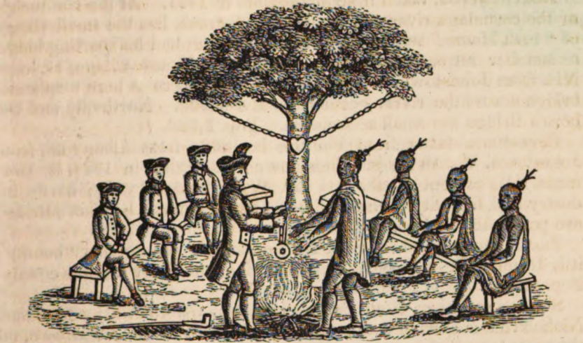
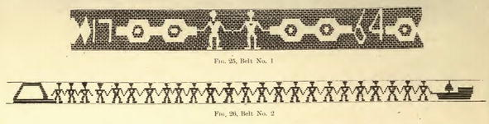
Covenant Chain Treaties

Slide 7
Aftermath of the Great Peace
Haudenosaunee now allied with both French and English
Divided Empire
Some groups stayed neutral in Anglo-French conflicts
Others fought as mercenaries (hired soldiers) in wars that suited their mutual interests
Continued Haudenosaunee commitment to avoid attacking Indigenous Nations as part of colonial conflict

Slide 8
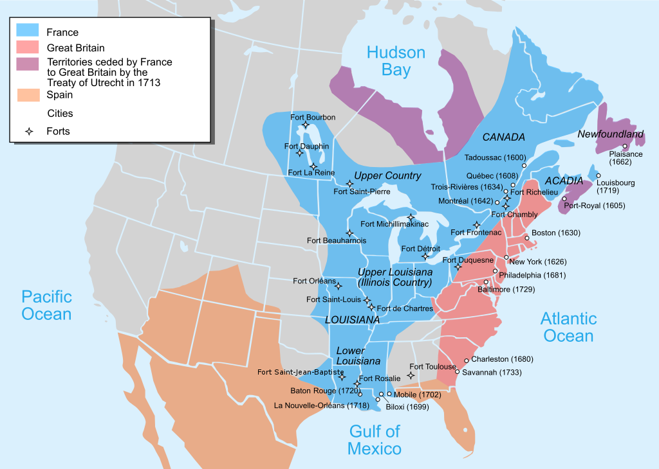

Slide 9
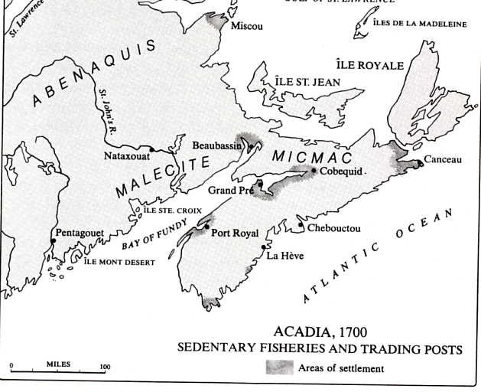

Slide 10
European Conflicts on Indigenous Lands
War of Spanish Succession, 1702-1712
European conflicts (argument over monarchy in Spain) resulted in wars in North America
“Empires of Paper”
Indigenous people chose allies who they thought best suited their goals
Wabanaki, Algonquin, some groups of Haudenosaunee allied with French
Some Haudenosaunee groups, Muscogee, Creek, Chickasaw, and Cherokee allied with British
War Ended by Treaty of Utrecht, 1713

Slide 11
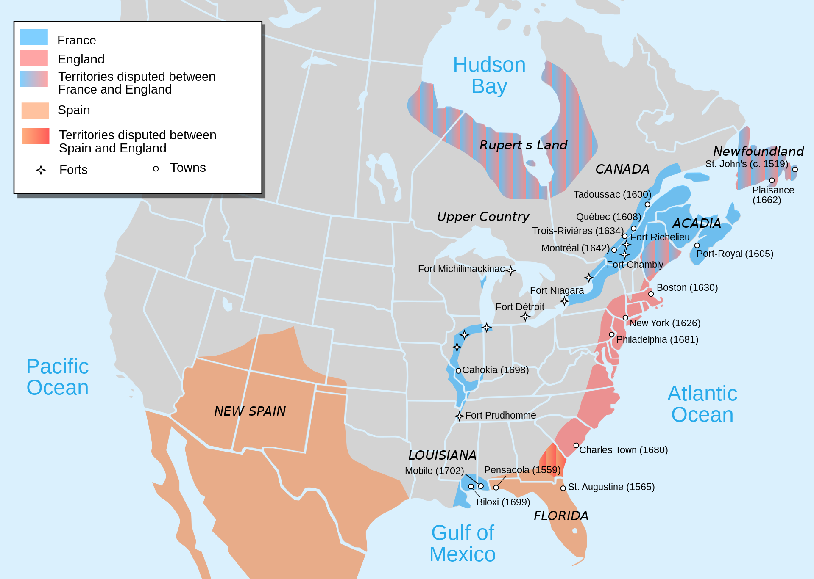

Slide 12
European Conflicts on Indigenous Lands
War of Spanish Succession, 1702-1712
European conflicts (argument over monarchy in Spain) resulted in wars in North America
“Empires of Paper”
Indigenous people chose allies who they thought best suited their goals
Wabanaki, Algonquin, some groups of Haudenosaunee allied with French
Some Haudenosaunee groups, Muscogee, Creek, Chickasaw, and Cherokee allied with British
War Ended by Treaty of Utrecht, 1713

Slide 13
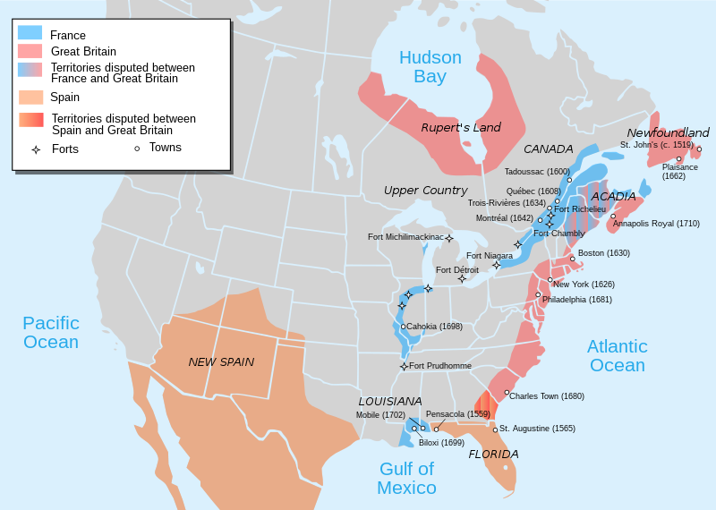
European Claims, 1713

Slide 14
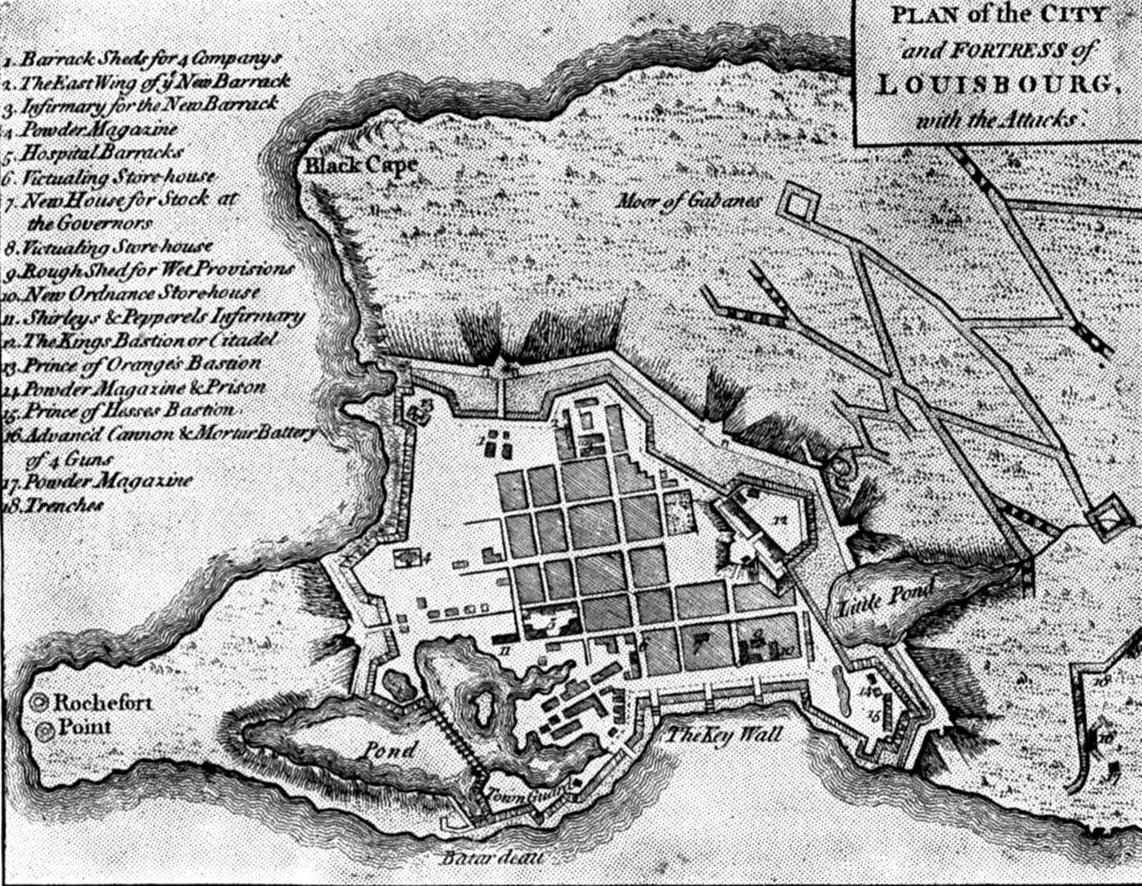
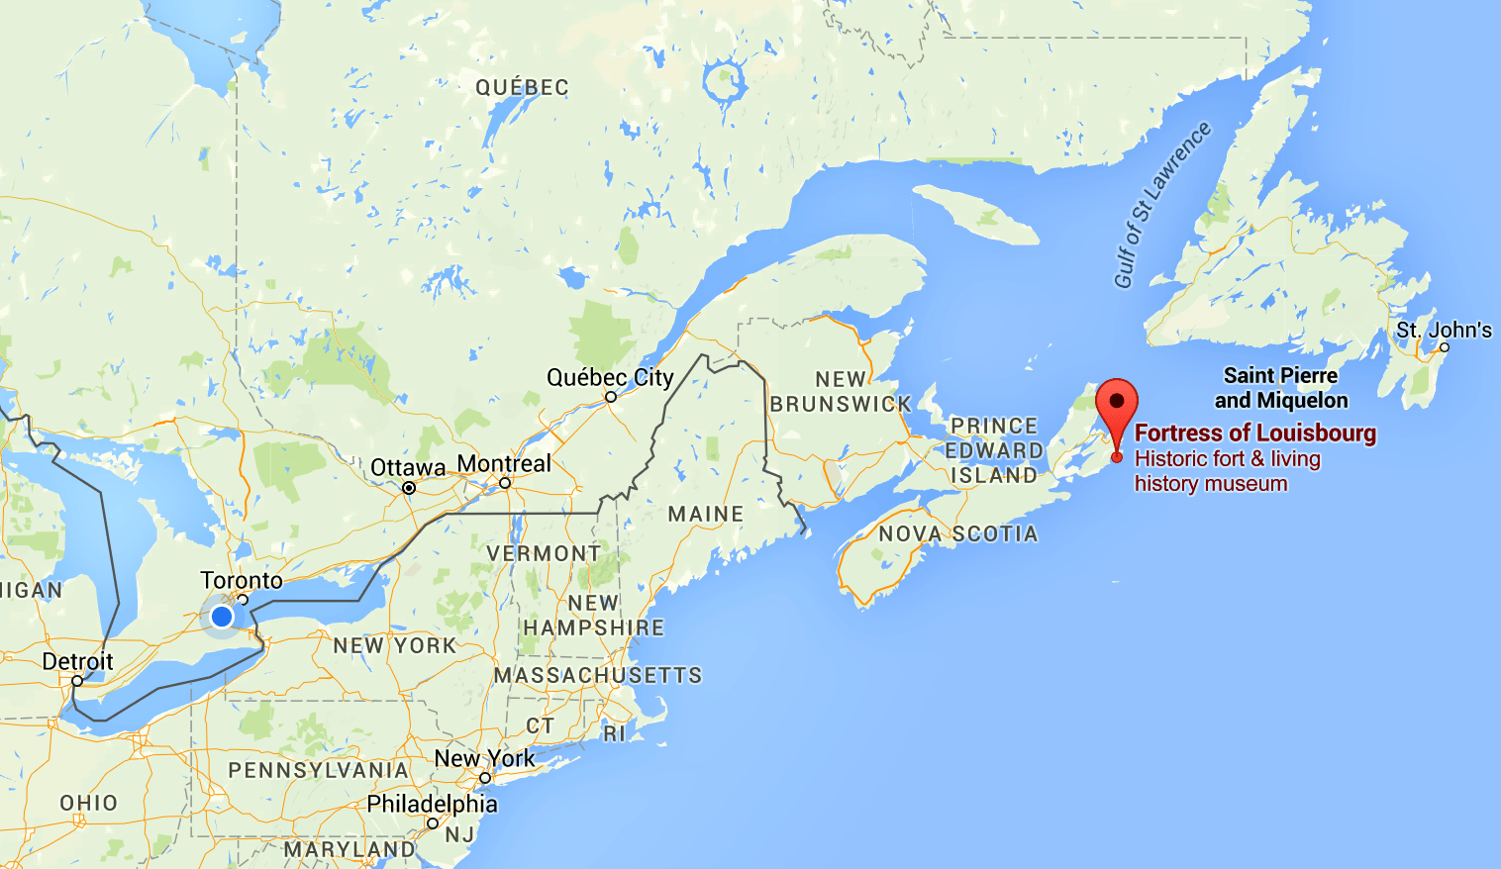

Slide 15
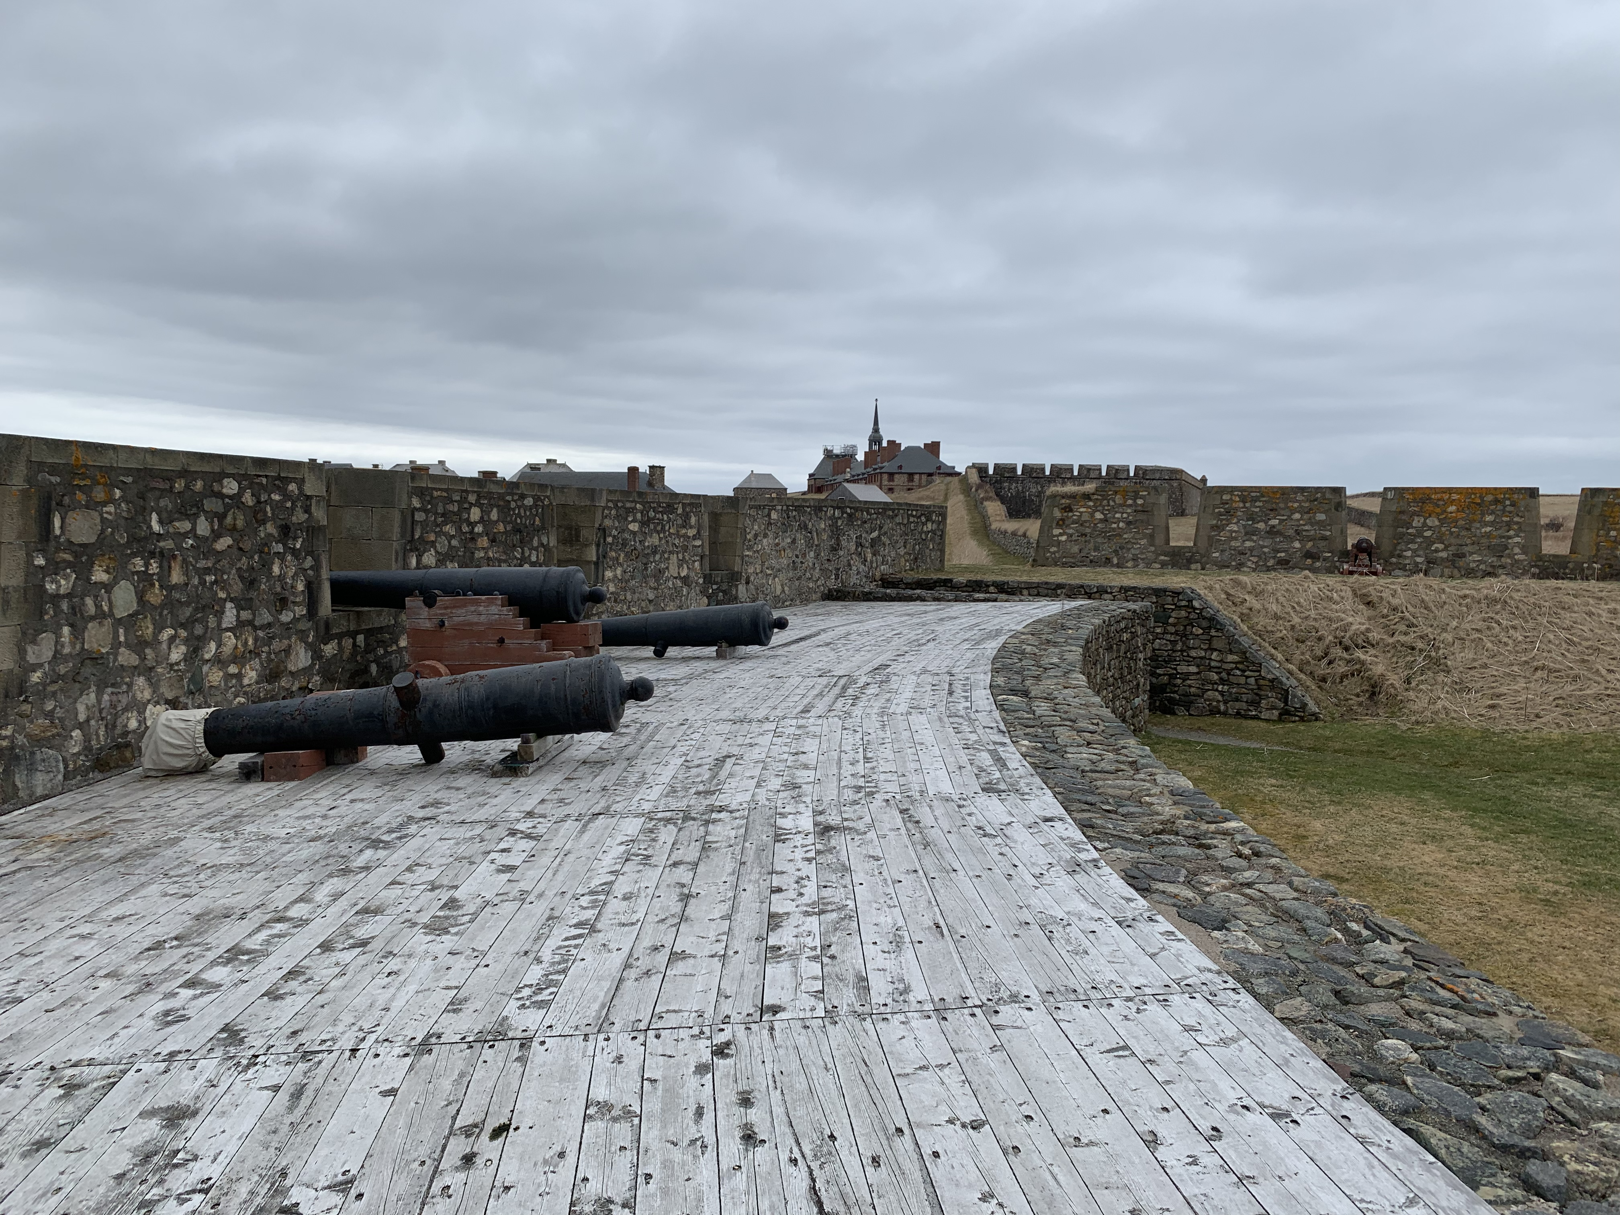
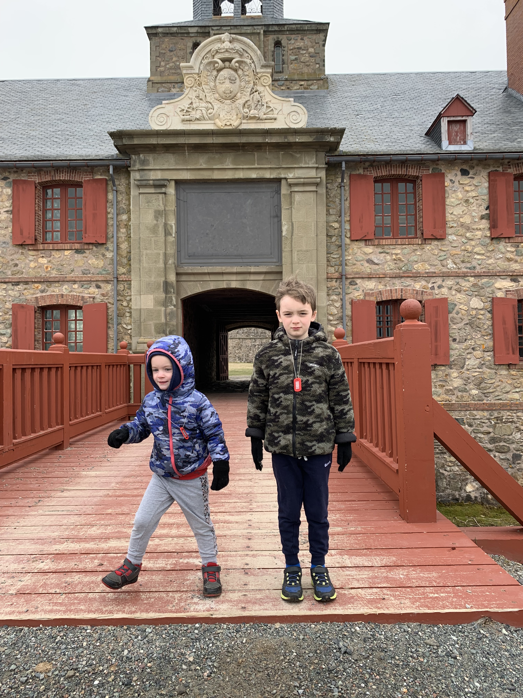
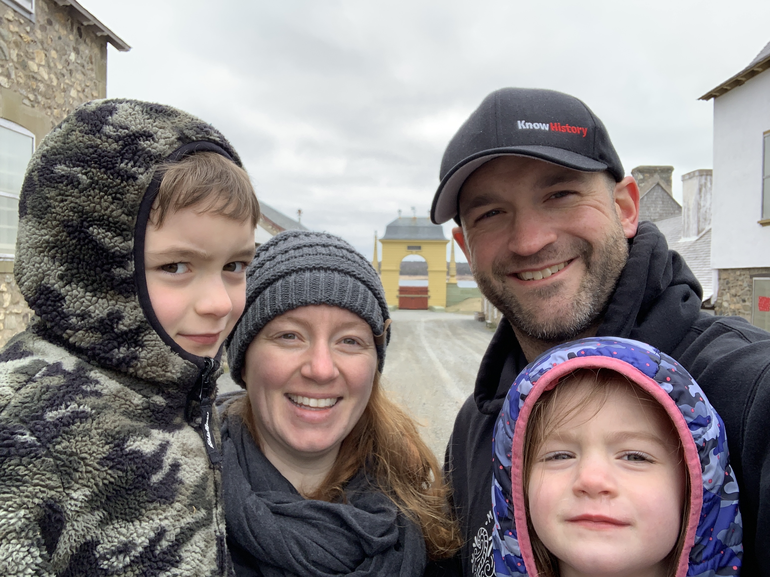
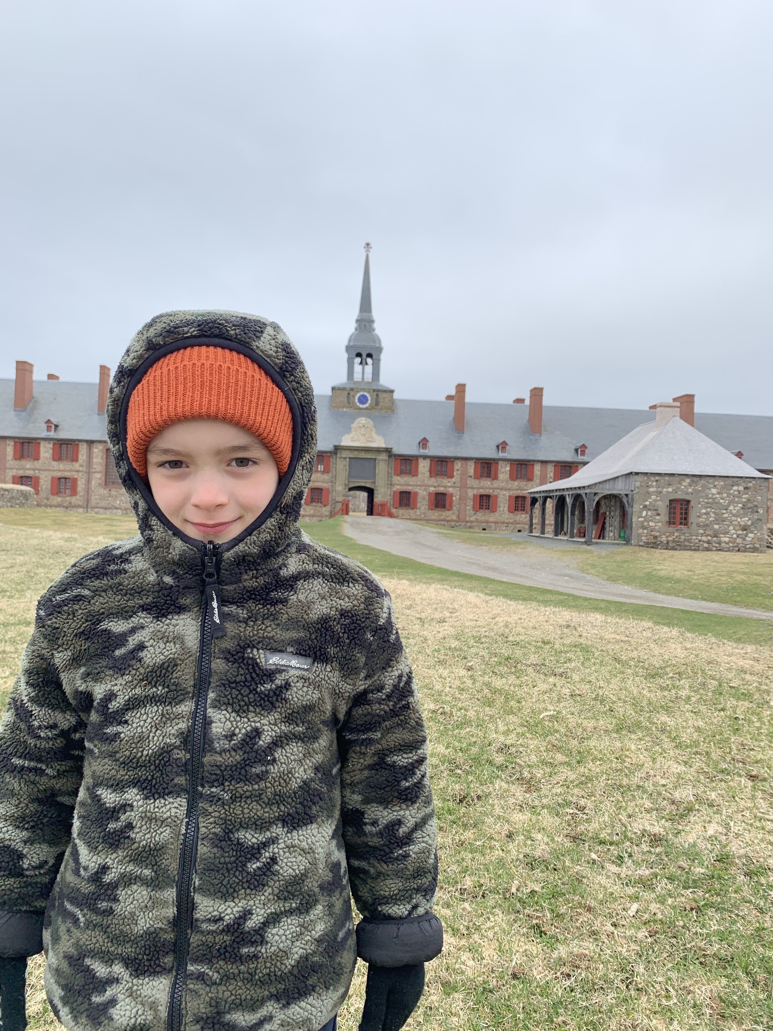

Slide 16
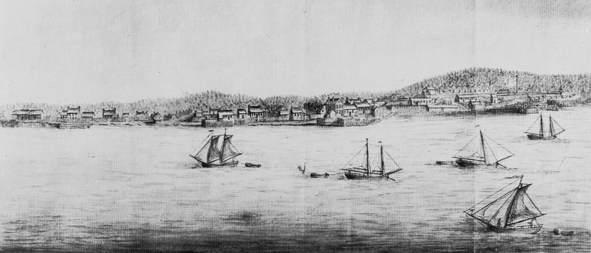
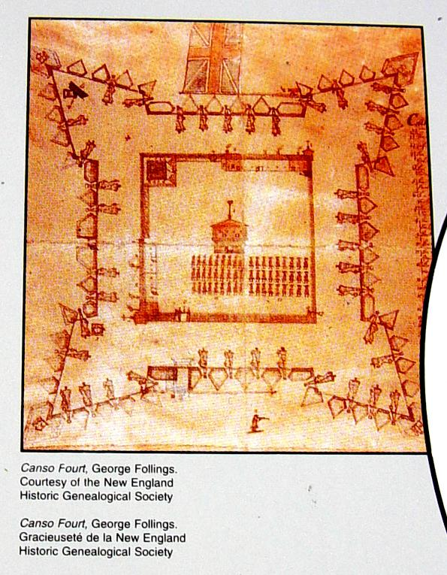
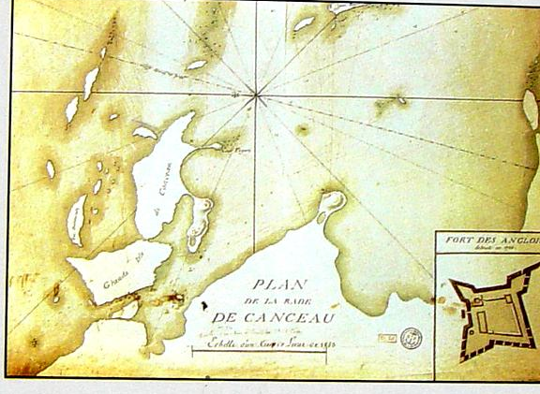
Fort Anne/Annapolis Royal, 1745
Sketch of Fort Canso, 1720

Slide 17
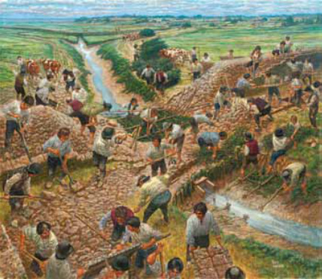
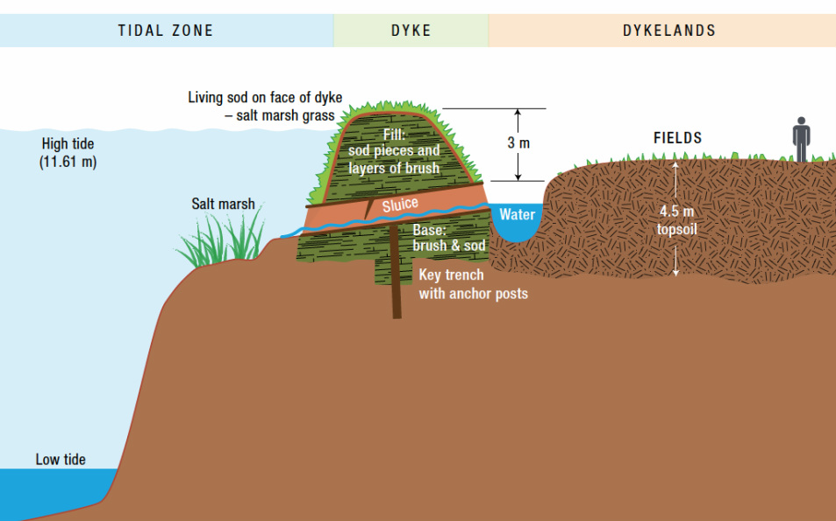

Slide 18
1725 Treaty with “Eastern Indians”
Signed at Boston in 1725, then brought to various other places (including Mi’kma’ki) for signatures
Two Parts
  Promises made to the British by the Wabanaki Confederacy
  Promises made by the British
Treaty was designed to create Peace and Friendship
Resumption of Trade
Did NOT include any discussion of land or surrender of territory to the British

Slide 19
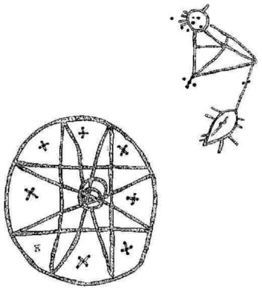
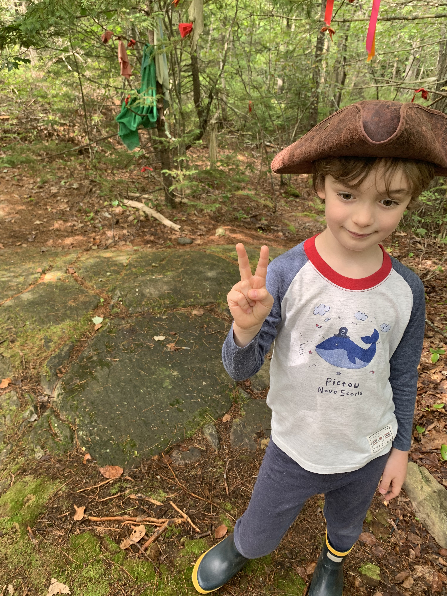
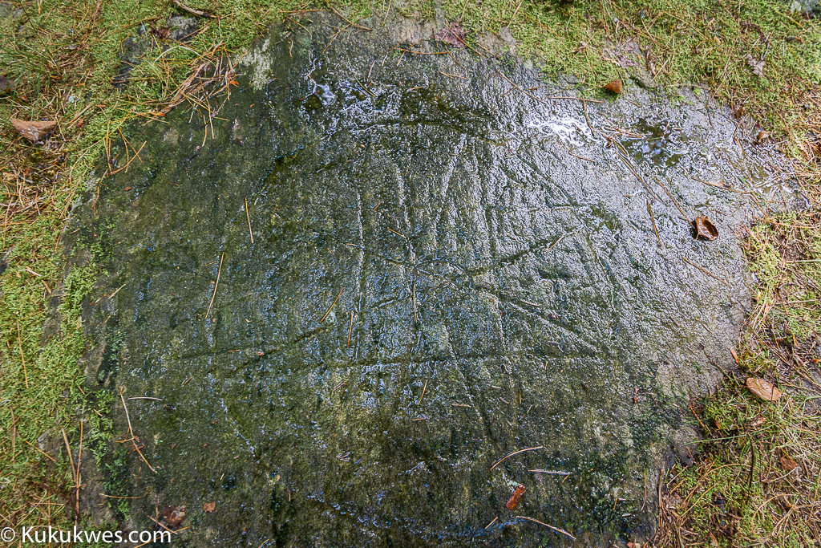
Bedford Petroglyphs National Historic Site, Halifax, N.S.

Slide 20
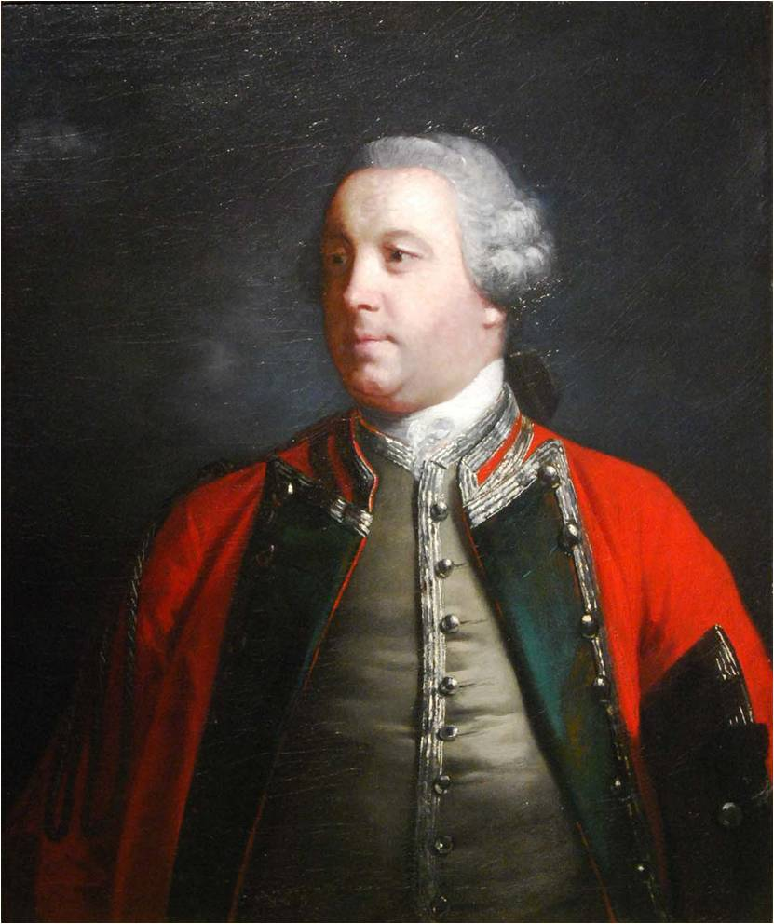
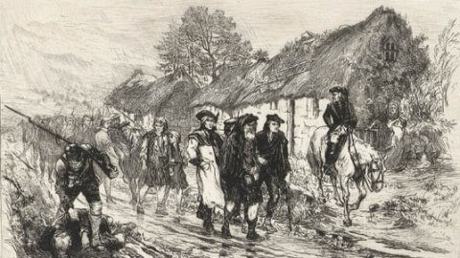
Left: Governor Edward Cornwallis Above: The Highland Clearances. 1740s

Slide 21
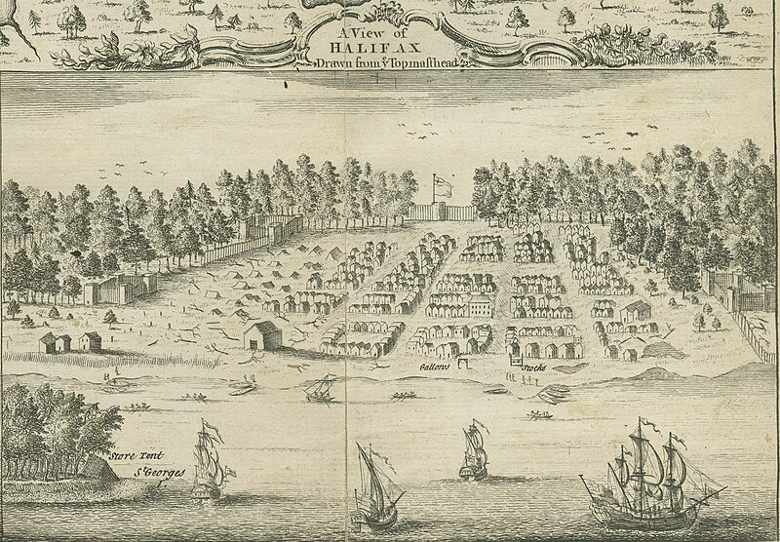

Slide 22
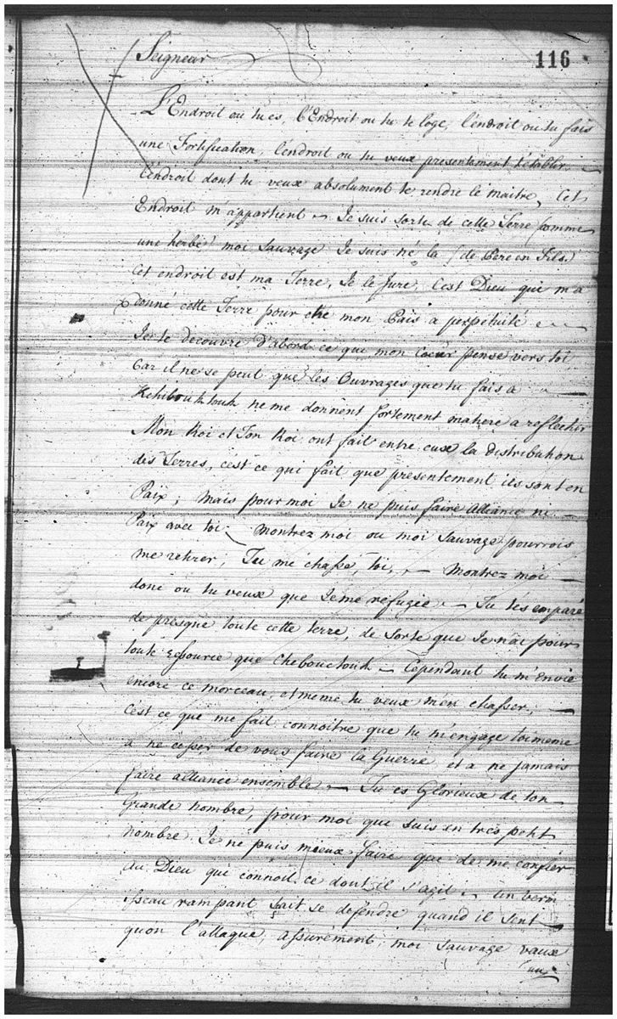
“The place where you are, the place where you live, the place where you are building a fortification, the place where you want now to establish yourself, the place of which you want to make yourself the absolute master, this place belongs to me. I come out of this earth like a blade of grass, me, the Indian, I have been born there the son [and] from father to son. This place is my land, I swear it. It is God who has given me this land to be my homeland forever…”
Mi’kmaq Declaration – written by Abbe Pierre Maillard on behalf of the Mi’kmaq, sent to Governor Cornwallis, September 23 1749

Slide 23
“…A crawling worm defends itself when it senses an attack. Assuredly, I, an Indian, am worth somewhat more than a worm, and thus with greater reason must I know to defend myself when I am attacked.
Yes, certainly I am going to go see you, soon I will see you.”
Mi’kmaq Declaration – written by Abbe Pierre Maillard on behalf of the Mi’kmaq, sent to Governor Cornwallis, September 23 1749

Slide 24
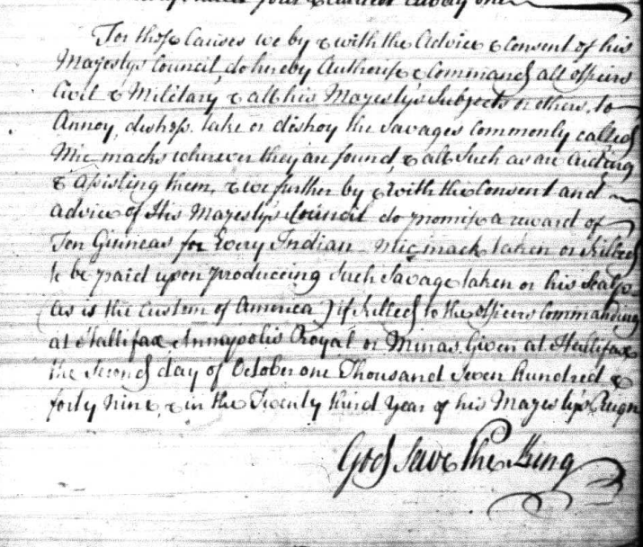
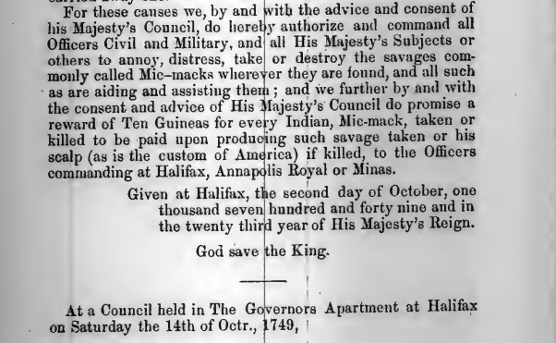

Slide 25
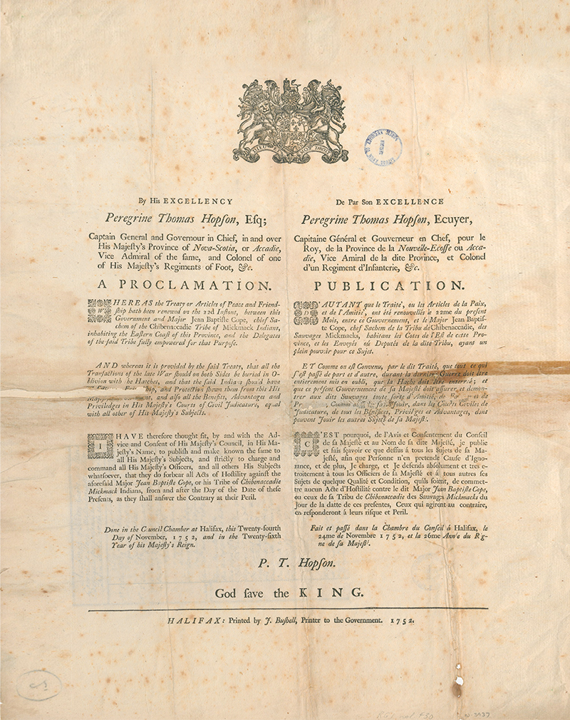
1752 Treaty
Cornwallis recalled to England
Governor Peregrine Hobson ended Scalp proclamation, ceasefire with Mi’kmaq
Mostly same text as 1725 Treaty
Included “Truckhouse” clause
Negotiated by Sagamow Jean-Baptiste Cope
Signed at Halifax in 1752

Slide 26
