Slide 1
Previous meeting
Postgis table with roads of 3 types
Get graphs directly from osm on 3 types roads

Slide 2
now
A postgis table for each road types
All road types :
A main table with the roads merged, keeping only specific attributes
Graphs from gdf from postgis with networkx (but not sure the format is a good one)
→ No need to get data from osm for experiments anymore

Slide 3
Solved problems
10,000 road objects per city takes a long time to retrieve
Attributes are heterogene, it creates tables with so much columns that ram memory is not enough to stock the dataframes
Some objects are not linestrings and need to be filtered in order to be contained in postgis and to create graphs

Slide 4
To check
Oriented graphs : do we have enough attributes with the direction of the roads ? POSSIBLE : convert to two edges with the 2 directions
Number of vertexes and number of edges ? So we can estimate the time needed to compute cycles
What method could we use to get cycles on our multigraph ?
Difference between a graph and a geodataframe from the computer pov ? What is this « graph » format ? Nico Ronio ?
Tested : Osmnx graph format is different from networkx graph format…

Slide 5
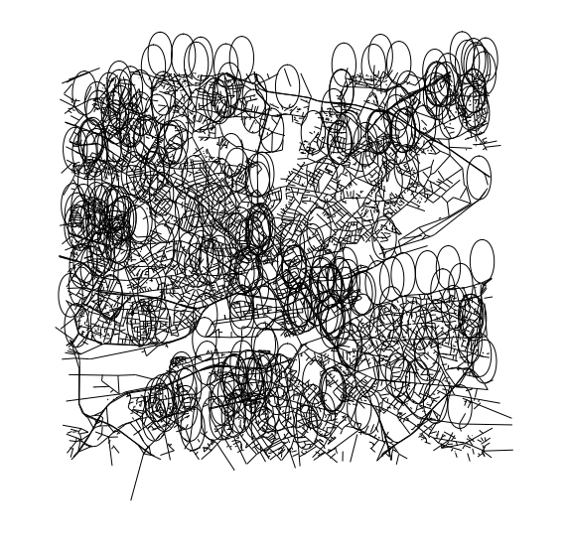
First draw

Slide 6
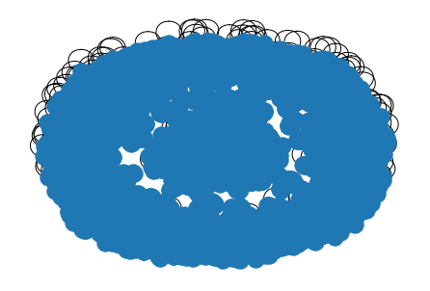
Second draw

