Slide 1




REST API to manage employees
By Asrar Ul Haq

Slide 2
Introduction
The Employee Management API is a RESTful service designed to facilitate efficient management of employee records within a company. This API provides a set of endpoints that allow for the creation, retrieval, updating, and deletion (CRUD) of employee information, enabling organizations to maintain accurate and up-to-date records.

Slide 3
Purpose
The primary purpose of this API is to streamline the employee management process by allowing authorized users to perform essential operations with ease. Key features include:
Create an Employee
Retrieve Employee Information
Update Employee Records
Delete Employee Records

Slide 4
Authentication
To authenticate with the Employee Management API, users can obtain a JSON Web Token (JWT) by sending a POST request to the /api/token/ endpoint, providing their credentials in JSON format. This request should include the username and password in the body, formatted as {"username": "your_username", "password": "your_password"}. Upon successful authentication, the API responds with an access token and a refresh token. The access token is then included in the Authorization header of subsequent requests to secure API endpoints, following the format Authorization: Bearer access_token_value. This token-based authentication mechanism ensures that only authorized users can access and manipulate employee records, enhancing the overall security of the API.

Slide 5
HOW TO USE
Initial Commands
pip install -r requirements.txt
python manage.py makemigrations
python manage.py migrate
python manage.py createsuperuser (here you can have login id and password)
python manage.py runserver (the project will start on port 8000)

Slide 6
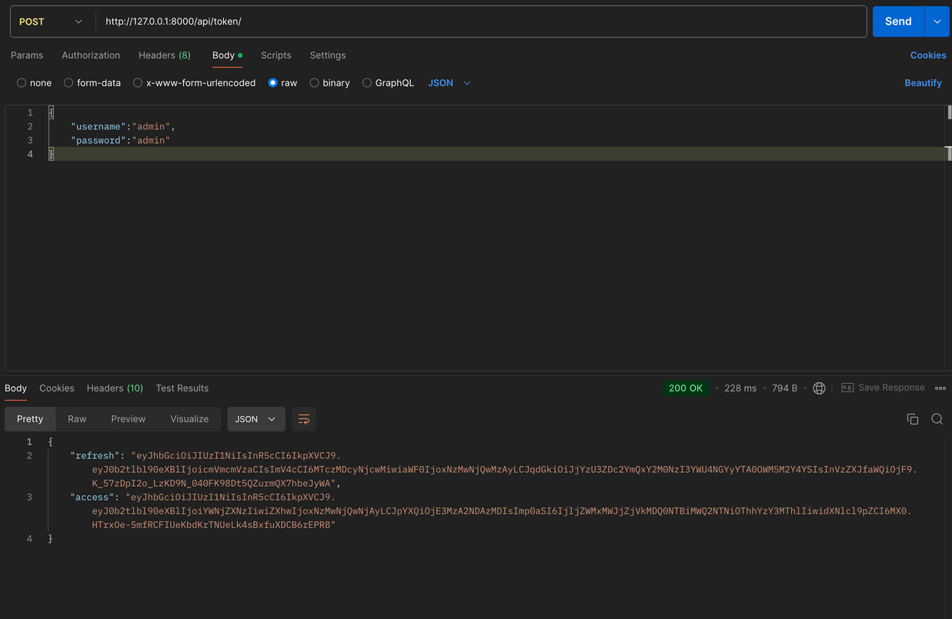
API Tests
Login
http://127.0.0.1:8000/api/token/
this api (post) will give you access_token and you will have to use that for future refrences.

Slide 7
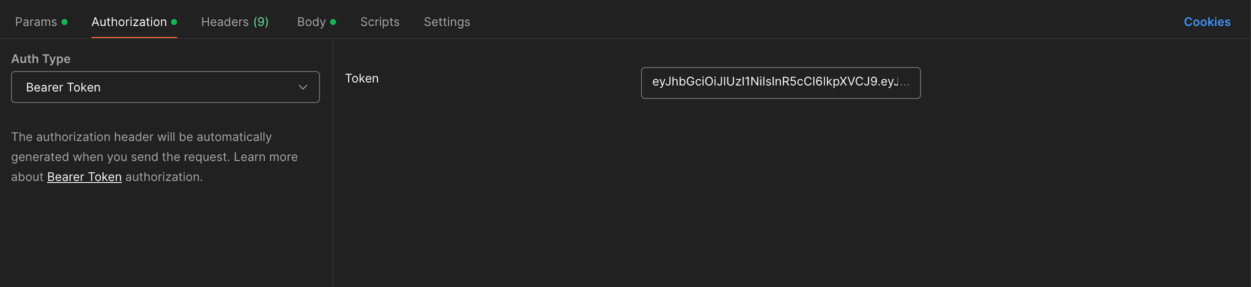
API Tests
Other Settings
copy access and open new tab go to authorization and choose Bearer Token and paste it there

Slide 8
API Tests
Get Employees
http://127.0.0.1:8000/api/employees/
if you want to check next page then
http://127.0.0.1:8000/api/employees/?page=2
this is get method to get employees

Slide 9
API Tests
Create Employees
http://127.0.0.1:8000/api/employees/
this is post method to create employees and add data like below in raw
{
"name": "Asrar",
"email": "asrajr@gmail.com",
"department": "cse",
"role": "rolee",
"date_joined": "2024-11-03"
}

Slide 10
API Tests
Update Employees
http://127.0.0.1:8000/api/employees/{id}/ (pass some id here say 1 the api will be like
http://127.0.0.1:8000/api/employees/1/
)
this is put method to update employees and add data like below in raw
{
"name": "Asrar",
"email": "asrar@gmail.com",
"department": "cse",
"role": "rolee",
"date_joined": "2024-11-03"
}

Slide 11
API Tests
Get particular Employees
http://127.0.0.1:8000/api/employees/{id}/ (pass some id here say 1 the api will be like
http://127.0.0.1:8000/api/employees/1/
)
this is get method to get a particular employees

Slide 12
API Tests
Delete Employees
http://127.0.0.1:8000/api/employees/{id}/ (pass some id here say 1 the api will be like
http://127.0.0.1:8000/api/employees/1/
)
this is delete method to delete a particular employee

Slide 13
Thank
You

