Slide 1
FaceMatch library
major components’ flowcharts

Slide 2
FaceMatch library dependencies
FaceMatch library
Utilities:
evaluation, visualization, I/O, synchronization
OpenCV:
image processing
Viola-Jones, RANSAC,
SIFT, SURF, ORB, LBPH
CUDA
GPU
FaceFinder:
image-specific face and landmarks detection
FaceRegionDetector:
tools for skin-aware face and landmarks detection
ImageMatcherFaceRegions:
descriptor ensemble based face region ingest, query, remove, list
multi-core CPU
OpenMP:
multi-threading
ImageMatcherWhole<descriptor>:
descriptor-specific whole image ingest, query, remove, list

Slide 3
image matching
start
error
HAAR: 0.1
LBPH: 0.3
ORB: 0.4
SURF: 0.8
SIFT: 0.9
HAAR: d₁₁, d₁₂, d₁₃, …
LBPH: d₂₁, d₂₂, d₂₃, …
SURF: d₃₁, d₃₂, d₃₃, …
ORB: d₄₁, d₄₂, d₄₃, …
SIFT: d₅₁, d₅₂, d₅₃, …
no
OK?
query
merge
yes
image
yes
index
dist1: image-ID
dist2: image-ID
dist3: image-ID
dist4: image-ID
…
Q?
descriptor extraction
Legend:
no
process
cond?
ingest
OK?
yes
no
yes
end
data item
error
storage
no
terminal
error

Slide 4


Near-dup detection / image search
source: multiple posts, recompression, resize
task: detect & group, exposing highest quality images
method: color Haar wavelet based IR technique
fast color image matching in YIQ space
robust to image noise, scale, compression
descriptor: 40 most significant wavelet coefs
s(Q,T) = w₀₀|Q₀₀ - T₀₀| + Sum_{ij}{ w_{ij}|q_{ij}-t_{ij}| }
results on PL: 40% near-dups in 20K images
tournament of all images in 4 minutes
robust to scale and re-compression
naturally gray-scale friendly
sensitive to rotations, crops, blanks
future work:
robustness to image transforms, blanks
more efficient look-up via clustering
different color spaces and wavelets

Slide 5
face detection
start
image
skin-mapper
{ANN | Hist}
skin map
extract
skin-blobs
skin blobs
color+ANN LM location
normalize:
resize, EQ
norm.image
landmarks
Viola-Jones
face, profile
face, profile candidates
FP elimination
face LM rectification
stronger candidates
horizontal eye-lines
corrected FD output
merge candidates
recovered FN
face+LM verification
end

Slide 6
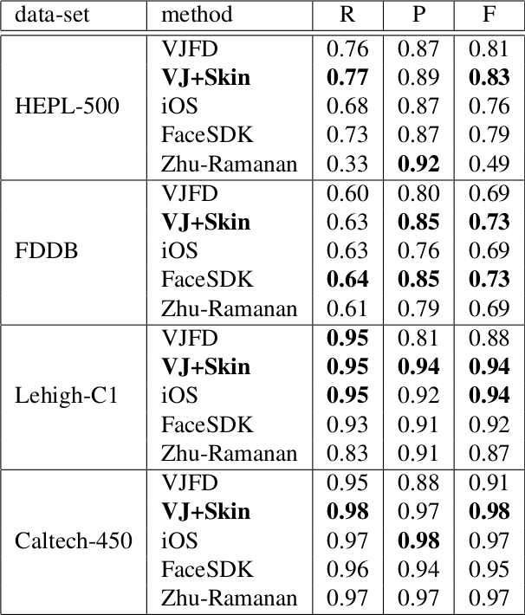
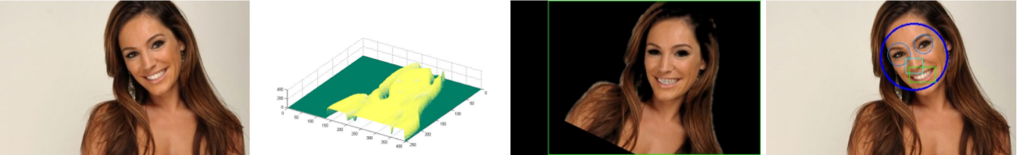
Face detection approach and results
recover false negatives (FN)
skinmap patch enhancement
color-based landmark detection
reject false positives (FP)
threshold skin mass in face region
landmark based rectification
results
better than baseline VJ
on-par or better than
commercial engines
leading open-source

Slide 7
face matching
start
error
HAAR: 0.1
LBPH: 0.3
ORB: 0.4
SURF: 0.8
SIFT: 0.9
HAAR: d₁₁, d₁₂, d₁₃, …
LBPH: d₂₁, d₂₂, d₂₃, …
SURF: d₃₁, d₃₂, d₃₃, …
ORB: d₄₁, d₄₂, d₄₃, …
SIFT: d₅₁, d₅₂, d₅₃, …
weighted-distance merge
no
OK?
query
image
yes
yes
dist1: region-ID
dist2: region-ID
dist3: region-ID
dist4: region-ID
dist5: region-ID
…
FLANN-capable
Index
[ID: descriptor]
faces?
yes
descriptor extraction
Q?
no
yes
no
face detection
faces?
ingest
OK?
yes
end
no
no
error

Slide 8
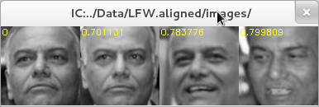
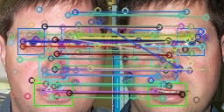
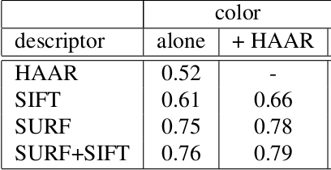
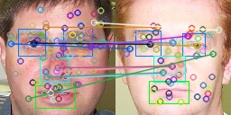
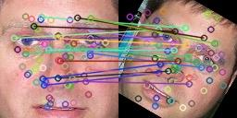
Face matching results
Descriptor ensemble based matching
Landmarks aware key-point filtering
average distance
decreases for same subject (.46->.41)
increases for diff subjects (.72->.74)
Utilizing color information improves accuracy
gray-scale key-point desciptors
color aware Haar wavelet descriptor
color-aware line descriptor
dataset | top-1 hit-rate
CalTech: 23 subj, 450 large faces, color, mostly frontal, some occlusions | 0.97
IndianFaces: 40 subj, 667 color images, varying pose | 0.79
ColorFERET: 1200 subj, 15K color images, varying pose, expression | 0.96

Slide 9
Visual indexing
several descriptors for face matching
=== structure:
DESC<tab>DscIndexFile.ndx<tab>ConfidenceWeight
=== example:
HAAR FM.demo.HAAR.ndx 0.4 # color-aware Haar wavelet [EB], 3x40 values
LBPH FM.demo.LBPH.ndx 0.2 # Local Binary Pattern Histogram [OpenCV+EB], 2¹⁴ values
ORB FM.demo.ORB.ndx 0.3 # Oriented FAST and Rotated BRIEF [OpenCV], k*500 bits
SURF FM.demo.SURF.ndx 0.9 # Speeded Up Robust Features [OpenCV], k*64 floats
SIFT FM.demo.SIFT.ndx 1.0 # Scale Invariant Feature Transform [OpenCV], k*128 floats
#RSILC FM.demo.RSILC.ndx 0.9 # Rotation and Scale Invariant Line Color desc [FM], k*512
===
combination: D = П d_{i}^{wi}
individual index: binary serialization of STL std::map<string, DESC>
key = ImageURL+FaceProfileRegion (unique)
value = descriptor buffer (variable)

Slide 10
FLANN
Fast Library for Approximate Nearest Neighbors
clustering based on descriptor-specific norm
5-10x query speed-up w.r.t. linear search
negligible loss in accuracy: 1-2 %-age points
automatic or on-demand re-indexing
one-time on-load index time penalty

Slide 11
unit tests
Testing all critical functions for
correctness: verify expected output
speed: verify expected timing
command-line tests: run overnight
NearDupImgDetector -test
FaceFinder -test
ImageMatcher -test

Slide 12
NearDupImgDetector -test
PrintAndGet: verify that print and get dups produce the same results
SelfMatch: for each input image (in list), find its dup and assert the distance is zero
SyntheticNearDups: for image list, synthesize near-duplicates, and assert the proper grouping
NearDups: for image list, find and group all near-duplicates, compare with the expected output

Slide 13
FaceFinder -test
FRD: load Face Region Detector (FRD) multiple times with(out) GPU.
EvalStats: verify evaluation stats for complete and partial matches.
Standard: for each image in list, get faces via gray-scale (VJ) detection, and compare the results to the expected output.
Landmarks: for each image in list, run standard face detection with sub-regions, and compare the results to the expected output.
SkinANN: for each image in list, get faces via Standard+SkinANN method, and compare the results to the expected output.
SkinHist: for each image in list, get faces via Standard+SkinHist method, and compare the results to the expected output.
SkinStat{BGR|HSV|Lab}: for each image in list, get faces via Standard+SkinStat{BGR|HSV|Lab} method, and compare the results to the expected output.
Multithread: for each image in list, run Standard+SkinANN face detection in parallel, and compare the results to the expected output.

Slide 14
ImageMatcher -test
ImageMatcherWhole{Seq|Par}: test whole image matching ingest/query/list/remove functions in {sequence|parallel} on HEPL
ImageMatcherFaceRegions{Seq|Par}: test face matching ingest/query/list/remove functions in {sequence|parallel} on HEPL
Serialization: test index YML and binary serialization via round-trip test

Slide 15
Plan
Large-scale FLANN indexing experiments
RSILC: speed-up computation & comparison
Fuse text and visual search results, e.g. by RRF
Automatic categorization: face tone, gender
Trainable face clustering: same/same/diff map
Extend FM to pet and object visual search

