Slide 1
Face Match System Overview
Presents an overview and describes the process on FM when new event is declared

Slide 2
FM - Action When New Event is Declared
PL – New Event
Assigns new Event ID
FaceMatch Web Service
Recognizes new Event ID
Ingest
Query
Indexed
Matches found
Bucket
Bucket
Bucket
Private event space
No personnel required for “new event” support. Always On, Automatic.

Slide 3
Dataflow, Roles and Responsibilities and User Action

Slide 4
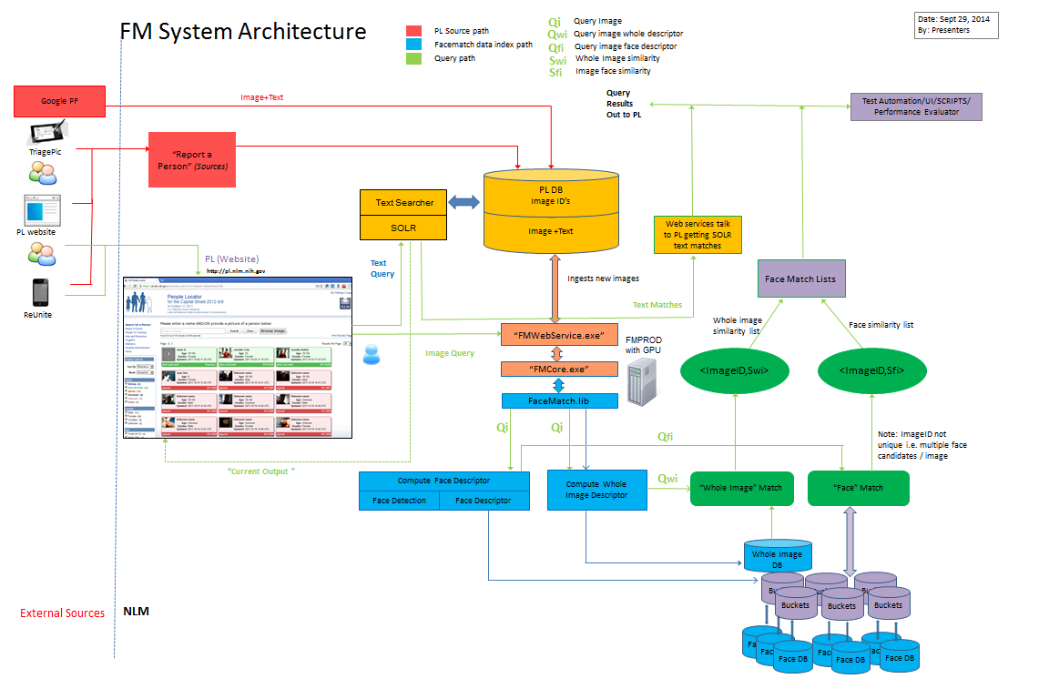

Slide 5
FM Web Services – Ingest (Face Regions)
image url, id, eventid, key
FMWebService.exe
PL
ingest
optional
age, gender, region
Yes
Region known?
No
Face Finder
No face detected
return
Bucket Manager(event)
SPLIT’s ingest space by gender, age
Executor
Thread pool
COM
Relevant buckets for event… [ age, gender ]…
FMCore.exe
Executed in Parallel
FM.lib ( EB)
ingest
ingest
ingest
ingest
Face Index
Face Index
Face Index
Face Index

Slide 6
FM Web Services – Query (Face Regions)
image url, eventid, key
FMWebService.exe
PL
query
optional
age, gender, region
Yes
Region known?
No
Face Finder
No face detected
return empty
Bucket Manager(event)
SPLIT’s query space by gender, age
Executor
Thread pool, parallel merge
COM
Relevant buckets for event… [ age, gender ]….
FMCore.exe
Queried in Parallel
FM.lib ( EB)
matcher
matcher
matcher
matcher
Face
Index
Face
Index
Face
Index
Face
Index
return hits
<id, distance>

Slide 7
FM Web Services – remove (Face Regions)
id, eventid, key
FMWebService.exe
PL
remove
Executor
COM
Removed from
ALL buckets for event…
FMCore.exe
FM.lib ( EB)
remove
remove
remove
remove
Face Index
Face Index
Face Index
Face Index

Slide 8
FM Web Services – Face Finder
image url, key
FMWebService.exe
PL
getFaces
Adjust for UI
COM
FMCore.exe
FM.lib ( EB)
GPU/CPU aided face detection
Face Finder
return regions

Slide 9
FM Web Services – deleteEvent
eventid, key
FMWebService.exe
Client
remove
Executor
COM
delete ALL buckets
for event… release event specific matcher
FMCore.exe
FM.lib ( EB)
matcher
matcher
matcher
matcher
Face
Index
Face
Index
Face
Index
Face
Index

Slide 10
FM Whole Image Web Services – Ingest
image url, id, eventid, key
FMWebService.exe
Client
ingest
Executor
COM
FMCore.exe
FM.lib ( EB)
ingest
WholeImageDB

Slide 11
FM Whole Image Web Services – Query
image url, eventid, key
FMWebService.exe
Client
query
Executor
COM
FMCore.exe
FM.lib ( EB)
query
WholeImageDB

Slide 12
FM Monitoring Service – Provides Availability Status and Failure Management
FM Web Service
FM Core
PL
ON/OFF
FM Monitor
FM.lib
FMPROD
OS Events

Slide 13
User Action - Specification
Interaction model with FM is specified in a User Interface Specification document
FM and PL – team reviewed and shared
FaceMatch.UserInterfaceSpecification5.docx
Clearly defined integration path
  Interfaces
  Behavior
  Methods, parameters, expected values
  Return codes, errors
Accounts for system and client growth

Slide 14
Data Storage and Indexing

Slide 15
Data Storage and Indexing
Indexing process occurs on demand
  Always On and Automatic
  Each event is private
  Incoming records go into buckets
Bucketing
  Based on metadata associated with image
  Groups of buckets make up an event index
  Each bucket is a face index
  FM does not save the images itself anywhere
Visual Indexing: enable visual search

Slide 16
Current Data Strategy (in production)
Built for performance
  Binary format (.ndx), faster load/save compared to R&D (.yml)
  Well suited for system and client growth
Bucketing
  Exploits parallel execution on all cores
  Exploits metadata to return 20x query speed improvements
  Vastly improved search quality
  Well suited for system and client growth
FLANN
  Being phased in (FMStage)
  Promises even faster queries on large events

Slide 17
FLANN
Fast Library for Approximate Nearest Neighbors
clustering based on descriptor-specific norm
5-10x query speed-up w.r.t. linear search
negligible loss in accuracy: 1-2 %-age points
automatic or on-demand re-indexing
one-time on-load index time penalty

Slide 18
FM System Dependencies

Slide 19
Face Match System Dependencies
FM Web Services.exe
WCF
(Windows Communication Foundation)
.NET 4.0
COM
FMCore.exe
FM.lib
OpenMP
OpenCV
CUDA 5.5
NVIDIA Driver
Windows Server 2008 R2

Slide 20
Opportunities for Failure
Hardware, OS and driver failures (e.g. computer overheating)
Unpredictable and hard-to-replicate software glitches (e.g. memory access violations in unmanaged code)
Anything that falls outside of the specified interfaces can lead to unpredicted behavior
  FM Web Services Specification
  FM library developer’s documentation

Slide 21
Failure Logging
Basic information
  Always logged, mainly as a part of startup
Detailed information
  Logging done only on exception
    Web Service Module
      Relevant call parameters, error and exception reason logged
      Fair amount of logging code added that is designed to log information to help resolve unexpected situations
    FMCore Module
      Relevant call parameters, error and exception reason logged
      Log all startup, GPU, and any runtime exceptions generated
      Log all FM.lib exceptions

Slide 22
Failure Management
Some failure management already exists in the FMMONITOR service
Checks for process failures
Execution faults, heap corruption or other issues
Checks are performed once every minute
Monitor
Processes Running
Execution Faults
Restart processes
FMMonitor service

Slide 23
Setup and Maintenance
Setup:
  Face Match System can be installed on a target machine by the following steps
  Install the latest CUDA 5.5 SDK or higher
  Install OpenCV 2.4 or higher and set environment variable OpenCVHome to point to it
  Build all projects to C:\FaceMatchSL\FaceMatch\bin folder
  Register FaceMatchCore as a COM server in above folder
  Install FaceMatchWebService in above folder as a windows service
  Install FaceMatchMonitorService in above folder as a windows service
  Start FaceMatchWebService and the FaceMatchMonitorService
Maintenance:
  Stable version tagging, ensures ability to rollback
  PL-triggered batch indexing

Slide 24
Face Match Testing
3 e) How is testing conducted? How is it updated?

Slide 25
Build and Test System (FMSTAGE)
Rebuild
GPU Tests
Reporting
Unit Tests
Web Service End to End Tests
Workflow currently used on FMSTAGE
Tests are updated when a new model is presented or an existing module changes

Slide 26
unit tests
Testing all critical functions for
  correctness: verify expected output
  speed: verify expected timing
command-line tests: run overnight
  NearDupImgDetector -test
  FaceFinder -test
  ImageMatcher -test

Slide 27
NearDupImgDetector -test
PrintAndGet: verify that print and get dups produce the same results
SelfMatch: for each input image (in list), find its dup and assert the distance is zero
SyntheticNearDups: for image list, synthesize near-duplicates, and assert the proper grouping
NearDups: for image list, find and group all near-duplicates, compare with the expected output

Slide 28
FaceFinder -test
FRD: load Face Region Detector (FRD) multiple times with(out) GPU.
EvalStats: verify evaluation stats for complete and partial matches.
Standard: for each image in list, get faces via gray-scale (VJ) detection, and compare the results to the expected output.
Landmarks: for each image in list, run standard face detection with sub-regions, and compare the results to the expected output.
SkinANN: for each image in list, get faces via Standard+SkinANN method, and compare the results to the expected output.
SkinHist: for each image in list, get faces via Standard+SkinHist method, and compare the results to the expected output.
SkinStat{BGR|HSV|Lab}: for each image in list, get faces via Standard+SkinStat{BGR|HSV|Lab} method, and compare the results to the expected output.
Multithread: for each image in list, run Standard+SkinANN face detection in parallel, and compare the results to the expected output.

Slide 29
ImageMatcher -test
ImageMatcherWhole{Seq|Par}: test whole image matching ingest/query/list/remove functions in {sequence|parallel}
ImageMatcherFaceRegions{Seq|Par}: test face matching ingest/query/list/remove functions in {sequence|parallel}
Serialization: test index YML and binary serialization via round-trip test

Slide 30
Web Service End to End Tests
Unit Tests and End to End tests are run overnight everyday on fmstage
All tests can be viewed or run through a user interface
Test failures are automatically notified to the team via e-mail with the name of the test that failed and any relevant trace information
Test history is recorded in a database for historical context (if such a need arises)
GPU_On Test :
  Checks to see if the GPU has been initialized correctly, is available and working by calling a specific function offered by FM.lib for this purpose
FaceFinder Test:
  Checks to see if the Face Finder is working as expected by checking if a face was found on an image that has a known face.
Ingest Test :
  Ingests records from a set of images and then queries the records and checks if all were ingested
Query Test:
  Checks to see if we are able to query the records ingested earlier and verifies existence of a self-match by providing an image known to have been ingested.
DeleteEvent Test:
  Checks to see if we are able to delete an event by checking there are no matches returned after event was deleted.

Slide 31
Web Service End to End Tests (Continued)
Bucketing Test:
  Checks to see if any known male records are returned for a query with female attribute specified.
Remove Test:
  Verifies that once an image is removed from an event a query does not return it as a match.
SaveEvent Test :
  Verifies that the web service is able to save an event
Version Test:
  Verifies that the web service returns its version number
ParallelMerge Test:
  Verifies that the parallel merge is working by checking the score ordering on the returned records
Concurrency Test:
  Verifies that the server is capable of handling multiple concurrent requests by dispatching them on multiple threads and then checking for the total number of threads outstanding which should be greater than a known number
NoGPU_FaceDetection Test:
  Verifies CPU based face detection using a known image and checking for the number of faces returned to match a known number.
GPU_FaceDetection Test:
  Verifies GPU based face detection using a known image and checking for the number of faces returned to match a known number.

