Slide 1
MINI PROJECT | MACHINE LEARNING
3
7
Handwritten Digit Recognition Using Machine Learning
1
9
4
0
A CNN benchmarked against four classical ML models on MNIST digits, then extended to recognise letters A–Z (36 classes) with EMNIST
8
2
PRESENTED BY
Yogisha Rani
2430256
Upasna Dey
Shreyansh Ray
2430257
Suyash Gupta
5
6
Notes:
Introduce the topic and team members.

Slide 2
INTRODUCTION
Project Overview
Problem Statement
99.34%
250,000+
Automatically recognise a handwritten digit (0-9) or letter (A-Z) from an image. Handwriting varies in slant, thickness, size and style, so fixed rules fail – the system must learn the patterns from examples.
digit accuracy (MNIST)
images (MNIST + EMNIST)
87.6%
66
digits + letters (36 classes)
digit errors out of 10,000
Objectives
▪ Build an end-to-end digit recognition pipeline
▪ Compare 4 classical ML models with a CNN
▪ Reach > 99% accuracy on unseen test data
▪ Extend to letters: recognise 0–9 and A–Z live
Why it matters
Digit recognition powers cheque processing, postal PIN-code sorting, form digitisation and exam-sheet scanning. It is also the standard benchmark for testing image-classification ideas.
Handwritten Digit Recognition Using Machine Learning
2 / 10
Notes:
Explain the problem, objectives, and headline results.

Slide 3
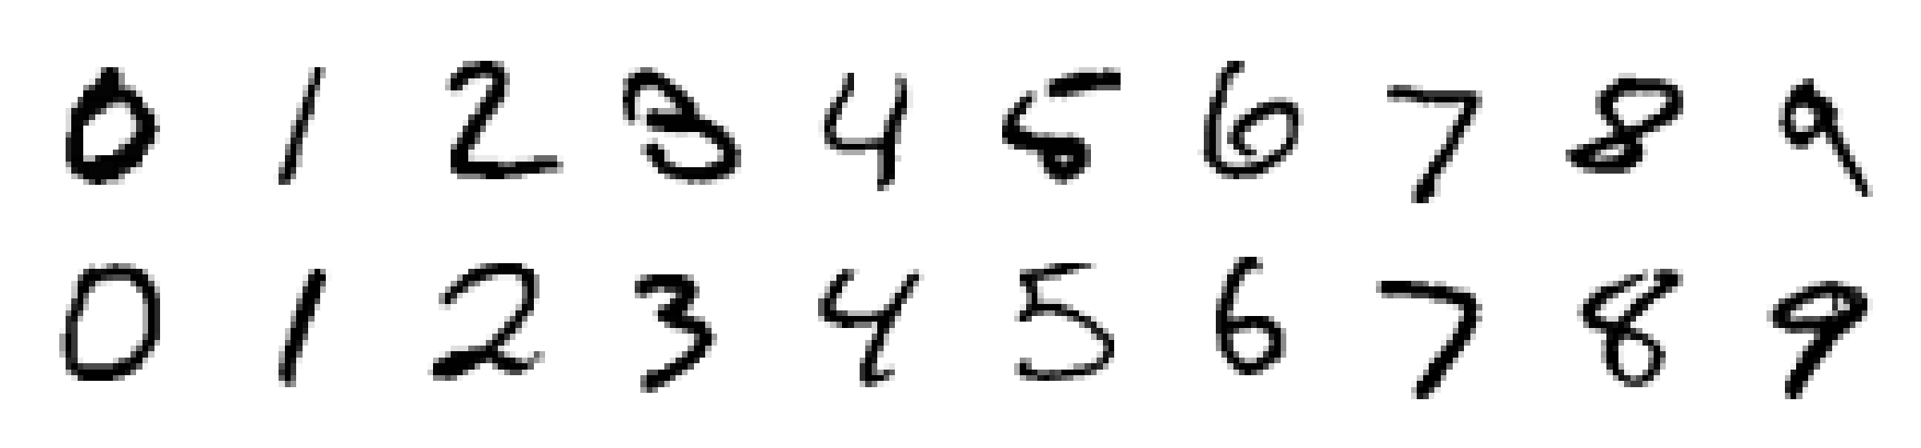
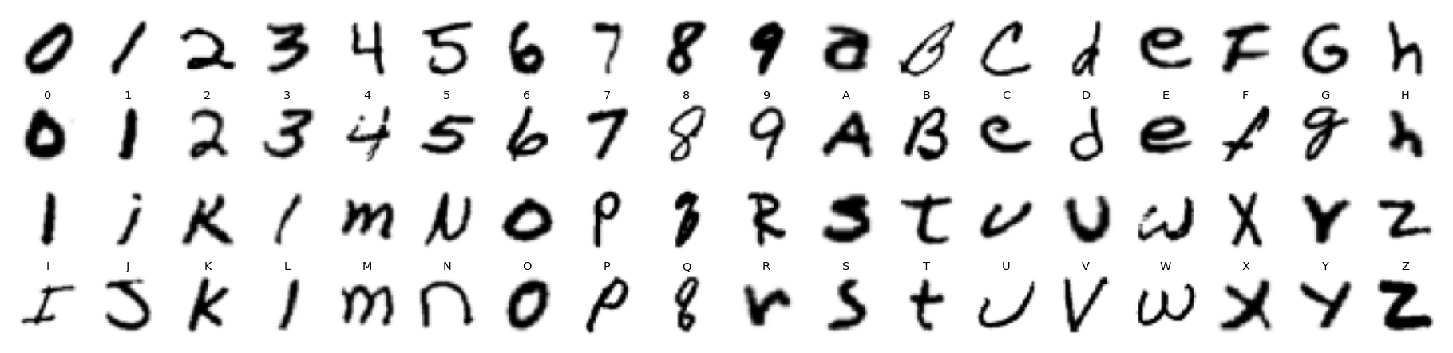
DATA
Dataset & Data Preprocessing
Datasets: MNIST (digits) + EMNIST (letters)
Preprocessing Steps
▪ MNIST: 70,000 digit images, 28 × 28 grayscale, 10 classes
▪ Split: 55,000 train | 5,000 validation | 10,000 test
▪ EMNIST: 179,959 train / 35,526 test images, 36 classes (0–9, A–Z; a = A)
▪ Test sets are never used during training or tuning
Normalise
pixels 0–255 scaled to 0–1
1
2
Reshape
28×28×1 tensor for CNN; flattened 784 vector for classical models
Samples: MNIST (top), EMNIST (bottom)
3
Dimensionality reduction
PCA to 50 components for k-NN and SVM
4
Augmentation
random rotation ±6°, shift 8%, zoom 10% (training only)
5
Real-input conversion
invert, Otsu threshold, crop, resize to 20×20, centre in 28×28 by centre of mass
Handwritten Digit Recognition Using Machine Learning
3 / 10
Notes:
MNIST details and the preprocessing chain, including conversion of user drawings to MNIST format.

Slide 4
ARCHITECTURE
Proposed System Architecture
A. TRAINING PHASE (offline)
MNIST + EMNIST
digits and letters
Preprocessing
normalise, 55k/5k/10k split
Augmentation
rotate, shift, zoom
CNN Training
Adam, early stopping
Trained Models
digit CNN + 36-class CNN
same weights reused
B. RECOGNITION PHASE (live)
User Input
digit or letter, drawn / image
Image Preparation
invert, threshold, crop, centre
28×28 Image
MNIST-style input
Trained CNN
classifies 0–9 and A–Z
Predicted Character
digit or letter + confidence
Evaluation: held-out test sets (10,000 MNIST and 35,526 EMNIST images) measure accuracy, F1 and confusion matrices; the digit CNN is also compared with 4 classical baselines.
Handwritten Digit Recognition Using Machine Learning
4 / 10
Notes:
Top row = how the model is built. Bottom row = how a new digit is recognised. The CNN weights from training are reused.

Slide 5
METHOD
Methodology / Working Procedure
1. Collect
2. Prepare
3. Baselines
4. Build CNN
5. Train
6. Evaluate
7. Deploy
Load MNIST and
create train /
validation / test
Scale pixels, reshape,
augment training
images
Train LR, RF,
k-NN, SVM on
flattened pixels
Stacked Conv +
BatchNorm + Pool
+ Dropout
Adam optimiser,
LR decay, early
stopping
Accuracy, F1,
confusion matrix,
error analysis
Drawing-pad app
with live
prediction
How the CNN recognises a digit
Training & validation strategy
▪ Early convolution layers detect edges and strokes
▪ Deeper layers combine them into loops, curves and corners
▪ Pooling keeps the strongest features and tolerates small shifts
▪ Softmax gives a probability for each of the 10 digits
▪ Loss: sparse categorical cross-entropy
▪ Validation set monitored every epoch; best weights restored
▪ Learning rate halved when validation stalls
▪ Test set used only once for the final report
Handwritten Digit Recognition Using Machine Learning
5 / 10
Notes:
Walk through the seven stages left to right.

Slide 6
IMPLEMENTATION
Model Development & Implementation
CNN layer structure
Input
28×28×1
Conv 3×3 × 2
32 filters, BN, ReLU
MaxPool + Dropout
0.25
Conv 3×3 × 2
64 filters, BN, ReLU
MaxPool + Dropout
0.25
Dense
128 units, Dropout 0.4
Softmax
10 or 36 classes
Hyper-parameters
Tools & code modules
Optimiser
Adam (lr 0.001, halves on plateau)
▪ Python 3.10 – TensorFlow / Keras, scikit-learn
▪ OpenCV, SciPy – image preparation
▪ Matplotlib, Seaborn – result plots
▪ Tkinter – drawing-pad application
▪ Modules: data.py, preprocess.py, prepare_emnist.py, train_cnn.py, train_alnum.py, app.py
Batch size
128
Epochs
digits 25 (max 30), letters 12 (max 12)
Parameters
468,586 / 471,940 (36-class)
Augmentation
rotation, shift, zoom
Random seed
42 (reproducible)
Handwritten Digit Recognition Using Machine Learning
6 / 10
Notes:
Describe the layers and the hyper-parameters.

Slide 7
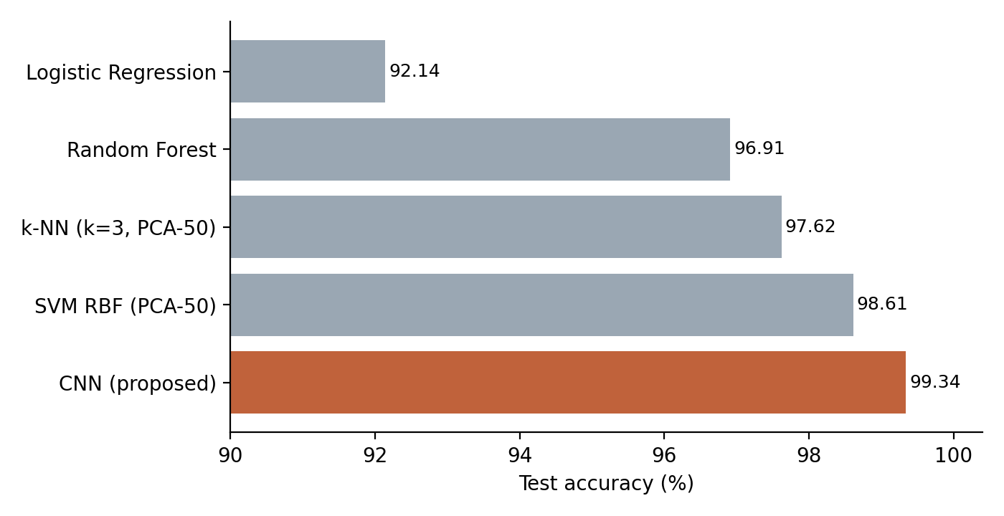
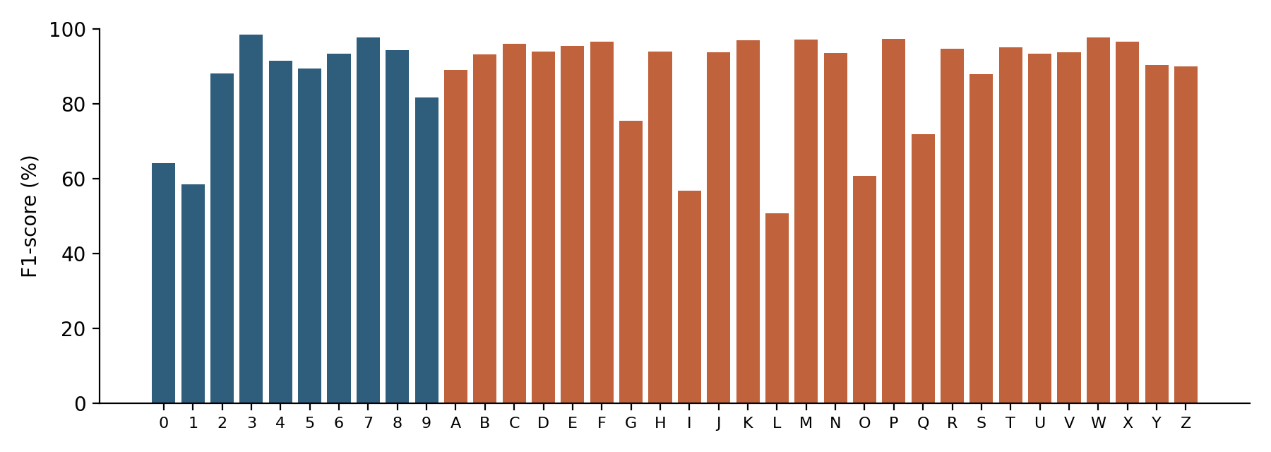
RESULTS
Experimental Results & Performance
Digits (MNIST): CNN vs classical models
Letters (EMNIST): 36-class CNN
F1-score per class (blue = digits, orange = letters)
87.57%
90.00%
86.62%
99.34%
99.34%
66
all 36 classes
digits only
letters only
accuracy
macro F1-score
errors / 10,000
Look-alike characters cause most errors (true→predicted): L→1, O→0, I→1, 0→O. 3,154 of 4,415 errors are digit↔letter mix-ups.
The CNN beats the best classical model (SVM, 98.61%) by 0.73 points. Most frequent digit error: 9 predicted as 4.
Handwritten Digit Recognition Using Machine Learning
7 / 10
Notes:
Left: five models on MNIST digits. Right: the same CNN design with a 36-way output trained on EMNIST. Letters are harder because O/0, I/1, L/1 look alike.

Slide 8
APPLICATION
Application
Live Drawing-Pad Application (app.py)
Real-world use cases
1
Draw any digit or letter with the mouse on the black canvas
▪ Bank cheque and amount reading
▪ Postal PIN-code sorting
▪ Digitising forms, tax and survey sheets
▪ Automatic grading of numeric answers
▪ Number-plate and meter reading (with extension)
2
On release, the stroke image is converted to MNIST format by preprocess.py
3
The CNN predicts instantly; a switch picks digits-only (99.3%) or digits + letters
4
Top-3 probabilities are displayed as confidence bars
Deployment notes
The model is only 469k parameters, so it runs on an ordinary laptop CPU in milliseconds and can be converted to TensorFlow Lite for mobile apps.
5
Clear and try again; also available as predict.py for image files
Handwritten Digit Recognition Using Machine Learning
8 / 10
Notes:
Demonstrate app.py live if possible.

Slide 9
SUMMARY
Conclusion, Limitations & Future Scope
99.34%
87.57%
+0.73 pts
digit accuracy (10,000 unseen MNIST images)
accuracy on 36 classes (digits + letters)
digit CNN gain over best classical (SVM)
Conclusion
Limitations
Future Scope
▪ Built a full pipeline: data, five models, evaluation and a drawing app
▪ CNN outperformed every classical model on digits (99.34%)
▪ Extended to A–Z: 87.6% on 36 classes; errors are mostly look-alikes
▪ Centring and scaling inputs is what makes it work on user drawings
▪ Single, centred characters only; words and long numbers need segmentation
▪ Look-alikes (L→1, O→0, I→1, 0→O) cause most errors
▪ Upper and lower case merged (a = A); no symbols
▪ Thin strokes, noise and unusual writing styles reduce accuracy
▪ Case-sensitive recognition (62 classes); Devanagari / Bengali digits
▪ Character segmentation to read words, numbers and cheques
▪ Ensembles or ResNet for lower error
▪ Mobile / web app with TensorFlow Lite; fine-tune on user drawings
Handwritten Digit Recognition Using Machine Learning
9 / 10
Notes:
Summarise results, be honest about limits, then outline extensions.

Slide 10
Thank You
Questions are welcome
Yogisha Rani | Upasna Dey | Shreyansh Ray | Suyash Gupta
Handwritten Digit Recognition Using Machine Learning

