Slide 1
Airline Pricing and Performance Optimization
Final Project for Visual Analytics
Sufyan Ahmed Khan, Awes Abdul
May 2, 2025

Slide 2
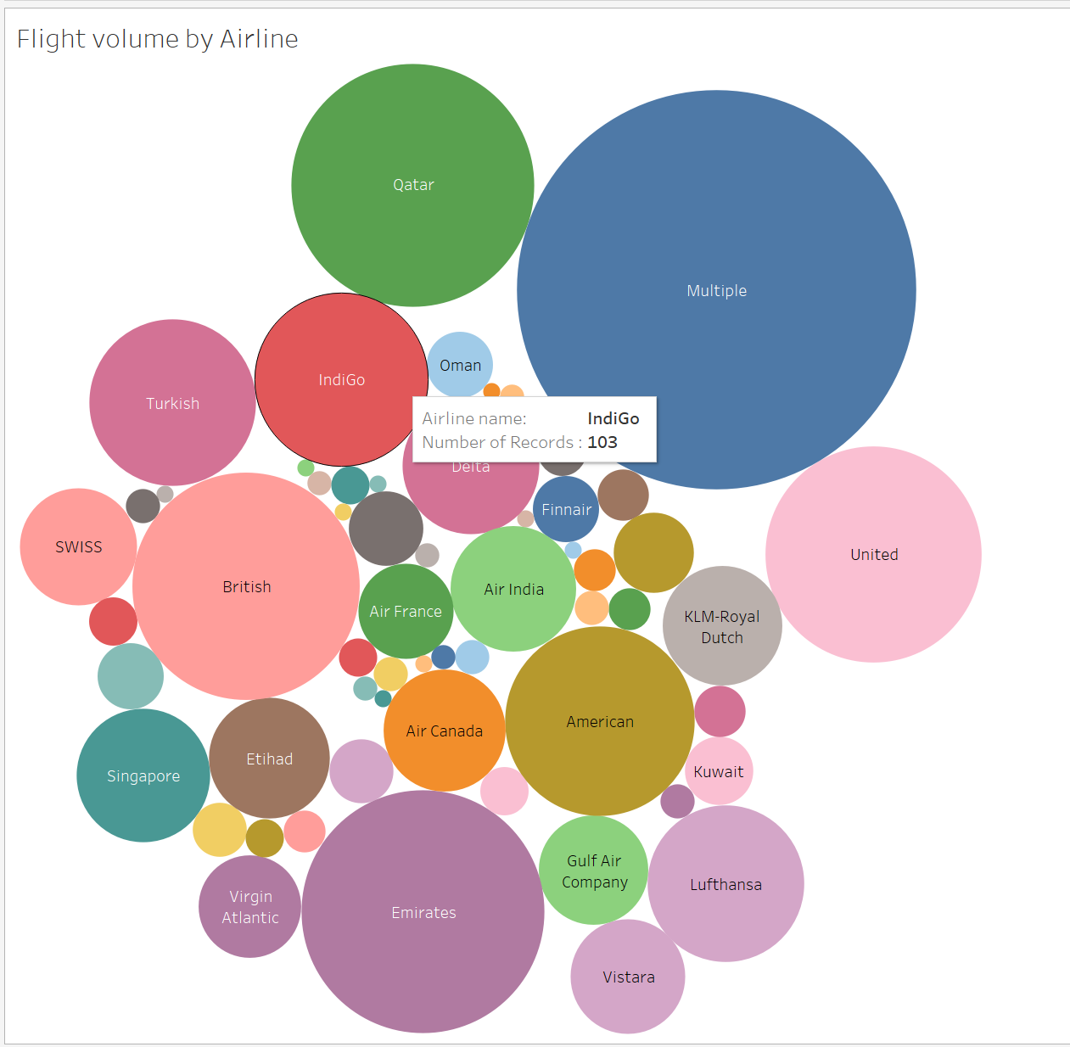
Flight Volume by Airline
This packed bubble chart shows the number of flight records per airline. The 'Multiple' category dominates, followed by Qatar and IndiGo, indicating high-frequency carriers.

Slide 3
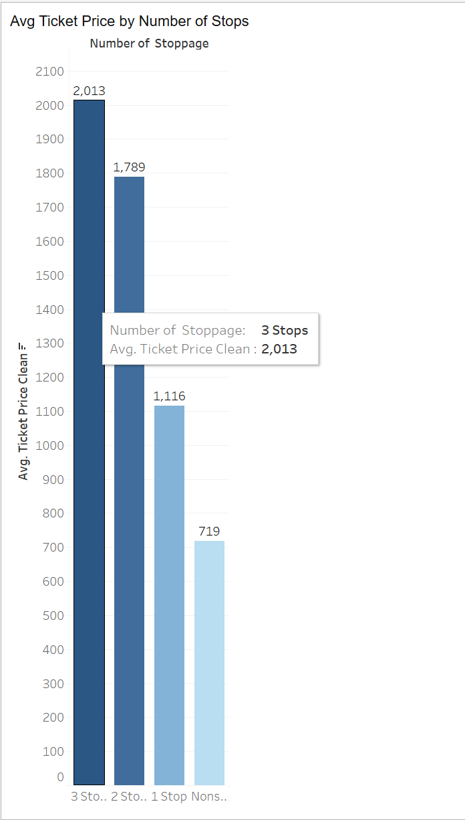
Avg Ticket Price by Number of Stops
This bar chart reveals that flights with more stops tend to have significantly higher average ticket prices. Nonstop flights are the most cost-effective.

Slide 4
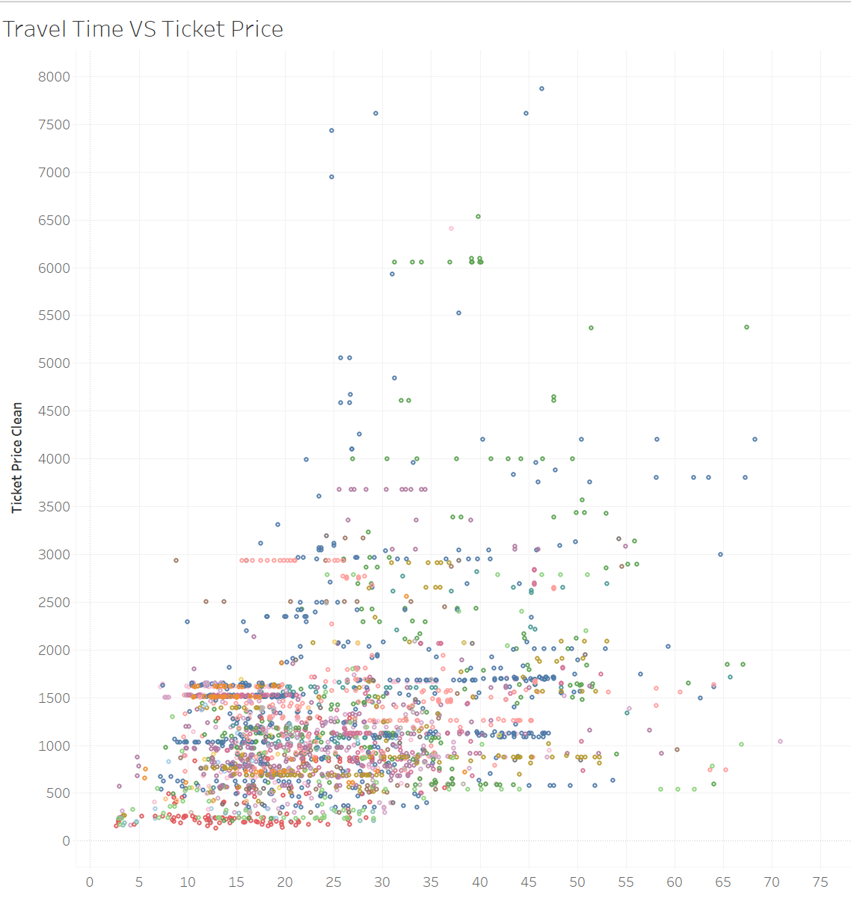
Travel Time vs Ticket Price
The scatter plot shows a moderate spread—indicating that longer travel times don’t always lead to higher ticket prices. Some expensive tickets still have short durations, highlighting pricing inconsistencies.

Slide 5
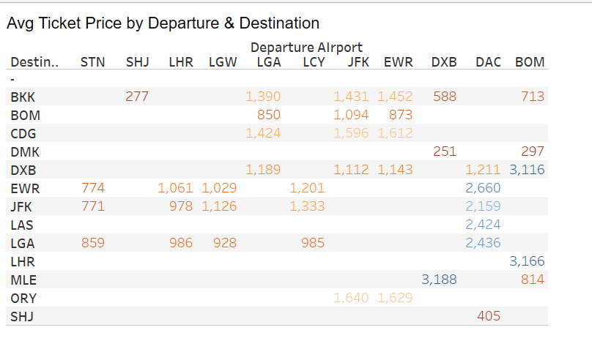
Avg Ticket Price by Departure & Destination
This highlight table reveals which airport combinations yield higher or lower average ticket prices. It helps identify cost-efficient routes between major hubs.

Slide 6
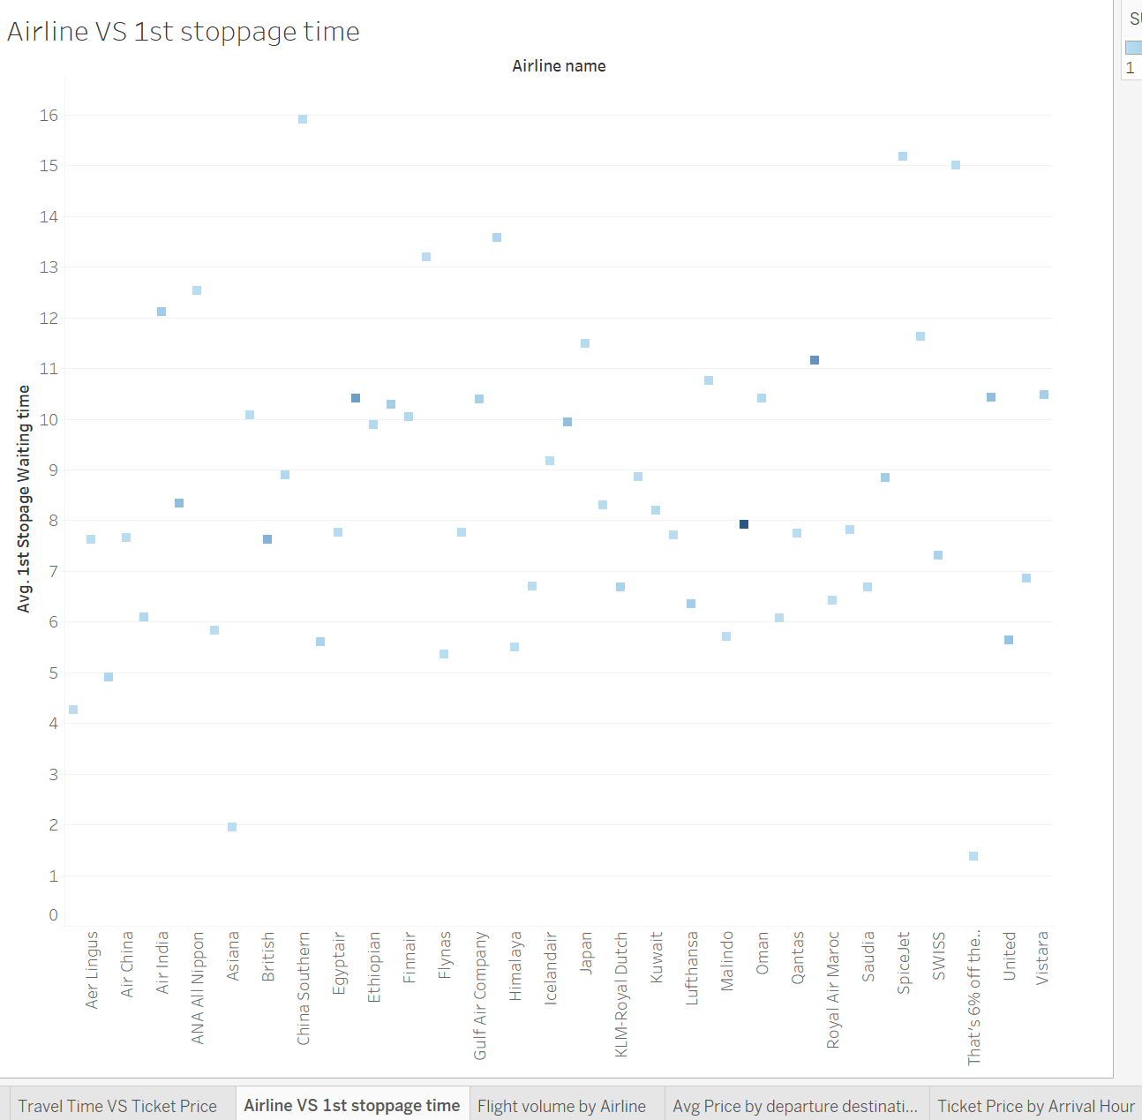
Airline vs 1st Stoppage Time
This dot plot visualizes the average waiting time at the first stop for each airline. Some airlines consistently have longer layovers, potentially affecting traveler satisfaction.

Slide 7
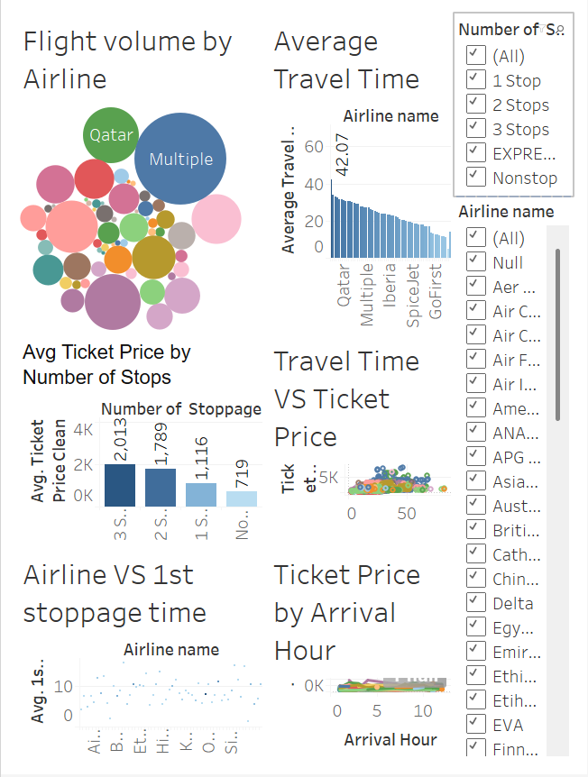
Interactive Dashboard Overview
This interactive dashboard combines multiple visualizations, enabling real-time exploration of travel trends, ticket prices, and wait times by airline or flight configuration.

