Slide 1
Project Recovery Assignment
Webshop of choice

Slide 2
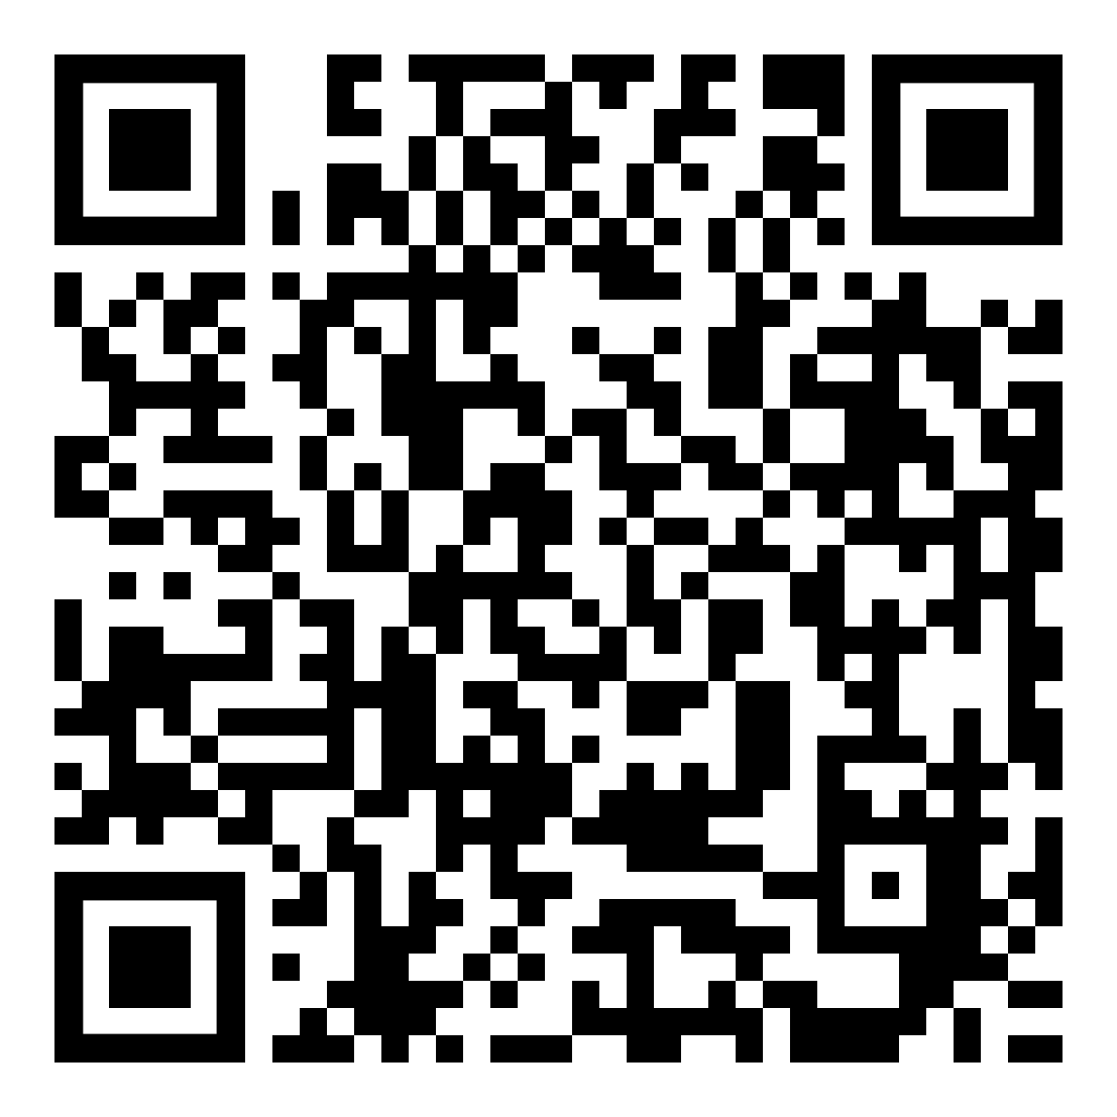
Welcome!
Herkansing Project periode 2 – Webapplicatie
Webshop
Subject of your choice
Online supermarket, electronics/gadgets, Crypto and NFTs
Functionalities are described in the assignment description
https://filesender.surf.nl/?s=download&token=3982c423-f890-460f-8489-94a69312b2bc

Slide 3
Frameworks and preconditions
> 4 weeks time
> Deadline: March 4, 2022 - 3:00 PM
> Groups of max. 3 students
> Warnings system – 3 warnings
> Warnings are supplied with motivation
> Only the software is important
> Design takes the 2nd place
> A design has been made for you

Slide 4
Example of the Functionalities
> Customer registration
> Admin page with a.o.
> Add Products
> Activate temporary discount
> Shopping cart that remembers products
> Products with age limit
> Unique addition invented and programmed by the group

Slide 5
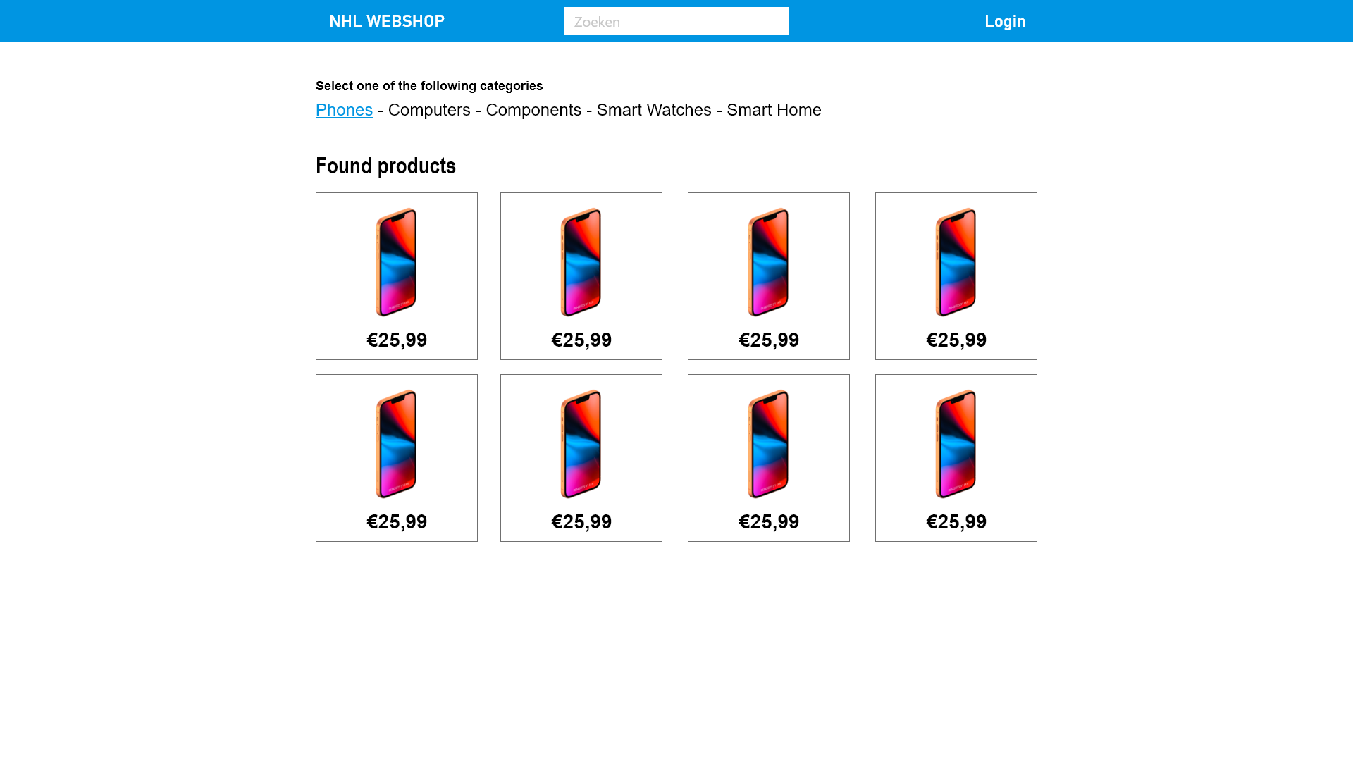
Design

Slide 6
Design

Slide 7
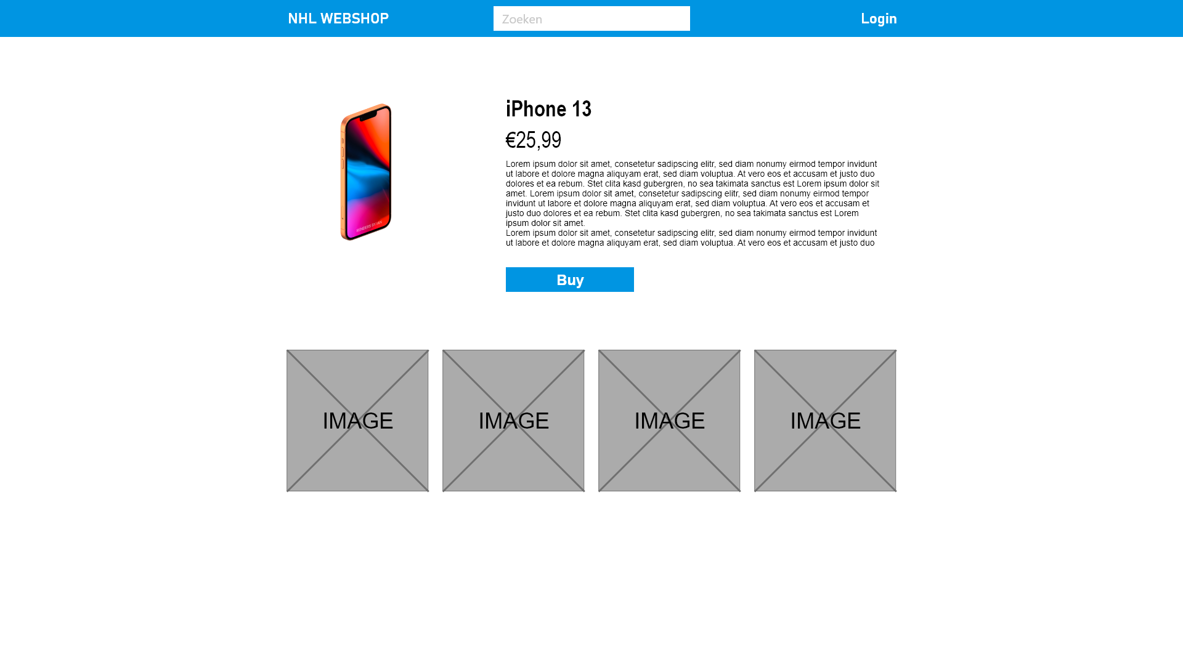
Design

Slide 8
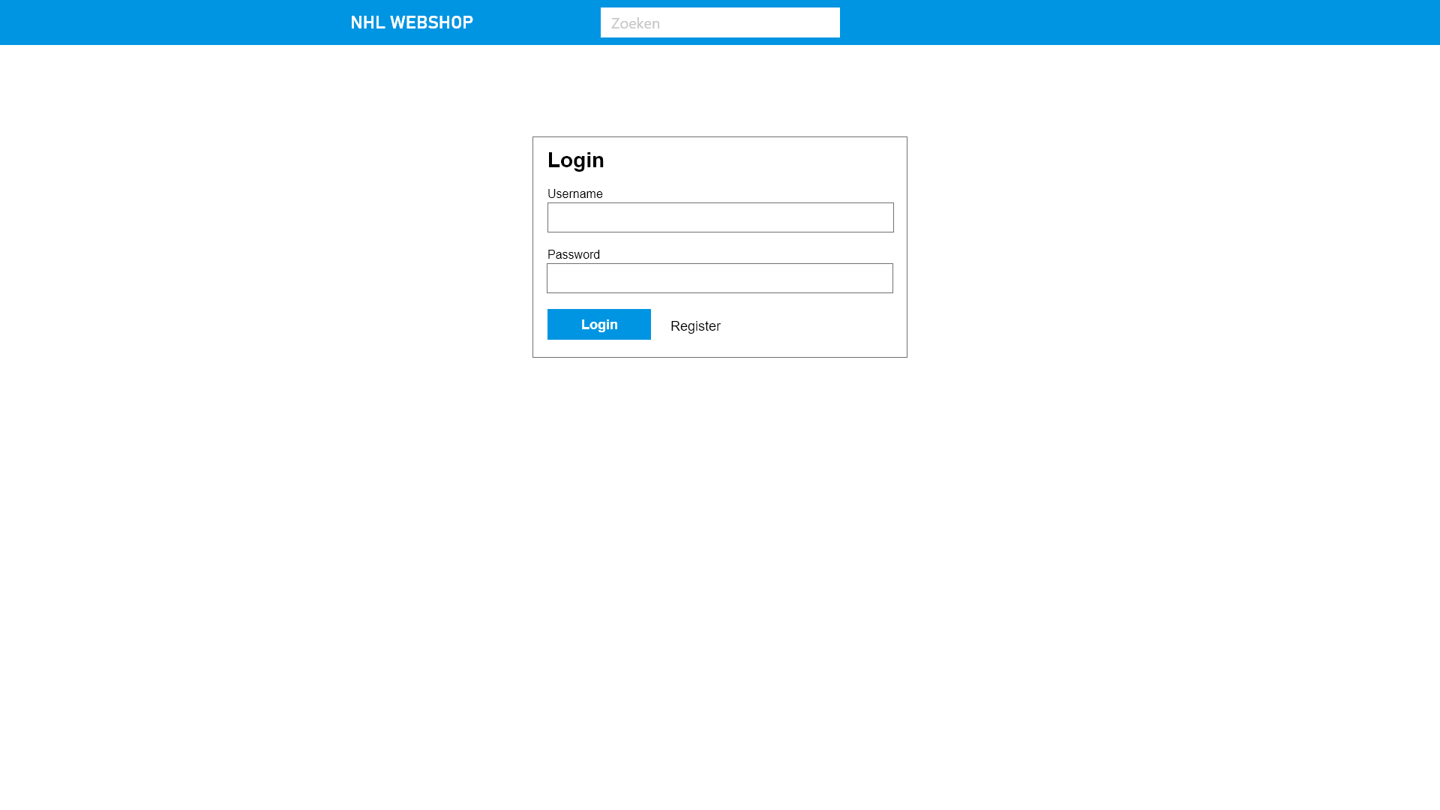
Design

Slide 9
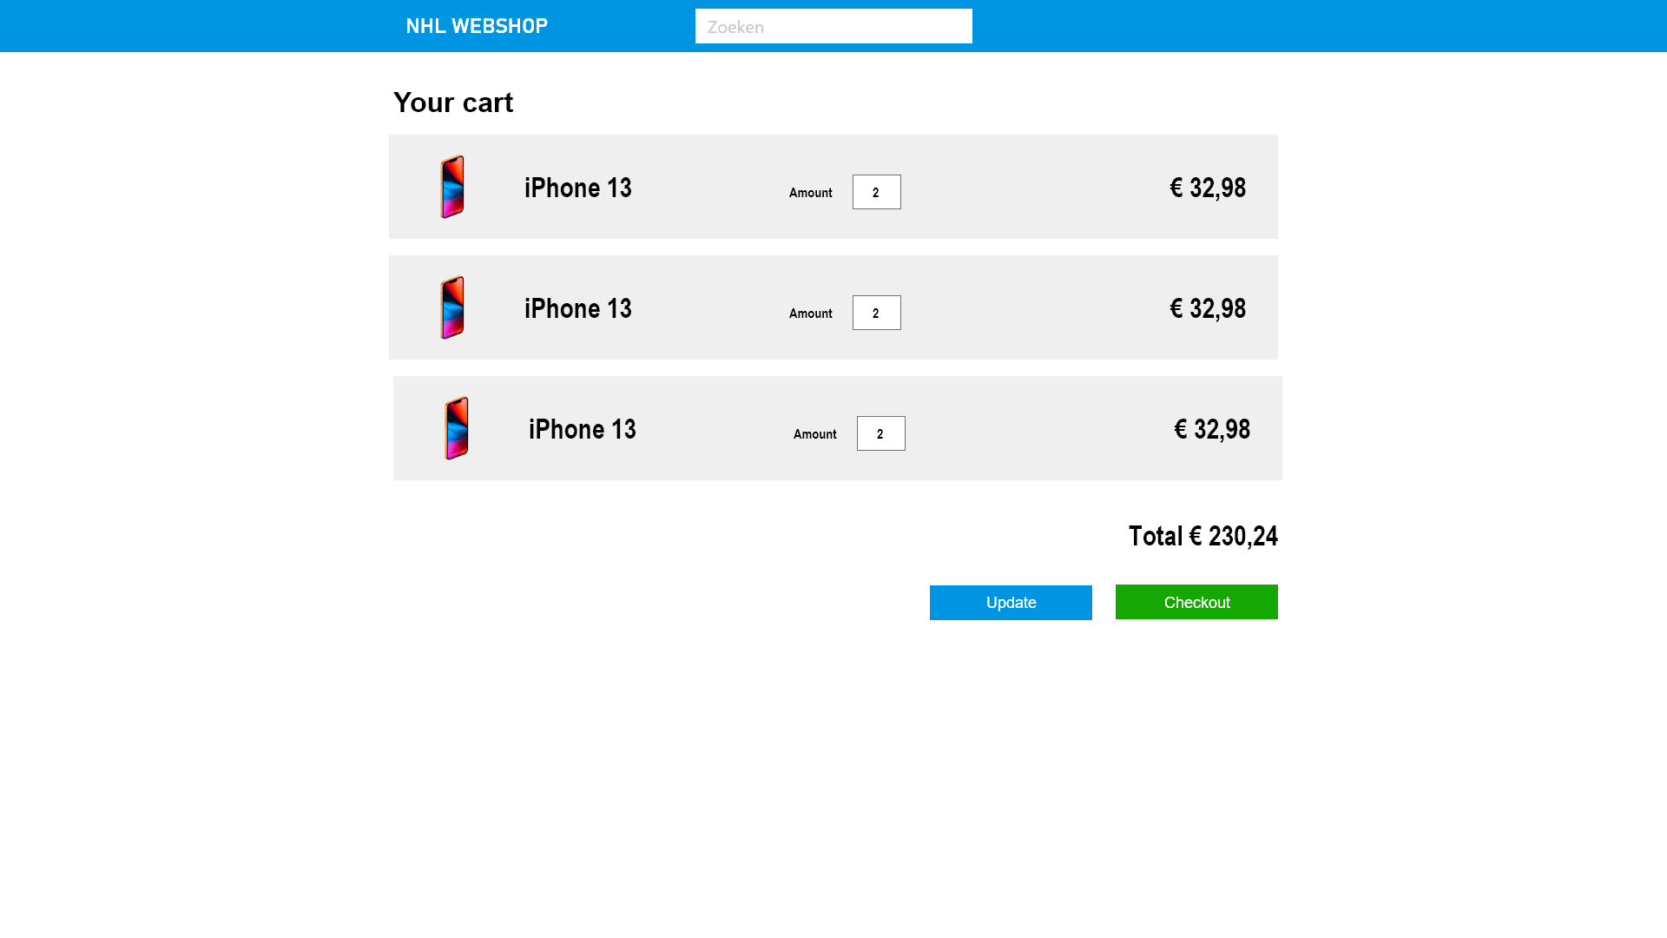
Design

Slide 10
Examination
> Examination consists of the following elements:
> Research on Github
> Code review with developersgroup > Questions based on the project and adjacent PHP knowledge
> All knowledge of previous workshops will be requested. Databases, File Upload, Code Quality, etc.
> Final grade is included in the assessment of period 2

Slide 11
Questions?

