Slide 1

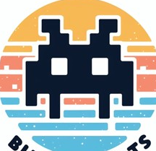
Bits and Bots study group meeting 3

Slide 2

Today
Catch-up
Introduction GitHub
Demo

Slide 3
Catch-up
Progress
Looking back and forward
HTML
Python

Slide 4
HTML Module 3
CSS (Cascading Style Sheets)
GitHub Styling

Slide 5
Python module 3
Reminder: flowcharts
Dragon Realm
Import libraries
Creating functions
If/else & while loops
Debugging

Slide 6
Next up
HTML
Embedding
Tools
JavaScript (sneak peak)
Python
Hangman
Lists
Dictionaries

Slide 7
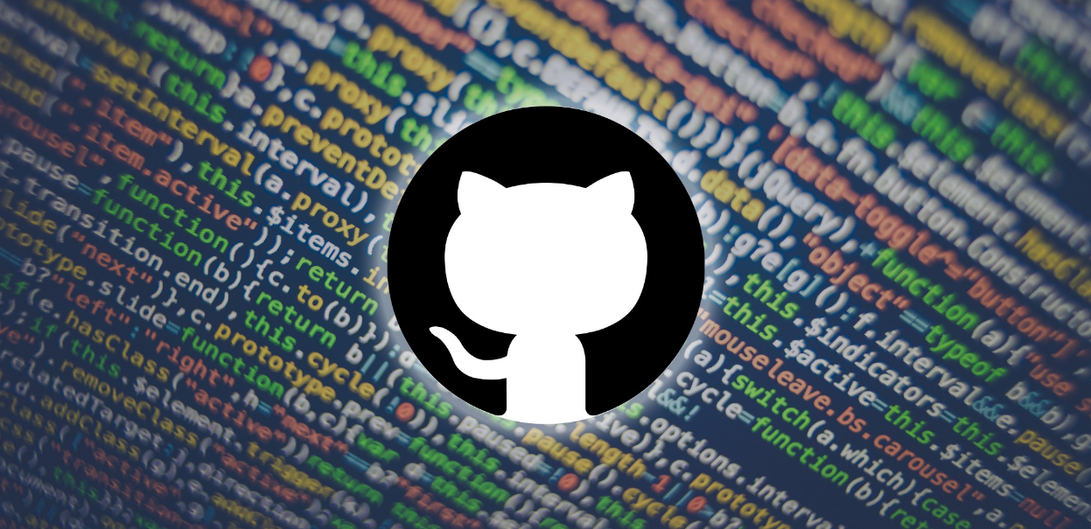
What is GitHub?
GitHub is a platform that allows anyone to create, store, manage and share content (mostly code).
GitHub uses a platform called Git which is a version control system for tracking changes in computer files.
GitHub is proprietary but Git is not!

Slide 8
Why is it great?
Data integrity (everything is tracked in GitHub)
Collaborative working, the tracking and control settings in GitHub allow for non-linear workflows and multiple contributions at a time
Other features: GitHub pages, issues, documentation areas, sharing workflows and project updates

Slide 9
Use Cases
Software development
Fan fiction!
Zines
Community/ crowdsourcing projects
Finding file samples
Educational resources
Reading lists
Datasets
Blog posts
Documentation

Slide 10
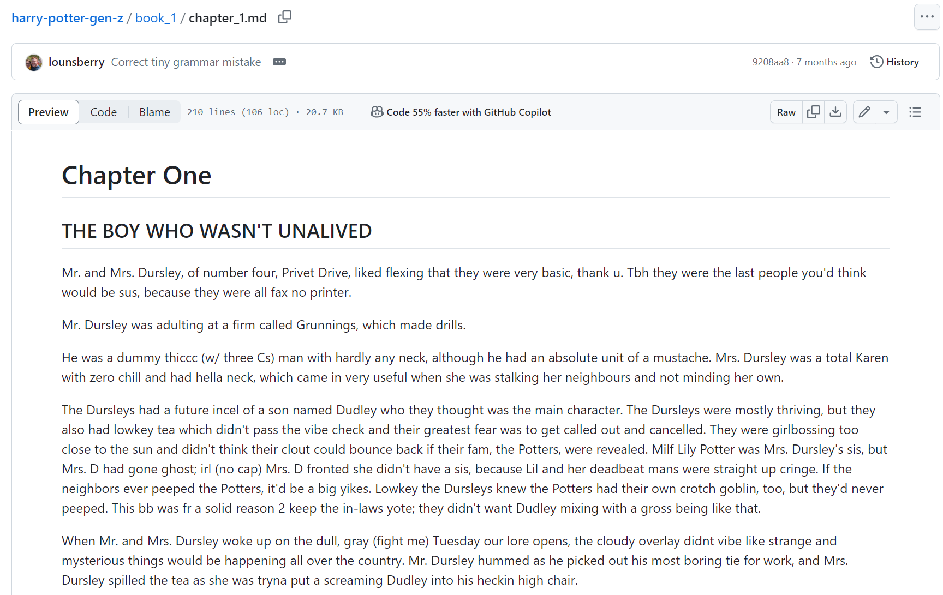

Slide 11
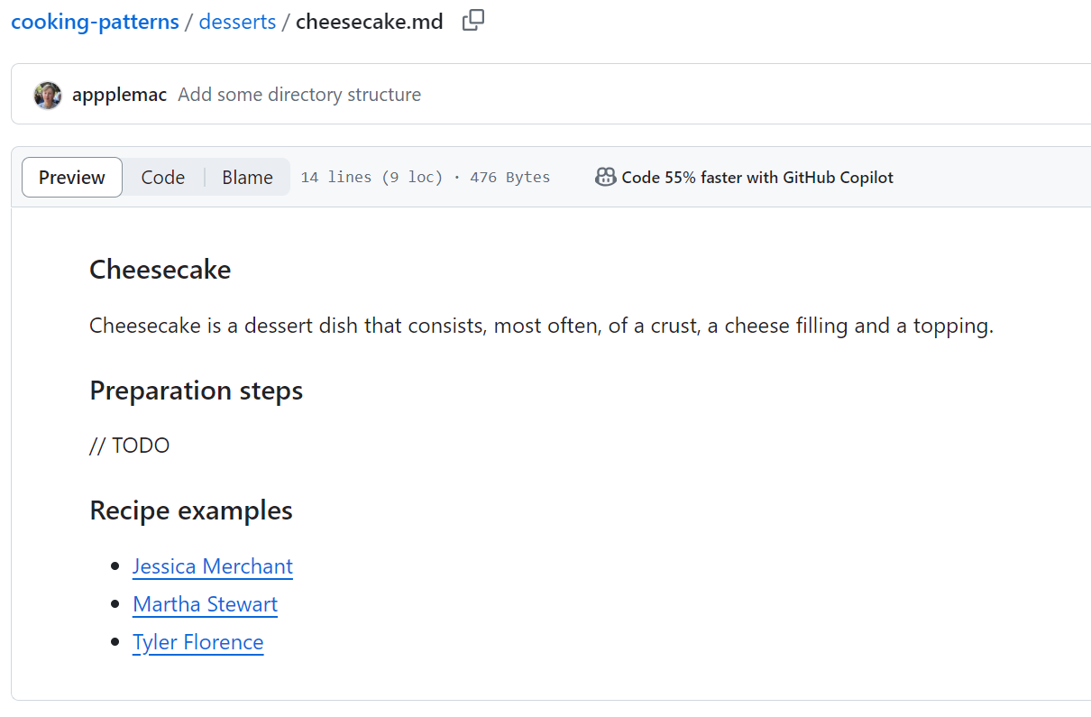
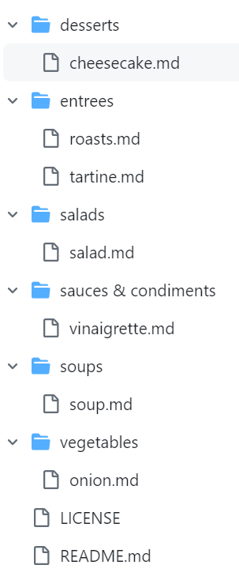

Slide 12
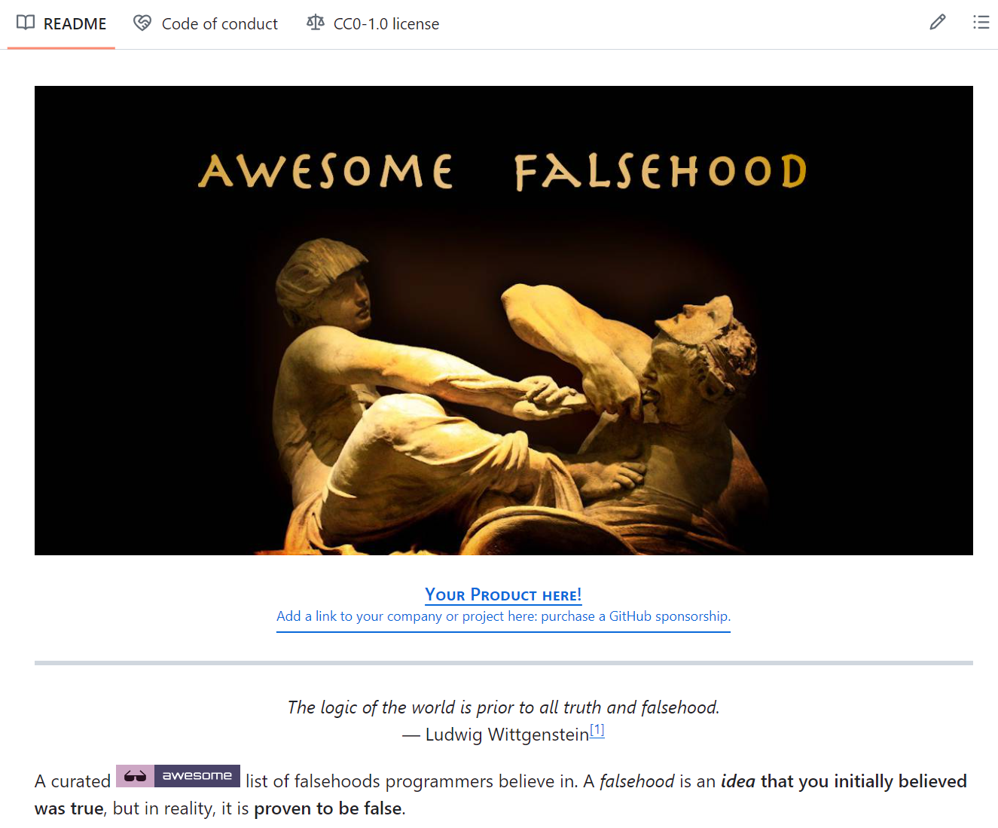
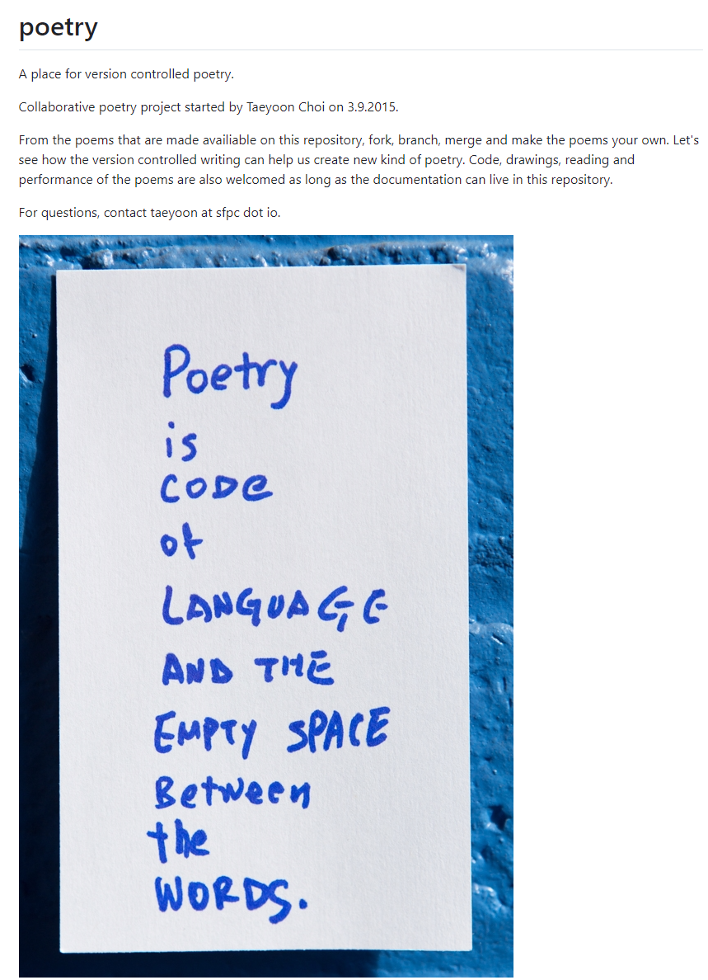

Slide 13
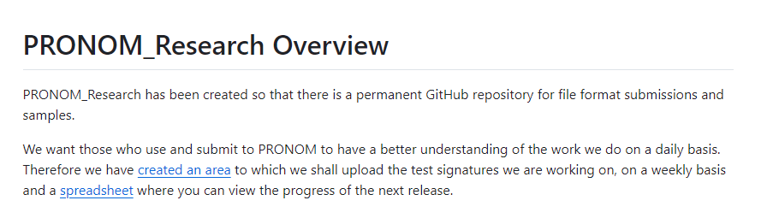
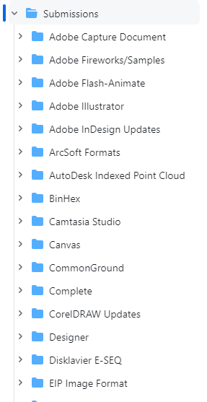
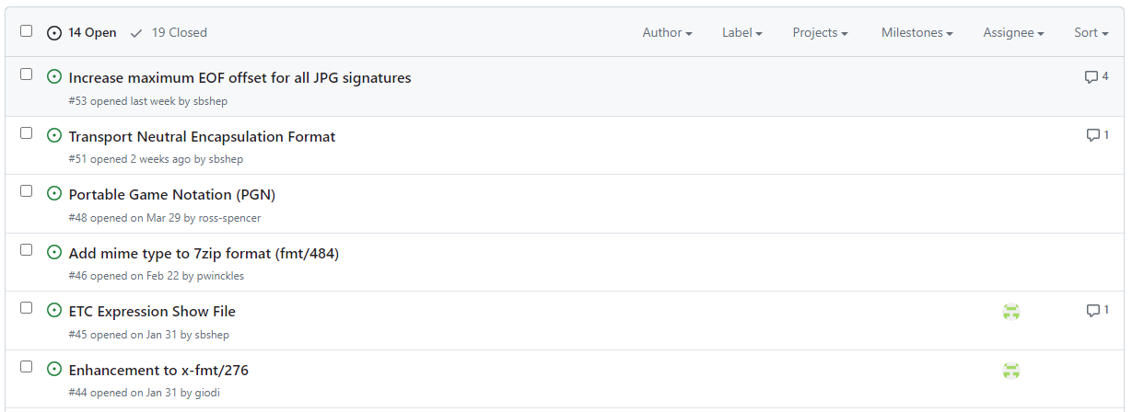

Slide 14
Demo

Slide 15
Planning
Module | Dates
1 | February 15th – March 15th
2 | March 15th – April 15th
3 | April 15th – May 15th
4 | May 15th – June 15th
5 | June 15th – July 15th
Summer Recess
6 | September 15th – October 15th
7 | October 15th – November 15th
8 | November 15th – December 15th

Slide 16
Bits and Bots Study Group Meeting 3

