Slide 1



Valerio «Lotti» Riva
Introduction to HTML5 game development (with Phaser)
valerio.riva@gmail.com
@ValerioRiva
http://it.linkedin.com/in/valerioriva/

Slide 2


Who am I?
Web developer @ past life
Game developer @ Interactive Project
MyGPTeam (http://www.mygpteam.com/)
MyGPTeam Turbo (http://www.mygpteam.com/turbo/)
OverVolt: crazy slot cars (coming soon!)

Slide 3


Intro
Core game development concepts
Phaser: Desktop and Mobile HTML5 game framework
Few useful tools
Deployment

Slide 4
HTML5 is the new Flash
No plugin needed!
Available on all mobile devices
Low performances on almost every mobile devices (especially on Android)
Overload of HTML5 game engine
Flash game frameworks ported to HTML5 (Flixel -> Phaser!)

Slide 5

To develop an HTML5 game you need…
Your favourite OS
Your favourite editor
Your favourite web server
Or you can just use Brackets! http://brackets.io/

Slide 6
Phaser (http://phaser.io/)
Easy to use
Focused on mobile
WebGL & Canvas
WebAudio & HTML Audio
Use pixi.js (http://www.pixijs.com/)
Various physics engine supported
“arcade”: simple AABB physics engine
p2.js: complete physics engine (http://schteppe.github.io/p2.js/)

Slide 7
Core Game Development Concepts
Loop
Sprite
Tilemap
Collision
Input

Slide 8
do { game } while (true);
The hearth of the game
update loop executes game logic
Inputs, AI, collisions… your game is computed here!
draw loop draws graphic elements to screen
Phaser game implementation
Game is a set of states
Each state has its own loops
Draw loop is supplied by pixi.js

Slide 9
Phaser game state
Main functions:
preload: used to load assets
create: state initialization
update: the real game loop
render: called after rendering. Use it for debugging and post-rendering purposes
Other function:
pause: called when the game is paused (on focus loss)
shutdown: called when leaving a state
…

Slide 10
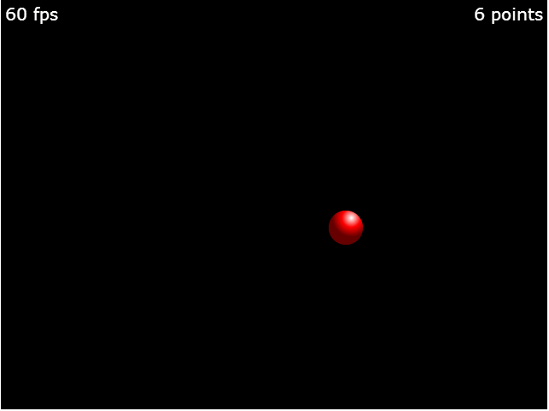
Hello Phaser!

Slide 11






Deployment
Web
Mobile
Any hosting!
Game portals
http://gamepix.com
http://kongregate.com
http://armorgames.com
Cordova (Phonegap)
Intel XDK
Accelerated webview
CocoonJS
Accelerated webview
API for Ads, IAP, accelerometer, etc.

Slide 12

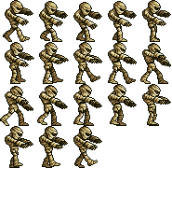
Sprite
“In computer graphics, a sprite is a two-dimensional image or animation that is integrated into a larger scene.”
Has a set of coordinates and sizes
Can be animated with sequential drawings
Main actor of a 2D game

Slide 13
ROME 11-12 april 2014 – Valerio Riva
What sprites can do
Be created
Scale
Rotate
Moves
Animate
Have physic body for collisions
and much more!
var s = game.add.sprite(x,y, "image");
s.scale.setTo(0.75,0.75);
s.angle=180 / s.rotation=3.141
s.x += 10; s.y -= 10;
s.animations.play("walk",fps);
game.physics.arcade.enable(s);

Slide 14
Group of sprites
Use it as z-ordered layer
Use it for fast pooling and object recycling too
Can apply transformation to all sprites of the group
Can call methods on all sprites of the group
var group = game.add.group();
var sprite = group.create(x, y, 'image');
group.x += 100;
group.callAll('kill');
var zombie = group.getFirstExists(false);
zombie.revive(); //cured!

Slide 15
Tilesprite
“A tilesprite is a sprite that has a repeating texture.”
var tilesprite = game.add.tileSprite(0, 0, 32, 64, 'image');
texture can be scrolled
tilesprite.tilePosition.setTo(10,20);
texture can be scaled
tilesprite.tileScale.setTo(1.5,1.5);

Slide 16
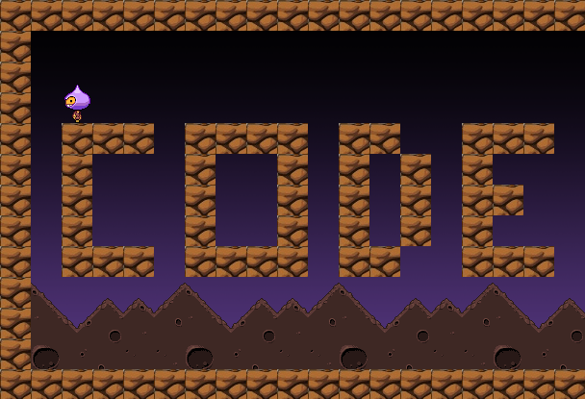
Tilemap

Slide 17
Tilemap
A tilemap is a map composed by a fixed number of same sized sprites (tiles)
Each tile can have different behavior
Used to create platform and map based games
Can be orthogonal or isometric
Easy to create with Tiled (http://www.mapeditor.org/)

Slide 18
Tilemap
function preload() {
game.load.tilemap('codem', 'tilemap/codem.json', null, Phaser.Tilemap.TILED_JSON);
game.load.image('block', 'sprites/block.gif');
}
function create() {
map = game.add.tilemap("codem");
map.addTilesetImage("block");
map.setCollisionByExclusion([]);
layer = map.createLayer("codemotion");
layer.resizeWorld(); }

Slide 19
Collision
“An instance of one moving object touching another.”
Both object must have a “body” (collider)
Object can be a sprite or a tilemap or even a group!
A body can be a rectangle, a circle or a polygon
Bodies can have a lot of properties (mass, gravity, velocity, material, …)
Last two statements depends on what physics engine you are using.
More complex is the engine, more computation is needed. Choose wisely!

Slide 20
Collision
function create() { game.physics.startSystem(Phaser.Physics.ARCADE);
sprite = game.add.sprite(0, 0, 'image');
game.physics.enable(sprite, Phaser.Physics.ARCADE);
sprite.body.collideWorldBounds = true;
sprite.body.bounce.set(1);
}
function update() {
game.physics.arcade.collide(sprite, [tilemap, group], function(sprite, other) { … });
}

Slide 21
Input
Phaser supports natively
Keyboard
Mouse
Multi-touch
Gamepads (up to four, each one with 10 axis and 16 buttons)
Supports even Xbox 360 gamepad! (button mapping depends on browser :\ )

Slide 22
Input: Keyboard
function update() {
if (game.input.keyboard.isDown(Phaser.Keyboard.UP)) {
ufo.y -= speed;
}
else if (game.input.keyboard.isDown(Phaser.Keyboard.DOWN)) {
ufo.y += speed;
}
if (game.input.keyboard.isDown(Phaser.Keyboard.LEFT)) {
ufo.x -= speed;
}
else if (game.input.keyboard.isDown(Phaser.Keyboard.RIGHT)) {
ufo.x += speed;
}
}

Slide 23
Input: Mouse
if (game.input.mousePointer.isDown) {
if (game.input.mousePointer.x < game.width*0.5) {
clickOnLeft = true;
}
else if (game.input.mousePointer.x > game.width*0.5) {
clickOnRight = true;
}
if (game.input.mousePointer.y < game.height*0.5) {
clickOnTop = true;
}
}
Swap mousePointer with activePointer to capture any active pointer (works with mouse and touch inputs)

Slide 24
Input: Multi-touch
Supports 10 pointers (= fingers)!
Two pointers are already available
Add another pointer
game.input.addPointer();
Read different pointers
game.input.pointer3; or game.input.pointer4;

Slide 25
Input: Gamepad
function create() {
game.input.gamepad.start();
pad1 = game.input.gamepad.pad1;
}
function update() {
if (game.input.gamepad.supported
&& game.input.gamepad.active
&& pad1.connected) {
//play with gamepad!
if (pad1.isDown(Phaser.Gamepad.XBOX360_DPAD_LEFT)) { … }
if (pad1.axis(Phaser.Gamepad.XBOX360_STICK_LEFT_X)) { … }
if (pad1.justPressed(Phaser.Gamepad.XBOX360_A)) { … }
}
else {
//play with boring keyboard!
}
}

Slide 26
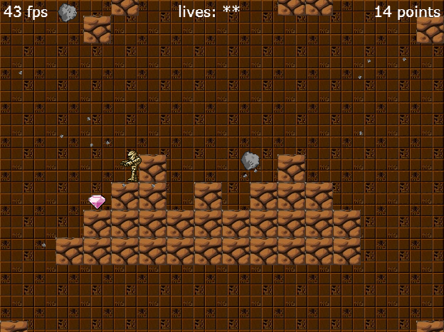
Dissecting the mummy

Slide 27
Want more?
Take a look to another example that implements P2 physics engine (http://github.com/Lotti/phaserTut)
Phaser examples (http://examples.phaser.io/)
Phaser docs (http://docs.phaser.io/)

Slide 28
Resources & Links
The mummy game
P2 physics engine example
Phaser’s forum
http://docs.phaser.io
http://examples.phaser.io
http://html5gameengine.com
http://brackets.io
http://www.pixijs.com
http://schteppe.github.io/p2.js
http://www.mapeditor.org
http://xdk-software.intel.com
https://www.ludei.com/cocoonjs
https://cordova.apache.org
http://phonegap.com

Slide 29
Thank you
Any Questions?
valerio.riva@gmail.com
@ValerioRiva
http://it.linkedin.com/in/valerioriva/

