Slide 1

Chicago Car Crashes
r
By: Yamuna Umapathy & Lotus Baumgarner

Slide 2
Business Problem:
Our Insurance Carrier wants us to build a model to predict the type of car crashes that lead to certain injuries (Incapacitating, Non-Incapacitating and No Injuries) in Chicago.
They want to use this information to help determine what type of injury they will be dealing with when they are presented with a new car accident.
Dataset:
Original Dataset comes from City of Chicago Data portal. It started with over 800K rows and 48 columns.

Slide 3
Feature Engineering
Our Target Variable: MOST SEVERE INJURY
Combined liked values within certain columns.
EX: Traffic Control Device had 19 different categorical values and was reduced down to 5 values.
Dropped 32 of the original columns.
Deemed not useful (Photos Taken)
Missing too many values (Work Zone - missing > 800K)
Repetitive (Location = Longitude + Latitude)
Dataset: >800k rows, 17 columns

Slide 4

Down Sampling our Dataset
Separated Dataframe by No Injury, Non-Incap, Incap
Set sample size to the length of Incap_Injury and used the sample() method to randomize the pulled rows.
Concatenated back into a single DataFrame.
Balanced Dataset: 44,000 rows and 17 columns

Slide 5
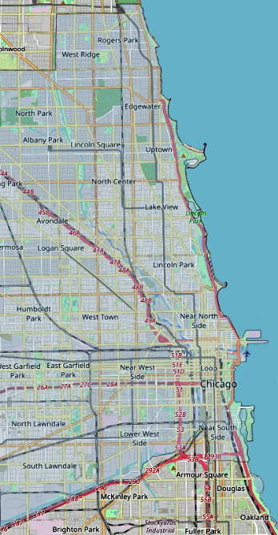
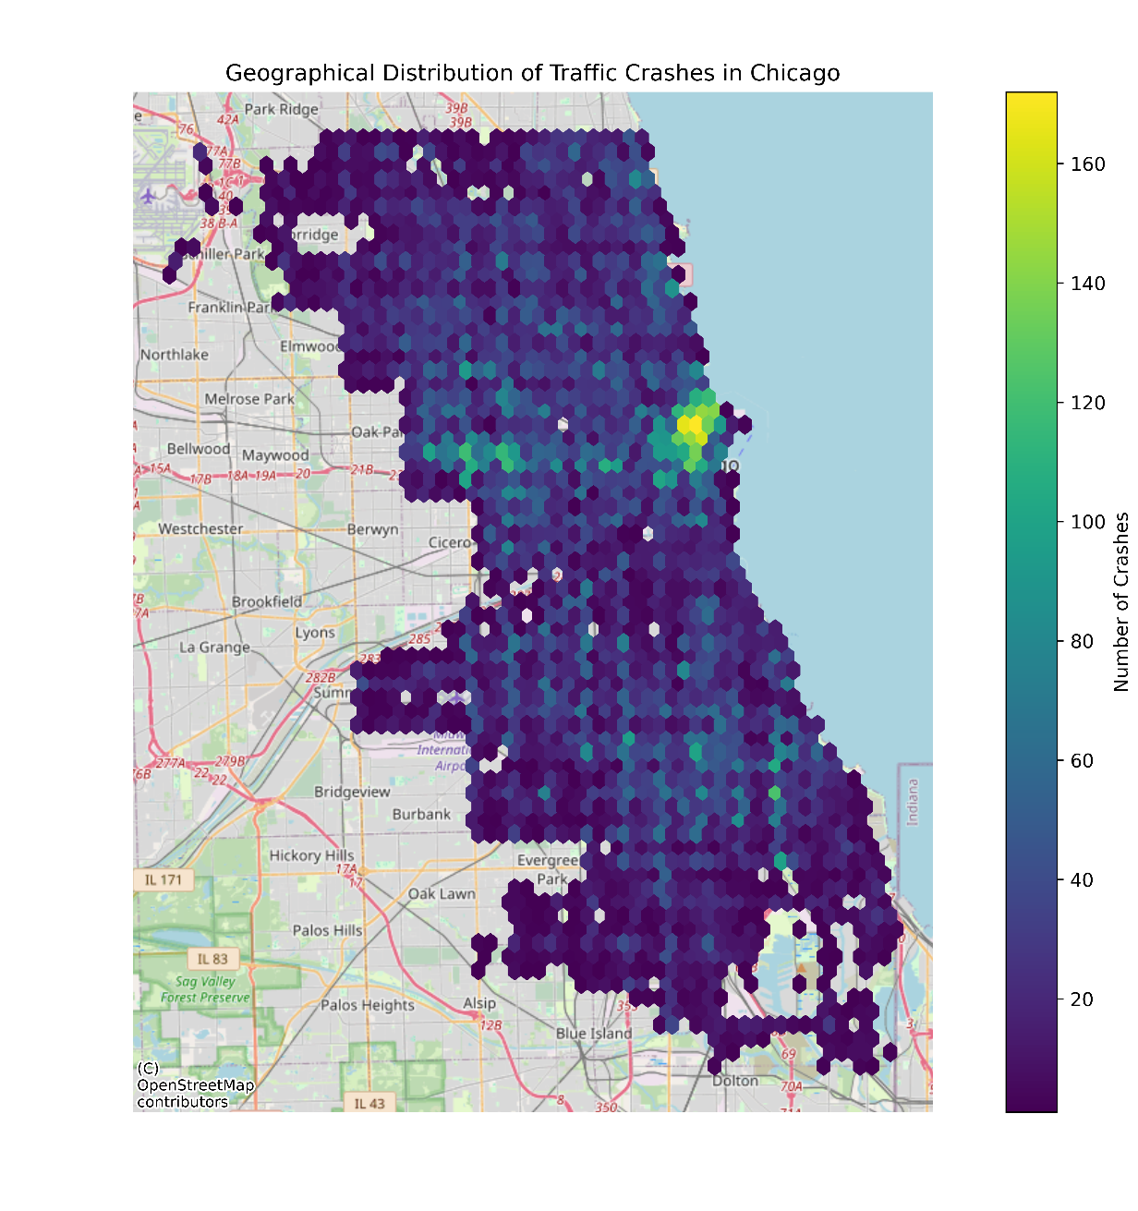
Visual: Crashes Vs Longitude, Latitude
Most crashes in a geographical area:
LAT: 41.90 & 41.95
LON: -87.65 & -87.60
Roughly the Near North Side area
Notes:
Interesting Visualization when going through EDAs

Slide 6

Target and Columns
X
16 Remaining Columns
Most_Severe_Injury
Metric : Accuracy
After Column Transformation: X had 147 columns
Notes:
Target Variable: Most Severe Injury. Started with 16 remaining columns. Metric: Accuracy since we have a balanced dataset. After Column Transformation: 147 columns

Slide 7
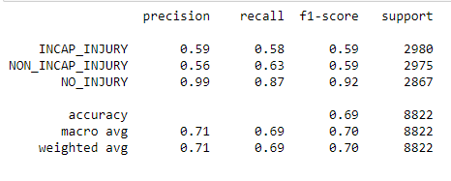
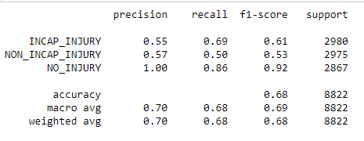
Models with Logistic Regression and Random Forest
Logistic Regression:
Random Forest Classifier:
Random Forest had a lower accuracy score on the test than Logistic Regression.
Notes:
First 2 models: Logistic Regression and Random Forest. Random Forest has lower accuracy test score than Logistic Regression.

Slide 8
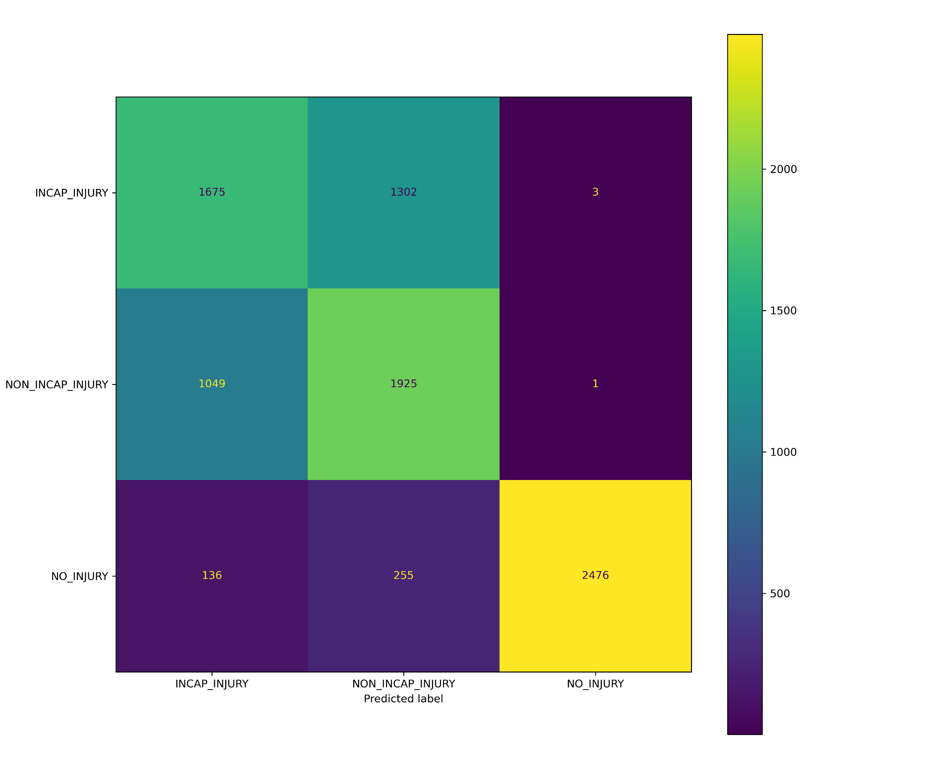
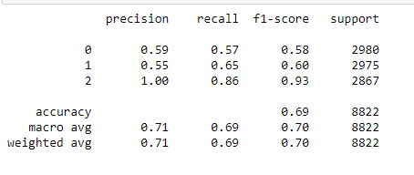
Model Using XG Boost
Notes:
As in the previous models we fit on the TRAIN and predicted on the TEST. Our XG Boost was also at 69% accuracy on the test.

Slide 9
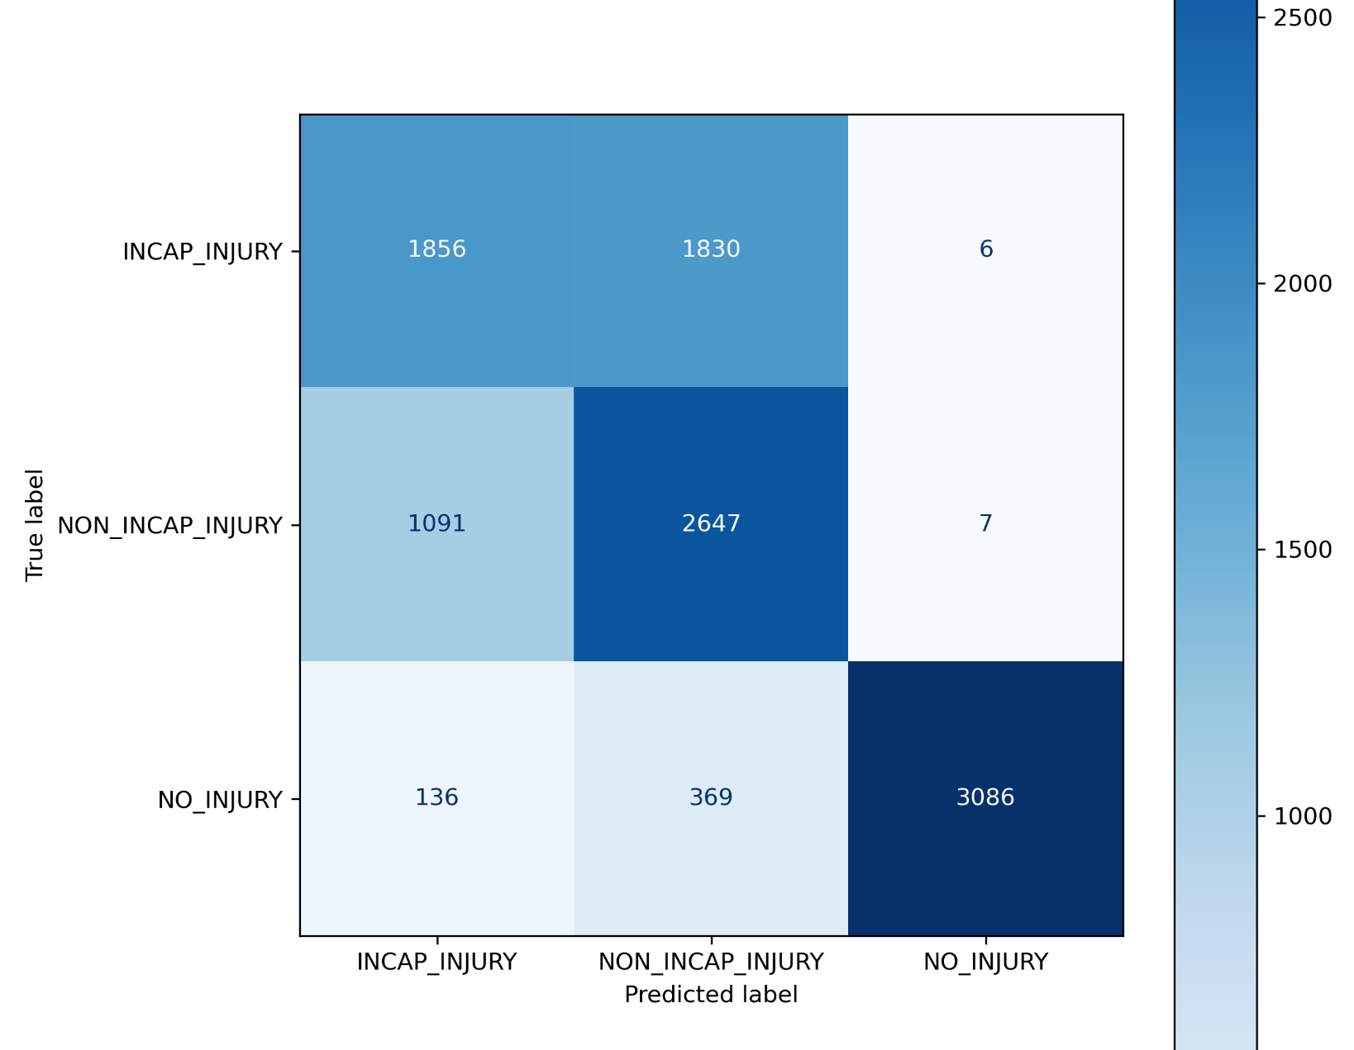
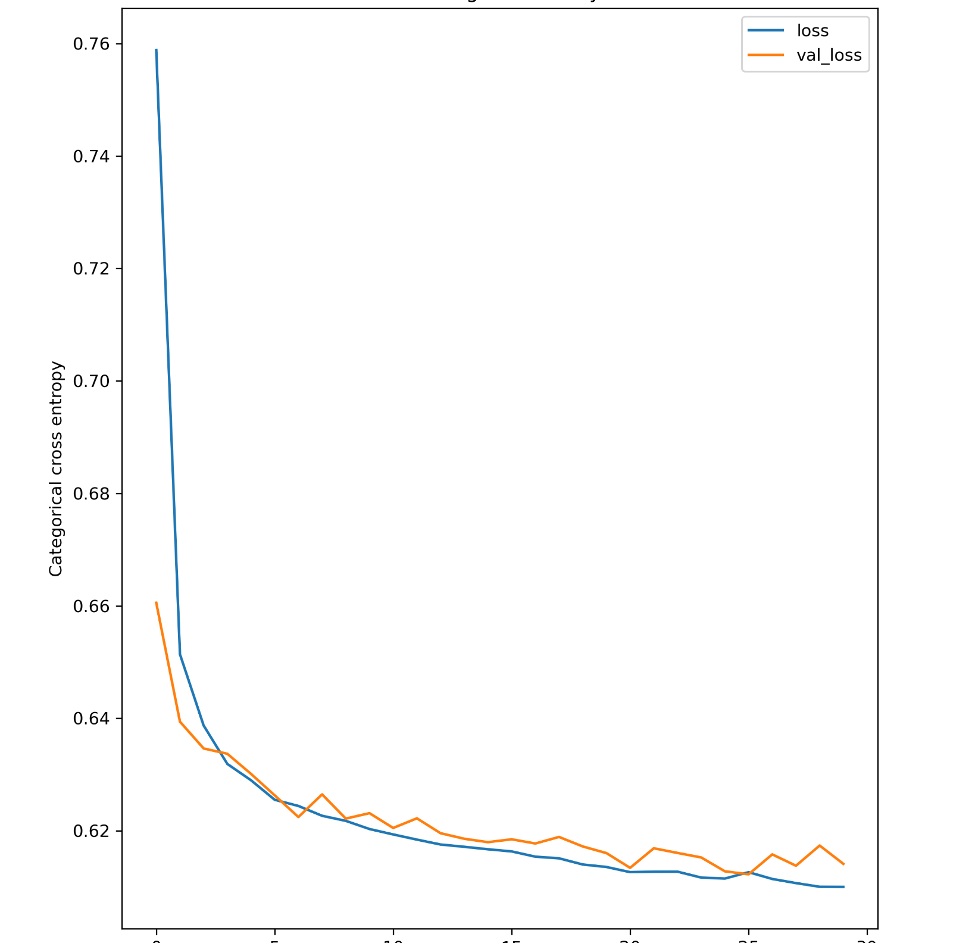
Tensorflow results
Notes:
Tensorflow model: came up with accuracy score 68, validation accuracy was better than training accuracy score.

Slide 10
Conclusions:
Next Steps:
Crashes and causes that tend to lead to Injuries:
RearEnd
Pedestrian/cyclist
Head-on collision
Driver’s physical condition
Weather
Late Night
Ours:
Work more on our Hyperparameter Tuning and Feature Importance to achieve a higher accuracy score.
Insurance Carrier:
Offer Drivers Insurance benefits such as lower premiums or deductibles for safer driving.
Focus on drivers who live, work or visit the Near North Side area since they have the most crashes.

Slide 11


Questions ?
Yamuna Umapathy
u.yamuna@gmail.com
https://www.linkedin.com/in/yamuna-umapathy/
Lotus Baumgarner
LotusBaumgarner@gmail.com
https://www.linkedin.com/in/lotus-baumgarner/

