Slide 1




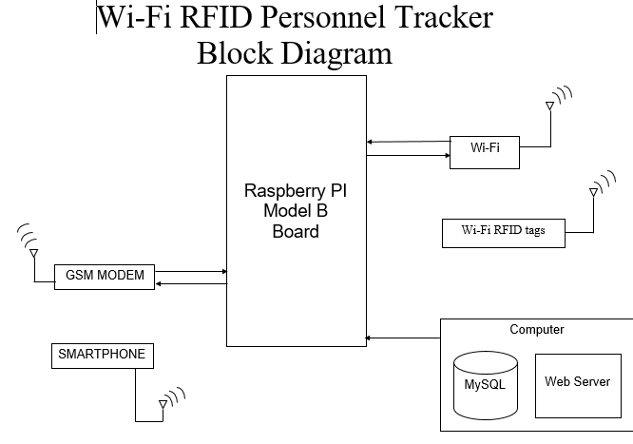
Wi-Fi RFID Personnel Tracker
Louise Ní Chonghaile
BEng Computer & Electronic Engineering
Summary
Hardware & Software
Wi-Fi RFID Tag
Tags ping of exiting wi-fi network to track personnel movement within the building
GSM Modem
SMS text message sent to security
Flow chart or UML
Wi-Fi
Track tag movement
Web Server
Provide Interface for User to access data
MySQL
Store tag data

