Slide 1

Smart Water Large Scale Data Labeling with Active Learning and H₂O.ai FSDL Final Project
Yufeng Wang
May 15th 2021

Slide 2
Menu
Intuition
Active Learning
Solution Architecture
Demo
Next Steps

Slide 3
Intuition
Data is Food for AI.
Source and Prepare high quality data.
From Model-centric to Data-centric AI
From Big Data to Good Data
Labeling data better can improve model performance
Data Labeling is expensive
Human expert: domain knowledge, time and money
Should label the data smartly

Slide 4
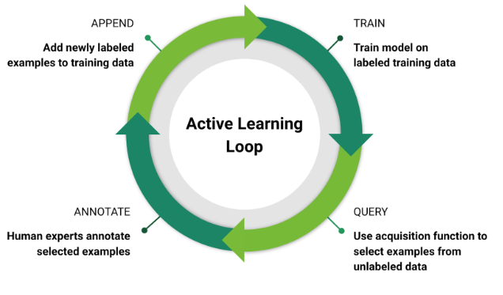
Active Learning Strategy
Margin Sampling
select k samples with the lowest difference between two highest class probabilities.
Entropy Selection
select ‘k’ samples with the highest entropy, i.e., with high uncertainty.
Least Confidence
select ‘k’ samples with the least confidence (max probability class)

Slide 5
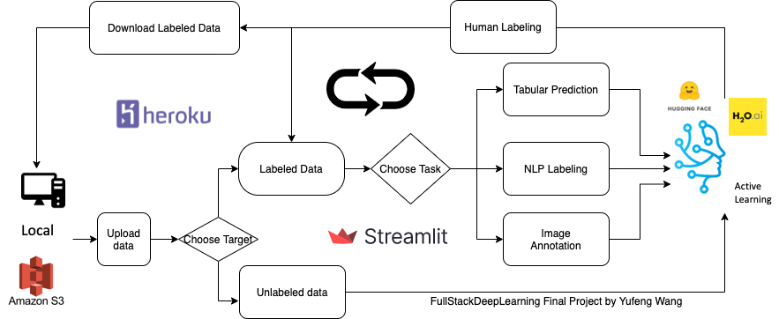
Solution Architecture: Smart Water Large Scale Data Labeling with Active Learning and H₂O.ai

Slide 6
Demo
Local: http://localhost:8501/
Heroku: https://smartwater001.herokuapp.com/

Slide 7
Next Steps
Optimization for computing resources to get labeling faster
GPU Parallel computing (now CPU)
Code efficiency (now no code review, just by myself)
Cloud Computing ( now with local machine)
Build For more and more tasks
NLP based tasks: Sentiment analysis, Named Entity Recognition, Topic Modeling, etc.
Image based tasks: image recognition, multi-object classification, etc
More human-friendly Layout and user interaction

