Slide 1
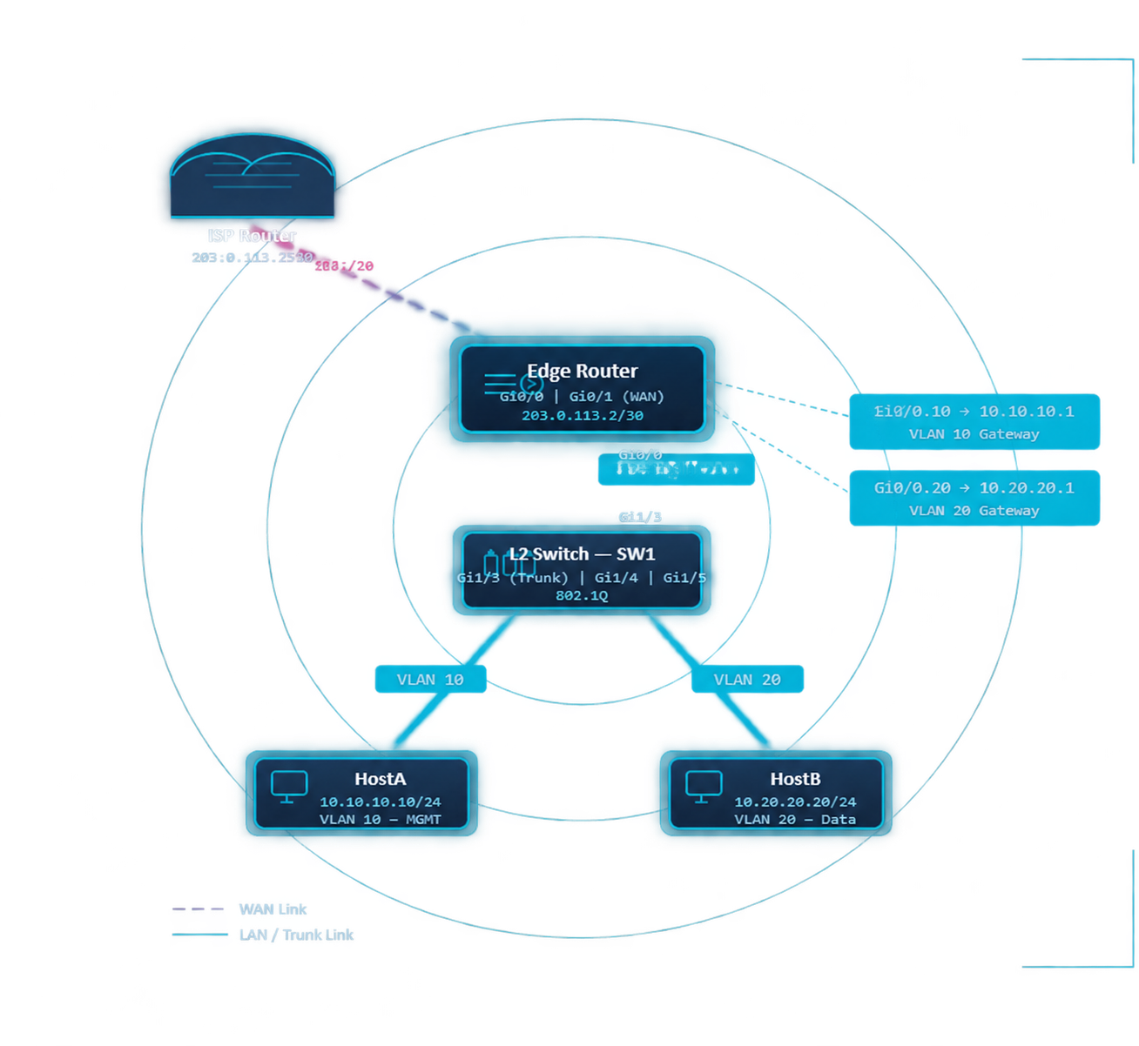


203.0.113.1/30
CISCO IOS LAB
Router-on-a-Stick VLANs & ACLs
Gi0/0.10: 10.10.10.1
Gi0/0
Gi0/0.20: 10.20.20.1
Cisco Inter-VLAN Routing, SSH Hardening
& Access Control Lists
Topology
VLANs
Subinterfaces
SSH
ACLs
Verification
Notes:
Original graphics retained. Diagram addressing is the intended lab design, not a captured router configuration.
Latest source: Screenshot 2026-10-16 095231.png. VLAN10 MGMT-VLAN10 active on Gi1/4; VLAN20 DATA-VLAN20 active on Gi1/5. Gi1/3 on/802.1q/trunking, native90, allowed10,20,90, active and forwarding10,20. VLAN90 is absent from show vlan brief and active/forwarding lists. Earlier screenshot is superseded. Router, host, SSH and ACL states are not established by this screenshot.
Sources: original user-supplied routeronastick.pptx; Cisco ACL documentation https://www.cisco.com/c/en/us/td/docs/ios-xml/ios/sec_data_acl/configuration/xe-3s/sec-data-acl-xe-3s-book/sec-create-ip-apply.html ; Cisco trunk documentation https://www.cisco.com/c/en/us/td/docs/switches/lan/c9000/lyr2-fwd/vlan/vlan-configuration-guide/configure-vlan-trunks.html

Slide 2
Network Topology Overview
LOGICAL & PHYSICAL
Point-to-Point Link
203.0.113.0/30
2 usable IPs · ISP ↔ Edge Router
Management / HostA
10.10.10.0/24
GW: 10.10.10.1 · Host: 10.10.10.10
Gi0/0
Data / HostB
Gi1/3
10.20.20.0/24
GW: 10.20.20.1 · Host: 10.20.20.20
802.1Q Encapsulation
Gi0/0 → SW1 Gi1/3
Tagged: 10,20; native: 90; allowed: 10,20,90
Router Gi0/0 uses .10 and .20 subinterfaces. SW1 Gi1/3 is the trunk.
Notes:
Gi0/0 is the router parent interface; switch Gi1/3 carries the trunk. Screenshot confirms Gi1/4 and Gi1/5 VLAN assignment. Router addressing remains to be tested.
Latest source: Screenshot 2026-10-16 095231.png. VLAN10 MGMT-VLAN10 active on Gi1/4; VLAN20 DATA-VLAN20 active on Gi1/5. Gi1/3 on/802.1q/trunking, native90, allowed10,20,90, active and forwarding10,20. VLAN90 is absent from show vlan brief and active/forwarding lists. Earlier screenshot is superseded. Router, host, SSH and ACL states are not established by this screenshot.
Sources: original user-supplied routeronastick.pptx; Cisco ACL documentation https://www.cisco.com/c/en/us/td/docs/ios-xml/ios/sec_data_acl/configuration/xe-3s/sec-data-acl-xe-3s-book/sec-create-ip-apply.html ; Cisco trunk documentation https://www.cisco.com/c/en/us/td/docs/switches/lan/c9000/lyr2-fwd/vlan/vlan-configuration-guide/configure-vlan-trunks.html

Slide 3
SLIDE 3
VLAN & IP Addressing Reference
VLAN 10
VLAN 20
Trunk / WAN
DEVICE
INTERFACE
VLAN
IP ADDRESS
SUBNET MASK
DEFAULT GATEWAY
ROLE
▸ WAN SEGMENT
ISP Router
Gi0/0
—
203.0.113.1
/30 255.255.255.252
—
ISP Upstream
Edge Router
Gi0/1
—
203.0.113.2
/30
—
WAN Uplink
▸ ROUTER SUBINTERFACES & VLAN GATEWAYS
Edge Router
Gi0/0.10
10
10.10.10.1
/24 255.255.255.0
—
VLAN 10 Gateway
Edge Router
Gi0/0.20
20
10.20.20.1
/24
—
VLAN 20 Gateway
▸ SW1 SWITCH PORTS
SW1
Gi1/3
10,20,90
N/A
—
—
802.1Q Trunk Port
SW1
Gi1/4
10
—
—
—
Access Port — HostA
SW1
Gi1/5
20
—
—
—
Access Port — HostB
▸ END HOSTS
HostA
NIC
10
10.10.10.10
/24
10.10.10.1
End Host
HostB
NIC
20
10.20.20.20
/24
10.20.20.1
End Host
SW1 confirmed: Gi1/4 = VLAN 10; Gi1/5 = VLAN 20. Native VLAN 90 is not active in the captured VLAN list.
Router and host addressing remains the intended lab design; verify it in Packet Tracer.
2
5
/30
VLANs
Devices
WAN Link
VLAN 10 (MGMT) · VLAN 20 (DATA)
ISP Router · Edge Router · SW1 · HostA · HostB
203.0.113.0/30 · 2 usable IPs (.1 ISP · .2 Edge)
Notes:
Layer2 access ports have no per-port default gateway. Edge default route via203.0.113.1 is only needed for destinations outside connected subnets. ISP needs return routes for host replies.
Latest source: Screenshot 2026-10-16 095231.png. VLAN10 MGMT-VLAN10 active on Gi1/4; VLAN20 DATA-VLAN20 active on Gi1/5. Gi1/3 on/802.1q/trunking, native90, allowed10,20,90, active and forwarding10,20. VLAN90 is absent from show vlan brief and active/forwarding lists. Earlier screenshot is superseded. Router, host, SSH and ACL states are not established by this screenshot.
Sources: original user-supplied routeronastick.pptx; Cisco ACL documentation https://www.cisco.com/c/en/us/td/docs/ios-xml/ios/sec_data_acl/configuration/xe-3s/sec-data-acl-xe-3s-book/sec-create-ip-apply.html ; Cisco trunk documentation https://www.cisco.com/c/en/us/td/docs/switches/lan/c9000/lyr2-fwd/vlan/vlan-configuration-guide/configure-vlan-trunks.html

Slide 4
LAYER 2 SWITCH
VLAN 10
VLAN 20
802.1Q Trunk
SW1: VLAN & Trunk Configuration
SW1 — Cisco IOS CLI • VLAN & Trunk Configuration
! === SW1: VLAN & TRUNK CONFIGURATION ===
! Configure Access Port - HostA (VLAN10)
!
SW1(config)# interface GigabitEthernet1/4
802.1Q Trunk Link
SW1# configure terminal
SW1(config-if)# description ACCESS-HostA-VLAN10
!
SW1(config-if)# switchport mode access
SW1 Gi1/3 carries tagged VLANs 10 and 20. Native VLAN: 90.
! Create VLANs
SW1(config-if)# switchport access vlan 10
SW1(config)# vlan 10
SW1(config-if)# spanning-tree portfast
SW1(config-vlan)# name MGMT-VLAN10
SW1(config-if)# no shutdown
SW1(config-vlan)# exit
SW1(config-if)# exit
PortFast on Host Ports
SW1(config)# vlan 20
Enable PortFast on Gi1/4 and Gi1/5, which connect directly to end hosts.
SW1(config-vlan)# name DATA-VLAN20
! Configure Access Port - HostB (VLAN20)
SW1(config-vlan)# exit
SW1(config)# interface GigabitEthernet1/5
SW1(config-if)# description ACCESS-HostB-VLAN20
! Configure Trunk Port to Router (Gi1/3)
SW1(config-if)# switchport mode access
Descriptive VLAN Names
SW1(config)# interface GigabitEthernet1/3
SW1(config-if)# switchport access vlan 20
SW1(config-if)# switchport trunk native vlan 90
SW1(config-if)# spanning-tree portfast
Captured names: MGMT-VLAN10 and DATA-VLAN20.
SW1(config-if)# switchport mode trunk
SW1(config-if)# no shutdown
SW1(config-if)# switchport trunk allowed vlan 10,20,90
SW1(config-if)# exit
SW1(config-if)# no shutdown
SW1(config-if)# exit
SW1(config)# end
SW1# write memory
Always: write memory
write memory saves the running configuration for the next reload.
Allowed: 10,20,90. Forwarding: 10,20. Native90 is not active.
Gi1/3 — Trunk Mode (802.1Q)
Gi1/4 — Access VLAN 10 (HostA)
Gi1/5 — Access VLAN 20 (HostB)
ROUTER-ON-A-STICK LAB
Notes:
Commands shown match the captured trunk allowance10,20,90 and native90. VLAN90 is not listed active: inspect show vlan brief and show interfaces Gi1/3 switchport. Creating VLAN90 changes the captured state. Keep10/20 tagged. PortFast on host ports is appropriate; there is no universal prohibition on edge trunks.
Latest source: Screenshot 2026-10-16 095231.png. VLAN10 MGMT-VLAN10 active on Gi1/4; VLAN20 DATA-VLAN20 active on Gi1/5. Gi1/3 on/802.1q/trunking, native90, allowed10,20,90, active and forwarding10,20. VLAN90 is absent from show vlan brief and active/forwarding lists. Earlier screenshot is superseded. Router, host, SSH and ACL states are not established by this screenshot.
Sources: original user-supplied routeronastick.pptx; Cisco ACL documentation https://www.cisco.com/c/en/us/td/docs/ios-xml/ios/sec_data_acl/configuration/xe-3s/sec-data-acl-xe-3s-book/sec-create-ip-apply.html ; Cisco trunk documentation https://www.cisco.com/c/en/us/td/docs/switches/lan/c9000/lyr2-fwd/vlan/vlan-configuration-guide/configure-vlan-trunks.html

Slide 5
ROUTER-ON-A-STICK CONFIGURATION
Gi0/0 · Gi0/0.10 · Gi0/0.20 · Gi0/1
Edge Router: Subinterface Configuration
PHYSICAL INTERFACE SETUP
Gi0/0 & Gi0/1
SUBINTERFACE CONFIGURATION (802.1Q)
dot1Q · L3
configure terminal
interface Gi0/0
no ip address
no shutdown
exit
interface Gi0/1
ip address 203.0.113.2 255.255.255.252
no shutdown
exit
interface Gi0/0.10
encapsulation dot1Q 10
ip address 10.10.10.1 255.255.255.0
exit
interface Gi0/0.20
encapsulation dot1Q 20
ip address 10.20.20.1 255.255.255.0
exit
end
write memory
NO ip address on Gi0/0 parent
WAN /30 → 203.0.113.2
VLAN10 → 10.10.10.1/24
VLAN20 → 10.20.20.1/24
IOS routers normally
route by default
Gi0/0 must be up. VLANs 10 and 20 use tagged subinterfaces; neither is native VLAN 90. Router and host configuration still needs verification.
Notes:
IOS routers normally have IP routing enabled. Native90 need not be routed to support tagged VLAN10/20. No router or host live tests were run.
Latest source: Screenshot 2026-10-16 095231.png. VLAN10 MGMT-VLAN10 active on Gi1/4; VLAN20 DATA-VLAN20 active on Gi1/5. Gi1/3 on/802.1q/trunking, native90, allowed10,20,90, active and forwarding10,20. VLAN90 is absent from show vlan brief and active/forwarding lists. Earlier screenshot is superseded. Router, host, SSH and ACL states are not established by this screenshot.
Sources: original user-supplied routeronastick.pptx; Cisco ACL documentation https://www.cisco.com/c/en/us/td/docs/ios-xml/ios/sec_data_acl/configuration/xe-3s/sec-data-acl-xe-3s-book/sec-create-ip-apply.html ; Cisco trunk documentation https://www.cisco.com/c/en/us/td/docs/switches/lan/c9000/lyr2-fwd/vlan/vlan-configuration-guide/configure-vlan-trunks.html

Slide 6
Secure Shell (SSH) Setup on Edge Router
SSH CONFIGURATION & VTY LINE HARDENING
1
Set Hostname & Domain
CONFIGURATION EXAMPLE
EdgeRouter IOS
hostname
EdgeRouter
EdgeRouter — SSH Hardening Configuration
ip domain-name
corp.local
configure terminal
hostname EdgeRouter
ip domain-name corp.local
crypto key generate rsa
! Choose 2048 bits when prompted
ip ssh version 2
ip ssh time-out 60
ip ssh authentication-retries 3
username admin privilege 15 secret <SECRET>
line vty 0 4
transport input ssh
login local
exec-timeout 10 0
exit
end
write memory
2
Generate RSA Keys
crypto key generate rsa modulus
2048
! Recommended key size, if supported
3
Create Local User & Enable SSHv2
username
admin
privilege
15
secret
<SECRET>
ip ssh version
2
ip ssh time-out
60
ip ssh authentication-retries
3
4
Configure VTY Lines
line vty
0 4
transport input
ssh
login local
exec-timeout
10 0
logging synchronous
Replace <SECRET> before use. Check the available VTY range and apply SSH, login local, timeout and the management ACL to every VTY line.
exit
Notes:
Replace <SECRET>. Apply settings to every available VTY line, including5–15 if present. RSA command syntax varies by image.2048-bit keys are a recommendation, not a universal SSHv2 compliance claim.
Latest source: Screenshot 2026-10-16 095231.png. VLAN10 MGMT-VLAN10 active on Gi1/4; VLAN20 DATA-VLAN20 active on Gi1/5. Gi1/3 on/802.1q/trunking, native90, allowed10,20,90, active and forwarding10,20. VLAN90 is absent from show vlan brief and active/forwarding lists. Earlier screenshot is superseded. Router, host, SSH and ACL states are not established by this screenshot.
Sources: original user-supplied routeronastick.pptx; Cisco ACL documentation https://www.cisco.com/c/en/us/td/docs/ios-xml/ios/sec_data_acl/configuration/xe-3s/sec-data-acl-xe-3s-book/sec-create-ip-apply.html ; Cisco trunk documentation https://www.cisco.com/c/en/us/td/docs/switches/lan/c9000/lyr2-fwd/vlan/vlan-configuration-guide/configure-vlan-trunks.html

Slide 7
STANDARD ACL · VTY RESTRICTION · SOURCE-IP FILTERING
Standard ACL: Restrict SSH to Management Subnet
ACL_SSH_MGMT permits VTY connections from 10.10.10.0/24. transport input ssh limits VTY access to SSH.
EdgeRouter# — acl_ssh_restrict.ios
SSH Restricted to VLAN10 Only
Only the management subnet passes this VTY ACL. Console and other services have separate controls.
configure terminal
ip access-list standard ACL_SSH_MGMT
permit 10.10.10.0 0.0.0.255
deny any
exit
line vty 0 4
access-class ACL_SSH_MGMT in
exit
end
write memory
Other Source Subnets Are Denied
deny any rejects sources outside 10.10.10.0/24. The base example does not enable ACL logging.
Wildcard Mask — Not Subnet Mask
Standard ACLs use wildcard masks: 0.0.0.255 matches any host in 10.10.10.x — equivalent to a /24 subnet mask inverted.
access-class Applies to VTY Lines, Not Interfaces
Use access-class on VTY lines for SSH control. Use ip access-group on interfaces for data-plane filtering — these are distinct mechanisms.
Optional Logging Depends on IOS Support
If supported, replace deny any with deny any log. Verify actual logs; messages may aggregate attempts.
SOURCE
MATCH ACL
YES → PERMIT
NO → DENY
LOGGING
Packet Arrives
10.10.10.0/24?
SSH ALLOWED
DENIED
Optional
Notes:
Named standard ACL support on access-class depends on IOS image. If unsupported, use numbered ACL10 with the same permit/deny and access-class10 in. Do not claim that the VTY ACL protects console or web management. Optional deny any log must replace the earlier deny, not follow it.
Latest source: Screenshot 2026-10-16 095231.png. VLAN10 MGMT-VLAN10 active on Gi1/4; VLAN20 DATA-VLAN20 active on Gi1/5. Gi1/3 on/802.1q/trunking, native90, allowed10,20,90, active and forwarding10,20. VLAN90 is absent from show vlan brief and active/forwarding lists. Earlier screenshot is superseded. Router, host, SSH and ACL states are not established by this screenshot.
Sources: original user-supplied routeronastick.pptx; Cisco ACL documentation https://www.cisco.com/c/en/us/td/docs/ios-xml/ios/sec_data_acl/configuration/xe-3s/sec-data-acl-xe-3s-book/sec-create-ip-apply.html ; Cisco trunk documentation https://www.cisco.com/c/en/us/td/docs/switches/lan/c9000/lyr2-fwd/vlan/vlan-configuration-guide/configure-vlan-trunks.html

Slide 8
Extended ACL — Interface Traffic Filtering
NAMED
Traffic Toward VLAN20
Extended ACL • Source + Dest + Proto + Port
Extended ACL Configuration
ACL_VLAN20_OUT
Applied: Gi0/0.20 out
ACL Logic Flowchart
Top-Down Sequential Match
EdgeRouter# — ACL_VLAN20_OUT
configure terminal
ip access-list extended ACL_VLAN20_OUT
permit icmp any any
permit tcp 10.10.10.0 0.0.0.255
10.20.20.0 0.0.0.255 eq 22
permit tcp any any established
deny ip any any
exit
interface Gi0/0.20
ip access-group ACL_VLAN20_OUT out
exit
end
write memory
! Enter the wrapped permit tcp rule
! as ONE command on one line.
Out means router to VLAN20. established checks ACK/RST flags, not session state. UDP return traffic is denied. Logging is optional and not configured here.
KEY RULE
Notes:
The wrapped permit tcp command is: permit tcp 10.10.10.0 0.0.0.255 10.20.20.0 0.0.0.255 eq 22. Out filters traffic leaving the router toward VLAN20, near the destination. established matches ACK/RST flags and is not stateful. Other UDP is denied. HostB must offer SSH service to complete an SSH test. No log is configured.
Latest source: Screenshot 2026-10-16 095231.png. VLAN10 MGMT-VLAN10 active on Gi1/4; VLAN20 DATA-VLAN20 active on Gi1/5. Gi1/3 on/802.1q/trunking, native90, allowed10,20,90, active and forwarding10,20. VLAN90 is absent from show vlan brief and active/forwarding lists. Earlier screenshot is superseded. Router, host, SSH and ACL states are not established by this screenshot.
Sources: original user-supplied routeronastick.pptx; Cisco ACL documentation https://www.cisco.com/c/en/us/td/docs/ios-xml/ios/sec_data_acl/configuration/xe-3s/sec-data-acl-xe-3s-book/sec-create-ip-apply.html ; Cisco trunk documentation https://www.cisco.com/c/en/us/td/docs/switches/lan/c9000/lyr2-fwd/vlan/vlan-configuration-guide/configure-vlan-trunks.html

Slide 9
CISCO IOS · VERIFICATION
Verification: Captured State & Expected Tests
Verify VLANs (Switch)
SW1
Verify Trunk (Switch)
SW1
Verify Subinterfaces (Router)
ROUTER
COMMAND
COMMAND
COMMAND
SW1# show vlan brief
SW1# show interfaces trunk
Router# show ip interface brief
CAPTURED OUTPUT
CAPTURED OUTPUT
EXPECTED OUTPUT
VLAN Name Status Ports
Port Mode Encap Status Native
Interface IP-Address OK? Status
Gi0/0.10 10.10.10.1 YES up/up
Gi0/0.20 10.20.20.1 YES up/up
Gi0/1 203.0.113.2 YES up/up
1 default active
Gi1/3
on
802.1q
trunking
90
10
MGMT-VLAN10
active
Gi1/4
Allowed: 10,20,90
20
DATA-VLAN20
active
Gi1/5
Active / forwarding: 10,20
Verify Routing Table
ROUTER
Verify ACL Definitions
ROUTER
Verify SSH Access
ROUTER
COMMAND
COMMAND
COMMAND
Router# show ip route
Router# show ip access-lists
Router# show ip ssh
EXPECTED OUTPUT
EXPECTED OUTPUT
EXPECTED OUTPUT
C
10.10.10.0/24
is directly via
Gi0/0.10
ACL_SSH_MGMT: permit management /24
ACL_VLAN20_OUT: ICMP, SSH, ACK/RST
Check actual hit counters after testing.
Use show ip interface to check attachment.
Expected: SSHv2, timeout 60s, retries 3
HostA SSH: expected login
HostB SSH: expected denial
These outcomes still need live testing.
C
10.20.20.0/24
is directly via
Gi0/0.20
C
203.0.113.0/30
is directly via
Gi0/1
CAPTURED
EXPECTED
TEST
Captured switch evidence is on slide 12. Router addressing, SSH, ACLs and reachability remain unverified.
Notes:
Captured switch output differs from illustrative router results. No invented counters are retained. show ip access-lists does not prove attachment: inspect show ip interface Gi0/0.20 and running-config VTY lines. Ping expected between hosts; SSH from HostA expected allowed and HostB expected denied after configuration.
Latest source: Screenshot 2026-10-16 095231.png. VLAN10 MGMT-VLAN10 active on Gi1/4; VLAN20 DATA-VLAN20 active on Gi1/5. Gi1/3 on/802.1q/trunking, native90, allowed10,20,90, active and forwarding10,20. VLAN90 is absent from show vlan brief and active/forwarding lists. Earlier screenshot is superseded. Router, host, SSH and ACL states are not established by this screenshot.
Sources: original user-supplied routeronastick.pptx; Cisco ACL documentation https://www.cisco.com/c/en/us/td/docs/ios-xml/ios/sec_data_acl/configuration/xe-3s/sec-data-acl-xe-3s-book/sec-create-ip-apply.html ; Cisco trunk documentation https://www.cisco.com/c/en/us/td/docs/switches/lan/c9000/lyr2-fwd/vlan/vlan-configuration-guide/configure-vlan-trunks.html

Slide 10
Common Issues & Fixes
Router-on-a-Stick · Troubleshooting
Slide 10 of 12
Symptom
Root Cause & Fix
1
VLANs not routing between hosts
1
Check gateways, access VLANs and dot1Q IDs.
2
Trunk not forming on SW1 side
2
Check Gi1/3 trunk state and allowed VLANs.
3
SSH connection refused from HostA
3
Check keys, user, show ip ssh and VTY ACL.
4
ACL blocking all traffic unexpectedly
4
Check first match, implicit deny and direction.
5
Subinterface shows down/down
5
Check cabling and no shutdown on Gi0/0.
6
Ping works but SSH denied from VLAN20
6
HostB SSH denial is intended by the VTY ACL.
DEBUG
Start with show commands; use targeted debugging only when needed.
⚠ Use with caution in production — high CPU impact
Notes:
HostB-to-router SSH rejection is intentional, not a reason to add a data-plane permit. Use show commands first. Validate a denied TCP packet via Simulation mode or ACL counters; a closed application port alone is not evidence of filtering.
Latest source: Screenshot 2026-10-16 095231.png. VLAN10 MGMT-VLAN10 active on Gi1/4; VLAN20 DATA-VLAN20 active on Gi1/5. Gi1/3 on/802.1q/trunking, native90, allowed10,20,90, active and forwarding10,20. VLAN90 is absent from show vlan brief and active/forwarding lists. Earlier screenshot is superseded. Router, host, SSH and ACL states are not established by this screenshot.
Sources: original user-supplied routeronastick.pptx; Cisco ACL documentation https://www.cisco.com/c/en/us/td/docs/ios-xml/ios/sec_data_acl/configuration/xe-3s/sec-data-acl-xe-3s-book/sec-create-ip-apply.html ; Cisco trunk documentation https://www.cisco.com/c/en/us/td/docs/switches/lan/c9000/lyr2-fwd/vlan/vlan-configuration-guide/configure-vlan-trunks.html

Slide 11
★ SLIDE 11 OF 12 — FINAL SUMMARY
Security Hardening Notes & Summary
LAB DESIGN
Lab security configuration and next steps
01
05
SSH Only — Disable Telnet
Limit Allowed VLANs on Trunk
transport input ssh
switchport trunk allowed vlan 10,20,90
02
Minimum RSA 2048-bit
06
crypto key generate rsa modulus 2048
Enable Exec Timeout
exec-timeout 10 0
03
Standard ACL on VTY
07
access-class ACL_SSH_MGMT in
Optional Denied-Traffic Logging
10.10.10.0/24
log (if supported)
04
Extended ACL Explicit Deny
deny ip any any
ARCHITECTURE SUMMARY
The screenshot confirms switch VLANs and trunking. The lab design adds inter-VLAN routing, SSH source restrictions and an egress ACL toward VLAN20.
NAT on Gi0/1
OSPF/EIGRP
Additional VLANs
DHCP Snooping
DAI
AAA/RADIUS
Next: inspect native VLAN 90, verify router/host settings and run traffic tests.
SSH Hardened
ACL Filtered
VLAN Segmented
Optional Logs
ROUTER-ON-A-STICK
•
CISCO IOS
Notes:
This is a lab design, not a verified production-ready deployment. If adding logging, verify support and actual output; messages may aggregate packets. Future NAT outside interface is Edge Gi0/1. Add default and return routes as needed.
Latest source: Screenshot 2026-10-16 095231.png. VLAN10 MGMT-VLAN10 active on Gi1/4; VLAN20 DATA-VLAN20 active on Gi1/5. Gi1/3 on/802.1q/trunking, native90, allowed10,20,90, active and forwarding10,20. VLAN90 is absent from show vlan brief and active/forwarding lists. Earlier screenshot is superseded. Router, host, SSH and ACL states are not established by this screenshot.
Sources: original user-supplied routeronastick.pptx; Cisco ACL documentation https://www.cisco.com/c/en/us/td/docs/ios-xml/ios/sec_data_acl/configuration/xe-3s/sec-data-acl-xe-3s-book/sec-create-ip-apply.html ; Cisco trunk documentation https://www.cisco.com/c/en/us/td/docs/switches/lan/c9000/lyr2-fwd/vlan/vlan-configuration-guide/configure-vlan-trunks.html

Slide 12
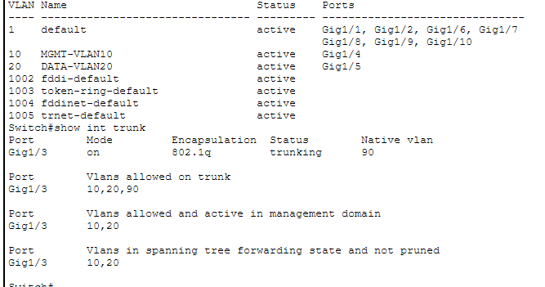
Captured VLAN and Trunk State
CONFIRMED
Gi1/4: VLAN 10
Gi1/5: VLAN 20
Gi1/3: trunking
Native: 90
Allowed: 10,20,90
Active: 10,20
Forwarding: 10,20
VLAN 90 is allowed and selected as native, but is absent from the active VLAN list.
Verify its creation/status before using native traffic.
Notes:
Latest source: Screenshot 2026-10-16 095231.png. VLAN10 MGMT-VLAN10 active on Gi1/4; VLAN20 DATA-VLAN20 active on Gi1/5. Gi1/3 on/802.1q/trunking, native90, allowed10,20,90, active and forwarding10,20. VLAN90 is absent from show vlan brief and active/forwarding lists. Earlier screenshot is superseded. Router, host, SSH and ACL states are not established by this screenshot.
Latest source: Screenshot 2026-10-16 095231.png. VLAN10 MGMT-VLAN10 active on Gi1/4; VLAN20 DATA-VLAN20 active on Gi1/5. Gi1/3 on/802.1q/trunking, native90, allowed10,20,90, active and forwarding10,20. VLAN90 is absent from show vlan brief and active/forwarding lists. Earlier screenshot is superseded. Router, host, SSH and ACL states are not established by this screenshot.
Sources: original user-supplied routeronastick.pptx; Cisco ACL documentation https://www.cisco.com/c/en/us/td/docs/ios-xml/ios/sec_data_acl/configuration/xe-3s/sec-data-acl-xe-3s-book/sec-create-ip-apply.html ; Cisco trunk documentation https://www.cisco.com/c/en/us/td/docs/switches/lan/c9000/lyr2-fwd/vlan/vlan-configuration-guide/configure-vlan-trunks.html

