Slide 1

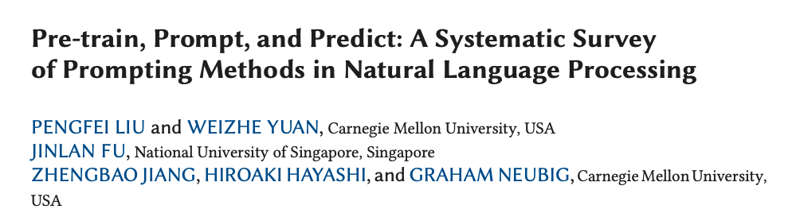

Slide 2
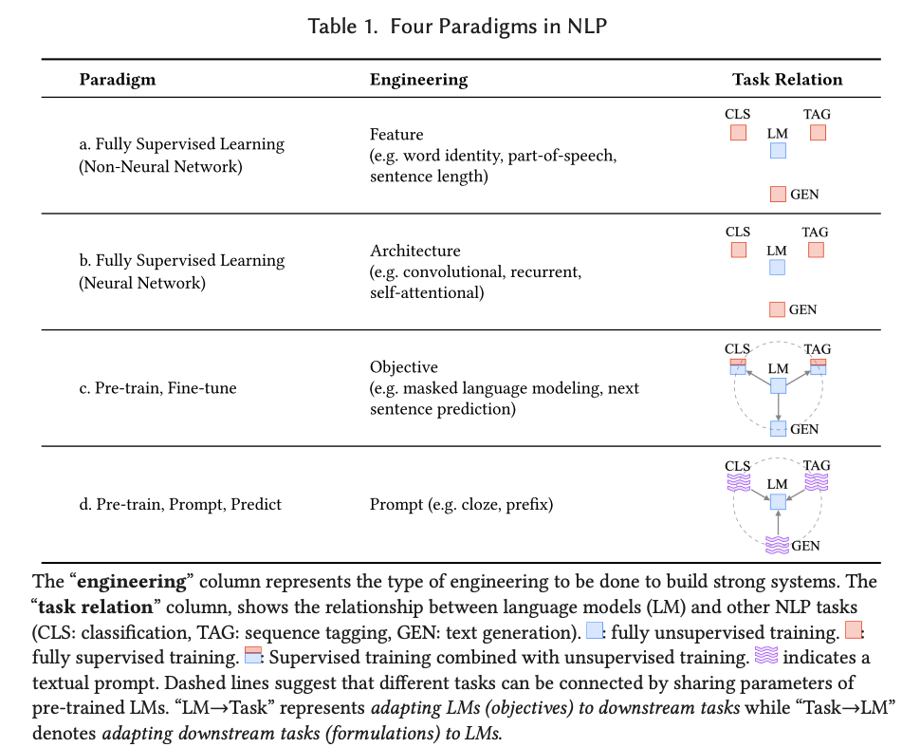
Feature Engineering:
Domain knowledge -> manually extract feature
Architecture Engineering:
CNN, RNN, etc. -> model train itself
Objective Engineering:
Design objective function at both pretrain & fine tune stages
Prompt Engineering: select the appropriate prompts without any additional training

Slide 3
What is Prompt Engineering?
The process of designing input prompts to guide pre-trained language models (LMs) in NLP tasks.
A new approach in NLP that minimizes the need for large, labeled datasets.
Why is it Important?
Few-shot and Zero-shot Learning: Models can perform tasks with little or no additional data.
Versatility: The same model can be used for various tasks just by changing the prompt.
Efficiency: Less time and computational resources needed for training.
Challenges:
Designing effective prompts is complex.
Model performance can be highly sensitive to the structure of the prompt.

Slide 4
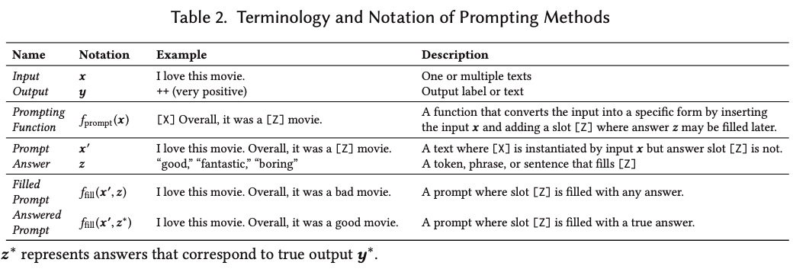
Input (x) → Processed by a Prompting Function (f_prompt(x)) → Creates a Prompt (x') → Filled with an Answer (z) → Results in a Filled Prompt (ffill(x', z)) → Ideally, filled with the True Answer (z)* to generate an *Answered Prompt (ffill(x', z))**.
Design Considerations: Pre-trained LM Choice, Prompt Template Engineering, Prompt Answer Engineering, Expanding the Paradigm, Prompt-based Training Strategies

Slide 5
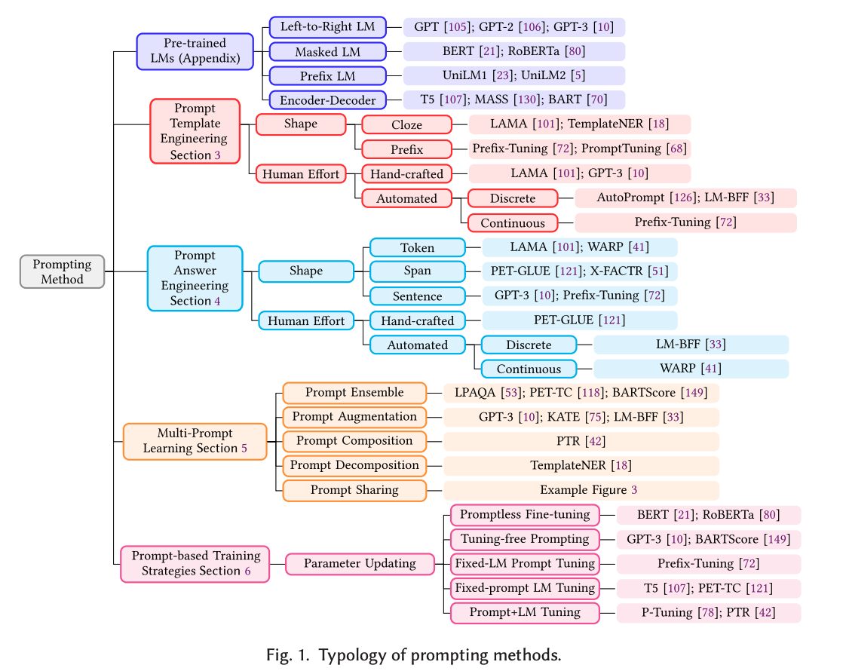

Slide 6
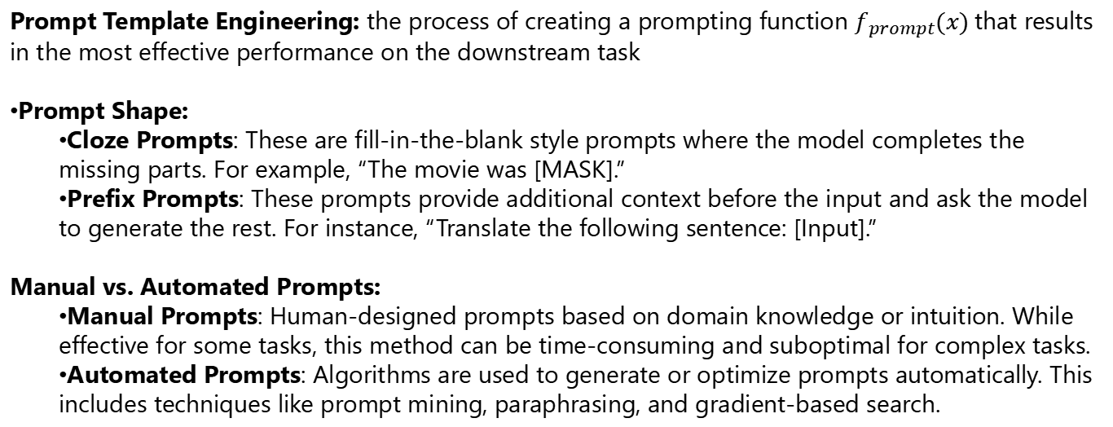
Prompt Template Engineering: the process of creating a prompting function $f_{prompt}(x)$that results in the most effective performance on the downstream task
Prompt Shape:
Cloze Prompts: These are fill-in-the-blank style prompts where the model completes the missing parts. For example, “The movie was [MASK].”
Prefix Prompts: These prompts provide additional context before the input and ask the model to generate the rest. For instance, “Translate the following sentence: [Input].”
Manual vs. Automated Prompts:
Manual Prompts: Human-designed prompts based on domain knowledge or intuition. While effective for some tasks, this method can be time-consuming and suboptimal for complex tasks.
Automated Prompts: Algorithms are used to generate or optimize prompts automatically. This includes techniques like prompt mining, paraphrasing, and gradient-based search.

Slide 7
Discrete prompts are natural language strings inserted into the input to guide the model’s behavior.
Automated Methods for Discrete Prompts
Prompt Mining:
Definition: Searches large text corpora (like Wikipedia) to find naturally occurring sentence patterns that can be used as prompts.
Example: For an input like “Obama,” the system might find a prompt like “Obama is the president of [MASK].”
Prompt Paraphrasing:
Definition: Starts with an initial prompt and generates variations by paraphrasing using methods like back-translation or synonym replacement.
Example: "The movie was [MASK]" could become "That film was really [MASK]."
Gradient-based Search:
Definition: Uses the gradients of the model to search for the optimal token sequence in the discrete prompt space.
Example: Tweaking the tokens in a prompt to maximize task performance, such as for sentiment classification.

Slide 8
Definition
Automated Methods for Continuous Prompts
Prefix Tuning:
Definition: Learns a sequence of continuous vectors that are prepended to the input. Only the prefix vectors are updated during training, while the language model remains fixed.
Example: For a summarization task, continuous vectors are added before the input sentence to guide the model toward summarizing the text.
Prompt Tuning:
Definition: Fine-tunes the continuous prompt embeddings while keeping the language model frozen, optimizing the task-specific vectors.
Example: In translation, the initial prompt is represented as a continuous vector that is further optimized for the task.
Hybrid Approach:
Definition: Starts with a manually designed discrete prompt and then fine-tunes it in the continuous space for better performance.
Example: A prompt like "The movie was [MASK]" might be initialized as discrete text and then fine-tuned into continuous embeddings.

Slide 9
Answer Shape
Token: The model’s output is a single word or token.
Example: "The movie was [MASK]." The model fills in [MASK] with "great," "bad," etc.
Span: The output is a sequence of words (i.e., a segment of text).
Example: Named Entity Recognition (NER) tasks where the model extracts a span, like "Barack Obama" from a sentence.
Sentence: The model generates an entire sentence or more as output.
Example: Machine translation tasks where the prompt might be "Translate: I love you," and the model generates the sentence "Je t'aime."

Slide 10
Automated Methods for Discrete Answer Engineering
Gradient-based Search:
Adjusts the discrete prompts by optimizing the tokens that form the prompt.
Example: In sentiment analysis, the model might search for optimal tokens like “good” or “bad” to fill the prompt: “The movie was [MASK].”
Paraphrasing:
Generates multiple valid phrasings of answers in natural language to improve generalization.
Example: For a question-answering task, the prompt "What is the capital of France?" can have multiple correct answers such as "Paris" or "The capital of France is Paris."
Prompt Pruning:
Prunes unlikely or incorrect answers by removing less effective tokens from the prompt’s output space.
Example: In text classification, irrelevant tokens (e.g., "neutral") are pruned to leave only high-probability answers like "positive" or "negative."

Slide 11
Automated Methods for Continuous Answer Engineering
Continuous Answer Space Tuning:
Instead of using natural language, continuous prompts operate in the model’s embedding space, where the system learns the best embeddings to guide output.
Example: In machine translation, continuous vectors guide the model to generate the correct translation without needing human-readable prompts.
Prefix Tuning:
Uses trainable embeddings (prefixes) added to the input text to tune the model’s output without altering the language model itself.
Example: For a summarization task, prefix tuning adds learned continuous vectors to the input sentence to steer the model toward generating a concise summary.
Answer Space Pruning in Embeddings:
Similar to discrete pruning, but the model prunes unlikely answer embeddings in the continuous vector space.
Example: For tasks like NER (Named Entity Recognition), the system narrows down the correct entity embeddings in the continuous space, optimizing predictions.

Slide 12
Multiple-Prompt Learning
Definition: Multi-prompt learning involves using multiple prompts for a single task to enhance model robustness and accuracy.
Prompt Ensembling: Combines multiple prompts for the same input. The predictions from each prompt are averaged or aggregated to improve overall performance.
Example: For sentiment analysis, two prompts like "The movie was [MASK]" and "Overall, it was a [MASK] film" might be combined, with the model averaging the predictions from both prompts.
Prompt Augmentation: Adds extra prompts with answered examples to help the model generalize. This is particularly useful in few-shot learning scenarios where the model is provided with a few demonstrations before the main input.
Example: Before translating a sentence, the model might first be shown a few example translations to learn the task better.

Slide 13
Prompt Composition:
Definition: Combines multiple prompts designed for different sub-tasks to create a more comprehensive task prompt.
Example: For a task like summarization, separate prompts for identifying key points and generating a concise text might be combined into one.
Prompt Decomposition:
Definition: Breaks down a complex task into smaller, manageable sub-tasks, each addressed by its own prompt.
Example: For a question-answering task, a single prompt might first identify relevant entities, and a second prompt might provide the answer.
Prompt Sharing:
Definition: Shares learned prompts across similar tasks to transfer knowledge. A prompt optimized for one task can help improve performance on a related task.
Example: A prompt for text classification in one domain (e.g., movie reviews) can be adapted and shared for another domain (e.g., product reviews).

Slide 14
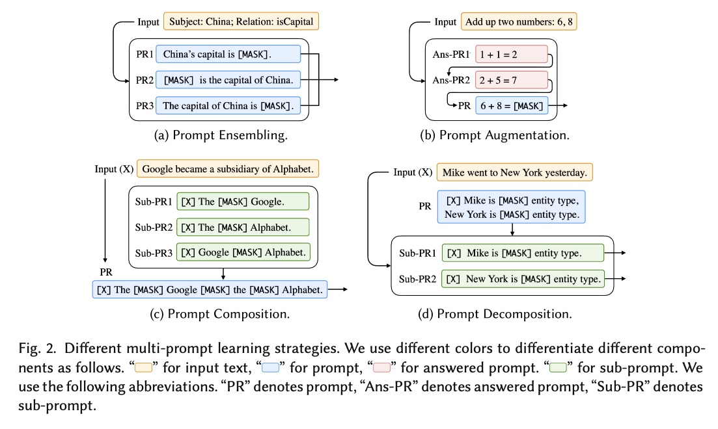

Slide 15
