Slide 1
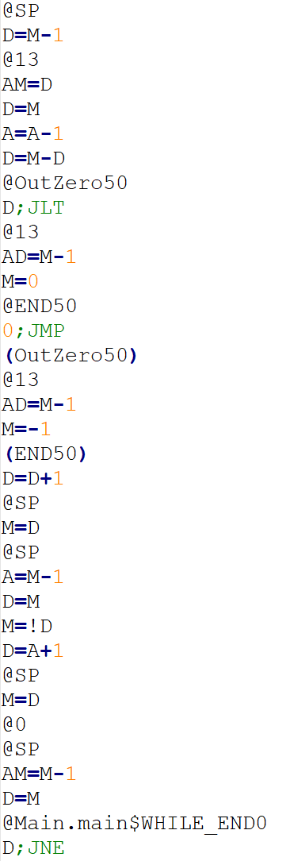
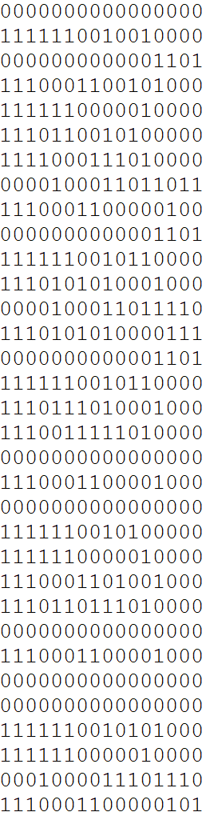
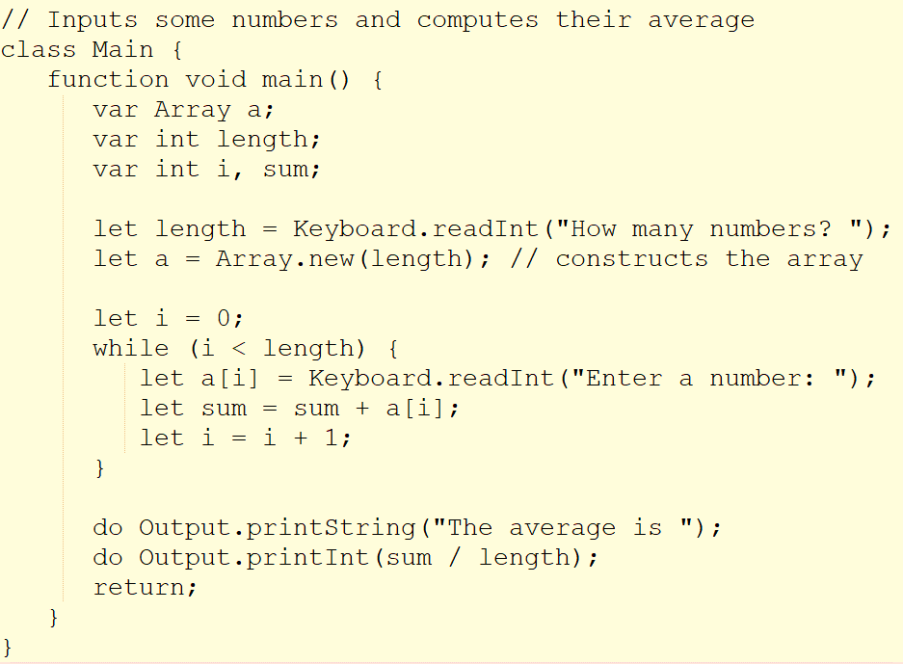
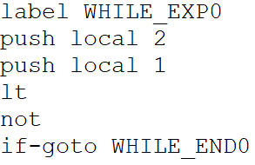
We are now at:
Assembly
Hack
Jack
VM
VM Translator
Compiler
Assembler

Slide 2
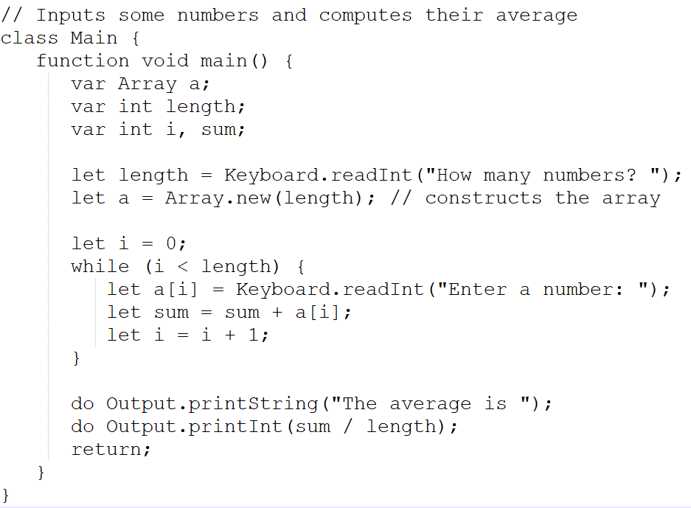
We are now at:
Assembly
Hack
Jack
VM
VM Translator
Assembler
Compiler

