Slide 1
Presentation for Week 6

Slide 2
Things we’ve achieved
1.Assembler
2.Nothing more

Slide 3
About Compiler
Consists of : 3 Languages
Consists of : 3 Stages
Parsing
Optimizatioin
Generation
Generalize : compiling process in modularization

Slide 4
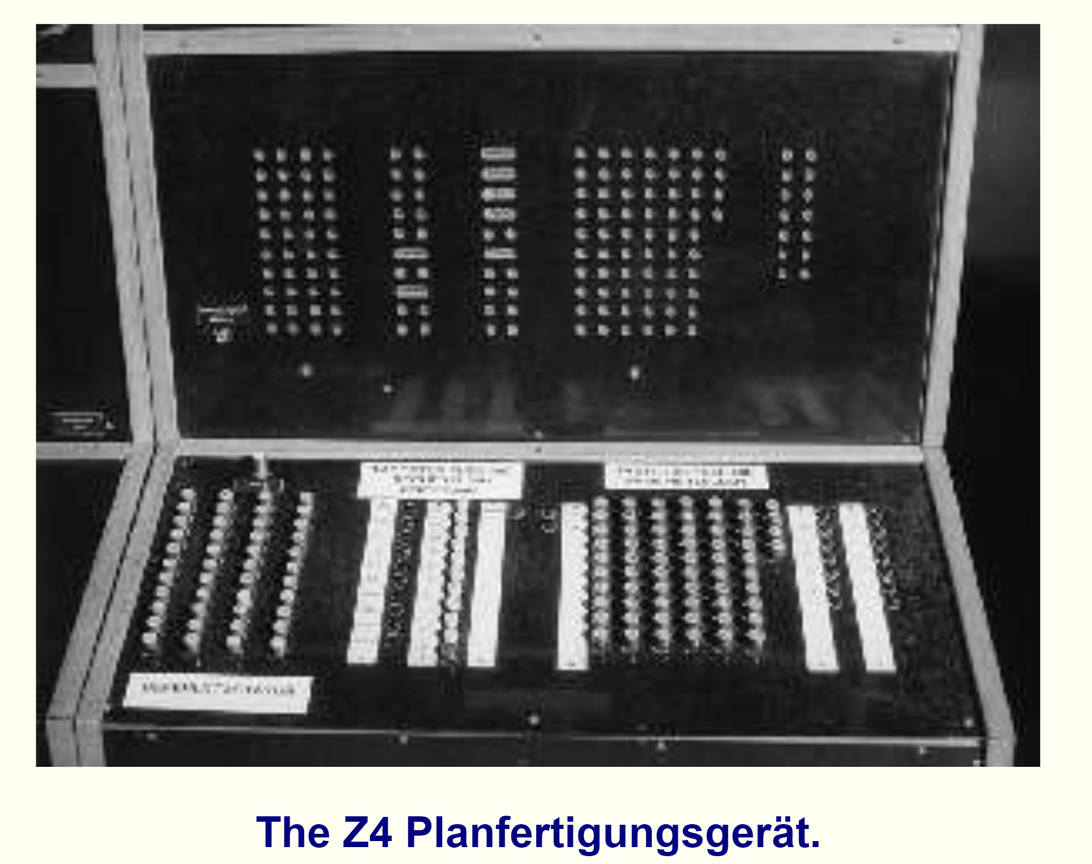
The 1st Compiler Z4 by Konrad Zuse
http://www.yorku.ca/lbianchi/sts3700b/lecture17a.html

Slide 5
Interpreting Process
OF Men
OF Machines

