Slide 1
Group 1
NaXin

Slide 2
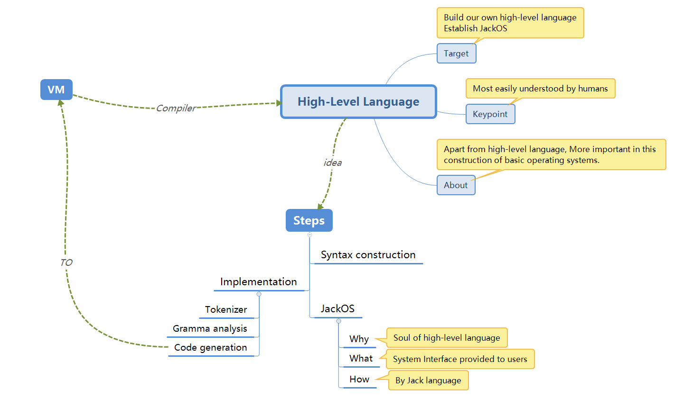

Slide 3
Current Progress
Have finished all 12 projects
Test results have also come out
Publication
Writing the Glossary Section
Our idea: using glossary to write the content

Slide 4
Jack OS
Definition
Operating system is the interface:
between the user and the computer.
between the computer hardware and other software.
Interface: The functions system provide for users
Importance:
It is the most basic system software that runs directly on the machine.
Any other software must run with the support of the operating system.

Slide 5
Thank You

