Slide 1
Weekly report
Group 1

Slide 2
Outline for first part of high level language
Context: We have a working VM language, but it is still not easy to use Nowadays we have languages like python and java that are easy to write
Goal: build a high level language that is friendly to programmers
Effect We do not need to use low-level languages such as assembly You can use a process-oriented, object-oriented approach to build a larger project This is unimaginable during the low-level language | Output A high-level language with such capabilities as the C language | Process Build grammars and keywords Determine variable types and symbol rules Identify grammar rules and errors Provide system reservation interface The compiling part: Pretreatment, Compiled, Link | Input Existing VM language rules Instructions that can be used
Outside factors: It’s pretty hard to build such a language

Slide 3
How to connect the senior language with the assembly language ?
STACK!
A stack is a basic abstract data structure
Everything can be stored in a stack
What else do we need ?
TREE!
Actually trees can be realized with stack
Trees help us to see the whole structure in an easy-understanding way

Slide 4
What do we have in a program?
Data
Insturction
Class/function/procedure are packages of data and instructions
Data seem trivial
How about instructions?

Slide 5
What kind of instructions do we have?
Select – if-goto & goto &label
Repeat – if-goto & goto &label
Calculation
Function call

Slide 6
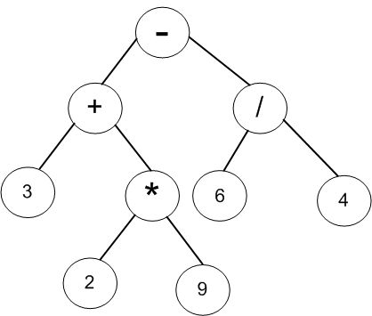
Calculation
Postfix Expression
(3+2*9) – (6/4)
It can be realized with a stack!

Slide 7
HACK & STACK

Slide 8
How to make a function call based on HACK?
THINK ABOUT: What is a function?
When we talk about “function”, what are we talking about?
List every element of a function:
Func name
Func addr
Func args
Func codes
Return res

Slide 9
What’s the relationship between main and sub?
arg addr
Main
func
Sub
func
How args interact?
Local args with local args
Local args with sub args
res

Slide 10
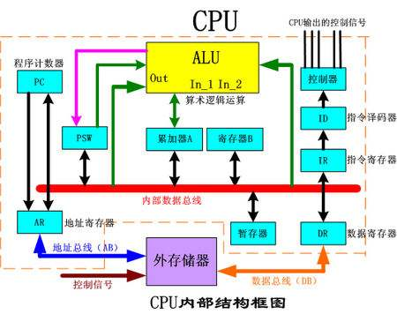
Conclude:We need a mem to remember where we are now and allow us to move to a certain instruction.
In order to simplify the question , we suppose there is a mem “PC” mapping direct to the real PC

Slide 11
eg: How to realize a factorial with HACK?
A very simple C++ program:
int fact(int n)
{
if (n < 1) return 1;
else return (n * fact(n-1));
}

Slide 12
Something to do with STACK
Old arg
Old res
main
fact(n-2)
fact(n-3)
fact(n)
fact(n-1)
Old addr
Old arg
Old res
Symbols:
SP: a reg to store the address of the top of stack
arg: a reg to store the value of current argment
addr: a reg to store the address of a certain instruction
res: a reg to store the result
Old addr
Old arg
Old res
Old addr
Old arg
Old res
Old addr
Old arg
Old res
…

Slide 13
Start with pseudo codes
fact:
SP=SP-2
SP[1]=addr
SP[0]=arg
if (arg<1) jump to next
res=1
SP=SP+2
jump to old addr
next:
arg=arg-1
push PC+2 into stack
jump to fact
arg=SP[0]
addr=SP[1]
SP=SP+2
res=res*arg
jump to old addr

Slide 14
Translate it into HACK codes
(FACT)
@2
D=A
@SP
M=M-D
@arg
D=M
@SP
@M
M=D
@addr
D=M
@SP
@M
A=A+1
M=D
@arg
D=M
D=D-1
@NEXT
D;JTL
@res
M=1
@2
D=A
@SP
M=M+D
@addr
D=M
@PC
M=D
(NEXT)
@arg
M=M-1
@PC
D=M
@addr
M=D
@10
D=M
@addr
M=M+D
@FACT
0;JMP
@SP
@M
D=M
@arg
M=D
@SP
@M
A=A+1
D=M
@addr
M=D
mult res res arg(pseudo code here)
@addr
D=M
@PC
M=D

Slide 15
THANKS

