Slide 1
Weekly report
Group 1

Slide 2
Outline for first part of high level language
Context: We have a working VM language, but it is still not easy to use Nowadays we have languages like python and java that are easy to write
Goal: build a high level language that is friendly to programmers
Effect We do not need to use low-level languages such as assembly You can use a process-oriented, object-oriented approach to build a larger project This is unimaginable during the low-level language | Output A high-level language with such capabilities as the C language | Process Build grammars and keywords Determine variable types and symbol rules Identify grammar rules and errors Provide system reservation interface The compiling part: Pretreatment, Compiled, Link | Input Existing VM language rules Instructions that can be used
Outside factors: It’s pretty hard to build such a language

Slide 3
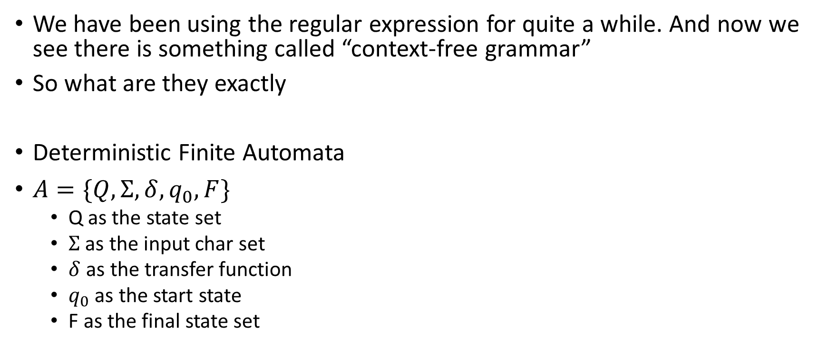
Some things about automata
We have been using the regular expression for quite a while. And now we see there is something called “context-free grammar”
So what are they exactly
Deterministic Finite Automata
$A=\{Q,Σ,δ,q_{0},F\}$
Q as the state set
$Σ$ as the input char set
$δ$ as the transfer function
$q_{0}$ as the start state
F as the final state set

Slide 4
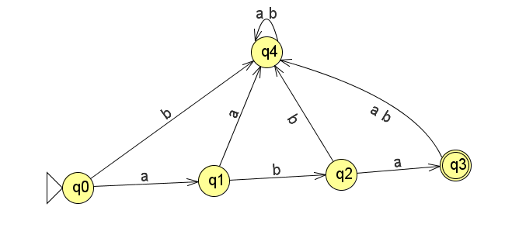
A simple example

Slide 5
Some things
Every DFA has a language that it can accept
The accept set is a set of strings
In this case, it’s {aba}, it only has one element
The amazing thing is
The language that accepted by a DFA, is exactly a language can be accepted by regular expression.
Every DFA has a equivalent regular expression.

Slide 6
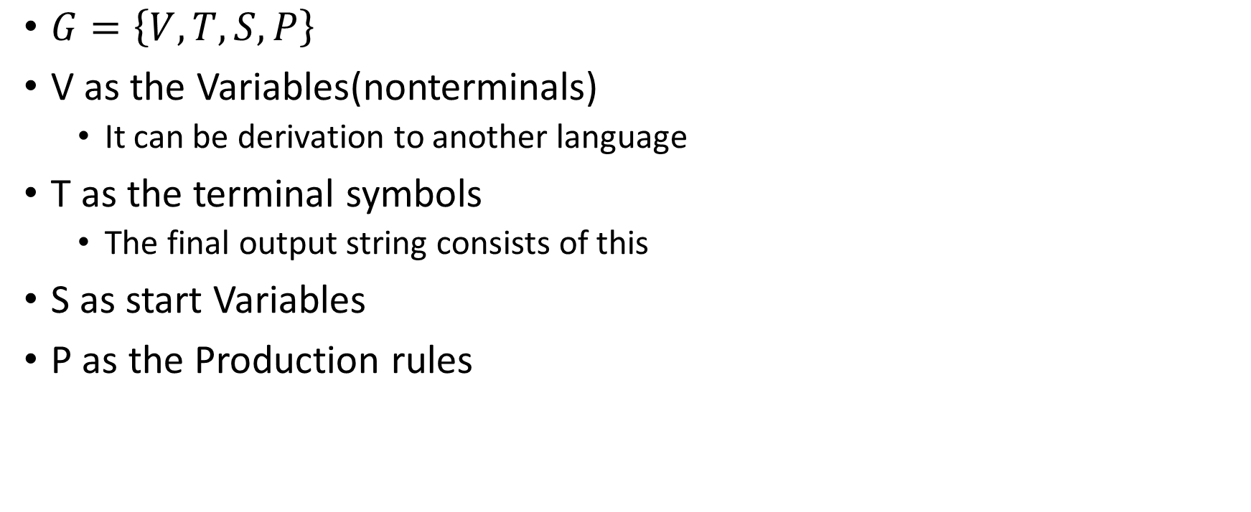
Context Free Grammar
$G=\left\{V,T,S,P\right\}$
V as the Variables(nonterminals)
It can be derivation to another language
T as the terminal symbols
The final output string consists of this
S as start Variables
P as the Production rules

Slide 7
Production rules
Let’s see a example first:
E → EOE
E → (E)
E → v
E → d
O →＋
O →∗
It can generate strings like this: v,d,v+d,(v+d)*d….
Also this grammar has a language it can generate

Slide 8
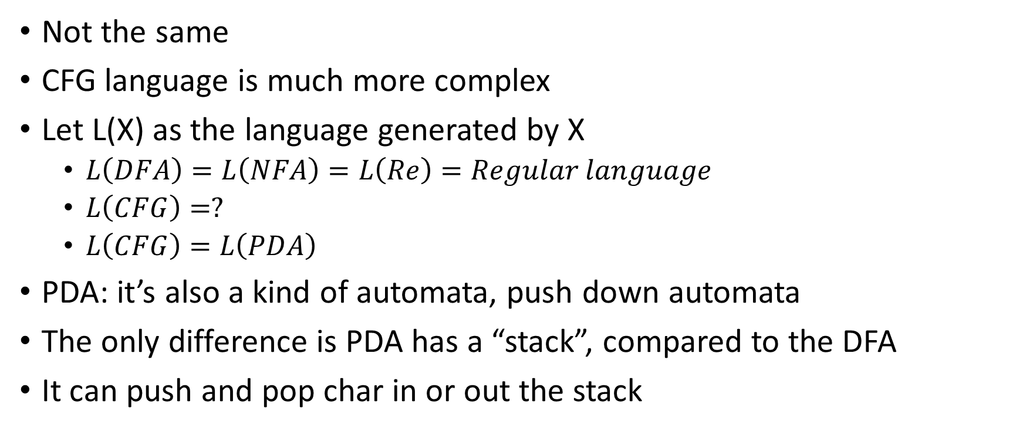
The regular language and the CFG language
Not the same
CFG language is much more complex
Let L(X) as the language generated by X
$L\left(DFA\right)=L\left(NFA\right)=L\left(Re\right)=Regular language$
$L\left(CFG\right)=?$
$L\left(CFG\right)=L\left(PDA\right)$
PDA: it’s also a kind of automata, push down automata
The only difference is PDA has a “stack”, compared to the DFA
It can push and pop char in or out the stack

Slide 9
Q&A
Group 1

