Slide 1
KK
Controlled delivery from code to production
Terraform • Ansible • Jenkins • Kubernetes • Security • Monitoring • AWS serverless receipts
KijaniKiosk
DevOps Capstone
3 / 3
3 / 3
0
0%
Production replicas
Final CI tests
Security audit
Stage error
Track A — Infrastructure-First Delivery
available
passed
vulnerabilities
final run
FINAL RELEASE
Release status
READY FOR SUBMISSION
v1.0.0
Final audited master • annotated tag v1.0.0 pushed • no open pull requests
Application image: kk-payments:v1.2.0

Slide 2
Capstone Mission
Build a production-style delivery system — not just a deployment.
Infrastructure as Code
Staging First
Quality Gates
Cloud Extension
Terraform provisions the staging namespace and AWS receipt resources. Ansible manages staging configuration and assertions.
Every production deployment is preceded by staging configuration, deployment, smoke testing and monitoring.
Unit/integration tests, npm audit, Terraform validation and an error-rate gate protect the promotion path.
Successful staging payments publish receipts to S3 and trigger Lambda-based processing and notification.
Final outcome
Code
Jenkins
Staging
Approval
Prod
feature branch + PR
CI + gates
validate first
manual gate
3/3

Slide 3
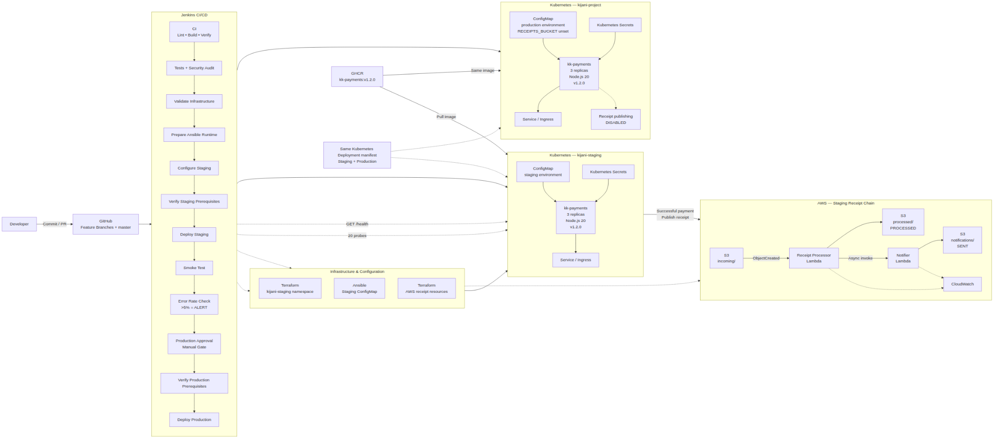
Final Architecture
The release architecture reflects the actual v1.0.0 implementation.

Slide 4
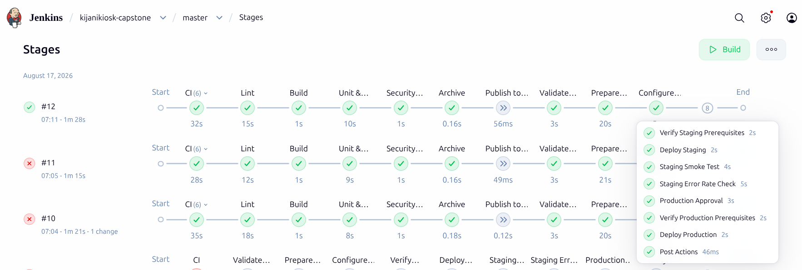
Final Jenkins Delivery
Build #12 validates the final application source and completes staging-to-production promotion.
BUILD #12
Final CI source
deployment-pipeline/containers
This closed the final traceability gap: Jenkins now tests the same receipt-capable source represented by the deployed v1.2.0 image.
CI
Validate Infrastructure
Configure Staging
Deploy Staging
Lint • Build • Tests • Security
Terraform
Ansible
Kubernetes
Smoke + Error Rate
Production Approval
Deploy Production
0% final
Manual
3/3 replicas
Publish to Nexus remains optional and was skipped in the final capstone run.

Slide 5
Environment Separation
One image and one Deployment manifest; environment behavior comes from configuration.
STAGING — kijani-staging
PRODUCTION — kijani-project
NODE_ENV=staging
DB_HOST=kk-postgres-staging
AWS_REGION=eu-north-1
RECEIPTS_BUCKET=kk-payments-receipts-staging
NODE_ENV=production
DB_HOST=kk-postgres
RECEIPTS_BUCKET=unset
RECEIPTS ENABLED
RECEIPTS DISABLED
Payment → S3 → Lambda processor → notifier
Production remains isolated from the staging-only AWS receipt chain.
Same manifest • same v1.2.0 image

Slide 6
Security & Monitoring Gates
Quality signals must pass before a human can promote to production.
3 / 3
0
20
0.00%
Receipt tests
npm audit
Staging probes
Final error rate
passed in final CI
vulnerabilities
live health requests
HEALTHY
Security gate
Monitoring gate
npm audit --audit-level=high
ERROR_RATE > 5% → ALERT
High-severity dependency findings fail CI. The final audited dependency set reports zero vulnerabilities.
Boundary test: 5.00% remains HEALTHY, 10.00% alerts. A failed monitor stage blocks Production Approval.

Slide 7
AWS Staging Receipt Chain
A successful staging payment triggers an event-driven receipt-processing workflow.
kk-payments
S3
Receipt Processor
S3
Notifier
S3
successful /payment
incoming/
Lambda
processed/
PROCESSED
Lambda
SENT
CloudWatch logs capture receipt_processed and receipt_notification_sent events
End-to-end proof
The same receipt ID was verified in the payment response, S3 incoming object, processor log, processed object, notifier log and notification object.
STAGING ONLY

Slide 8
Failure, Recovery & Governance
The final solution includes operational recovery and transparent engineering governance.
Failure & Recovery
AI Governance
Repository Hygiene
A deliberately invalid image demonstrated rollout failure. Kubernetes rollout history and rollback restored the known-good image.
AI output was reviewed, tested and corrected before use. The governance log records what was right, wrong and changed.
Secret scans passed, generated Terraform plans/state are excluded, and obsolete tracked plan artifacts were removed.
Transparent limitation
Formal peer review was not completed because no peer reviewer was available. The project does not fabricate peer feedback or treat AI/self-review as peer review.
Technical confidence comes from automated tests, security gates, infrastructure validation, pull requests, live deployment checks and the final successful Jenkins run.

Slide 9
Final Release State
The audited capstone is frozen on master and tagged for submission.
Final audit checklist
v1.0.0
✓
Root README finalized
FINAL RELEASE
✓
Architecture source + PNG/SVG committed
✓
One-page scope PDF committed
Release commit
fb731f540efb52b27e1f3eba2ba59189fa110494
✓
Presentation deck committed
✓
Reflection + AI governance log committed
✓
Terraform + serverless Terraform valid
NO OPEN PRs
✓
Ansible + shell syntax checks pass
✓
3/3 tests pass; npm audit = 0 vulnerabilities
Annotated tag pushed to origin
✓
Production v1.2.0 = 3/3 replicas
✓
v1.0.0 tag pushed successfully
KijaniKiosk Track A is ready for submission and live demonstration.

