Slide 1
KijaniKiosk
DevOps Capstone
Track A — Infrastructure-first delivery
Kubernetes • Terraform • Ansible • Jenkins • AWS S3/Lambda
v1.2.0
Final payments image
3/3
Production replicas
0.00%
Staging error rate
0
High vulnerabilities
From GitHub pull requests to gated production deployment, with staging-only receipt processing on AWS.

Slide 2
OBJECTIVE
Capstone mission
Build a delivery path that makes production changes deliberate, observable, and recoverable.
1
Infrastructure first
Terraform provisions the staging namespace; Ansible configures the staging runtime.
2
Staging before production
Every master build deploys and validates staging before any production approval is possible.
3
Gated promotion
Smoke tests, security audit, and >5% error-rate gate protect production.
4
Event-driven extension
A real staging payment publishes a receipt into S3 and triggers Lambda processing.
KijaniKiosk DevOps Capstone • 2

Slide 3
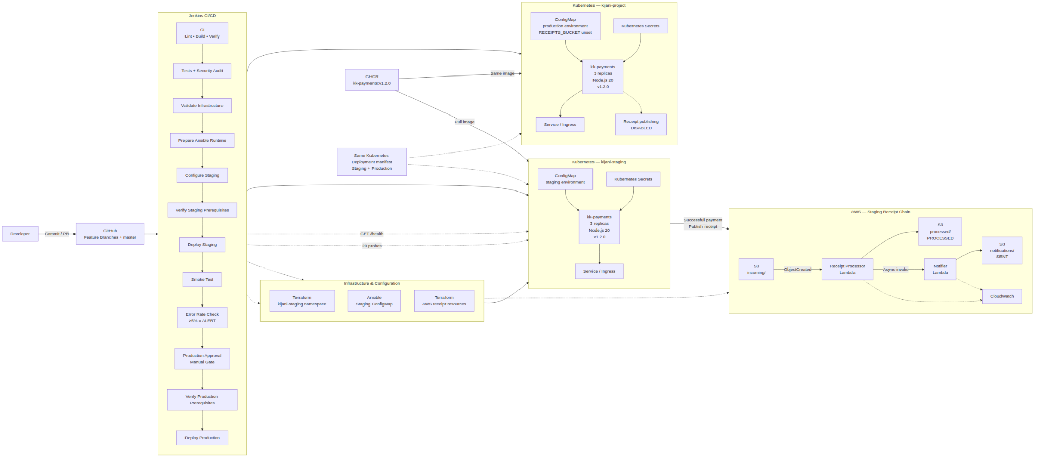
SYSTEM VIEW
Final architecture
KijaniKiosk DevOps Capstone • 3

Slide 4
CI/CD
Staging-first Jenkins delivery
CI
Security
Audit
Validate
Infrastructure
Configure
Staging
Deploy
Staging
Smoke
Test
Error-rate
Gate
Manual
Approval
Production is unreachable until staging deployment, smoke testing, monitoring, and human approval all succeed.
• Jenkins stage graph reached Production Approval only after a 0.00% staging error-rate result.
• Final master build promoted v1.2.0 to production with 3 available replicas.
Deploy
Production
• The 403 commit-status message was GitHub token scope only; the Jenkins build itself finished SUCCESS.
KijaniKiosk DevOps Capstone • 4

Slide 5
STAGING VS PRODUCTION
Environment separation
kijani-staging
kijani-project
NODE_ENV
staging
NODE_ENV
production
DB_HOST
kk-postgres-staging
DB_HOST
kk-postgres
RECEIPTS_BUCKET
kk-payments-receipts-staging
RECEIPTS_BUCKET
unset
AWS_REGION
eu-north-1
AWS_REGION
not required
Receipt publishing
enabled
Receipt publishing
disabled
Same deployment manifest
Same v1.2.0 image
Different ConfigMaps & Secrets
KijaniKiosk DevOps Capstone • 5

Slide 6
QUALITY CONTROLS
Security and monitoring gates
npm audit
--audit-level=high
0 high vulnerabilities
after remediation
20 staging probes
against /health
>5% error rate
blocks production
Controlled threshold proof
Final Jenkins evidence
5.00%
HEALTHY
10.00%
ALERT
TOTAL_REQUESTS=20
ERROR_REQUESTS=0
ERROR_RATE=0.00%
STATUS=HEALTHY
KijaniKiosk DevOps Capstone • 6

Slide 7
AWS SERVERLESS
Receipt-chain integration
Payment
/amount=2500
S3
incoming/
Processor
Lambda
S3
processed/
Notifier
Lambda
S3
notifications/
Actual receipt proven end-to-end
processingStatus
PROCESSED
notificationStatus
SENT
rcpt-1786890391408-07143259 appeared in the payment response, S3 incoming/, processor CloudWatch log, S3 processed/, notifier CloudWatch log, and S3 notifications/.
KijaniKiosk DevOps Capstone • 7

Slide 8
FINAL PROOF
Evidence and outcomes
Jenkins
Build #6 finished SUCCESS after staging, monitoring, approval, and production deployment.
Production
kk-payments v1.2.0 is live with 3 available replicas in kijani-project.
Security
High-severity npm findings remediated; audit reports 0 vulnerabilities.
Monitoring
Staging error-rate gate reported 0.00% and archived evidence.
Receipts
A real payment created incoming, processed, and notification S3 records.
Technical Track A implementation is complete; remaining work is submission packaging and final audit.
KijaniKiosk DevOps Capstone • 8

Slide 9
SUBMISSION READINESS
Final documentation audit checklist
✓
Root README
updated and aligned to actual Jenkins stages
✓
AI governance log
committed with 12 reviewed AI-use entries
✓
Architecture
updated for v1.2.0, monitoring, and AWS receipt chain
✓
Scope + reflection
generate final PDF and explain missing peer review honestly
✓
Presentation
export final slide deck and keep screenshots/evidence
✓
Repository hygiene
clean git status, no secrets, no tfplan/tfstate tracked
✓
Release tag
create annotated v1.0.0 after final audit passes
KijaniKiosk DevOps Capstone • 9

