Slide 1
SUNSHINE FAMILY
GIGGLES AND FOOD

Slide 2
Giggles and Food
Who are we??? Sunshine Family - 3 Web Developers
What do we offer?- Giggles and Food application
What problem did we solve? Help with find restaurants with play equipment.

Slide 3
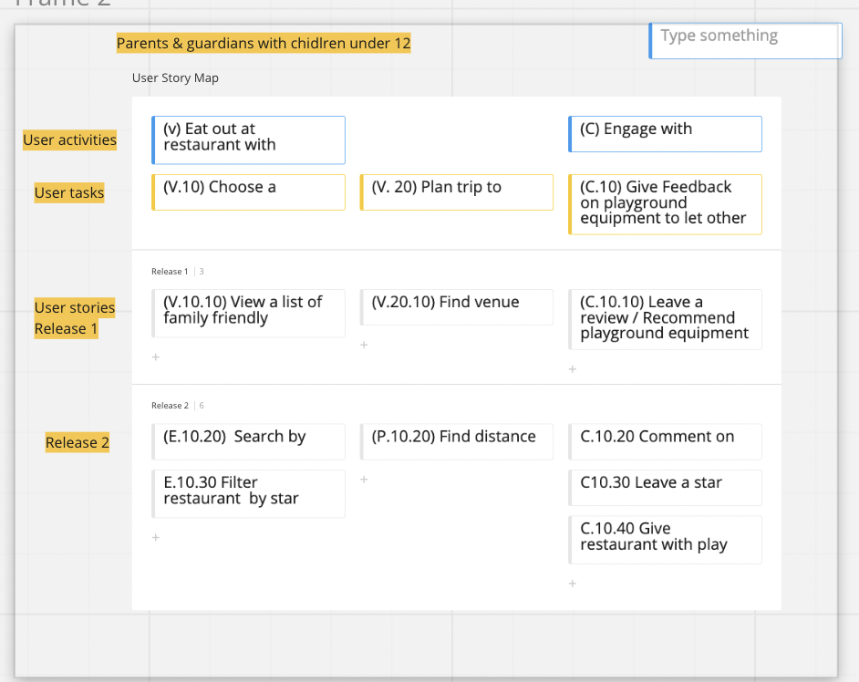
Concept
Description
To have free range kids.
Motivation for development?
Judgmental looks, screaming bored children while waiting for food to arrive, hard to find enough space for kids to run about.

Slide 4
Process
Technologies used
Breakdown of tasks and roles
Challenges
Successes

Slide 5
So what’s new
You can Sign Up to our site and Log in.
View the restaurant and click on read more button to view what the restaurant offers.
View the location of the restaurant chosen
View previous reviews on individual restaurants.
Add your own reviews and or add a restaurant that you want to share to the rest of the community. ( in the process of doing it)
See the date and time stamp on it to make sure you are up to date on the review (working on this)
Rate the restaurant (working on it)
You can view all reviews even if not logged in but have to sign up to leave a review.

Slide 6
Demo

Slide 7
Directions for Future Development
Filter search according to suburbs, and rating
Discover the distance to you and the restaurants

Slide 8
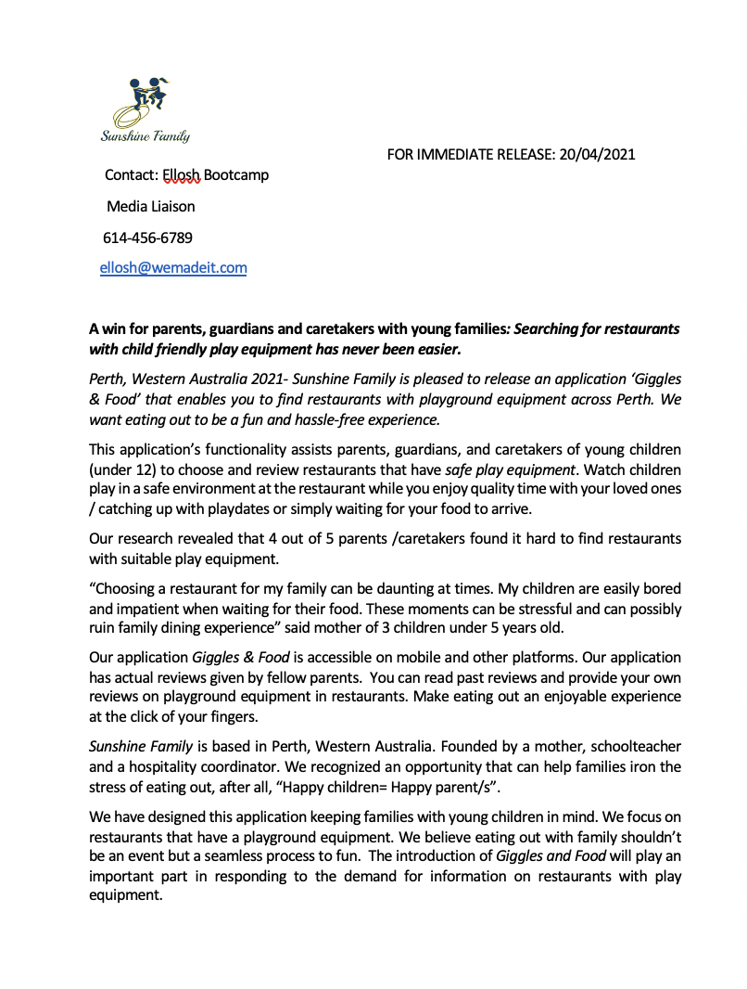
Press Release

