Slide 1

CyberSIEM
“To provide and enable strategic threat detection and response in the wake of sophisticated security needs.”
Title

Slide 2
Company Overview
Founded in | 2018
Headquarter | San Francisco
Employees | 175
Company Domain | Cyber Security
Mission Statement | To provide and enable strategic threat detection and response in the wake of sophisticated security needs
Target Market | Security Information and Event Management solution (SIEM)
Title

Slide 3

Challenges
Internal SOC* Team(Customer 0) has to perform:
Manual end-to-end testing for each release with RBAC
Mainline and Hotfixes
Testing Process:
Currently, there are 300 manual test cases. As the company’s Product Engineering team develops new capabilities, new manual tests may be added/revised
Total Regression Test & Feedback turnaround (168 hours)
Test setup (72 hours)
Manual execution of the test cases (48 hours)
Manual analysis of the test results (48 hours)
Bottlenecks - inaccurate, intractable testing leading to inefficient and time-consuming testing process
*Security Operations Center
Simple

Slide 4
Business
Objectives
Reduce end-to-end regression testing efforts and costs by 230% [1][2]
Reducing the time taken to give feedback to the development team by 50%[3], in turn enabling the development team’s throughput
Identifying and reporting bug/s impacting the strategic threat detection and incident response workflows
[1] Challenges: Slide 6
[2] Architecture & Design: Slide 52, Slide 53
[3] SMART Analysis: Slide 8
Simple

Slide 5
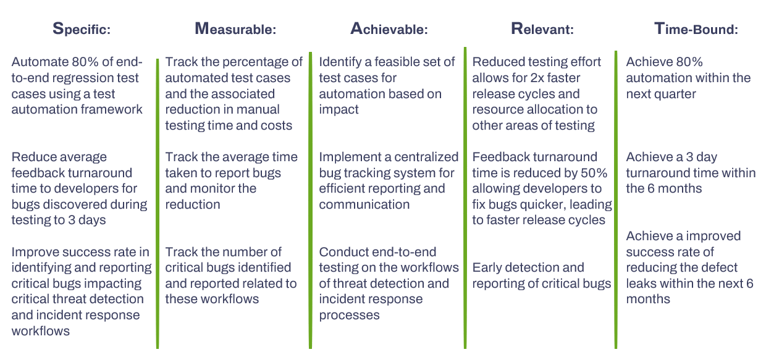
BO.1
BO.2
BO.3
Simple

Slide 6
Market Research
Title

Slide 7
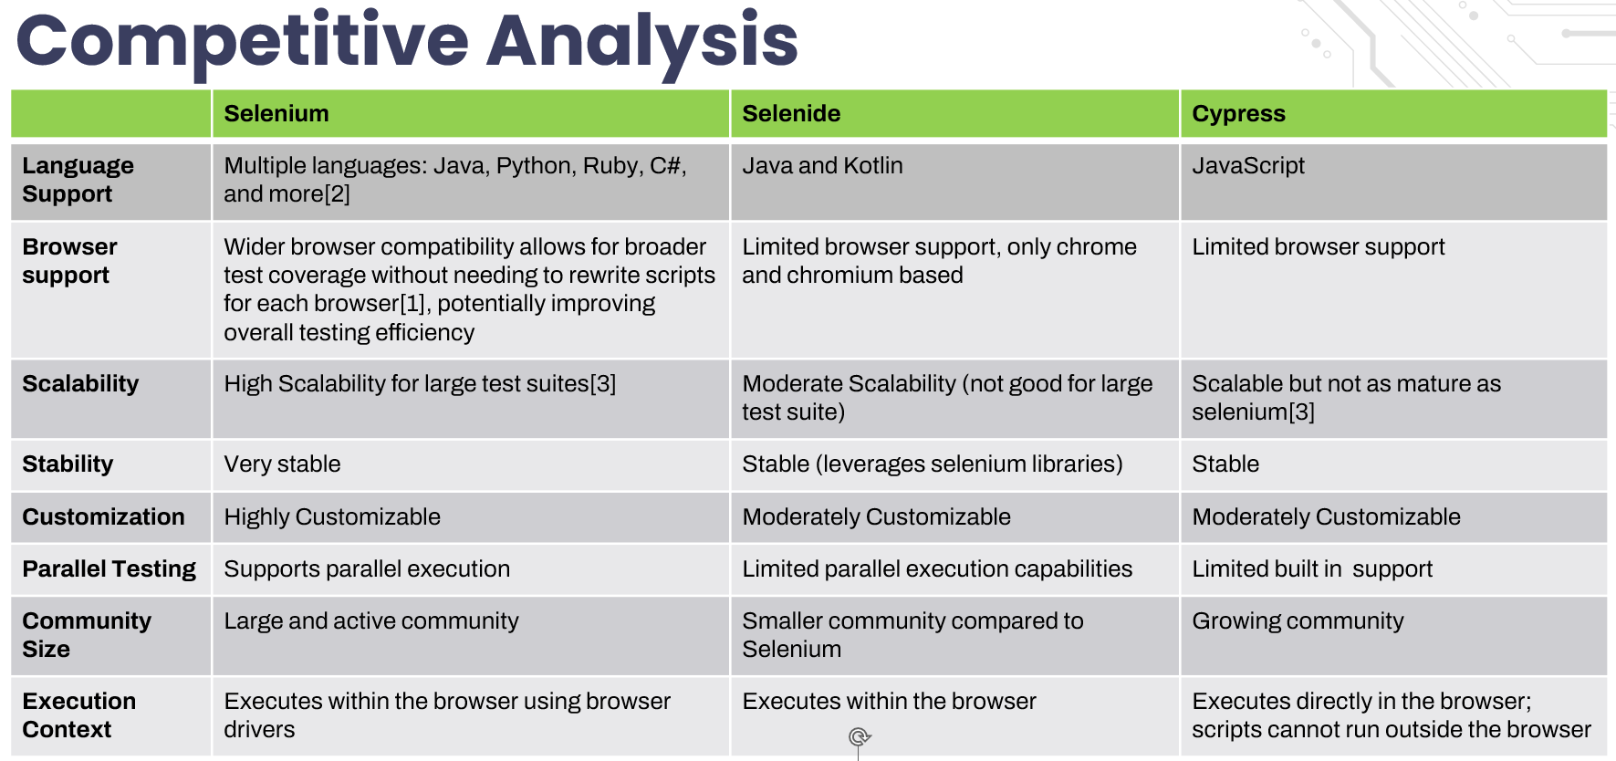
[1]Selenium Documentation, Supported Browsers v4.0(2022), https://selenium.dev/documentation/webdriver/browsers/
[2]Selenium Documentation, Installing Libraries v4.0(2023), https://selenium.dev/documentation/webdriver/getting_started/install_library/
[3] Himanshu Sheth, Selenium Tutorial and its Advantages, April, 2024, https:/.lambdatest.com/blog/why-selenium
[4]Selenium Documentation ,Bi Directional Functionality v4.0(2023),https://selenium.dev/documentation/webdriver/bidirectional/
Simple

Slide 8

‘Magic Quadrant’ Analysis
Cross-X Support
Mature and widely accepted and used across industries with cross and multi language and browser support [2]. Framework allows more control over browser interactions and integrations
Selenium
Simplified API offers less fine-grained control over browser interactions compared to Selenium, leverages selenium libraries and has browsers support other than chromium instances
Selenide
Niche
Scalability
Niche Player in the market and is inflexible for customization options for test data management [1], reporting, and framework integration.
Cypress
Inflexible
[1]Jash Unadkat, Comparison of Cypress, 2023,https://browserstack.com/guide/cypress-vs-selenium
[2] Himanshu Sheth, Selenium Tutorial and its Advantages, April, 2024, https:/.lambdatest.com/blog/why-selenium
Simple

Slide 9
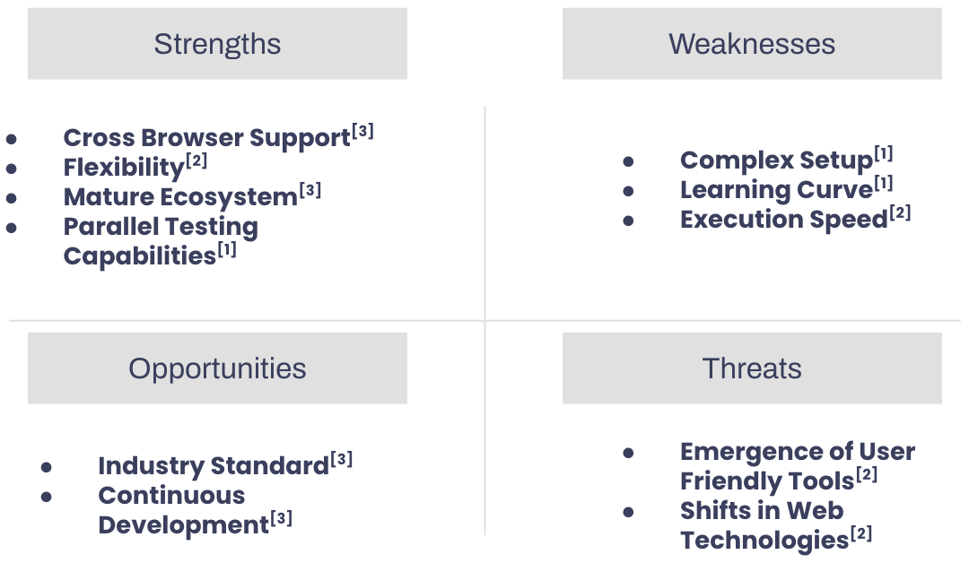
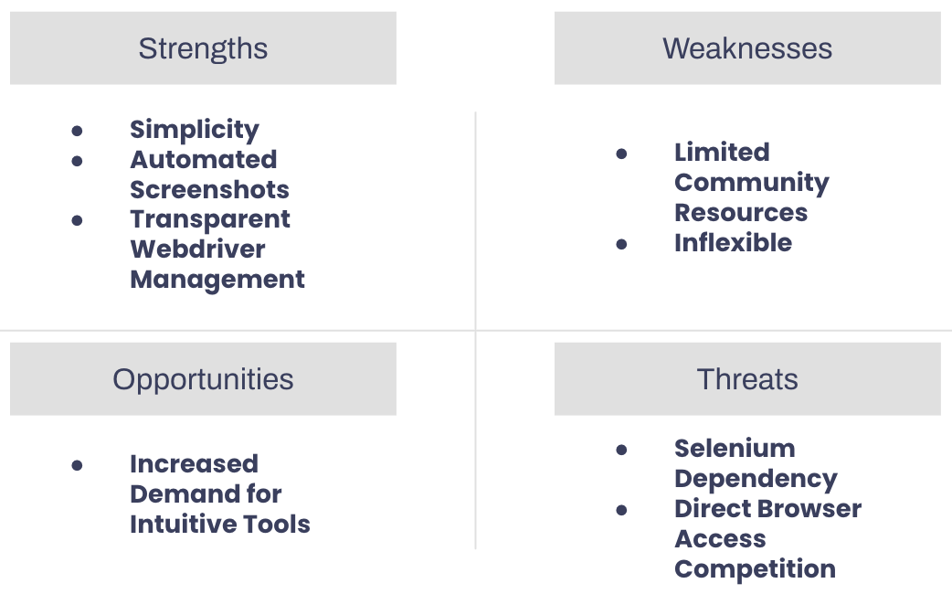
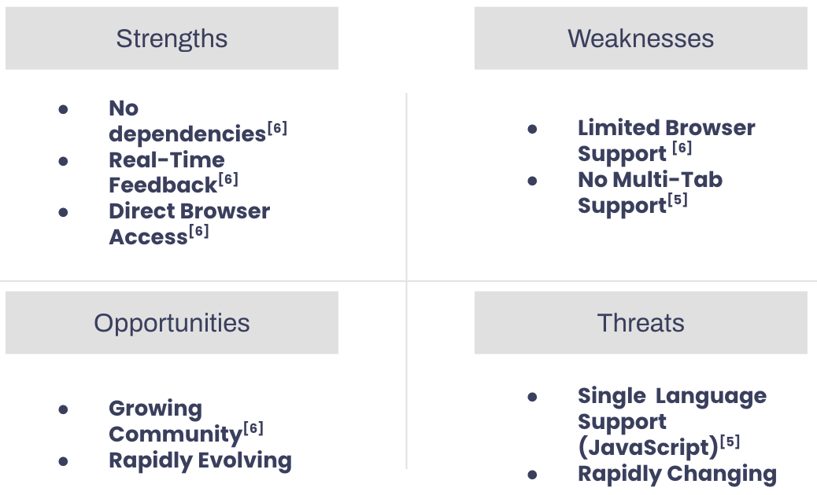
SWOT Analysis
Selenium
Selenide^{[4]}
Cypress
[1] (2024). Selenide vs. Selenium. Retrieved April 22, 2024, from https://selenide.org/documentation/selenide-vs-selenium.html
[2] Sheth, H. (2020). Cypress vs. Selenium Comparison. LambdaTest. Retrieved April 22, 2024, from https://www.lambdatest.com/blog/cypress-vs-selenium-comparison/
[3](2024). Selenium Tutorial. Retrieved April 22, 2024, from https://www.lambdatest.com/selenium
[4] (2024). Selenide vs. Selenium. Retrieved April 22, 2024, from https://selenide.org/documentation/selenide-vs-selenium.html
[5] Trade-offs. Cypress Documentation. Retrieved April 22, 2024, from https://docs.cypress.io/guides/references/trade-offs
[6] Sheth, H. (2020). Cypress vs. Selenium Comparison. LambdaTest. Retrieved April 22, 2024, from https://www.lambdatest.com/blog/cypress-vs-selenium-comparison/
Simple

Slide 10
OSS Research
Title

Slide 11
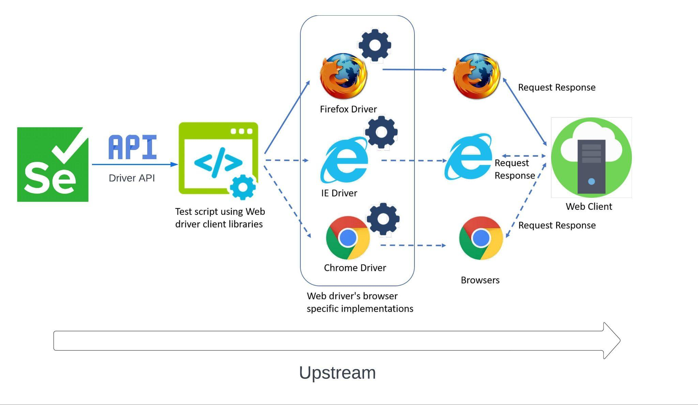
Upstream[1]
[1] BrowserStack. "Difference Between Selenium RemoteWebDriver and WebDriver." Accessed April 19, 2024. https://www.browserstack.com/guide/difference-between-selenium-remotewebdriver-and-webdriver.
Simple

Slide 12
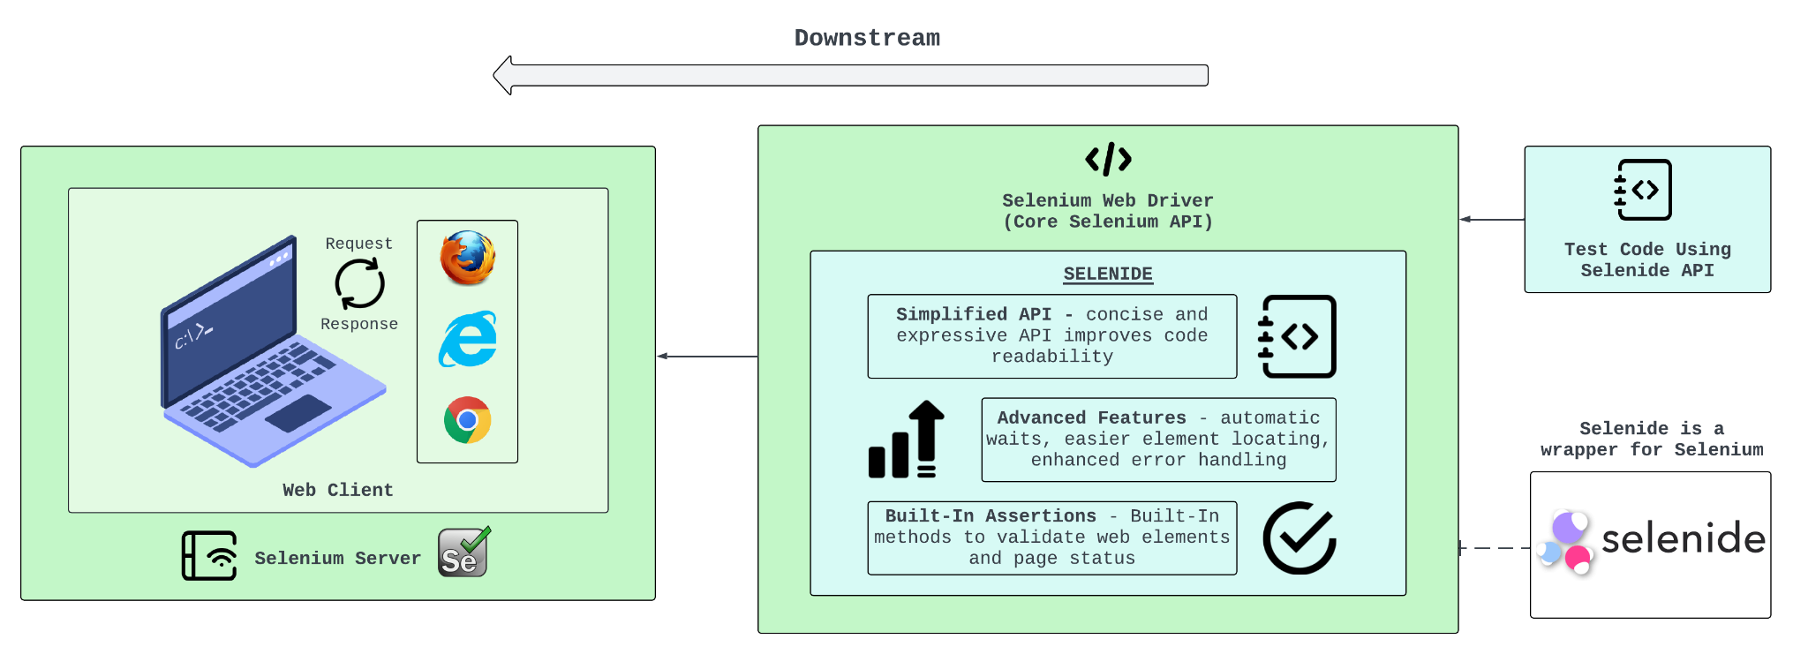
Downstream[1, 2]
[1] 2024. Selenide: concise UI tests in Java. Retrieved April 22, 2024 from https://selenide.org/
[2] Selenide vs. Selenium: What Are The Main Differences?. Retrieved April 22, 2024 from https://www.cybersuccess.biz/selenide-vs-selenium/
Simple

Slide 13
OSS Principles
Selenium is not tied to a specific programming language or platform. It offers bindings for various languages[3], allowing users to choose the one that best suits their needs. Additionally, the open-source nature makes it highly customizable for specific testing scenarios
Flexible
Selenium's source code is freely available under the Apache License 2.0 [1]
The Selenium project thrives on a vibrant community of developers [2]. They contribute code, documentation, and bug fixes, fostering a collaborative environment that results in a robust and feature-rich framework.
Principals:
Project Committers: Community members
Contributors: Jason Huggins (Selenium creator), Simon Stewart (WebDriver), Jim Evans (NET bindings), etc. [4]
Triagers: Andrei Solntsev, Isaul Vargas, Rajendra kadam, Chris NeJame, Todd Tarsi, etc. [5]
Maintainers: Simon Stewart (WebDriver creator), Jim Evans, Diego Molina (Selenium infrastructure), etc. [6]
Sponsors: Bright Data, BrowserStack, SauceLabs, Digital.ai, Applitools, Perfecto, LambdaTest, Subject7, Avo Automation, etc. [7]
Distributors: Selenium website, GitHub repository, Package managers, Cloud-based testing services, etc.[6]
End Users: Test engineers and QA professionals, DevOps teams, Automation engineers, Developers, etc. [8]
Open Source
Selenium
Collaboration
Cross-Browser and Multi Platform support
Cross-X Support
[1]Selenium Documentation, License v4.0,(2023),
https://selenium.dev/documentation/about/copyright/#license
[2]Selenium Repository,Framework and Ecosystem,https://github.com/SeleniumHQ/selenium
[3]Selenium Documentation, Supported Browsers v4.0(2022), https://selenium.dev/documentation/webdriver/browsers/
[4] The history of selenium testing: Sauce Labs: Sauce Labs. The History Of Selenium Testing | Sauce Labs | Sauce Labs. (n.d.).
https://saucelabs.com/resources/blog/a-brief-history-of-the-selenium-testing-framework
[5] Selenium project structure. Selenium. (n.d.). https://www.selenium.dev/project/structure/#selenium_triagers
[6] SeleniumHQ. (n.d.). SeleniumHQ/selenium-assistant: An assistant to help selenium maintainers keep the project in good shape. GitHub. https://github.com/SeleniumHQ/selenium-assistant
[7] Sponsors. Selenium. (n.d.-b). https://www.selenium.dev/sponsors/
[8] A deeper look at selenium. Selenium. (2022, September 4). https://www.selenium.dev/documentation/overview/details/
Simple

