Slide 1

Architecture
& Design
Title

Slide 2
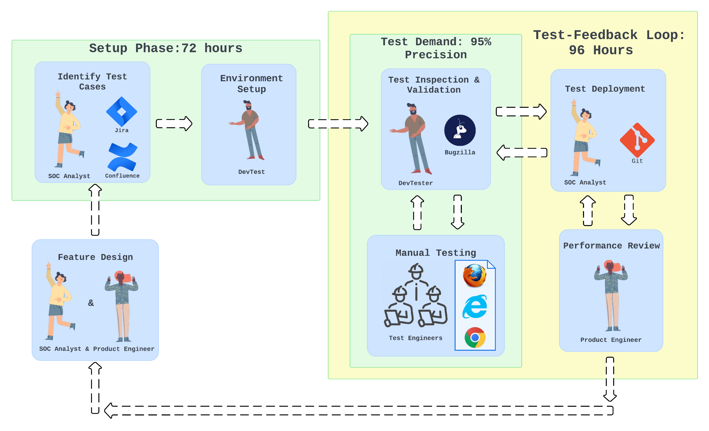
As-Is
[1]Logo: Google Chrome, Browser, https://www.google.com/chrome/
[2] Logo: Microsoft Edge, https://microsoft.com/en-us/edge
[3]Logo:Mozilla Firefox, Browser, https://mozilla.org/en-US/firefox/new/
[4]Logo:Jira,https://atlassian.design/foundations/logos
[5]Logo:Confluence,https://www.atlassian.com/legal/trademark#our-trademarks
[6]Logo:git,https://git-scm.com/downloads/logos
[7]Logo:bugzilla,https://www.svgrepo.com/svg/331330/bugzilla
[8]Automation rules and templates for Confluence Premium. Retrieved May 13th, 2024 from https://www.atlassian.com/software/confluence/automation
[9]Environments and deployments | GitLab. Retrieved May 10th, 2024 from https://docs.gitlab.com/ee/ci/environments/
[10] How To Write Effective Test Cases & Bug Reports With Jira and Bugzilla. Retrieved May 13th, 2024 from https://medium.com/@noel.B/how-to-write-effective-test-cases-bug-reports-with-jira-and-bugzilla-58e222d4b099
[4]
[7]
[6]
[5]
300 Manual Tests
[3]
[2]
[1]
Simple

Slide 3
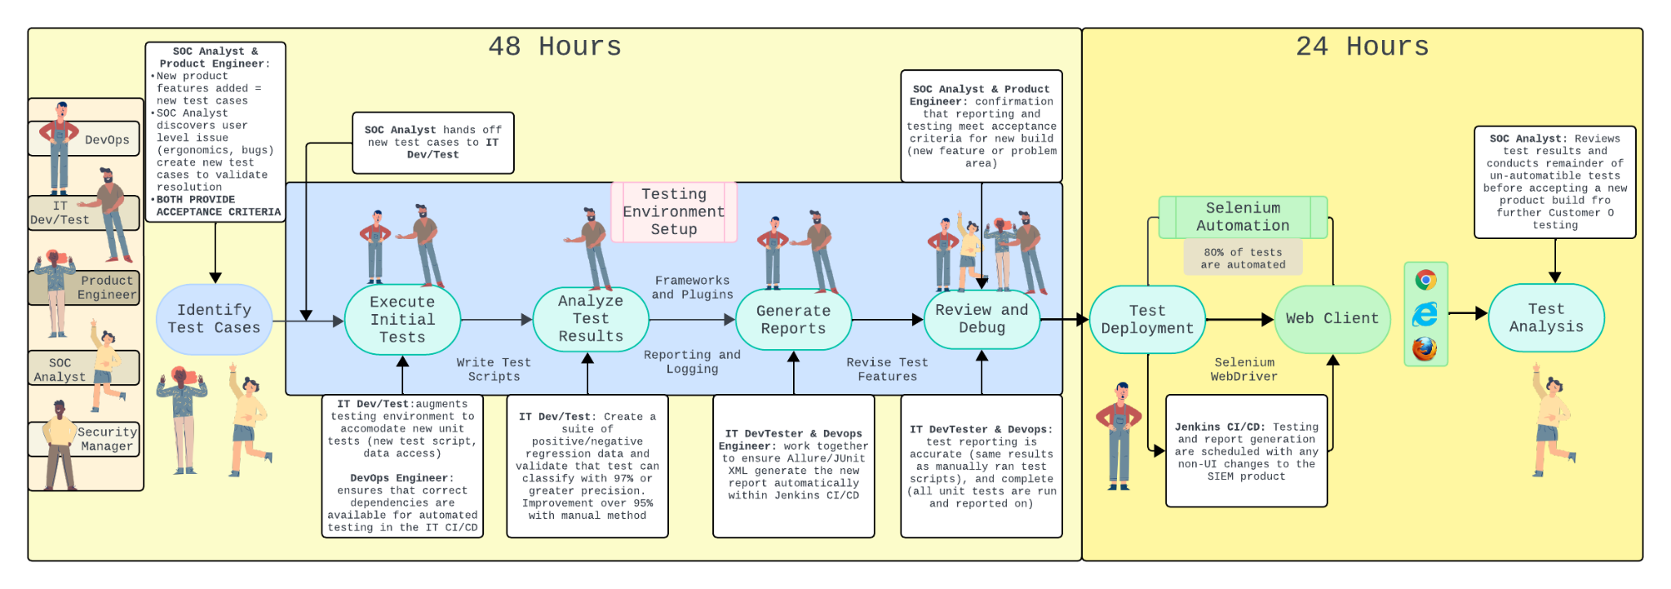
To-Be
[1]
[2]
[3]
[1]Logo: Google Chrome, Browser, https://www.google.com/chrome/
[2] Logo: Microsoft Edge, https://microsoft.com/en-us/edge
[3]Logo:Mozilla Firefox, Browser, https://mozilla.org/en-US/firefox/new/
Simple

Slide 4
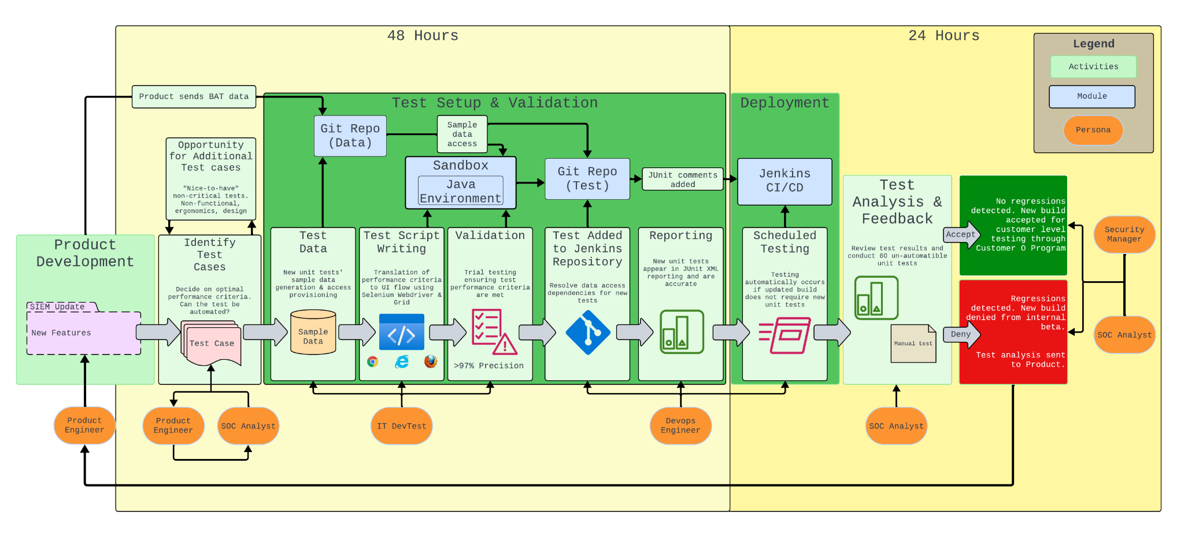
Architecture
[1] [2] [3]
[1]Logo: Google Chrome, Browser, https://www.google.com/chrome/
[2] Logo: Microsoft Edge, https://microsoft.com/en-us/edge
[3]Logo:Mozilla Firefox, Browser, https://mozilla.org/en-US/firefox/new/
Average

Slide 5
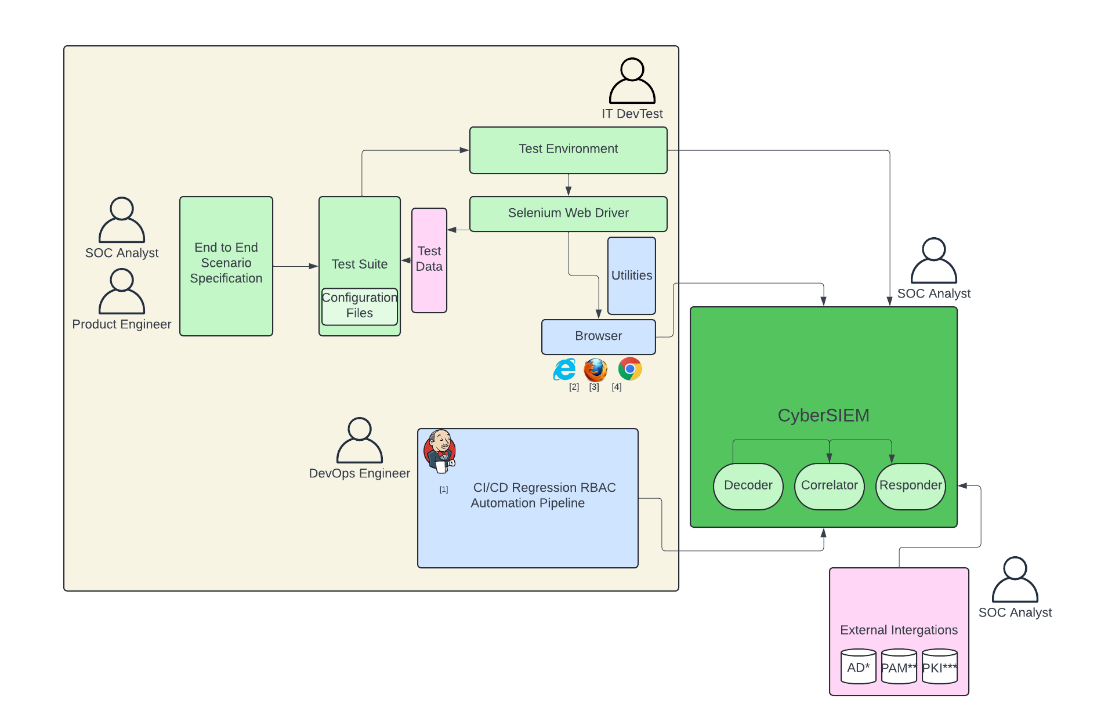
High Level Design
[1] Logo: Jenkins, Jenkins Pipeline https://jenkins.io/
[2] Logo: Microsoft Edge, https://microsoft.com/en-us/edge
[3]Logo:Mozilla Firefox, Browser, https://mozilla.org/en-US/firefox/new/
[4]Logo: Google Chrome, Browser, https://www.google.com/chrome/
*Active Directory
**Privileged Access Management
***Public Key Infrastructure
Simple

