Slide 1
Change Management
Title

Slide 2
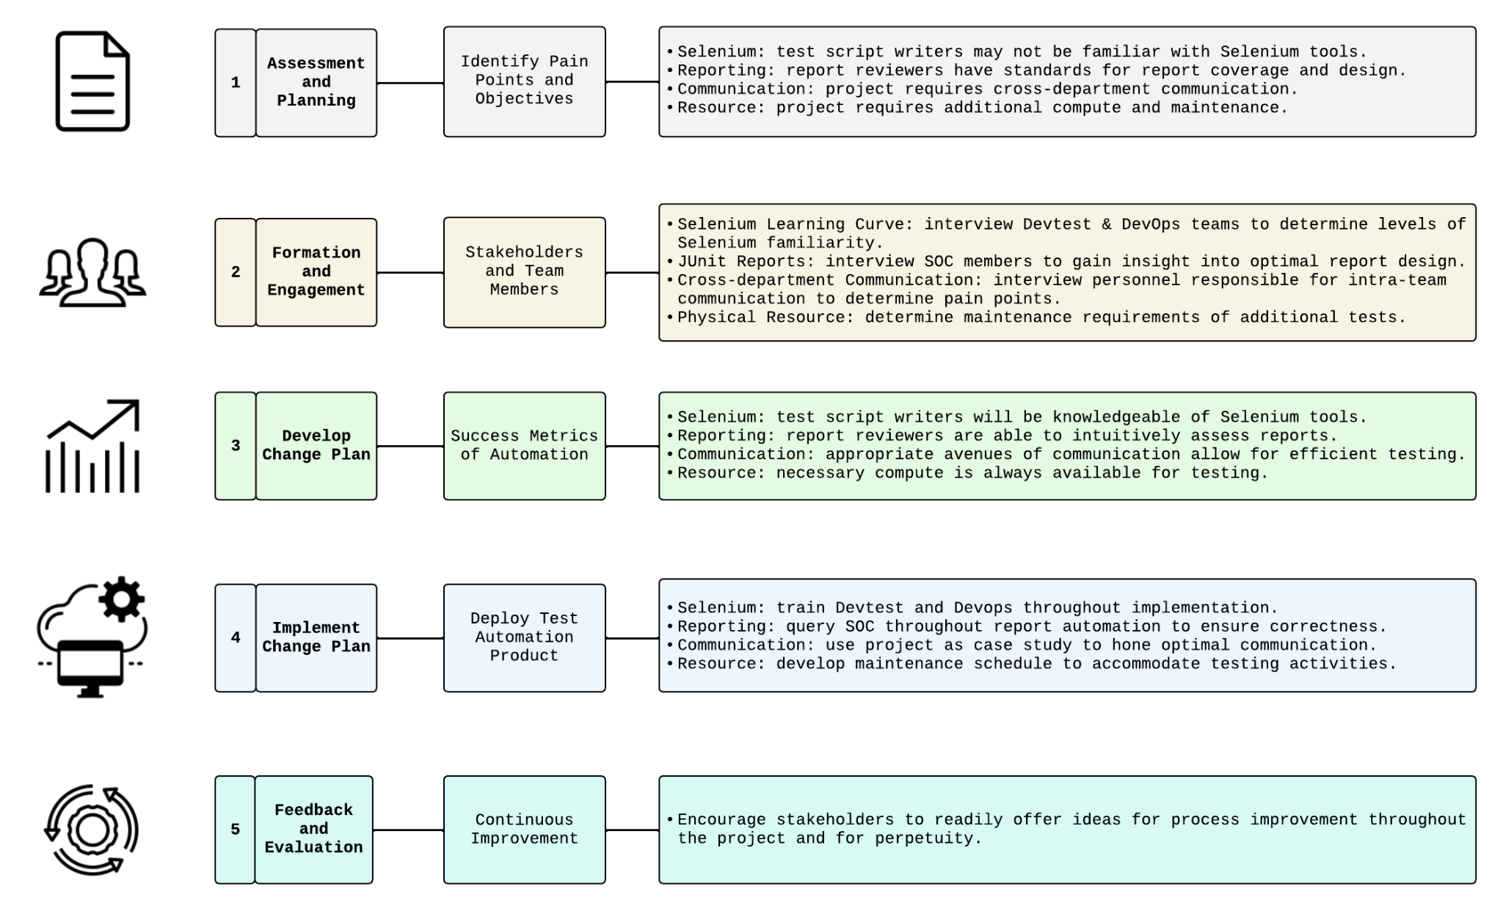
Change Management [1]
[1] 2024. 5 critical steps in the change management process. Retrieved May 17, 2024 from https://www.atlassian.com/blog/strategy/change-management-steps
Simple

Slide 3
Project Plan
Title

Slide 4
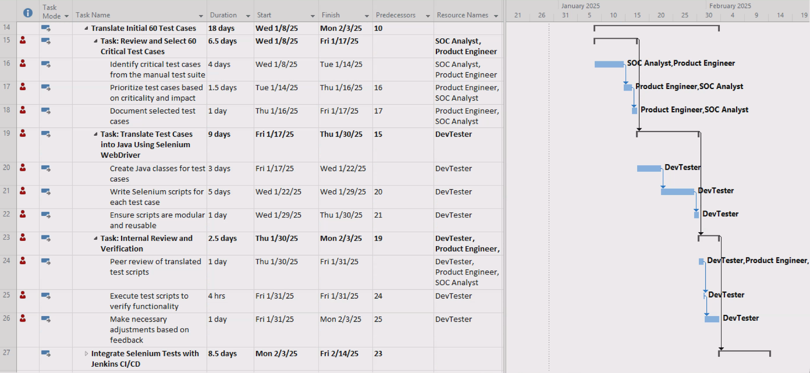
Increment 1, Sprint 1 Project Plan
Section: “Translate Initial 60 Test Cases”
Simple

Slide 5
“Translate Initial 60 Test Cases” RACI ^{[1]}
[1] TeamGantt. RACI Chart Definition, Tips, and Example. Retrieved June 2, 2024, from https://www.teamgantt.com/blog/raci-chart-definition-tips-and-example#:~
=simple%20RACI%20chart-,RACI%20definitions%20explained,have%20on%20an%20individual%20deliverable
Theme | Tasks | Responsible | Accountable | Consulted | Informed
Review and Select 60 Critical Test Cases | Identify critical test cases from the manual test suite | SOC Analyst: selects critical tests from customer perspective | Security Manager: verifies that test cases capture critical controls | DevTest: advises selection from IT maintenance perspective | Product Engineer
 | Prioritize test cases based on criticality and impact | SOC Analyst | DevTest: verifies that tests are automatible | Product Engineer: ensures initial test selection is representative of UI BATs | Security Manager
 | Document selected test cases | SOC Analyst | Security Manager | DevTest | CIO
 |  | Product Engineer
Translate Test Cases into Java Using Selenium Webdriver | Create Java Classes for test cases | DevTest | Product Engineer: ensures code quality | DevOps: opportunities for CI/CD efficiencies | Security Manager
 | Write Selenium scripts for each test case | DevTest | Product Engineer | DevOps | Security Manager
 | Ensure scripts are modular and reusable | DevTest | Product Engineer | DevOps | Security Manager
Internal Review and Verification | Peer review of translated test scripts | Product Engineer | DevTest | SOC Analyst | Security Manager
 | Execute test scripts to verify functionality | DevTest | SOC Analyst: expected test points covered | Product Engineer: opportunities to reuse BAT sample data | Security Manager
 | Make necessary adjustments based on feedback | DevTest | SOC Analyst | Product Engineer | Security Manager
Simple

