Slide 1

Product Roadmap
Title

Slide 2
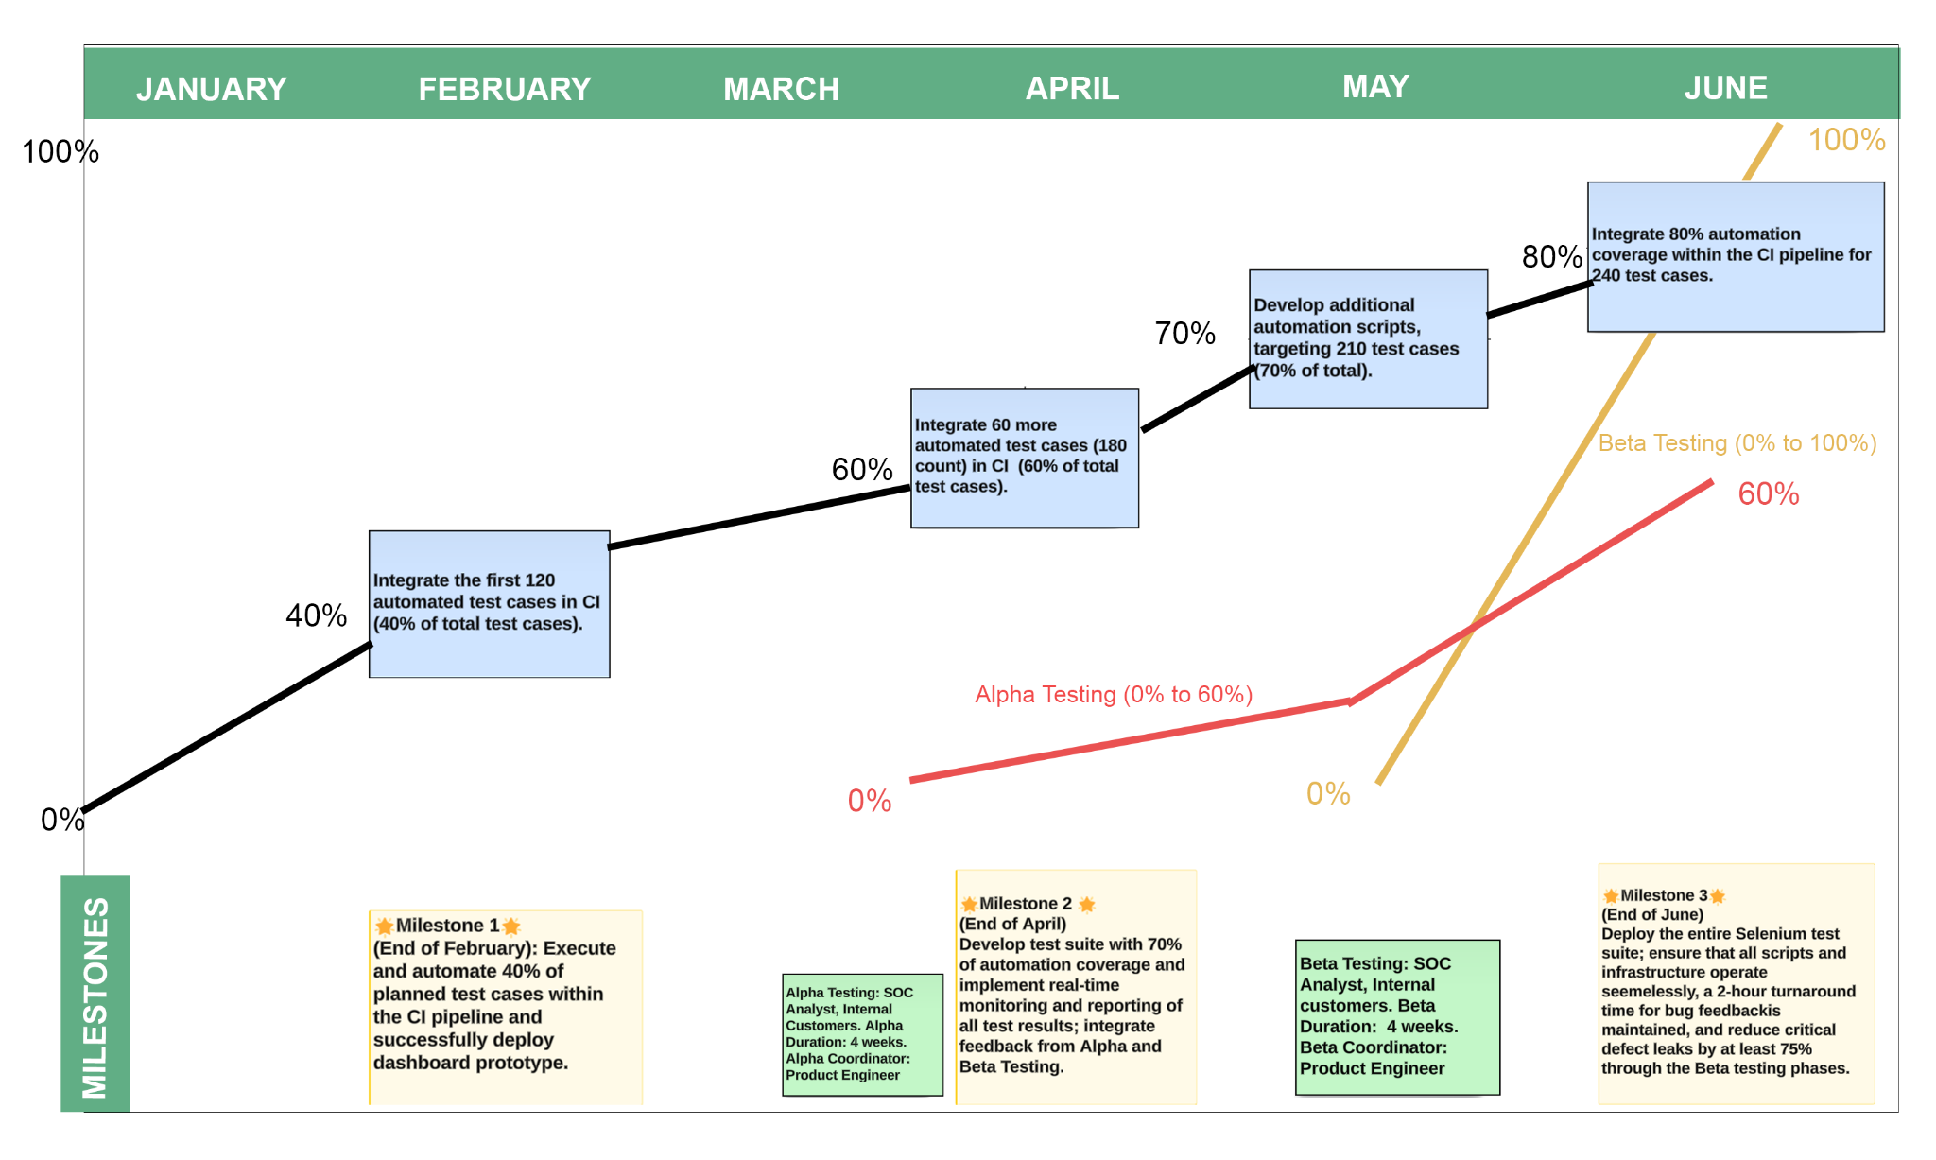
Product Roadmap
Simple

Slide 3
Sprint Planning
Title

Slide 4
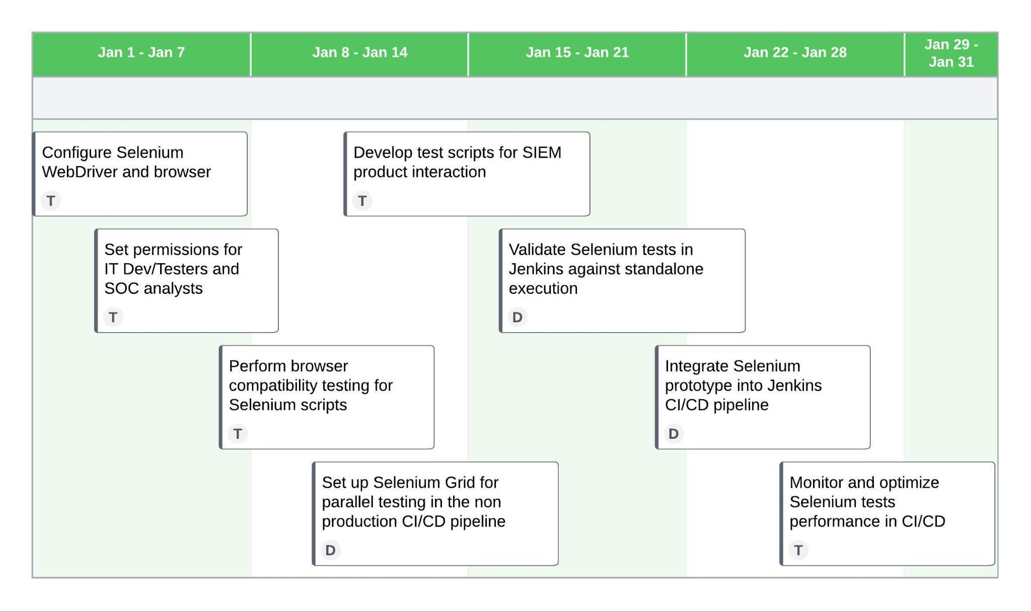
Sprint 1
Sprint 1 Goal: Setup environment for Selenium implementation; Initial integration of the Selenium script prototype into IT CI/CD to validate stability.
Story ID | User Story | Owner | Story Points
J.1.1 | Integrate Selenium Webdrivers and Grid | DevOps Engineer | 5
J.1.2 | Regression tests optimization | DevOps Engineer | 3
B.1.1 | Testing environment setup | DevTester | 5
B.1.2 | Testing performance monitoring | DevTester | 3
B.1.4 | Automation time reduction | DevTester | 3
Simple

Slide 5
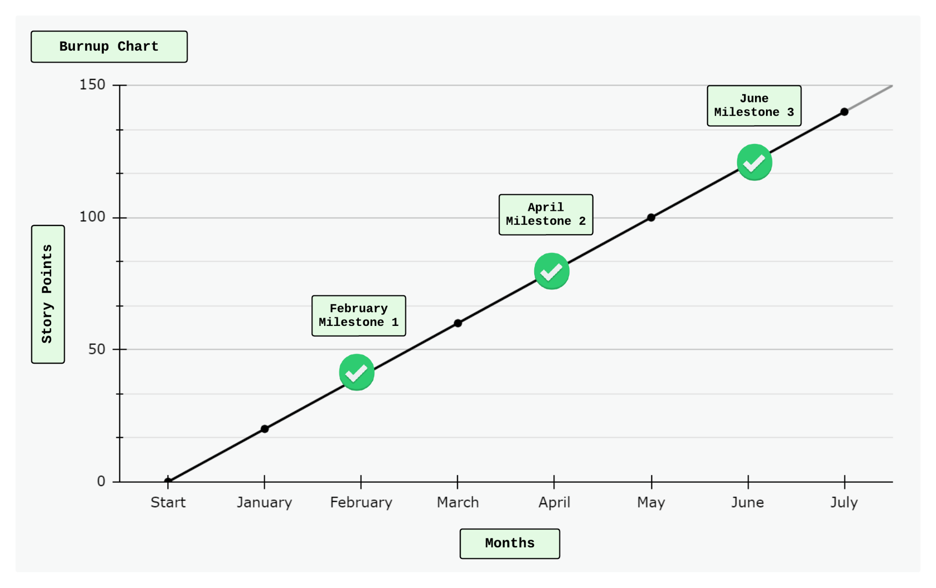
Burnup Chart
Milestone #1:
Execute and automate 40% of planned test cases within the CI pipeline and successfully deploy dashboard prototype.
User Stories:
B.1.1., B.1.2, B.1.4, J.1.1
Milestone #2:
Achieve 70% of automation coverage and achieve real-time monitoring and reporting of all test results.
Alpha Testing with 60% resolution rate for verified issues in alpha
User Stories:
J.1.2, J.1.3, B.1.3, K.1.1, K.1.2, K.1.3
Milestone #3:
Full deployment of the Selenium test suite, with functioning scripts and infrastructure.
User Stories:
J.1.1, A.1.1, A.1.2, A.1.3
Simple

