Slide 1
Team Nirvana Sprint Execution
Standups
Progress Stages
Done
Sun - 1 hr Zoom: set week goals/gain consensus
M/W - 20 minute: before class prog update
T/Th - 1 hr Zoom: incorporate new insights from class
Fri: ½ - 1 hour Zoom: Reassess after Prof. insights, plan for weekend
PROG1: Research conducted and organized
PROG2: Translation of research to user story solution
PROG3: Pending team consensus
Team Nirvana agrees that “done” is when a user story solution has pertinent references, overwhelming majority consensus (over ⅔ team approval), and is added to the deck in an aesthetically continuous manner.
Backup

Slide 2
Story Points
 | GRADING | POINTS | RATIONALE
Planning Poker (Fibonacci) | Very Simple | 1 | The deliverable is extremely straightforward The team has all necessary resources at hand and can be easily comprehended It is expected to be completed quickly without any dependencies
 | Simple | 2 | The deliverable is clear with minimal intricacies, perhaps requiring one short discussion for alignment. It requires a single team member without needing input or assistance and can be completed independently
 | Moderately Simple | 3 | The deliverable is still simple and well understood but might require breaking it down into a couple of subdivisions. The team understands the primary goal but might need to clarify certain aspects or prerequisites. Deliverable would involve dependencies.
 | Moderate | 5 | A deliverable of moderate complexity, which might require a series of discussions to fully understand. The team can decompose it into 2-3 divisions that may require sequential flow and requires dependencies to drive it to completion
 | Fairly Complex | 8 | A highly complex deliverable that involves various aspects of the project and requires significant effort or problem-solving It will need to be divided into more than 3 smaller divisions and will require effort to define and clarity. The deliverable may have unknowns which might induce risk and has multiple dependencies
Backup

Slide 3
Draft Report Sprint Backlog Plan
Sprint 1 (23 points)
Sprint 2 (37 points)
Sprint 3 (54 points)
April 12: (Proposal) Context Setting & Articulation (12 pts)
Context/Setting (3 pts)
OSS Project (5 pts)
Hypothesis (2 pts)
Challenges (2 pts)
April 12: OSS Research (6 pts)
Upstream (3 pts)
Downstream (3 pts)
April 12: OSS Principles (5 pts)
Whos, Who (5 pts)
April 19: Market Research (11 pts)
SWOT (3 pts)
COMP Analysis (5 pts)
GOAL/Problem (3 pts)
April 19: ROI/ROV (13 pts)
ROI (8 pts)
ROV (5 pts)
April 19: SDLC Model (8 pts)
April 19: SW Disaster (5 pts)
Relevance (2 pts)
Risks (3 pts)
April 25: 5 Personas (2 pts x 5 = 10 pts)
Characterization (1 pts)
Rationalization (1 pts)
April 25: 5 User Stories (5pts x 5 = 25 pts)
Epic Stories (2 pts)
Decomposition (3 pts)
April 25: Relative Sizing Algo (5 pts)
April 25: Roadmap (8 pts)
April 25: Burnup Chart (3 pts)
April 25: Sprint 1 Planning (3 pts)
Backup

Slide 4
Draft Report Sprint Backlog Execution
Sprint 1 (18 points)
Sprint 2 (39 points)
Sprint 3 (62 points)
April 12: (Proposal) Context Setting & Articulation (12 pts)
Context/Setting (3 pts)
OSS Project (5 pts)
Hypothesis (2 pts)
Challenges (2 pts)
April 9: OSS Research (6 pts)
Upstream (3 pts)
Downstream (3 pts)
April 19: OSS Principles (5 pts)
Whos, Who (5 pts)
April 19: Market Research (11 pts)
SWOT (3 pts)
COMP Analysis (5 pts)
GOAL/Problem (3 pts)
April 19: ROI/ROV (13 pts)
ROI (8 pts)
ROV (5 pts)
April 19: SW Disaster (5 pts)
Relevance (2 pts)
Risks (3 pts)
April 19: [Replan] Context Setting & Articulation (+ 5pts)
April 25: SDLC Model (8 pts)
April 25: 5 Personas (2 pts x 5 = 10 pts)
Characterization (1 pts)
Rationalization (1 pts)
April 25: 5 User Stories (5pts x 5 = 25 pts)
Epic Stories (2 pts)
Decomposition (3 pts)
April 25: Relative Sizing Algo (5 pts)
April 25: Roadmap (8 pts)
April 26: Burnup Chart (3 pts)
April 27: Sprint 1 Planning (3 pts)
Backup

Slide 5
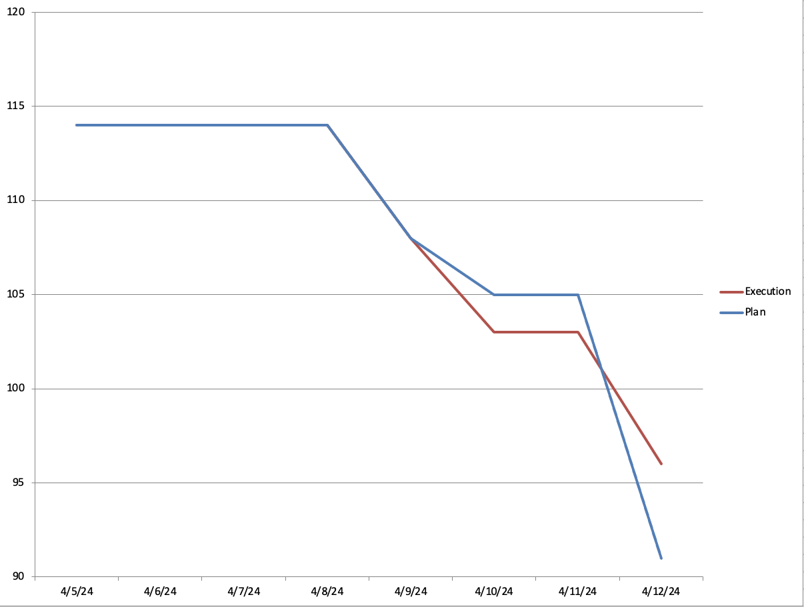
Sprint 1 Burndown Chart
Backup

Slide 6
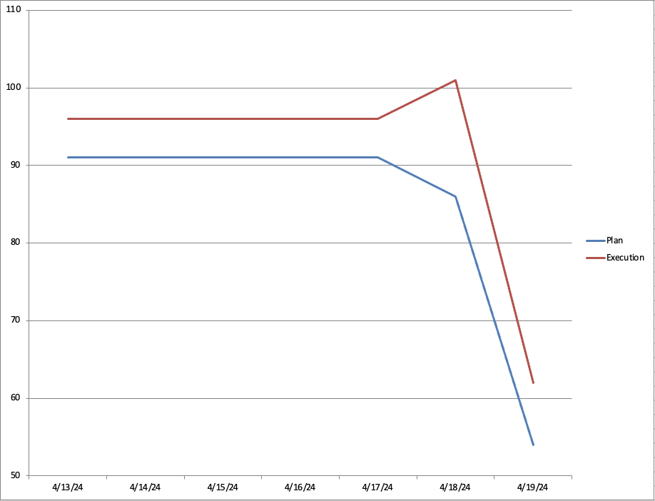
Sprint 2 Burndown Chart
Replan
Backup

Slide 7
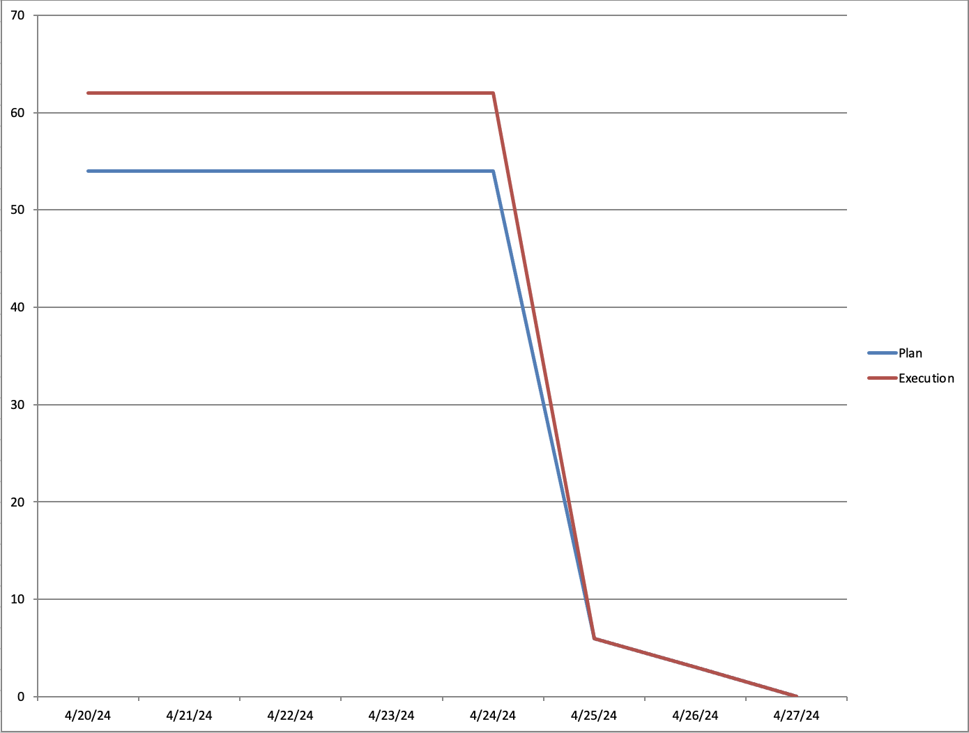
Sprint 3 Burndown Chart
Backup

Slide 8
Final Report Sprint Backlog Execution
Sprint 4 (14 points)
Sprint 5 (47 points)
Sprint 6 (34 points)
May 20: Architecture, design (8 pts)
Architecture: Call and Return (8 pts)
May 20: As-Is, To-be (10 pts)
As-is (5 pts)
To-be (5 pts)
May 20: User Story Update (6 pts)
DevOps (2 pts)
Dev/Test (2 pts)
Prod Engineer (2 pts)
May 20: SMART Update (3 pts)
May 21: Change Management (3 pts)
May 21: Risk Management (3 pts)
May 23: Testing (8 pts)
Testing Methodology/Rationale (5 pts)
Test Matrix (3 pts)
May 23: Product Roadmap Update (3 pts)
May 23: Burnup Chart Update (3 pts)
May 14: As-Is, To-Be (2 pts)
Adding personas & relevant details as needed (2 pts)
May 14: ROI/ROV (3 pts)
Productivity as ROI (3 pts)
May 14: User Story update (4 pts)
SOC Analyst (2 pts)
SOC Manager (2 pts)
May 14: Story Point Algo Update (3 pts)
May 14: Challenges Update (2 pts)
May 28: Architecture, design (5 pts)
High level design (5 pts)
May 28: Release (11 pts)
Bug Lifecycle (3 pts)
Bug Management Criteria (2 pts)
Release Criteria (3 pts)
Release Checklist (3 pts)
May 28: Release Plan (8 pts)
May 28: Project Plan (5 pts)
May 28: OSS execution (5 pts)
Backup

Slide 9
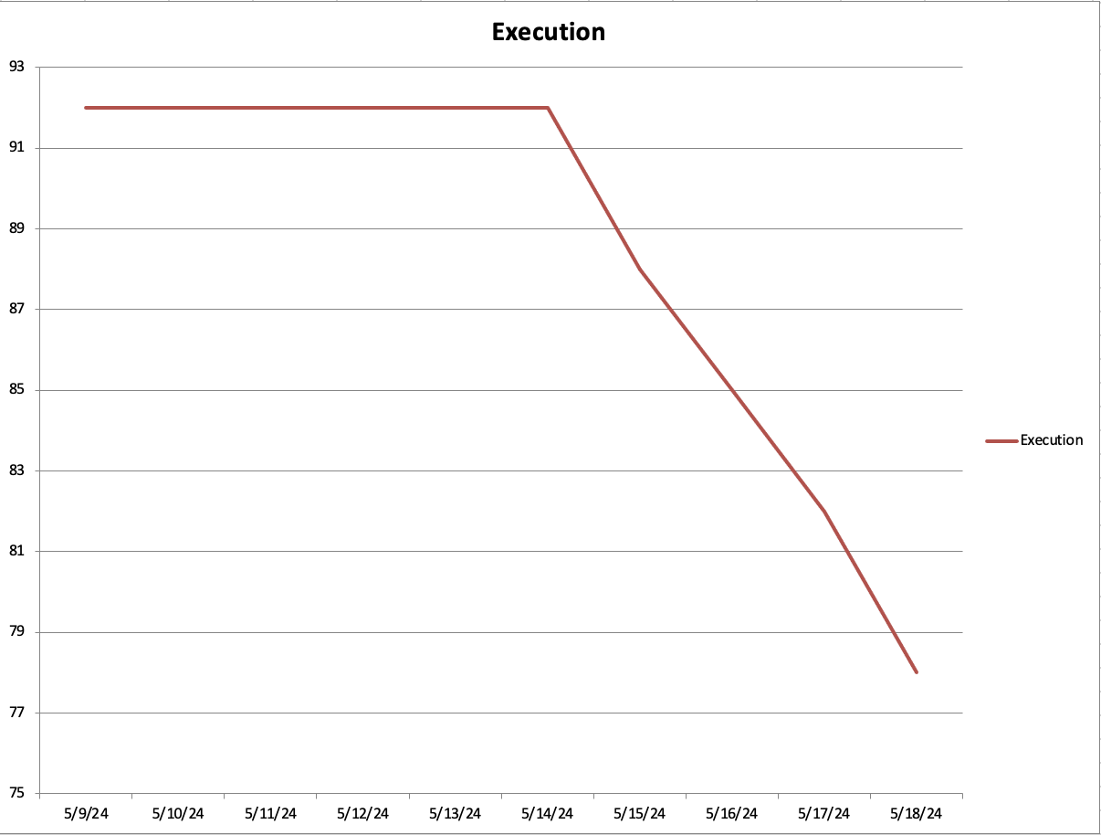
Sprint 4 Burndown Chart
Backup

Slide 10
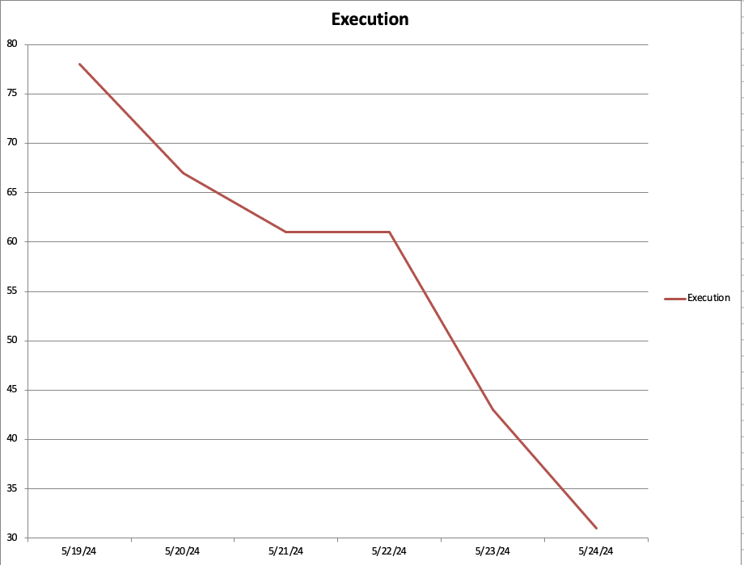
Sprint 5 Burndown Chart
Backup

Slide 11
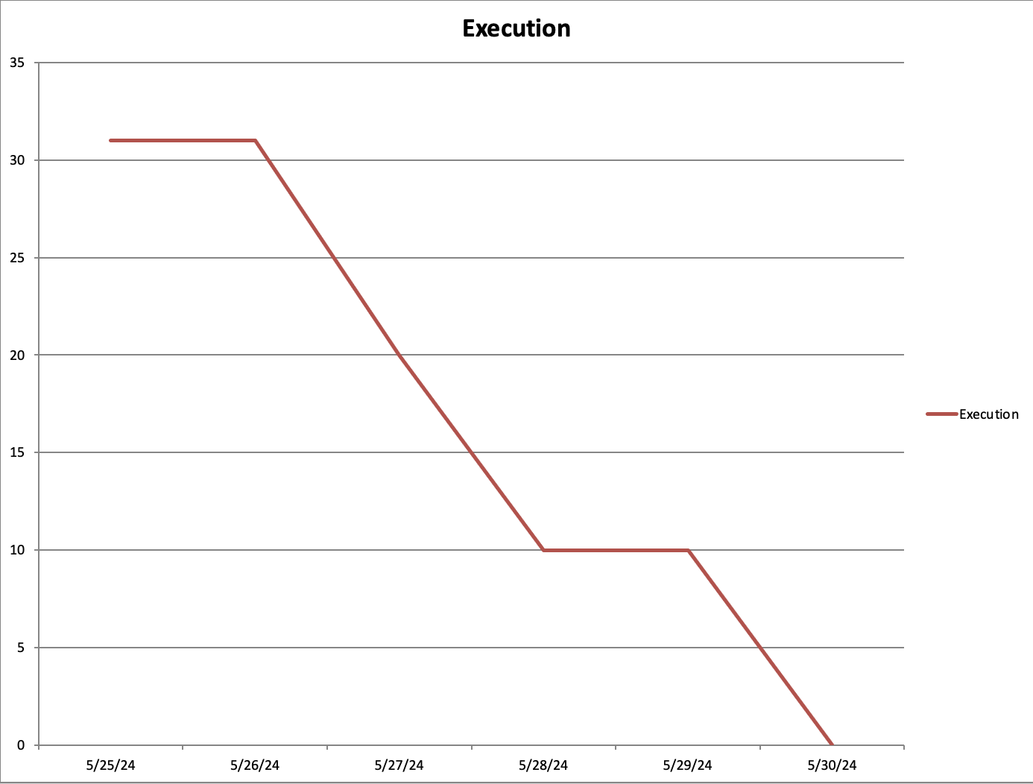
Sprint 6 Burndown Chart
Backup

Slide 12
Artifacts
Backup

Slide 13
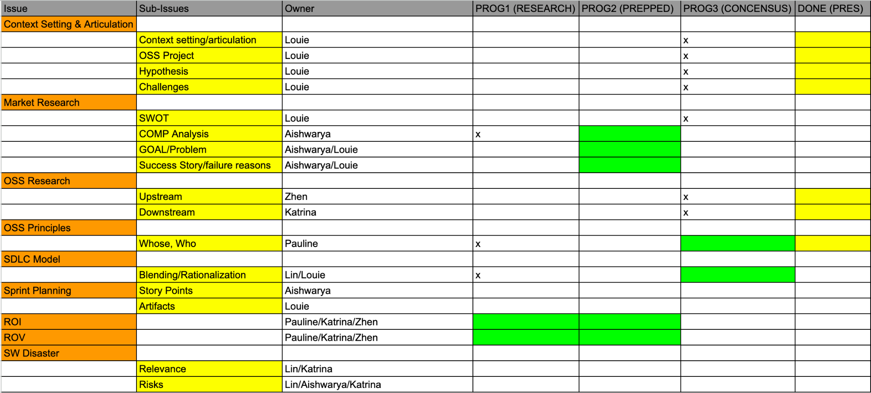
April 18-April 19
Backup

Slide 14
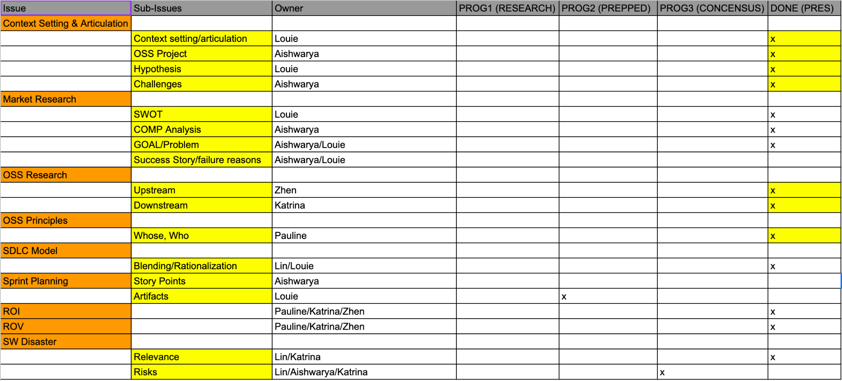
April 19-April 23
Backup

Slide 15
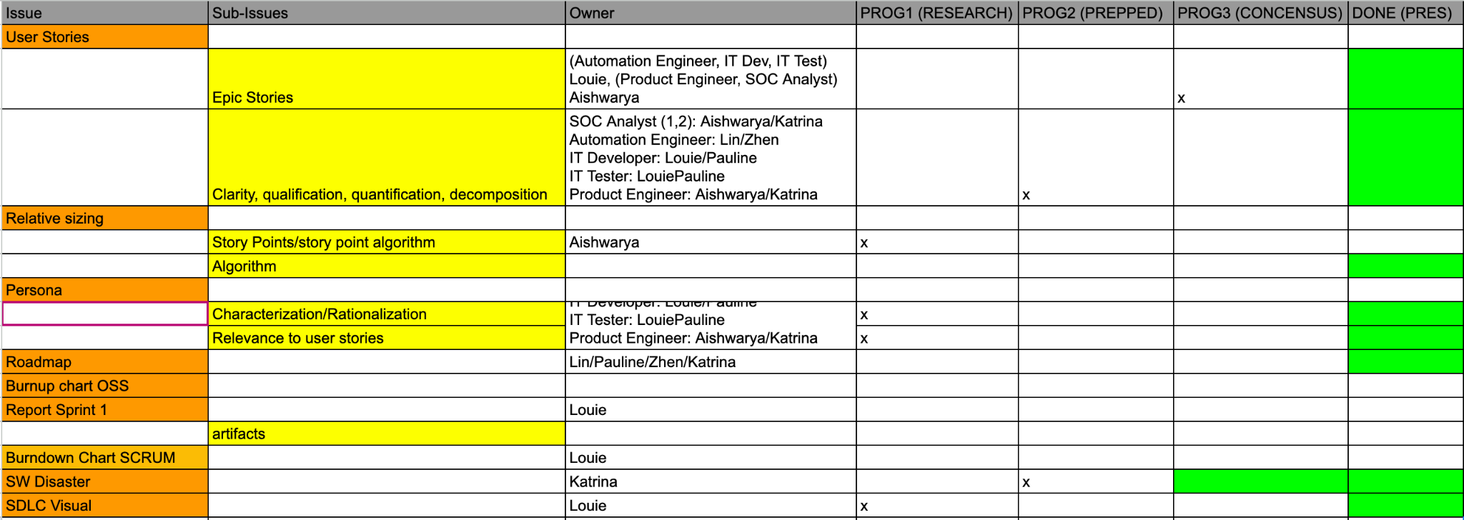
April 23-April 25
Backup

Slide 16

April 25-April 26
Backup

Slide 17

April 26-April 27
Backup

Slide 18
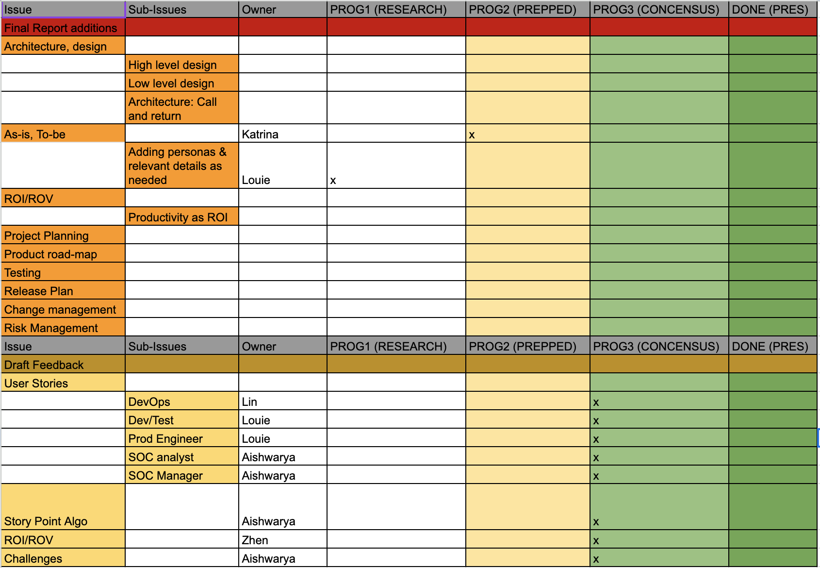
May 10-May 13
Backup

Slide 19
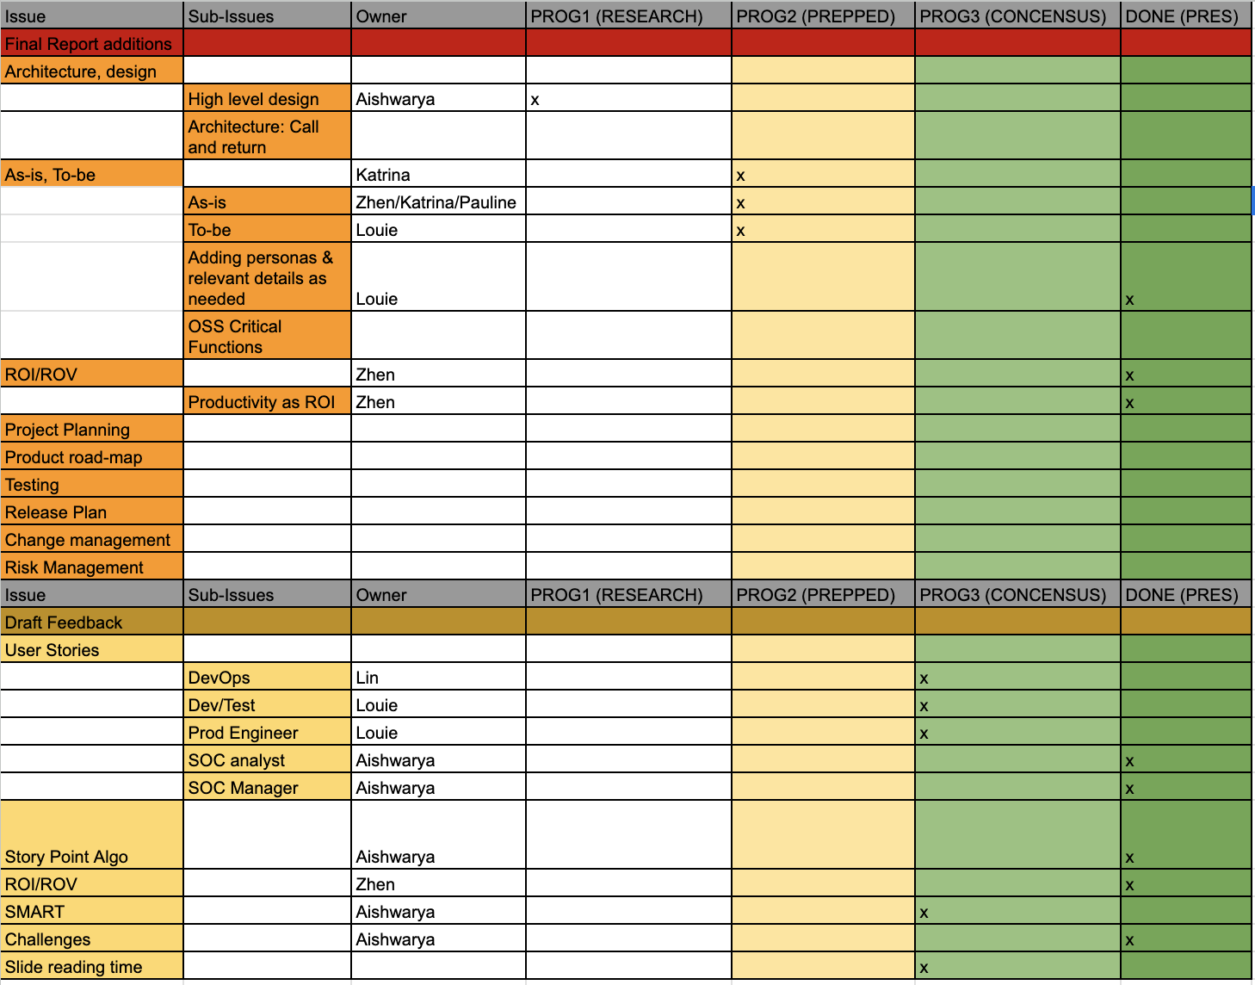
May 14-May 19
Backup

Slide 20
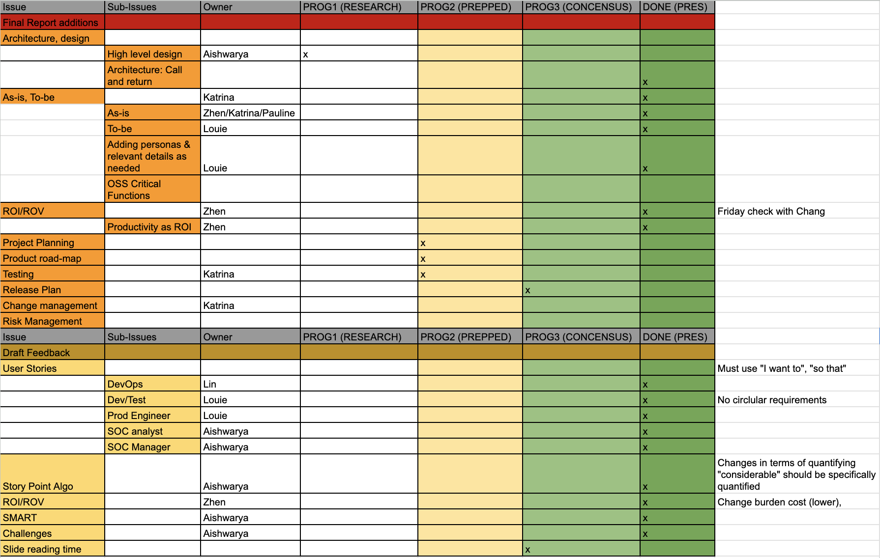
May 20 - May 21
Backup

Slide 21
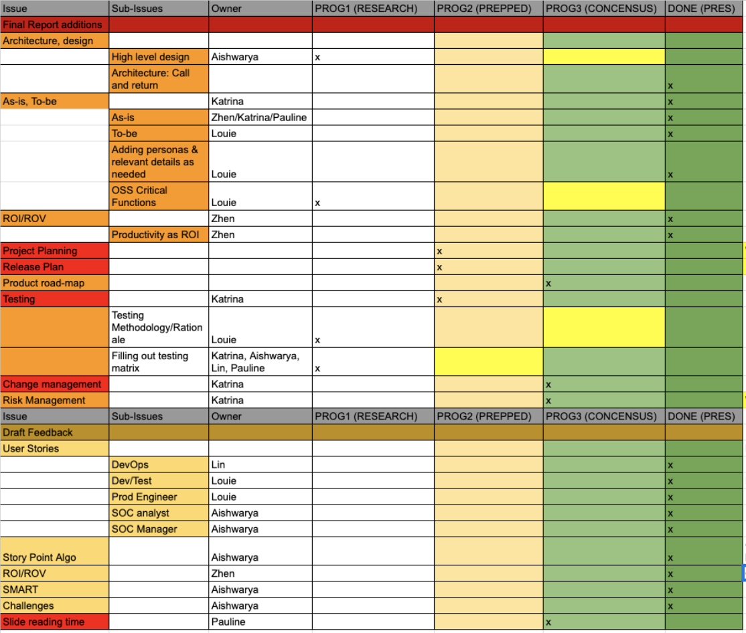
May 21 - May 22
Backup

Slide 22
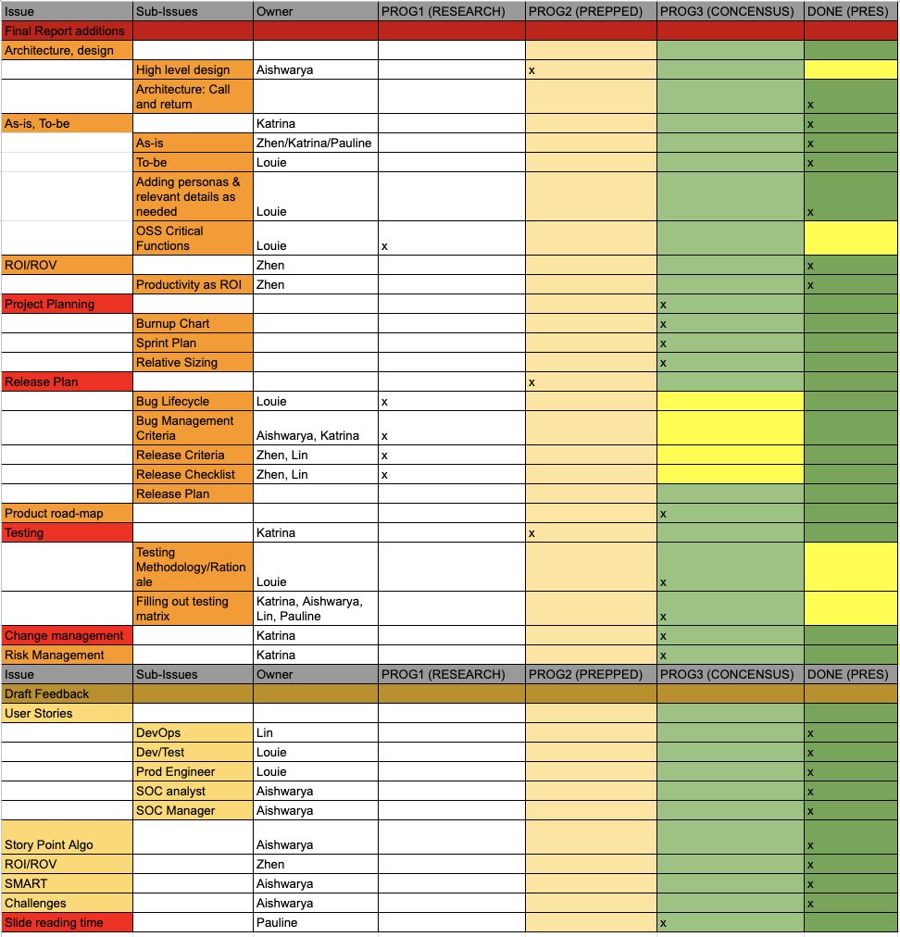
May 23 - May 27
Backup

Slide 23
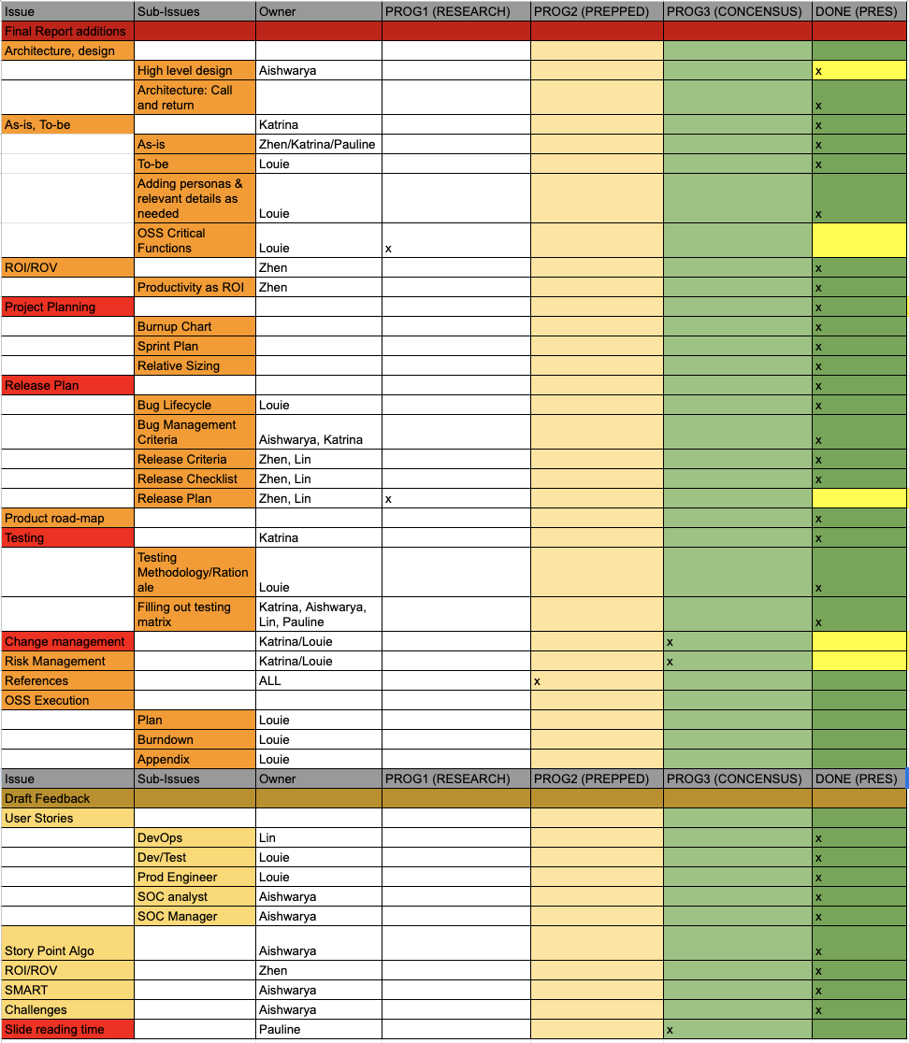
May 28 - May 30
Backup

Slide 24
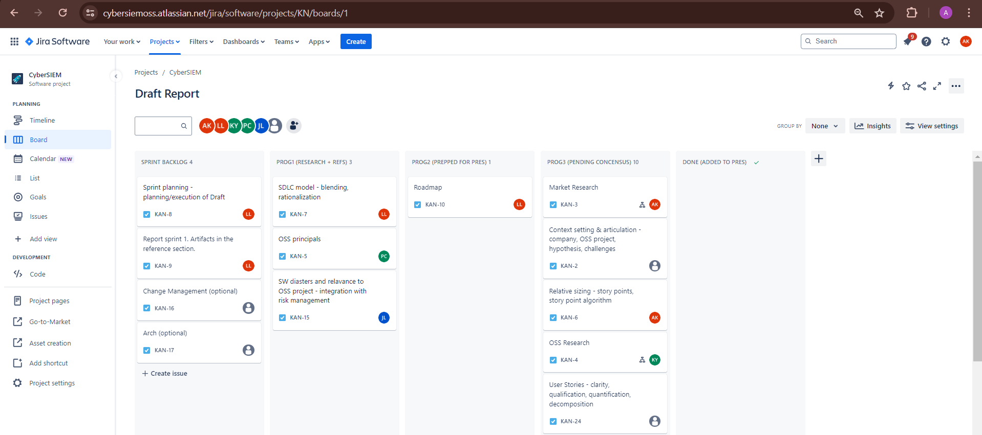
Kanban Board
Backup

Slide 25
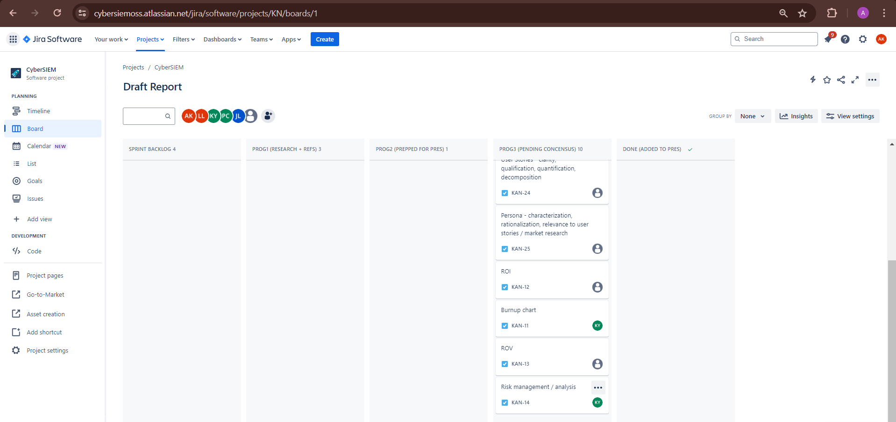
Kanban Board
Backup

