Slide 1

ROI & ROV
Title

Slide 2
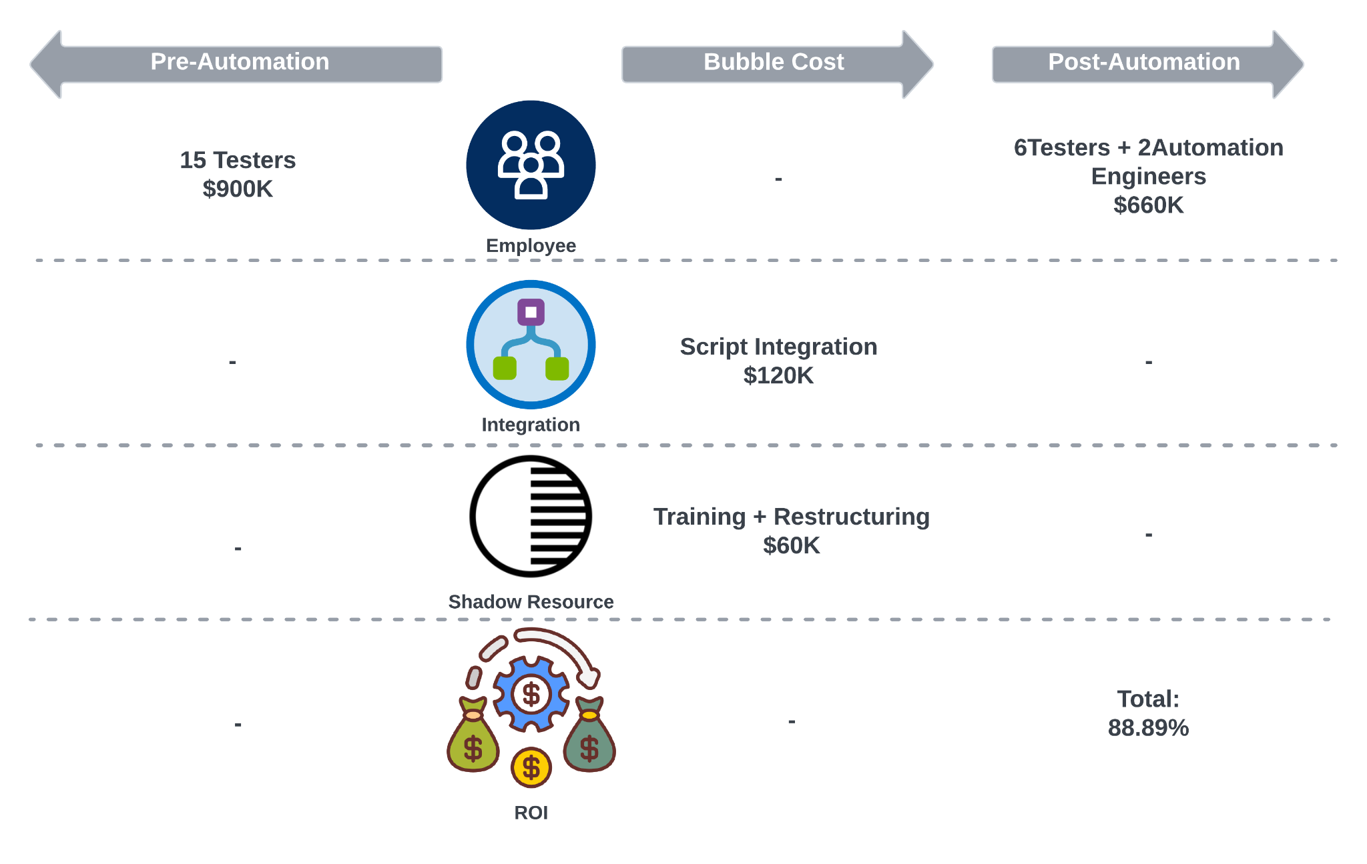
ROI
Simple

Slide 3
ROV
Time Efficiency | Reduce time expense per case by 64.17%, from 11.22 minutes to less than one minute.
Test Coverage and Frequency | Improve test coverage from 70% to 90%. Reduced false positive rate of test cases from 5% to 3%.
Resource Optimization and Cost Efficiency | Save team’s time on testing by 57.14%. Generate $16K of financial value per month from productivity improvement.
Consistency and Reproducibility | Shorten the test setup and validation process from 72 hours to 48 hours.
Rapid Feedback and Continuous Improvement | Reduce the reaction time from Internal SOC (Customer 0) to Product from 48 hours to 24 hours.
Simple
Notes:
Time Cost per Case Calculation:
Pre-automation:
Total test duration: 7 days
Number of test cases: 300
Work hours per day: Assuming 8 hours/day
Total work hours: 7 days×8 hours/day=56 hours
Time cost per test case:56 hours / 300 cases ≈ 0.187 hours/case
Post-automation:
Total test duration: 3 days
Number of test cases: 360
Work hours per day: Assuming 8 hours/day
Total work hours: 3 days × 8 hours/day = 24 hours
Time cost per test case:24 hours / 360 cases ≈ 0.067 hours/case
Resource Benefit Calculation:
Pre-automation monthly test hours: 2000×0.187=374 hours/month
Post-automation monthly test hours: 2000×0.067=134 hours/month
Assumed Hourly Rates:
Tester's hourly rate: $50
Automation engineer's hourly rate: $75
Cost Calculation:
Pre-automation cost: Cost = 374 hours/month × 15 testers ×$50/hour=$24,933.33/month
Post-automation cost: Cost =134 hours/month × (6 × $ 50 + 2 × $ 75 ) = $8,950/month
Monthly Shadow Resource Benefit: Shadow Resource Benefit =$24,933.33 − $8,950 = $15,983.33/month
Shadow Resource Benefit over 6 months: Shadow Resource Benefit (6 months)=$15,983.33×6=$95,900

