Slide 1

SDLC Model
Title

Slide 2
Why Incremental with SCRUM?
Our development model is made up of three distinct increments, each comprising two 4-week sprints. This structure allows us to progressively develop and deliver usable features of the end product, while being responsive to changing requirements and diverse stakeholder feedback.
Project Requirements:
Quality: High repercussions require each feature to be rigorously tested
Flexibility: Clear core requirements, but diverse stakeholders come with changing needs
Early Delivery: User feedback requirement, and high Selenium learning curve requires incremental feature familiarity
Blend Benefits:
Each increment delivers deployable, testable software features, promptly enabling learning and stakeholder feedback. [2]
Early issue identification and resolution to focus resources effectively. [2]
Scrum encourages cross-department collaboration and minimum viable product delivery
Flexible Scrum practices within each increment allow for adaptation to changes. [3]
[1] ScrumStudy. Scrum and Quality. Retrieved April 22, 2024 from https://www.scrumstudy.com/whyscrum/scrum-quality
[2] Built In. Iterative vs. Incremental. Retrieved April 22, 2024 from https://builtin.com/software-engineering-perspectives/iterative-vs-incremental
[3] LinkedIn. Best Practices for Combining Extreme Programming. Retrieved April 22, 2024 from https://www.linkedin.com/advice/0/what-best-practices-combining-extreme-programming-19htc
[4] ScrumStudy. Scrum and Change. Retrieved April 22, 2024 from https://www.scrumstudy.com/whyscrum/scrum-change
Simple

Slide 3
SDLC Ingredients
Project Requirements | Incremental | SCRUM | Other Principles
High Quality | Validation: At the end of each increment, a testable feature is added, allowing for validation of requirements. [2] | Continuous Improvement: Requirements are re-evaluated at the end of each sprint. [1] Regular in-person meetings with stakeholders ensure correct project direction. | Pair Programming: Ensures that interdepartmental tasks are high quality, efficient, and result in knowledge sharing. [3] Testing: Tests are developed to accompany user stories for these tasks. These tests further reduce ambiguities.
Change Accommodation | Flexible: Each increment is split into 2 Sprints. Increment-level requirements can change with Sprint-level requirement churn. [2] | Sprint Planning & Retrospective: Short feedback loop (4 week Sprint) between project team and customer ensures accommodation of changing stakeholder requirements. [4]
Early Delivery | Deployable: Each increment is expected result in an updated product, building upon the last increments' features. [2] This gives stakeholders time to learn how to use Selenium, as more features/tests are added. |  | Simplicity: The team will focus on delivering the minimum functional solution first, then work on increasingly complex functionalities [3]
[1] ScrumStudy. Scrum and Quality. Retrieved April 22, 2024 from https://www.scrumstudy.com/whyscrum/scrum-quality
[2] Built In. Iterative vs. Incremental. Retrieved April 22, 2024 from https://builtin.com/software-engineering-perspectives/iterative-vs-incremental
[3] LinkedIn. Best Practices for Combining Extreme Programming. Retrieved April 22, 2024 from https://www.linkedin.com/advice/0/what-best-practices-combining-extreme-programming-19htc
[4] ScrumStudy. Scrum and Change. Retrieved April 22, 2024 from https://www.scrumstudy.com/whyscrum/scrum-change
Simple

Slide 4
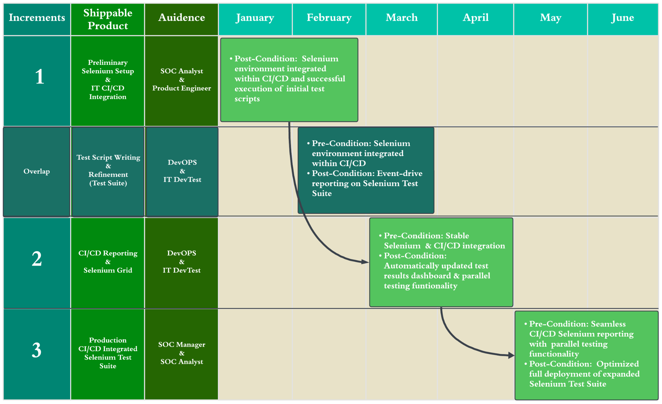
Simple

