Slide 1
Testing
Title

Slide 2
Test Strategy & Methodology
Test Theme | Test Strategy Rationale | Test Strategy Requirements | Test Methodology
Precision | Ensure that automated test scripts throw out fewer false positives than manual testing and provide increased test coverage of the SIEM functionalities. | Need to determine what can and cannot be automated; reducing the risk of insufficient test coverage is crucial. Due to the Customer 0 program, internal use (IT team/ SOC) of the updated build depends on thorough regression testing and accurate reporting. Different browsers may have different UI flows, so ensure performance consistency. | Unit Testing: Historical product build with known issues is tested with the prospective automated test script. Result of test is compared with historical manual method report. Regression Testing: CI/CD triggered test scripts retain same level of precision as before CI/CD integration. Integration Testing: CI/CD triggered JUnit test reports summarize problem areas and trends. JUnit Reports are compared with historical manual reports. Beta (UAT) Testing: Proactive communication between Customer 0 (SOC Team), Product and DevTest when simulating each build so that issues with test precision, accuracy, and consistency are identified prior to release.
Efficiency | The previous manual method took 7 days to setup and execute testing on 300 unit tests. In comparison, the setup and automated test execution only takes 72 hours for both 300 automated unit tests and around 60 remaining manual unit tests | CI/CD testing triggers verify whether updated builds include new UI features. Make sure that Selenium Grid enables parallel testing across multiple browsers. Multiple copies of the updated build may be required for parallel testing, necessitating hardware capable of handling the load. DevTest requires continuous communication with Product to anticipate new UI features well in advance of updates. Regular updates are crucial to mitigate environment setup bottlenecks and achieve the 72-hour timeframe. | Unit Testing: If the updated build has no new UI features, CI/CD testing is automatically triggered and testing begins immediately. Otherwise, test execution is paused until Devtest manually triggers. System Testing: Optimize number of Selenium Grid instances possible with proposed hardware. If number of instances causes system crash. Alpha Testing: Continuous line of communication with Product allows DevTest to begin environment setup before the updated build is officially released.
Security | Need to ensure that access to sample data and test script repository are restricted to only IT, Devops, and Product teams; also prepare crisis management strategies and security training for all company employees | Need to ensure that all changes to the test suit are continuously reported with doxygen comments. Obtain consensus between Product, DevTest, and SOC groups before a change is made to the test suite. Ensure active logging, monitoring, and communication regarding potential issues and threats. Establish an incident response and recovery plan in case access is breached. | Unit Testing: Verify that only Product Engineer, SOC Analyst, IT DevTest, and DevOps Engineer can access test script repository; all changes must involve consensus between at least two parties. Alpha Testing: Conduct early-phase testing in an isolated testing environment. Log real-time feedback from the team in addition to automated reports. Recruit Regression Testing: Automate security scans to identify and report issues for each build so that the team is aware of potential threats. Security Testing: Create comprehensive incident response and recovery plan through rollbacks, automated test backups, intrusion detection systems (IDS).
Average

Slide 3
Test Plan
[1] Connect Jira Service Management to Slack and Microsoft teams. Retrieved May 23, 2024 from https://www.atlassian.com/software/jira/service-management/product-guide/tips-and-tricks/chat\
[2] How to integrate Jenkins with Selenium?. Retrieved May 23, 2024 from https://browserstack.wpengine.com/guide/jenkins-selenium/
[3] JUnit. Retrieved May 23, 2024 from https://plugins.jenkins.io/junit
Increment | Testing Type | Test Theme | User Stories | Test Objective | Architecture/Tools | Criteria
1 | Unit | Precision | As IT DevTester Brian Tran, I want to first develop a suite of 300 automated unit tests to ensure automated builds and then develop 60 more unit tests with 50% fewer false positives | Develop automated tests and compare results with manual testing method to confirm high level of precision with automation | Unit Testing: Java Test Framework, Selenium WebDriver 2] | Test the automated product build to ensure that it has 50% less false positives as compared to the original manual method
1, 2 | Integration | Efficiency | As DevTester Brian Tran, I want to create a Selenium integrated environment with Jenkins CI/CD for test scripts. | Achieving seamless integration between Selenium, Jenkins, and the Java environment | Integration Testing: sandbox environment, Selenium Grid, Selenium WebDriver, Web Browsers | Verify that Jenkins efficiently initiates and executes Selenium test scripts while ensuring proper logging of test results
 |  |  | As DevOps Jamie Teller, I want to integrate the Automation Tools into so that the test execution time is reduced by 75% | Enhance the testing process to ensure efficiency, stability, and minimized execution time | Integration Testing: Selenium WebDriver, Selenium Grid, JUnit | Use parallel testing in Selenium Grid to optimize the testing process and ensure system stability under peak load
2 | Alpha | Efficiency | As Product Engineer Krista Adams, I want to get critical feedback from the SOC Analyst and internal customers (product development teams) to quickly identify and implement improvements per feedback | Ensure test environment functionality by gathering and documenting feedback from Product, Devops, and DevTest teams | Alpha Testing: Slack app / Microsoft Teams, Jira platform [1] | Proactive communication between SOC, Product and DevTest teams for initial environment setup before build release
2 | Regression | Precision | As Product Engineer Krista Adams, I want to enable reliable regression testing analysis to ensure test precision within the CI/CD pipeline | Ensure that test precision level is consistent throughout CI/CD pipeline creation and Integration processes | Regression Testing: Jenkins, JUnit (Pipeline Integration) [3] | Retain high-level precision before, during, and after the integration process; monitor and document integration needs
2 | Beta (UAT*) | Precision | As DevTester Brian Tran, I want to maintain test precision and accuracy for each build when expanding test coverage | Validate each build through simulated scenarios to determine precision and reduced false-positives | Beta Testing: Sandbox environment (Simulation); Bugzilla (Validation); Jira (Tracking) | Ensure a 50% reduction in false positives and use sandbox environment to ensure test precision for new features
 |  |  | As Product Engineer Krista Adams, I want to collect detailed feedback from beta testers to improve test precision, accuracy, and functionality | Gather comprehensive feedback from Customer 0 (SOC Team) beta experience to enhance test precision, accuracy, and functionality | Beta Testing: Jira (Tracking); Slack/Microsoft Teams | Active communication between Customer 0 (SOC Team), Product, DevTest and DevOps for identifying precision and functionality issues
*User Acceptance Test
Average
Notes:
Unit Testing: Historical product build with known issue is tested with prospective automated test script. Result of test is compared with historical manual method report.
Regression Testing: CI/CD triggered test scripts retain same level of precision as before CI/CD integration.
Integration Testing: Optimize number of Selenium Grid instances possible with proposed hardware. If number of instances causes system crash
Alpha Testing: Continuous line of communication with Product allows DevTest to begin environment setup before the updated build is officially released

Slide 4
Test Plan Cont.
[1] The Benefits and Challenges of Pair Programming And Pair Testing. Retrieved May 23, 2024 from https://www.mabl.com/blog/benefits-challenges-pair-programming-and-testing
[2] Visualize Jira project data in Power BI or Tableau | Appfire. Retrieved May 23, 2024 from https://appfire.com/resources/blog/how-to-visualize-jira-data-in-power-bi-tableau
[3] 2024. Azure Security vs. AWS Security: A Comparative Analysis. Retrieved May 23, 2024 from https://www.wiz.io/academy/azure-security-vs-aws-security
[4] What is ServiceNow Incident Management? Retrieved from https://www.bigpanda.io/blog/what-is-servicenow-incident-management/
Increment | Testing Type | Test Theme | User Stories | Test Objective | Architecture/Tools | Criteria
3 | System | Efficiency | As Product Engineer Krista Adams, I want to create a robust testing framework with timely feedback, quick integration of new features, and clear analysis of results | Identify issues, implement changes efficiently and enhance software quality | System Testing: Selenium WebDriver, JUnit, Jenkins | Ensure testing efficiency and stability for each build; maintain adaptability when integrating new features
3 | Performance | Efficiency | As DevOps Jamie Teller, I want to ensure efficient testing performance by integrating automation tools and incorporating pair programming for streamlined execution [1] | Ensure performance accuracy and testing efficiency through collaborative working environment | Performance Testing: Selenium WebDriver, Selenium Grid, Slack/Microsoft Teams | Ensure that there is a scheduling system, documentation of errors/fixes, and performance evaluation
 |  |  | As Security Manager Alex Hart, I want to track key performance indicators (KPIs) for the SOC team so that they are updated on the overall system performance | Enable effective tracking of KPIs and active communication of these metrics with SOC team stakeholders | Performance Testing: Tableau/Power BI (Visualization), Jira (Tracking), Google Docs/Microsoft Word (Documentation) [2] | Establish communication channels with SOC team and provide clear visualization dashboards
3 | Security | Security | As SOC Analyst Jennifer Clark, I want to mitigate potential defects, risks, and threats, ensuring effective response to security incidents | Safeguard sensitive information within the testing environment to prevent and respond to security threats | Security Testing: AWS Identity and Access Management, Microsoft Entra ID (IAM in Azure) [3] | Work with security team to implement log analysis, vulnerability assessments, rollbacks, strict access controls
 |  |  | As Security Manager Alex Hart, I want to maintain company security by implementing crisis communication methods, training programs, and incident analysis | Ensure test integrity and confidentiality while maintaining company-wide security operations | Security Testing: ServiceNow (Incident Management Platform), Excel (RACI Matrix) [4] | Define levels of incident severity for crisis response; report audits; and develop training program for DevOps, DevTesters, Engineers
Simple

Slide 5
Bug Management
Title

Slide 6
Bug Life Cycle
[1]Bug Life Cycle. Retrieved May 26, 2024, from https://www.bairesdev.com/blog/bug-life-cycle/
[2] Bugzilla vs Jira. Retrieved May 26, 2024, from https://www.nuclino.com/solutions/bugzilla-vs-jira#:~:text=Bugzilla%20is%20an%20excellent%20choice,requiring%20comprehensive%20project%20management%20tools.
[3] Bug life cycle in testing. Retrieved May 26, 2024, from https://www.browserstack.com/guide/bug-life-cycle-in-testing
[4] Bugzilla Life cycle Workflow. Retrieved May 26, 2024, from https://www.bugzilla.org/docs/2.18/html/lifecycle.html
[5] Bug Metrics & Reporting. Retrieved May 26, 2024, from https://medium.com/@b0661064248/software-quality-key-metrics-for-the-bug-finding-process-3c8254eba4b0
[6] How to write a Bug Report. Retrieved May 26, 2024, from https://www.browserstack.com/guide/how-to-write-a-bug-report
Tool: Bugzilla
Rationale: free to use, simple UI & engineered specifically for issue tracking, easy setup & maintenance_{[1][2]}
Stage [4] | Description | Conditions | Metrics [5] | Reporting & Analysis
New | A new bug is reported and entered into the system. The precondition of new is either unconfirmed or immediately designated as a new bug. [4] | Bug is identified and reported. Bugs reported by QA are unconfirmed until achieving 75% of QA team's votes. Bugs reported by developers are immediately designated as new, and initial triage is conducted depending on priority. [4] | Number of Bugs Reported, Bug Severity Distribution, Bug Density | Track the count of new bugs over time to identify trends in software quality. Analyze the severity distribution. [5]
Assigned | The bug is assigned to a developer or team member for resolution. [3] | Bug is accepted and assigned to a responsible person or team. | Open Bug Count, Time to Assignment, Bug Status Distribution, Defect Density | Monitor the assignment rate and efficiency. Ensure bugs are assigned promptly to avoid delays in resolution. [6]
Resolved | The assigned developer has fixed the bug, and the solution is documented. In Bugzilla, there are various types of resolutions: Fixed, Duplicate, Wontfix, Worksforme, Invalid, Remindmelater. [4] | Developer marks the bug as fixed, awaiting QA verification. | Time to Resolution, Code Churn due to Bugs, Bug Reopen Rate, Cost to Fix a Bug | Measure the average resolution time and code churn to evaluate development efficiency. Track reopen rates. [5]
Verified | QA team verifies the fix in the testing environment. [3] | QA confirms the bug is fixed and the resolution is satisfactory. | Defect Removal Efficiency (DRE), Escape Rate, Bugs Found Post-release, Root Cause Analysis | Verify the fix effectiveness and track post-release bugs to assess the quality of verification. [6]
Closed | The bug has been verified as fixed and is officially closed. [3] | QA is satisfied with the fix, and the bug is closed. | Bug Closure Rate, Bug Aging, Cost to Fix a Bug | Monitor the closure rate and bug aging to ensure timely resolution and closing of issues. [5]
Reopen | If QA is not satisfied with the fix, the bug is reopened for further action. [3] | QA finds that the issue persists or the fix is inadequate. | Bug Reopen Rate, Time to Resolution (for reopened bugs), Root Cause Analysis (for reopening reasons) | Track the reasons for reopening bugs and the resolution time for reopened issues to identify recurring problem areas. [6]
Simple

Slide 7
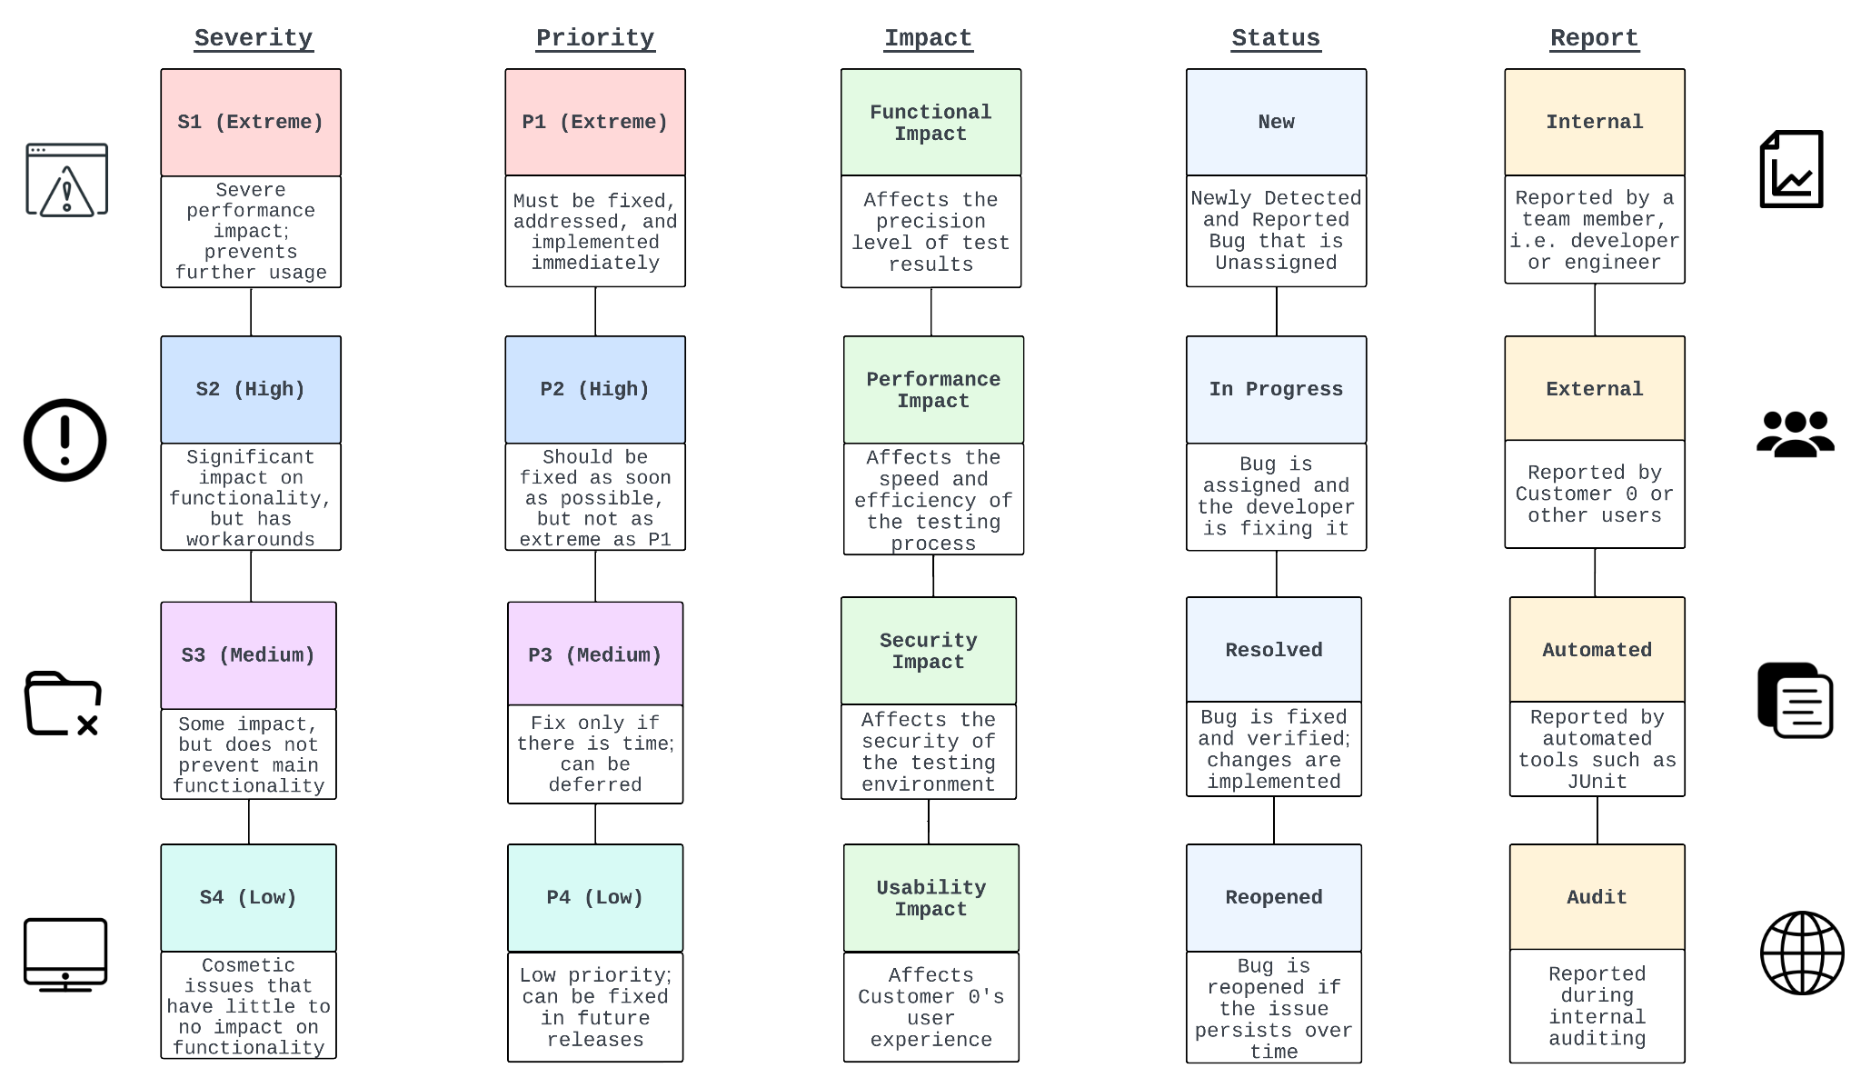
Bug Management Criteria [1, 2]
[1] Understanding Bug Life Cycle in Software Testing. Retrieved May 25, 2024 from https://browserstack.wpengine.com/guide/bug-life-cycle-in-testing/
[2] What is Defect/Bug Life Cycle? A Complete Guide. Retrieved May 25, 2024 from https://katalon.com/resources-center/blog/bug-defect-life-cycle
Simple

