Slide 1
Chart junk
Don’t get cute.

Slide 2
“The interior decoration of graphics generates a lot of ink that does not tell the viewer anything new.” – Tufte

Slide 3
Tufte’s minimalism again
“It is all non-data-ink or redundant data-ink”
“Graphical decoration … comes cheaper than the hard work required to produce intriguing numbers and secure evidence.”
Not all chart junk is artsy bolted on fluff.
“Conventional graphical paraphernalia routinely added …”
“Over-busy grid lines, excess ticks … the debris of computer plotting.”

Slide 4
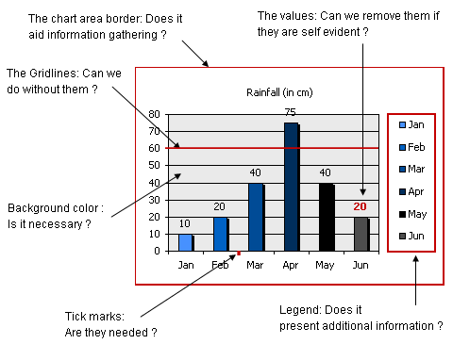
Chart junk

Slide 5
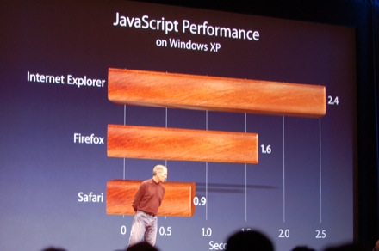
Chart junk

Slide 6
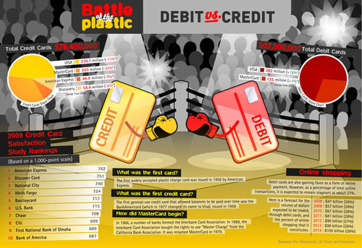
Chart junk

Slide 7
What here is chart junk, if anything?

Slide 8
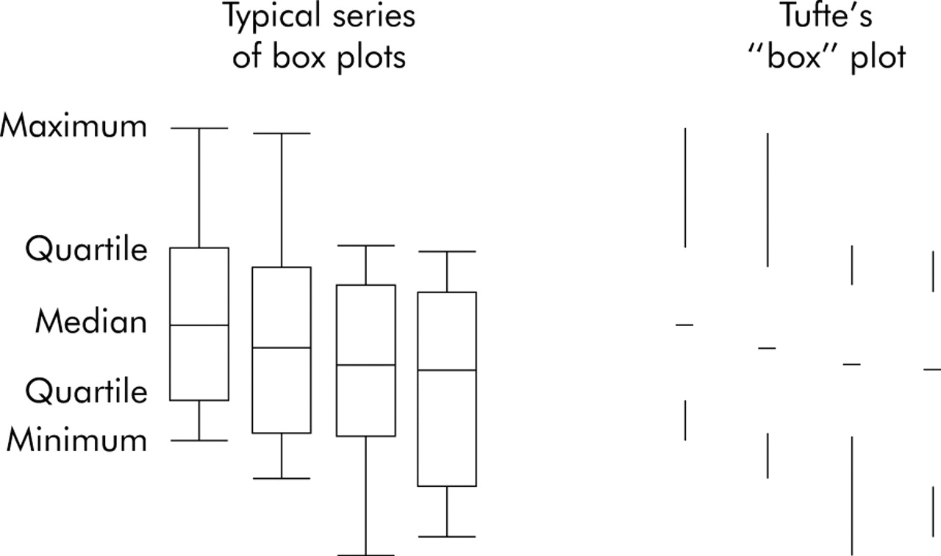
Chart junk?

Slide 9
Erasing exercise

Slide 10
For Thursday
There will be no class on Thursday. I’ll be in the air on the way to New York. So … enjoy.
THERE WILL BE AN ASSIGNMENT. To be announced. It will be an introduction to Tableau. Still working on exact details.
Read Tufte 2 and 3.
Read additional links on the course schedule on Github.

