Slide 1
Chart junk
Don’t get cute.

Slide 2
Tufte and XKCD

Slide 3
“The interior decoration of graphics generates a lot of ink that does not tell the viewer anything new.” – Tufte

Slide 4
Tufte’s minimalism again
“It is all non-data-ink or redundant data-ink”
“Graphical decoration … comes cheaper than the hard work required to produce intriguing numbers and secure evidence.”
Not all chart junk is artsy bolted on fluff.
“Conventional graphical paraphernalia routinely added …”
“Over-busy grid lines, excess ticks … the debris of computer plotting.”

Slide 5
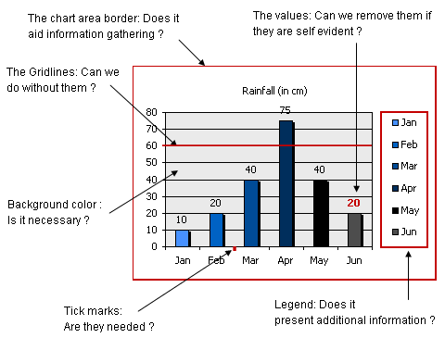
Chart junk

Slide 6
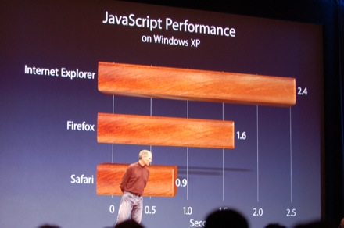
Chart junk

Slide 7
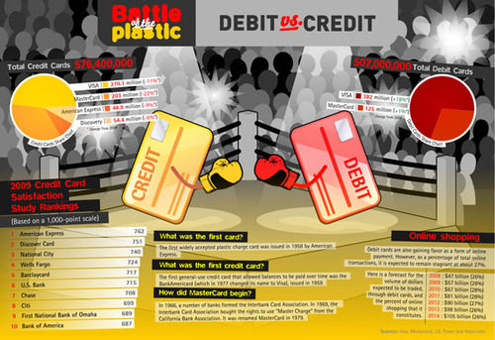
Chart junk

Slide 8
What here is chart junk, if anything?

Slide 9
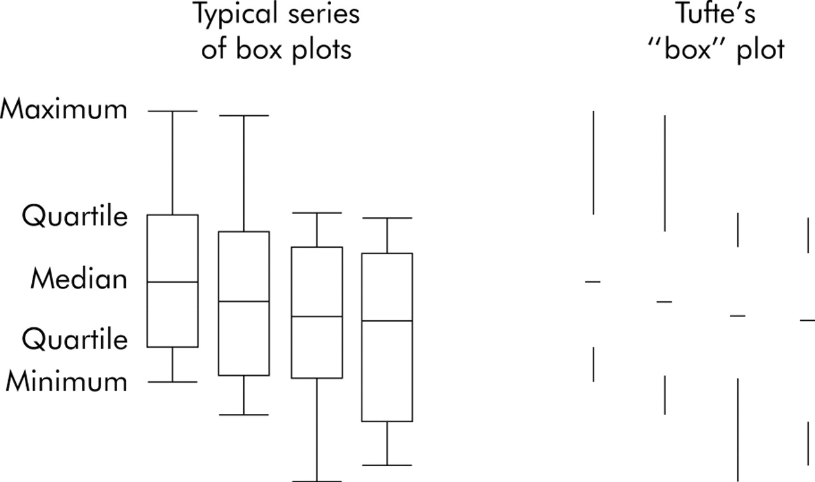
Chart junk?

Slide 10
Erasing exercise

Slide 11
For Thursday
Look for three data visualizations -- in print, online, wherever -- and bring to class on Tuesday. Read the Junk Chart Trifecta and label each of your three data visualizations using the rubric in that post. Be prepared to discuss on Thursday.
Read Visual Literacy in the Age of Data

